Slide 1

Introduction to Unix
Alejandra Medina Rivera
@AleMedinaRivera
amedina@liigh.unam.mx
Material by Jacqui Keane
@drjkeane
drjkeane@gmail.com
Notes:
- this morning we will start to learn some basic UNIX skills, excited?
- how many used UNIX/command line before?
anyone that hasn’t used UNIX before don’t panic when see the UNIX prompt, all exercises this morning are step by step and all commands are provided
anyone who has used UNIX, be patient, exercises are short and in the later we will introduce more advanced UNIX concepts

Slide 2
Unix
What is Unix?
Standard operating system (alternative to MS Windows, Mac OS)
Provides a way for you to interact with the computer
Many ‘flavours’ of Unix, using Linux
Originally created to provide a free UNIX-like OS for PCs
Why use Unix?
Output of lots of biological research exists in large text files
Very suitable for working with such files
Powerful and flexible commands for processing large text files
Save you time
Widely used in scientific community
Powerful, robust and stable operating system

Slide 3
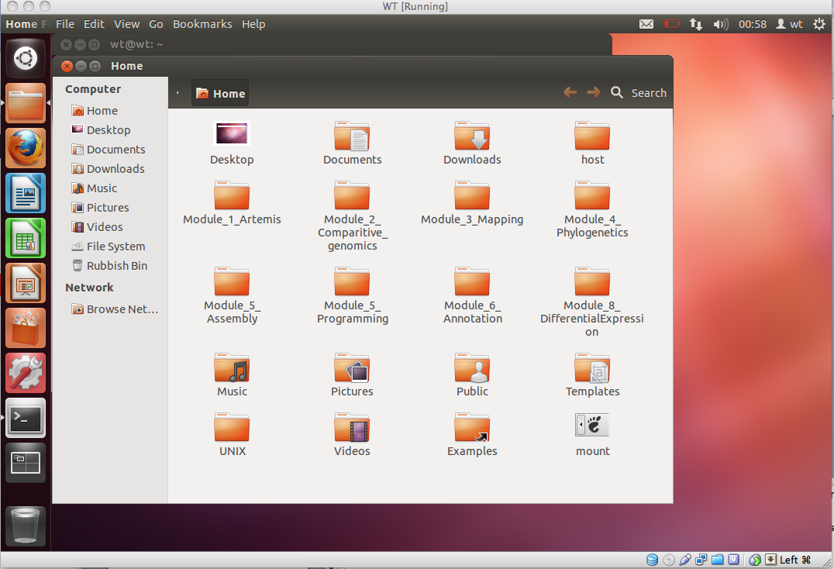
Using Unix
Notes:
How do you use the UNIX operating system?
Just like any other operating system, have a graphical user interface, click on icons to launch programs, explore files and folders on disk using a file manager

Slide 4
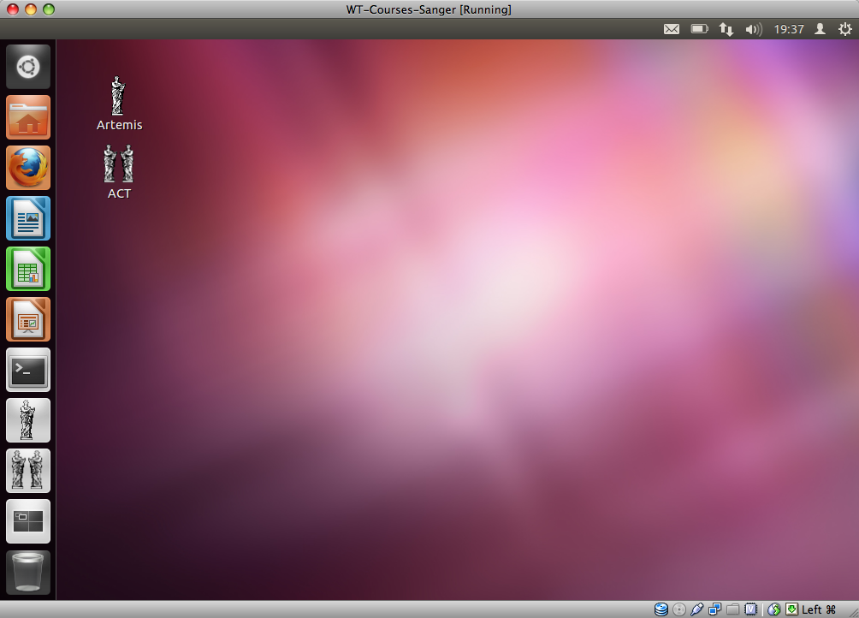
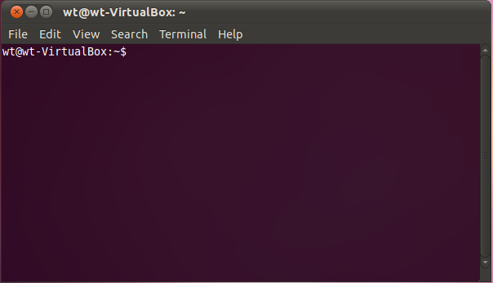
Terminals and Commandline
UNIX prompt
Notes:
However another really cool feature about UNIX is the ability to interact and provide instructions to the computer using a series of text based commands
The commands/instructions are provided to the computer in a terminal window on the commandline
Very powerful as it allows you to carry out certain tasks very quickly that otherwise may take be time consuming if using the file manager e.g. moving or deleting hundreds of files

Slide 5
Unix Commands
Command
What it does
ls
List the contents of the current directory
cd
Changes a directory
mv
Moves a file
cp
Copies a file
rm
Remove a file
less
Displays the contents of a file
head
Displays the first ten lines of a file
tail
Displays the last ten lines of a file
cat
Concatenate files together
pwd
Print working directory
mkdir
Make a new directory
Notes:
Mention the terseness of the commands

Slide 6
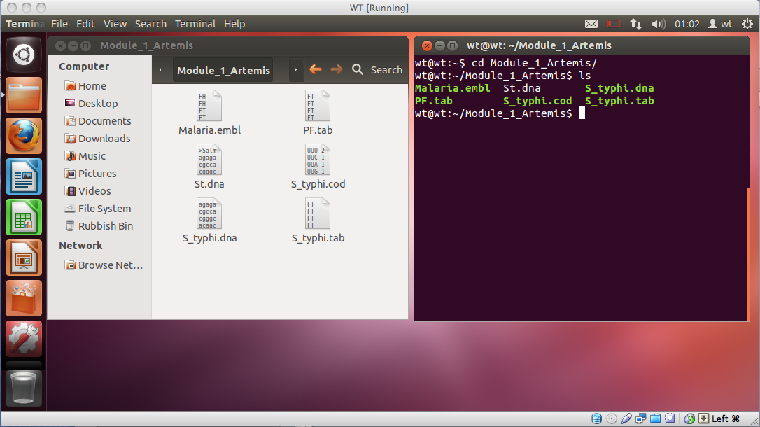
ls command

Slide 7
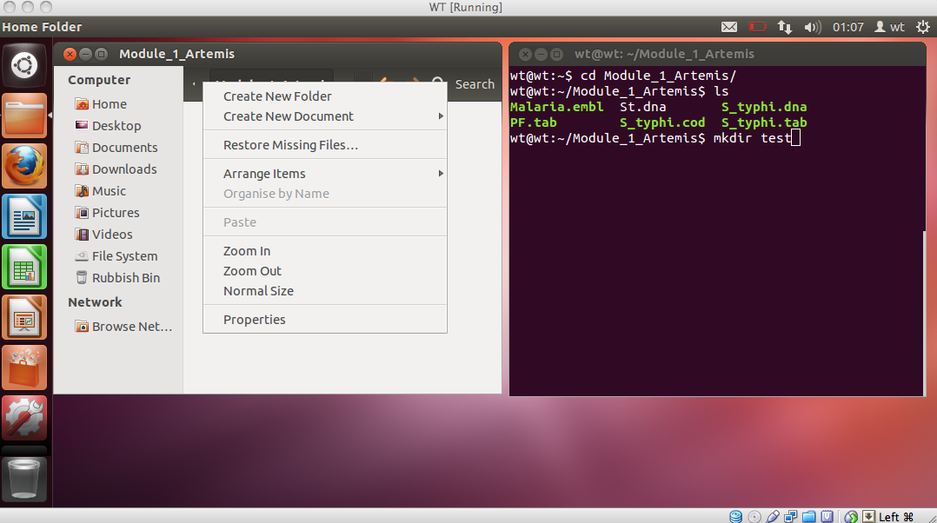
mkdir command

Slide 8
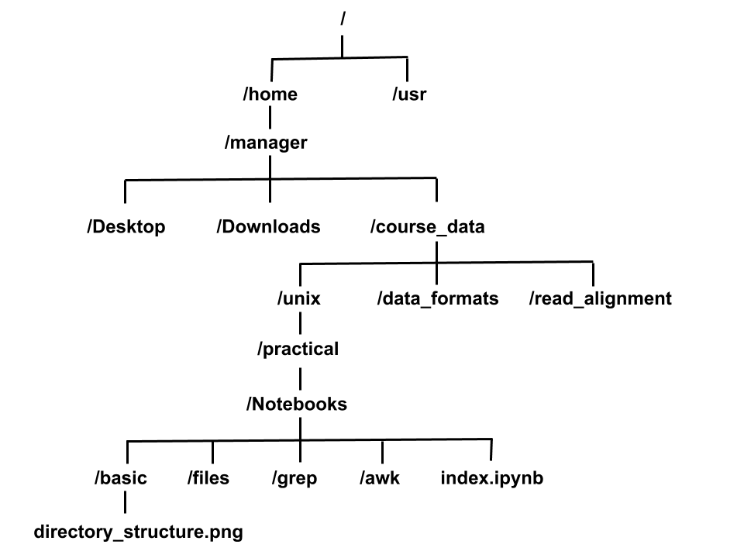
Directory Structure
root directory
/home/manager/course_data/unix/practical/Notebooks/index.ipynb
Notes:
Shows a typical directory structure in UNIX, a directory is equivalent to folder in Windows
Organised in a hierarchy, directories can have subdirectories and so on
Very useful for organising your work – organise files for different projects into different directories to keep them separate
The most top level directory in the hierarchy is called the root directory and is denoted by a forward slash
The full location or path of a specific files given by listing it’s location from the root directory

Slide 9
Unix Tips & Tricks
Unix is case sensitive
Typing LS is NOT the same as typing ls
You need to put spaces between
a command
the values passed to the command
mkdir new_dir will create a new directory
mkdirnew_dir will just give an error!
Unix is not psychic! If you misspell the name of command or a file it will not understand you
Notes:
When learning UNIX some common mistakes we see happen over and over
Forgetting that UNIX is case sensitive, to add spaces and mis-spelling commands/file names
-Some of this may not make sense until you start looking at examples, therefore open Introduction to UNIX module under section 4, read through the module which gives a bit more background to UNIX and make a start on the exercises – as always if you have any questions on UNIX please feel free to ask any of us

