Slide 1
Life Expectancy AI
Demi Oluwafemi
MS CIS & Business Analytics
Capstone Project

Slide 2
Life Expectancy AI CISBA Capstone
Project Overview
Project Overview
County‑level Decision Support System (DSS)
Predicts life expectancy using socioeconomic and health factors
Built on real public health data from the County Health Rankings dataset
Why This Matters
Life expectancy varies dramatically across U.S. counties
Decision‑makers often lack simple, interactive analytical tools
Communities need data‑driven what‑if insights to explore potential interventions

Slide 3
LIFE EXPECTANCY AI CISBA CAPSTONE
FROM IDEA TO DSS
Data Management → Clean & Merge
Transform raw public‑health data into a usable, consistent dataset.
Data Analytics → Train & Evaluate Model
Build and validate a predictive model for county‑level life expectancy.
Software Systems → Build Interactive Dashboard
Develop a Streamlit UI that lets users explore, predict, and run what‑if scenarios.
Cybersecurity → Ethical & Secure Design
Add disclaimers, responsible‑use notes, and plan for secure deployment.
Synthesis of all 4 MS‑CISBA areas, A complete pipeline that integrates data, analytics, systems, and security into one functioning DSS.

Slide 4
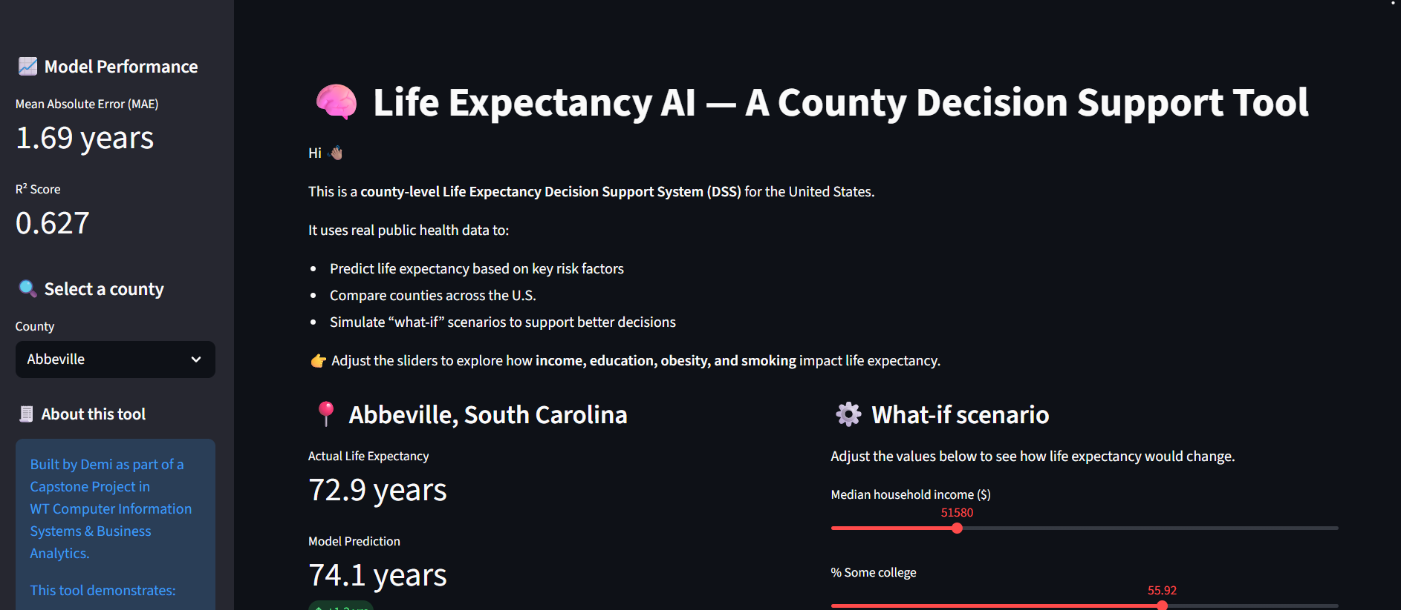
LIFE EXPECTANCY AI CISBA CAPSTONE
LIVE DEMO
Left: Features → Right: Benefits
Select any county → Compare local conditions
Actual vs predicted values → Understand gaps and disparities
Adjust sliders for what‑if analysis → Test potential interventions
See real‑time impact → Support planning and decision‑making

Slide 5
Life Expectancy AI CISBA Capstone
Why This Project Proves Synthesis
Data Management
Cleaned messy multi‑sheet Excel from County Health Rankings 2025
Merged datasets using FIPS to produce a reliable, analysis‑ready CSV
Data Analytics
Built a linear regression model using key predictors: income, education, obesity, smoking
Performance: MAE = 1.69 years, R² = 0.627
Software Systems
Developed a Streamlit dashboard
Interactive sliders enable real‑time what‑if simulations for any county
Cybersecurity & Networking
Added an ethical disclaimer to guide responsible use
Outlined future HTTPS + authentication for secure deployment
None of these alone would create a working, responsible system. Together, they do. This is a synthesis of a unified DSS pipeline, not a collection of parts.

Slide 6
LIFE EXPECTANCY AI CISBA CAPSTONE
What’s Next for the DSS
Real‑time data integration (e.g., CDC APIs for live public‑health updates)
Explainable AI using SHAP values to show why predictions change
Secure cloud deployment with HTTPS, authentication, and user roles
Scalable decision tool that can support national‑level public‑health planning
This prototype is the first step toward a national public‑health decision tool. It demonstrates synthesis by showing a feasible understanding, as each MS-CISBA area is not only present but also necessary and interconnected.
Data Management → Analytics → Software Systems → Cybersecurity. All four work together to produce a functioning, responsible Decision Support System.

Slide 7
Thank You
Questions?

