Slide 1
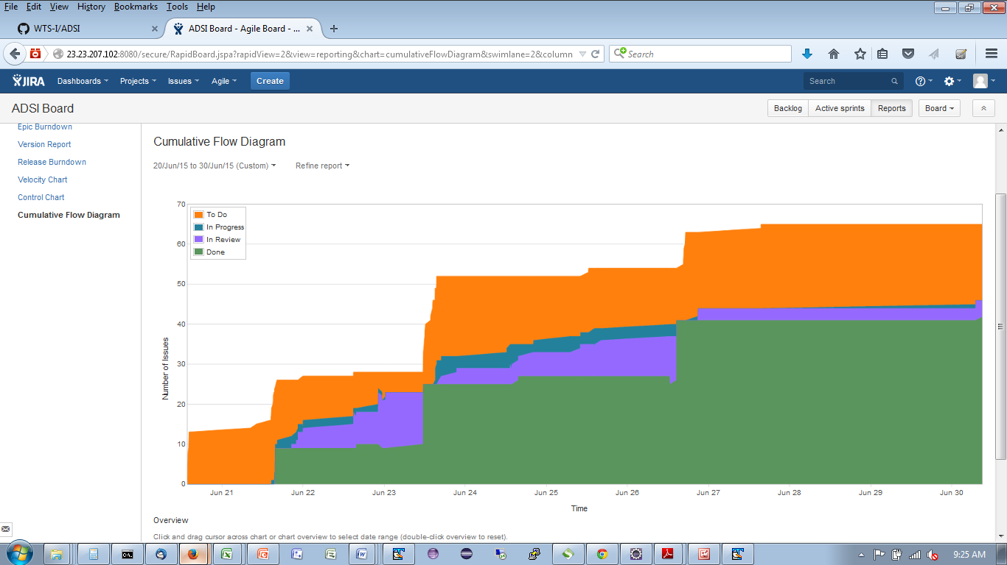
“Inception”
Establishment of the ADSI DevOps and Delivery Infrastructure
“Sprint 1 - MVP”
Delivery of Minimal Viable Product (MVP) Driven by Protosketching Session and Initial Field User Input
DevOps CI and CM Enhancements
“Sprint 2 - Functionality”
Functional Enhancements Driven by Field User Feedback after Sprint 1 Review
DevOps Build Automation Enhancements and Container Definitions
“Sprint 3 -Simplicity”
Usability Enhancements Driven by Field User Feedback after Sprint 2 Review
DevOps Deployment Automation Enhancements and Container Publication

Slide 2
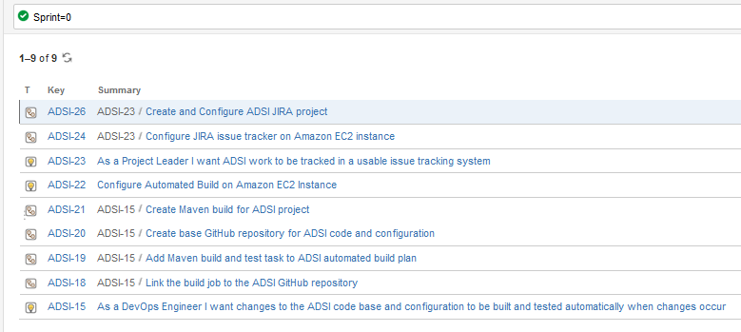

Slide 3
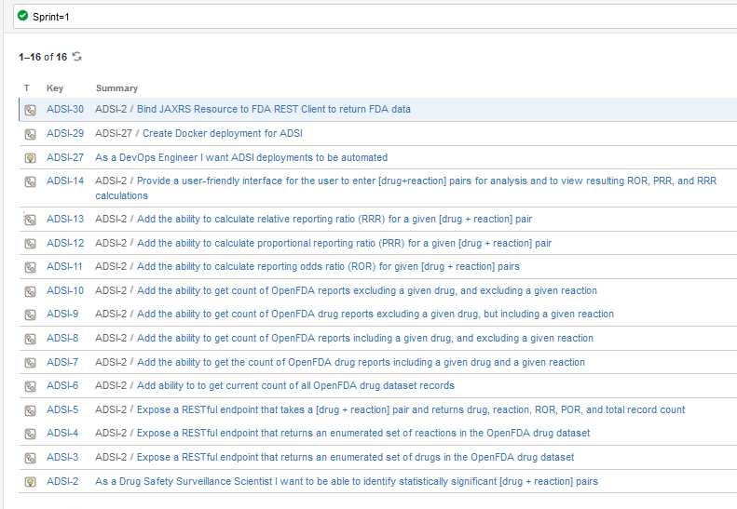

Slide 4
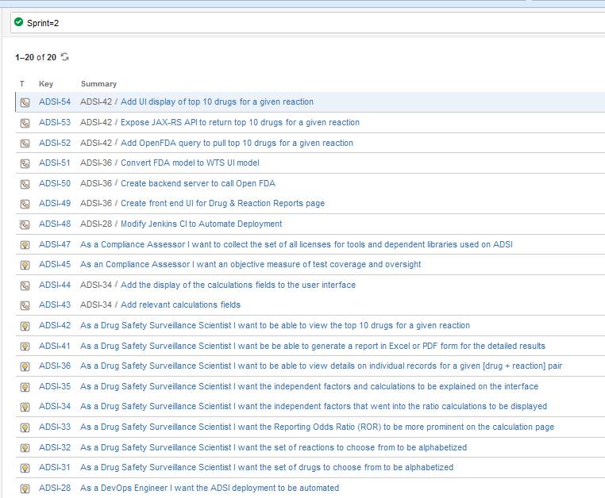

Slide 5
