Slide 1

Azure Women Hackathon
Round 1: Idea Submission
Team Name: WTS
Team Leader: KHUSHI RAJ DAS
Problem Statement: E-COMMERCE AND EDUCATIONAL
PLATFORM FOR RURAL WOMEN
Project Name: FemmePower
1

Slide 2
Azure Women Hackathon
Problem identified:
• Lack of education.
• Lack of access to technology.
• Lack of knowledge.
• Insufficient funding in rural areas by government.
• Traditional Artisans not being able to make to the global market.
Market Research:
Who are your customers and end-users?
• Rural Women
• Women who strive for financial freedom
• People interested in hand-made artisan products
• Companies looking for hiring women work force
What are the solutions already available in market for your
problem? How is your solution better than existing solutions?
Solutions available in the market are not a complete package, The
solutions available are scattered and bringing all of these together to a
successful business can be quite technically challenging. Our Solution
provides a complete package of e-commerce, finance and education to
one place in your native language. We want to take all the technical
challenges so the women can focus on building a successful business.
What impact will your project make on the current market?
We will be seeing more financially independent women. Traditional arts
which haven’t seen the light of the global market will be recovered.
Bring up the local business will definitely help bring up the financial
situation of the whole region.
2

Slide 3
Azure Women Hackathon
Describe your solution:
● E-Commerce website for rural women to set up an online store and a
journey towards financial independence.
● For the ease of use, our website’s language can be smoothly
transitioned to their regional language.
● We have added tutorial videos to for a complete guide on how to use
our website.
● Funding is the main show stopper for any business and rural regions
are known to have improper funding.To solve this issue we have
portals for government as well as private fundings.
● There is portal to apply for education in government schols and
colleges
Technology Stack:
• Frontend- bootstrap
• Backend- NodeJs
• Database- SQL
• Azure Cloud Services
Innovativeness:
• Complete E-Commerce Package
• Native language support
• Portals For Basic Education
• Portals for Government and Private Funding
Show Stoppers:
• BUDGET
3

Slide 4
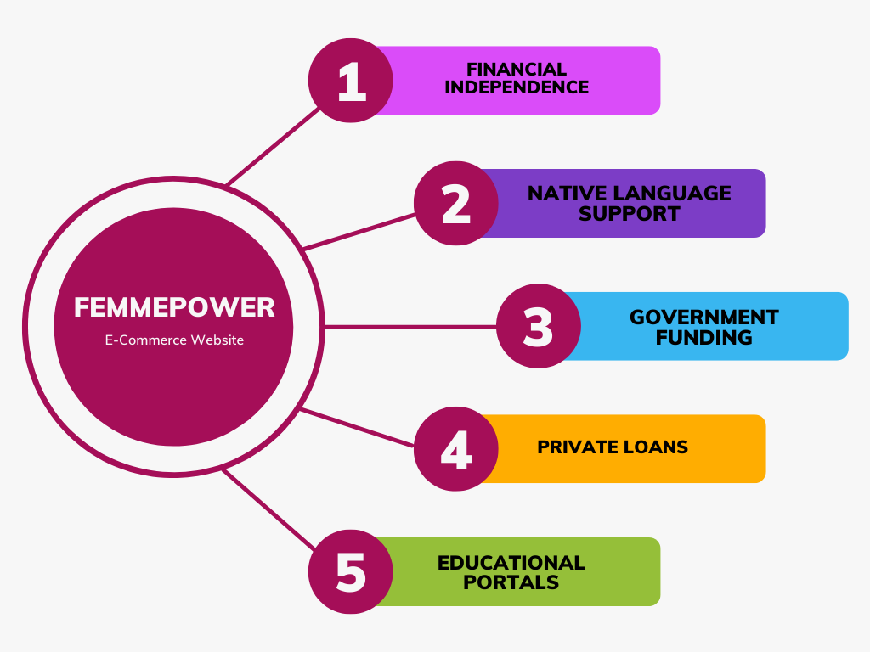
Azure Women Hackathon
Use Case Diagram:
4

Slide 5
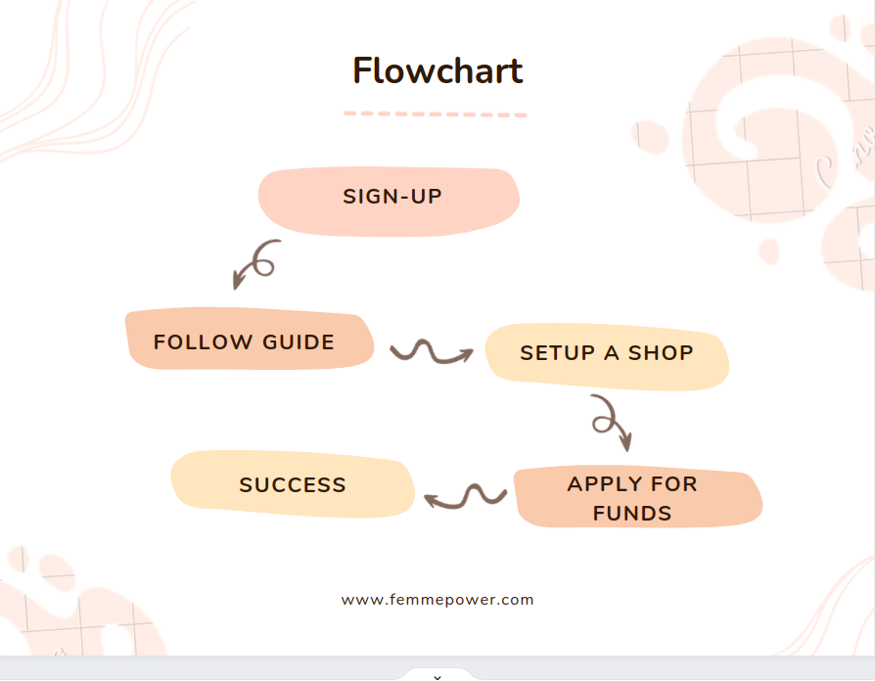
Azure Women Hackathon
Flow Diagram:
5

