Slide 1
SOLID
15 letters that will change your code

Slide 2
About me:
software developer
Jarosław Stadnicki
jstadnicki@pgs-soft.com jaroslaw.stadnicki@gmail.com
@j_stadnicki
jstadnicki.blogspot.com

Slide 3
SOLID - is a mnemonic acronym introduced by Michael Feathers for the "first five principles" named by Robert C. Martin in the early 2000s that stands for five basic principles of object-oriented programming and design. The principles, when applied together, intend to make it more likely that a programmer will create a system that is easy to maintain and extend over time. The principles of SOLID are guidelines that can be applied while working on software to remove code smells by causing the programmer to refactor the software's source code until it is both legible and extensible. It is part of an overall strategy of agile and adaptive programming - wikipedia

Slide 4
SOLID - is a mnemonic acronym introduced by Michael Feathers for the "first five principles" named by Robert C. Martin in the early 2000s that stands for five basic principles of object-oriented programming and design. The principles, when applied together, intend to make it more likely that a programmer will create a system that is easy to maintain and extend over time. The principles of SOLID are guidelines that can be applied while working on software to remove code smells by causing the programmer to refactor the software's source code until it is both legible and extensible. It is part of an overall strategy of agile and adaptive programming.

Slide 5
S
O
L
I
D
S | R | P
O | C | P
L | S | P
I | S | P
D | I | P

Slide 6
S

Slide 7
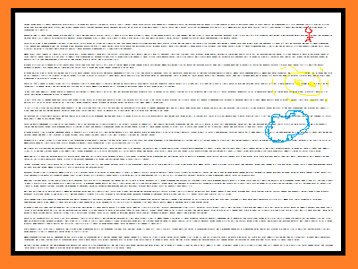
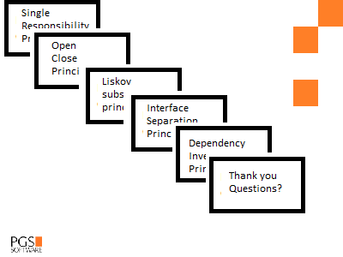

Slide 8
Single responsibility principle
a class should have only a single responsibility (i.e. only one potential change in the software's specification should be able to affect the specification of the class)

Slide 9
public void SaveNewProjectToDatabase(NewProjectModel newProjectModel)
{
var authorization = new AuthorizationService();
if (authorization.CurrentUserIsAuthenticated == false)
{
var logger = new Logger();
logger.Log("Unauthorized access");
throw new NotAuthorizedAccess();
}
var database = new Database();
try
{
database.Add(newProjectModel);
database.SaveChanges();
}
catch (Exception e)
{
var logger = new Logger();
logger.Log("Fail to add or save changes on adding new project model")
}
finally
{
var logger = new Logger();
logger.Log("success, new project model added"); /* ooops, actually that’s not true */ }
}

Slide 10
Single responsibility principle
public void SaveNewProjectToDatabase(NewProjectModel newProject)
{
database.Add(newProject);
database.SaveChanges();
}

Slide 11
srp => focus

Slide 12
O

Slide 13
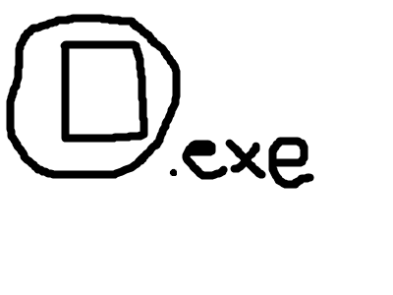
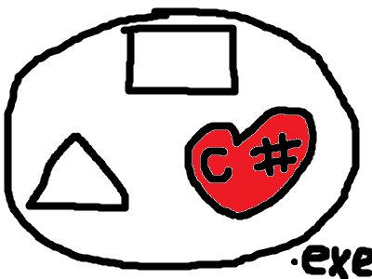
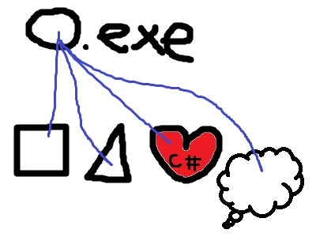
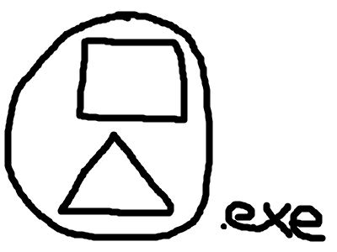

Slide 14
Open close principle
“software entities … should be open for extension, but closed for modification.”

Slide 15
Open close principle
public decimal GetTotalArea()
{
var totalSize = 0m;
foreach (var shape in shapes)
{
if (shape is Rectangle)
{
/* calculate area of rectangle */
}
if (shape is Circle)
{
/* calculate area of circle */
}
} return totalSize;
}

Slide 16
Open close principle
public class SadDemoBasket
{
public decimal CalculateRegularPrice()
{
/* calculate regular price of products */
}
public decimal CalculateDiscountPrice()
{
/* calculate price of products with discount */
}
public decimal CalculateWholesalePrice()
{
/* calculate price of products using wholesale prices */
}
}

Slide 17
Open close principle
public decimal CalculatePrice(PriceCalculatorType calculatorToUse)
{
switch (calculatorToUse)
{
case PriceCalculatorType.Regular:
return priceCalculator.GetPriceForProducts(products);
case PriceCalculatorType.Discount:
return discountPriceCalculator.GetPriceForProducts(products);
case PriceCalculatorType.Wholesale:
return wholesalePriceCalculator.GetPriceForProducts(products);
}
}

Slide 18
Open close principle
public class HappyAreaCounter
{
private List<IShape> shapes;
public decimal GetTotalArea()
{
var totalSize = 0m;
shapes.ForEach(shape => totalSize += shape.Area());
return totalSize;
}
}

Slide 19
Open close principle
public class HappyDemoBasket
{
private List<Product> products;
public decimal CalculatePrice(IPriceCalculator calculator)
{
return calculator.GetPriceForProducts(this.products);
}
}

Slide 20
ocp => plugins

Slide 21
L

Slide 22
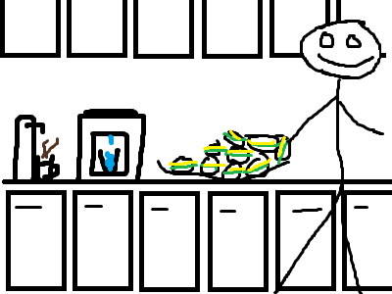
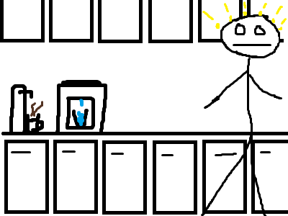
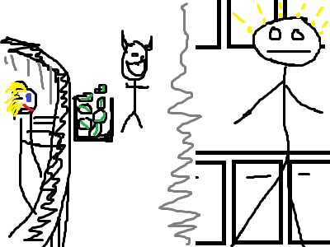

Slide 23
Liskov substitution principle
“objects in a program should be replaceable with instances of their subtypes without altering the correctness of that program”

Slide 24
Liskov substitution principle
interface IFile
{
void Write(byte[] data);
byte[] Read();
}

Slide 25
Liskov substitution principle
class File : IFile
{
public void Write(byte[] data){ /* writes stuff */ }
public byte[] Read() { /* reads stuff */ }
}
class ReadOnlyFile : IFile
{
public void Write(byte[] data) { throw new NotImplementedException();}
public byte[] Read(){ /* reads stuff*/ }
}

Slide 26
Liskov substitution principle
public void SadTestMethod()
{
var files = new List<IFile>();
files.Add(new File());
files.Add(new ReadOnlyFile());
files.ForEach(file=>file.Read());
files.ForEach(file=>file.Write(new byte[1]));
}

Slide 27
Liskov substitution principle
public interface IDuck
{
void Swim()
}

Slide 28
Liskov substitution principle
public class OrganicDuck : IDuck
{
public void Swim(){ /* do the swim */ }
}
public class ElectricDuck : IDuck
{
private bool isTurnedOn;
public void Swim()
{
if (!isTurnedOn)
throw new Exception("Toy must be turn on in order to swim");
/* do the swim */
}
public void TurnOn() {isTurnedOn = true; }
public void TurnOff(){isTurnedOn = false;}
}

Slide 29
Liskov substitution principle
public interface IWritable
{
void Write(byte[] bytes);
}
public interface IReadable
{
byte[] Read();
}

Slide 30
Liskov substitution principle
public void HappyTestMethod()
{
var canRead = new List<IReadable>();
var canWrite = new List<IWritable>();
canRead.Add(new File());
canRead.Add(new ReadOnlyFile());
canWrite.Add(new File());
canRead.ForEach(file => file.Read());
canWrite.ForEach(file => file.Write(new byte[1]));
}

Slide 31
lsp => contracts

Slide 32
I

Slide 33
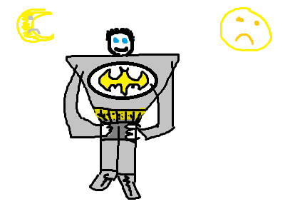
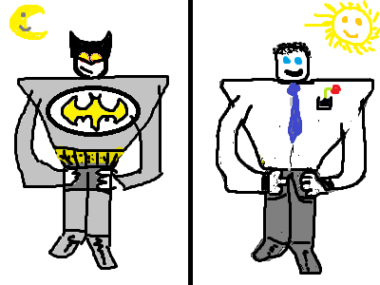

Slide 34
Interface segregation principle
“many client-specific interfaces are better than one general-purpose interface.”

Slide 35
Interface segregation principle
public interface IPerson
{
string Name { get; set; }
string HomeAddress { get; set; }
string Nickname { get; set; }
List<string> SuperSkills { get; set; }
bool IsSuperHero { get; }
}

Slide 36
Interface segregation principle
public void SadTestMethod()
{
var persons = new List<IPerson>();
persons.Add(CreateBruceWayne());
persons.Add(CreateJohmSmith());
persons.ForEach(PrintPersonDetails);
}

Slide 37
Interface segregation principle
return new Person
{
Name = "Bruce Wayne",
HomeAddress = "Gotham City",
IsSuperHero = true,
Nickname = "Batman",
SuperSkills = new List<string> {
"Kick ass",
"Do the right thing",
“Being deadly serious"
}
};
return new Person
{
Name = "John Smith",
HomeAddress = "Gotham City",
IsSuperHero = false,
Nickname = string.Empty,
SuperSkills = null
};

Slide 38
Interface segregation principle
public void PrintPersonDetails(IPerson person)
{
Console.WriteLine(person.Name);
Console.WriteLine(person.HomeAddress);
Console.WriteLine(person.IsSuperHero);
Console.WriteLine(person.Nickname);
Console.WriteLine(person.SuperSkills);
}

Slide 39
Interface segregation principle
public interface IPersonPublicInformation
{
string Name { get; set; }
}
public interface IPersonPrivateInformation
{
string Name { get; set; }
string HomeAddress { get; set; }
}
public interface IPersonAlterEgo
{
string Nickname { get; set; }
List<string> SuperSkills { get; set; }
bool IsSuperHero { get; }
}

Slide 40
Interface segregation principle
public interface Person:
IPersonPublicInformation,
IPersonPrivateInformation
{
string Name { get; set; }
string HomeAddress { get; set; }
}
public interface PersonWithPowers:
IPersonPublicInformation,
IPersonPrivateInformation,
IPersonAlterEgo
{
string Name { get; set; }
string HomeAddress { get; set; }
string Nickname { get; set; }
List<string> SuperSkills { get; set; }
bool IsSuperHero { get; }
}

Slide 41
Interface segregation principle
public void PrintPersonPublicDetails(IPersonPublicInformation person)
{
Console.WriteLine(person.Name);
}
private void PrintPrivateDetails(IPersonPrivateInformation person)
{
Console.WriteLine(person.Name);
Console.WriteLine(person.HomeAddress);
}
public void PrintPersonAlterEgoDetails(IPersonAlterEgo person)
{
Console.WriteLine(person.IsSuperHero);
Console.WriteLine(person.Nickname);
Console.WriteLine(person.SuperSkills);
}

Slide 42
isp => secrets

Slide 43
D

Slide 44
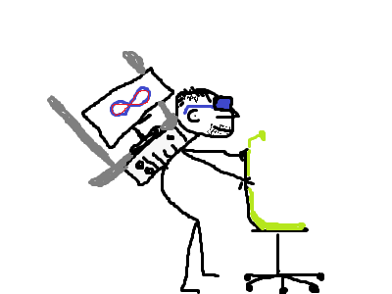
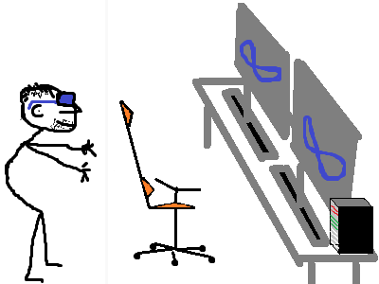

Slide 45
Dependency inversion principle
one should “Depend upon Abstractions. Do not depend upon concretions.”

Slide 46
Dependency inversion principle
public void SadDemoMethod()
{
var service = new SadDemoService();
var database = new SadDemoDatabase();
var data = database.LoadData();
service.Handle(data);
var loger = new SadFileLoger();
loger.Write("Im sad!");
}

Slide 47
Dependency inversion principle
public void HappyDemoMethod(IDatabase database,
IService service,
ILoger loger)
{
var data = database.LoadData();
service.Handle(data);
loger.Write("Im happy!"); /* SRP warning here */
}

Slide 48
Dependency inversion principle
public class HappyDemoClass {
private readonly IDatabase database;
private readonly IService service;
private readonly ILoger loger;
public HappyDemoClass(IDatabase database, IService service, ILoger loger)
{
this.database = database;
this.service = service;
this.loger = loger;
}
public void HappyDemoMethod()
{
/* code goes here */
}
}

Slide 49
dip => demand

Slide 50
S | O | L | I | D
focus | plugins | contract | secrets | demand

Slide 51
What else
KISS | OOP | TDD | GIT
DRY | POCO | BDD | MAGIC NUMBERS
YAGNI | BLAME | DDD | XP
WTF | FLAME WAR | AOP | KANBAN
RTFM | REVIEW | JIRA | more!

Slide 52
That’s all folks
Thank you
Questions?
Feedback

