Slide 1
Literate programming

Slide 2
Why I am interested in other paradigms for writing code?
Too many software projects fail (below from http://calleam.com/WTPF/)
17 percent of large IT projects go so badly that they can threaten the very existence of the company
On average, large IT projects run 45 percent over budget and 7 percent over time, while delivering 56 percent less value than predicted
My own disaffection toward some current ‘best practices’
Little attention to requirements (i.e. user stories)
Too much attention to testing (i.e. TDD)
My irritation at looking at other people code and not figuring it out
My irritation at looking at my own old code and not figuring it out

Slide 3
Donald Knuth (1937 - …)
Fabled computer scientist
Turing Award, ACM award, …
Exploits:
Wrote The Art of Computer Programming
Coded TeX - the language Latex is written with
Invented ‘Literate Programming’
And a billion of other things …
Pays a check for each bug you find in his programs/books
Doesn’t read email. “Email is a wonderful thing for people whose role in life is to be on top of things. But not for me; my role is to be on the bottom of things. What I do takes long hours of studying and uninterruptible concentration.”

Slide 4
Literate Programming
Main idea:
Treat a program as a piece of literature, addressed to human beings rather than to a computer.
Implications
Write it as you would describe the code to someone new to your team.
Code organization should be optimal for the reader, not the compiler
You should be able to ‘print’ your code as a proper book
“The practitioner of literate programming can be regarded as an essayist, whose main concern is with exposition and excellence of style. Such an author, with thesaurus in hand, chooses the names of variables carefully and explains what each variable means. He or she strives for a program that is comprehensible because its concepts have been introduced in an order that is best for human understanding, using a mixture of formal and informal methods that reinforce each other.” - Knuth

Slide 5
Implementations
Classical interpretation (i.e. Web, CWeb):
You write a section of text followed by the code described in the text
A preprocessor produces the code to compile and the book to print
You can reference section of text that you haven’t written yet
Literate Haskell
You use a special character (>) before each line of code
The compiler is run with a switch to enable to read such lines
Haskell declarations are order independent
My approach (not jus mine, actually)
You use special characters inside your code comments (as javadoc)
You run a program that creates an Asciidoc/markdown document
Asciidoc/markdown translates to html, pdf, latex, ….

Slide 6
CWeb
@ When you type a word, we first convert uppercase letters to lowercase; then
we chop off all but the first five characters, if the word was longer than
that, and we look for your word in a small hash table. Each hash table entry
contains a string of length 5~or~less, and two additional bytes for the word's
type and meaning. Four types of words are distinguished: |motion_type|,
|object_type|, |action_type|, and |message_type|.
@s wordtype int
@<Type...@>=
typedef enum@+{@!no_type,@!motion_type,@!object_type,
@!action_type,@!message_type}@!wordtype;
typedef struct {
char text[6]; /* string of length at most 5 */
char word_type; /* a |wordtype| */
char meaning;
} hash_entry;

Slide 7
Literate Haskell
Recursion
=========
A recursive implementation that calculates the nth Fibonacci number can be written remarkably close to the mathematical definition:
> fibr :: Integer -> Integer
> fibr n
> | n == 0 = 0
> | n == 1 = 1
> | n > 1 = fibr (n-1) + fibr (n-2)
Alternatively, the recursive `fibr` function can be written using pattern-matching instead of guards. This looks less like the mathematical definition, but is more concise. (And also, strictly speaking, wrong for inputs less than zero, for `fibp` doesn't terminate in this case.)
> fibp :: Integer -> Integer
> fibp 0 = 0
> fibp 1 = 1
> fibp n = fibp (n-1) + fibp (n-2)

Slide 8
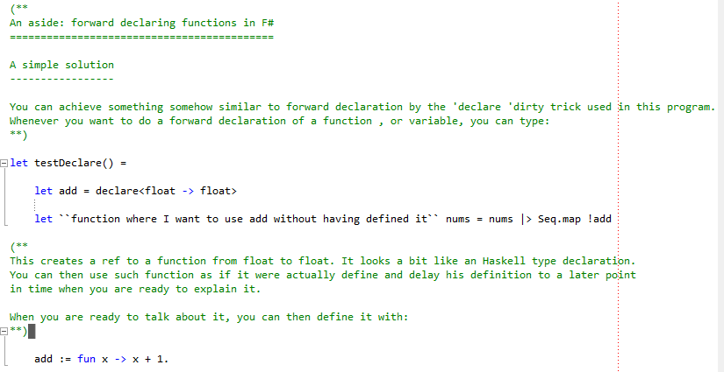
LLite – F#

Slide 9
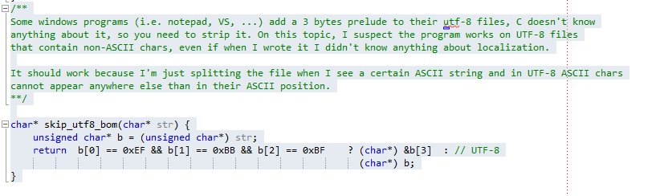
LLite – C

Slide 10
Some objections
The code should speak for itself
Does it? Really?
It takes too long to do it this way
So what?
You can’t see the code with all that text
But once you see it you understand it
I’m a programmer because I’m not good at communicating with people
Then you are probably not a very good one

Slide 11
Demo
F# code
F# tricks
C code

Slide 12
What’s left to do on LLite
Make LLite work for multiple files and libraries
In which order to ‘write the book’, given multiple files
Cross file referencing
Various polishing …
Ditch it? And instead use F# Formatting …
http://tpetricek.github.io/FSharp.Formatting/demo.html

Slide 13
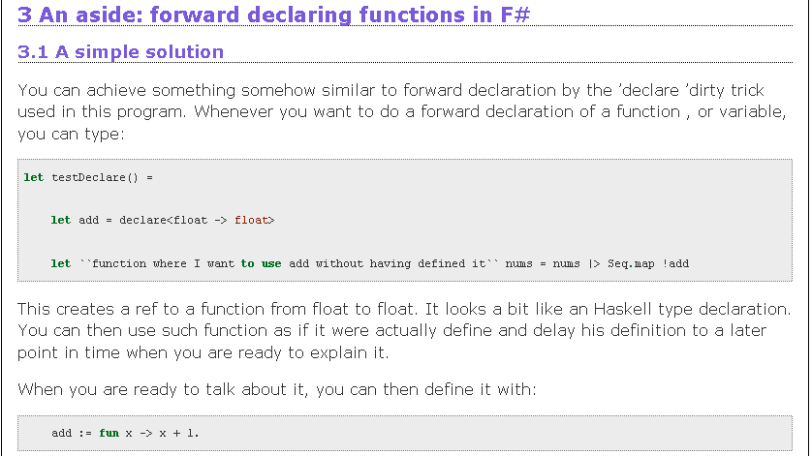
HTML output

Slide 14
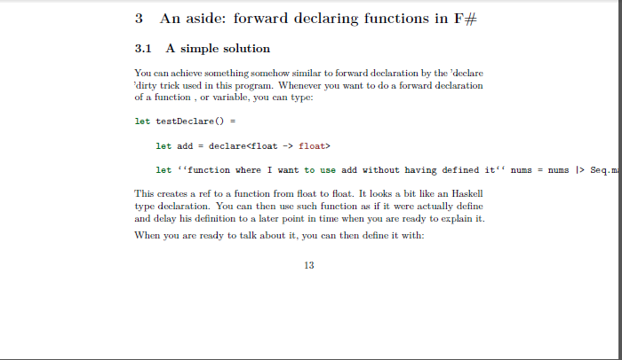
PDF output

Slide 15
Do software projects fail?
Source : McKinsey & Company in conjunction with the University of Oxford Date : 2012
A study of 5,400 large scale IT projects (projects with initial budgets greater than $15M) finds that the well known problems with IT Project Management are persisting. Among the key findings quoted from the report:
17 percent of large IT projects go so badly that they can threaten the very existence of the company
On average, large IT projects run 45 percent over budget and 7 percent over time, while delivering 56 percent less value than predicted
Most research papers found similar numbers

Slide 16
Why software project fail (10 biggest themes)
The underestimation of complexity, cost and/or schedule
Failure to establish appropriate control over requirements and/or scope
Lack of communications
Failure to engage stakeholders
Failure to address culture change issues
Lack of oversight / poor project management
Poor quality workmanship
Lack of risk management
Failure to understand or address system performance requirements
Poorly planned / managed transitions
(from http://calleam.com/WTPF/)

Slide 17
Who is to blame?
Management
Failure to establish appropriate control over requirements and/or scope
Lack of communications
Failure to engage stakeholders
Failure to address culture change issues
Lack of oversight / poor project management
Poorly planned / managed transitions
Development
Poor quality workmanship
Failure to understand or address system performance requirements
Both
The underestimation of complexity, cost and/or schedule
Lack of risk management

Slide 18
But we use all the best practices !!
TDD
Continuous integration
Patterns
Functional programming
… Add your own list of practices here
Hypothesis A: these failed projects didn’t follow such best practices
Hypothesis B: there is something more fundamental that we are doing wrong

Slide 19
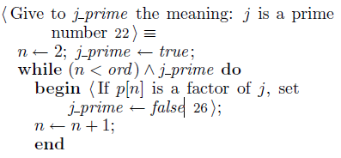
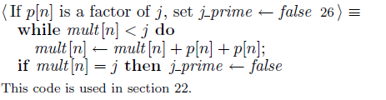
An example of Web …

Slide 20
Let’s assume it is ‘B’ – we are doing something wrong
Where there ever competing paradigms on how we write code?
What is roughly the current paradigm?
Spend as little as possible, but not less, on requirement gathering
Try to get your customer to work in the same room as devs (but fail)
Architect as little as possible, but not less
Refactor extensively
Write plenty of testcases to cover your as$
Try to get a test team to find your bugs
Growing recognition that we need more upfront activities:
More requirement gathering, risk exploration, architecture …

Slide 21
At the micro-level of writing code …
Are there styles of coding that ‘force’ you to think more upfront?
Hacking
Literate programming
Informal
Code review, testing, …
Formal verification
verification

