Slide 1
Promise to never callback
Karol Tomaszewski

Slide 2

About me
Karol Tomaszewski
karotom.it@gmail.com

Slide 3
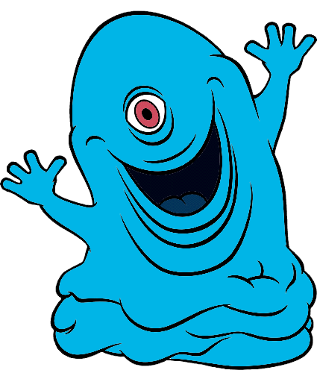

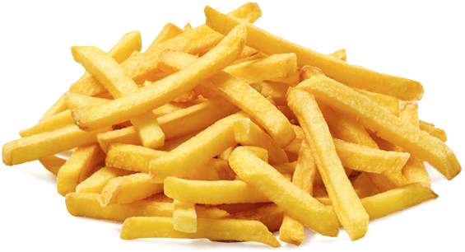
A story

Slide 4
How to prepare chips
Wash potato
Peel potato
Cut potato
Fry potato
string Wash(string)
string Peel(string)
string Cut(string)
string Fry(string)

Slide 5
Demo

Slide 6

Unit test

Slide 7
Demo

Slide 8
Promise strengths
Easy to chain
Simple way to handle errors
Unit tests more robust
Native since ES6
Parallel requests

Slide 9
Alternative
callback
promise (native in ES6)
yield (e.g. boa for node.js)
async/await (native in ES7)

Slide 10
Extra
Promise visualizer
http://bevacqua.github.io/promisees/

Slide 11
Thank you!

