Slide 1
Stress - the true friend that sticks around during bad times
Adrian Stefaniak Wroclaw, 23.02.2017

Slide 2

Stressor -> Perception -> Stress
“If you just sit and observe, you will see how restless your mind is, If you try to calm it, it only makes things worse, but over time it does calm, and when it does, there's room to hear more subtle. Your mind just slows down, and you see a tremendous expanse in the moment. You see so much more than you could see before. It's a discipline; you have to practice it." Steve Jobs
Notes:
Geneza stressu – pozwala nam przetrwac w sytuacji decydujacej o życiu i śmierci. Element naturalny z ktorym funkcjonujemy kazdego dnia. Stress jest efektem naszego postrzegania rzeczywistosci, ktore nie zawsze ma 100% odbicie w rzeczywistosci.

Slide 3
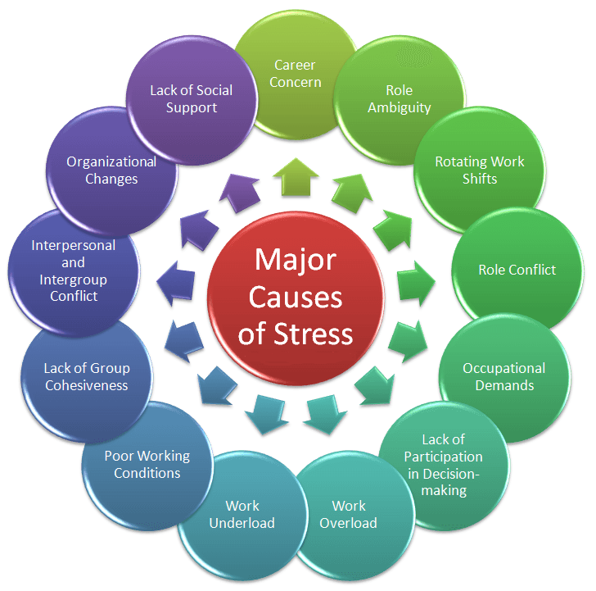
Major Causes of Stress
Notes:
Projekty scramowe, team, scum master, scrum project owner,
Respect, wsparcie, współudział w dezyzyjności, Stress a pefekcjonizm!

Slide 4

Job impact on personal life

Slide 5
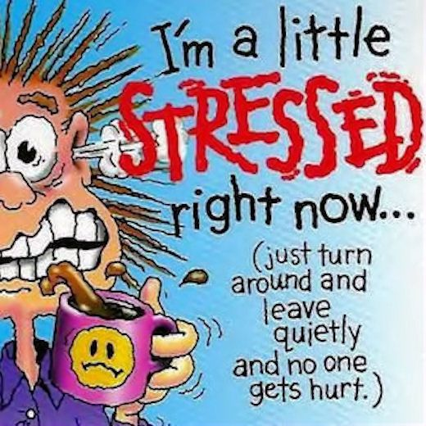
So I am stressed, what’s next?

Slide 6
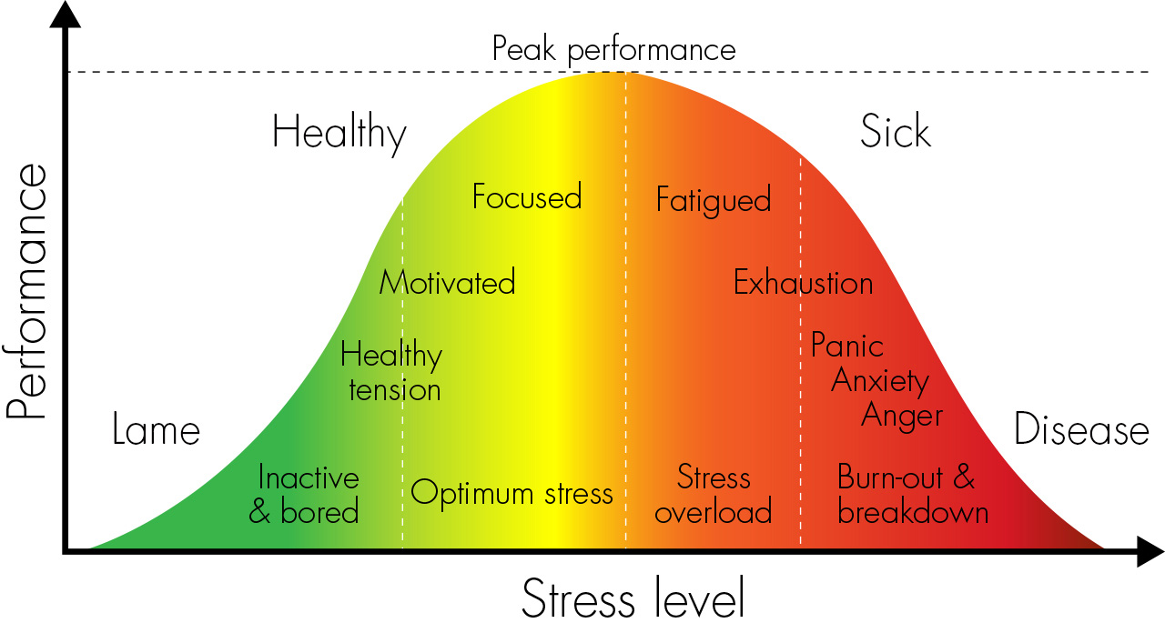
Understanding stress
Notes:
Strefa smierci na osmio tysiecznikach
Efekty stresu: Głowa: skoki nastrojów, smutek, złość, depresja, kłopoty ze spaniem, migreny Serce podwyzszone cisnienie, Żołądek kłopoty z trawieniem, brak apetytu, Układ odpornościowy
Samonapędzająca sie przepowiednia! Radzenie sobie ze stresem – każdy jest inny: Oxytocyna, aktywność fizyczna, ćwiczenia, sen, medytacja, kontakt z naturą, zarządzanie czasem, muzyka, bliskość z innymi!

Slide 7
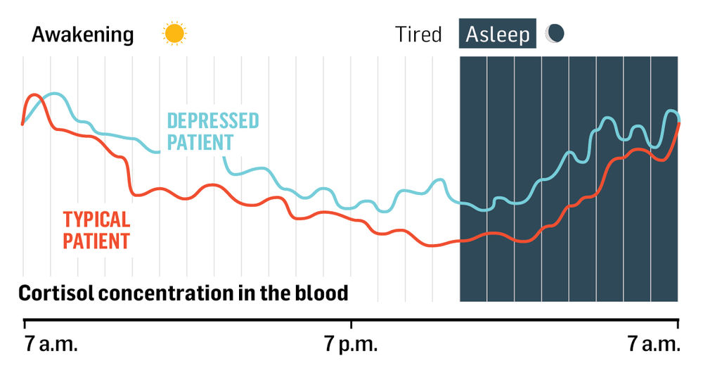
Cortisol – stress hormone

Slide 8
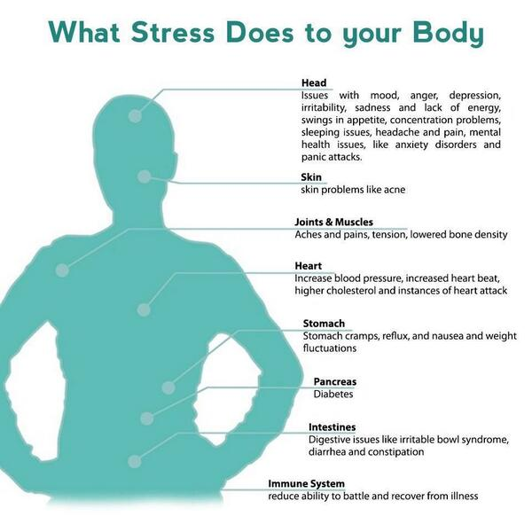
Stress and your body
Notes:
Physical complaints where medical illness has been ruled out or is seen as only
part of the problem
• Musculo-skeletal problems such as tics, headaches, backaches and cramps
• Gastrointestinal difficulties such as frequent indigestion or nausea
2) Behavioral irregularities
• Withdrawal
• Increased alcohol and drug use
• Change in eating habits and weight (increase or decrease)
• Change in sleeping habits (increase or decrease)
3) Emotional discomfort
• Chronic fatigue
• Irritability
• Feeling "out of sorts"
• Crying for no apparent reason
• Depressed mood; sadness
• Non-specific anxiety; worry

Slide 9
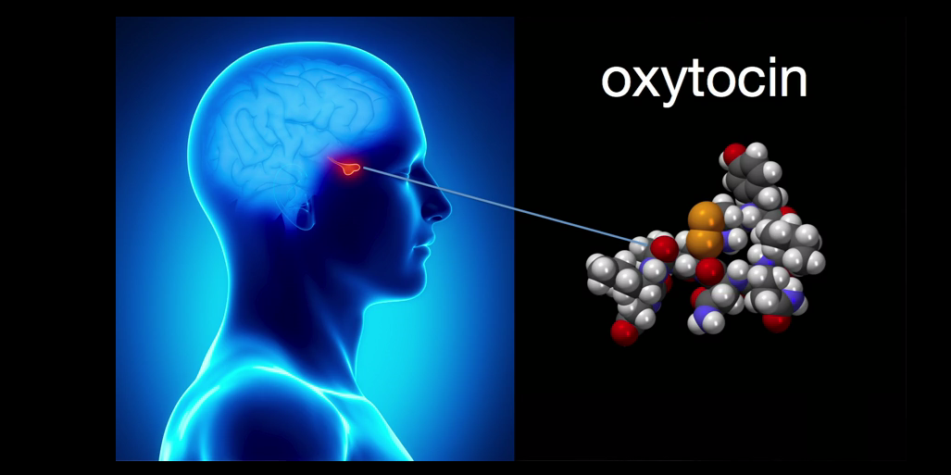
Oxytocin generates anti-stress-like effects

Slide 10
Stress management
Practice good nutrition
Exercise moderately
Learn a formalized relaxation method
Eliminate stressors from your physical environment
Manage your time
Set realistic expectations
Know when you need to ask others for help
Recognize anxiety messages
Accept the full spectrum of feelings
Learn new ways to express feelings
Return to basic values
Enjoy simple pleasures
Seek self-help materials
Notes:
Practice good nutrition. Limit caffeine, nicotine and sugar because they are central
nervous system stimulants that can aggravate anxiety. Avoid excess alcohol and food intake, especially during demanding times.
Exercise moderately. Appropriate exercise (e.g., even 30 minute walks daily)
facilitates the exit of the body's stress hormones and stimulates well-being. Highly
competitive exercise adds more strain.
Learn a formalized relaxation method. Meditation, breathing techniques,
progressive muscle relaxation and self-hypnosis can positively affect blood pressure,
metabolic rate and immune function when practiced over time.
Eliminate stressors from your physical environment. Noise, pollution,
uncomfortable room temperature and poor lighting are subtle stressors and can affect
your ability to concentrate.
Manage your time. Establish priorities based on your primary goals and schedule time for those pursuits as well as time for relaxation. Job loss can suddenly leave you with time on your hands. Try joining an organized activity through a church or community center. You may find great satisfaction volunteering for a charitable organization.
Set realistic expectations. Are you putting unrealistic demands on yourself? Don't
expect to be able to do everything and please everybody. Learn to speak up and set
necessary limits.
Know when you need to ask others for help. Accept the fact that you are not
responsible for everything and everyone.
Recognize anxiety messages. Don't burden yourself with messages like "Always be strong..." "Be perfect…" and "Everyone else seems to be coping better."
Accept the full spectrum of feelings. Be aware of pressure to feel only joy and
happiness without acknowledging the complexities of human experience. Sadness, anger and disappointment may be present alongside hope and other positive feelings.
Learn new ways to express feelings. Talk honestly with friends. Begin a journal of thoughts, ideas and feelings to give yourself an open forum. Learn to use art or music to express yourself.
Allow recollections. Recent or even old losses may emerge more poignantly during times of stress. Permit memories to co-exist with the present.
Return to basic values. Quiet time with friends or family, showing appreciation
through thoughtful gestures rather than material tokens can help you focus on the
meaningful aspects of your life and enjoy the warmth and caring of human relationships.
Enjoy simple pleasures. We all need to refuel regularly with some pleasure and
relaxation. It might be as simple as taking a walk or a hot bath, calling a friend, or turning on some music.
Seek self-help materials. Many useful books and tapes are available such as The
Relaxation and Stress Reduction Workbook by Davis, McKay, and Eshelman.

Slide 11
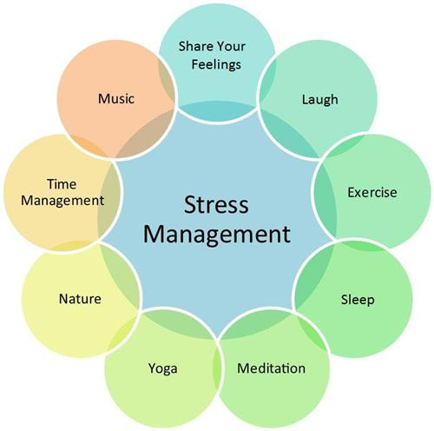
Stress management
Notes:
Practice good nutrition. Limit caffeine, nicotine and sugar because they are central
nervous system stimulants that can aggravate anxiety. Avoid excess alcohol and food intake, especially during demanding times.
Exercise moderately. Appropriate exercise (e.g., even 30 minute walks daily)
facilitates the exit of the body's stress hormones and stimulates well-being. Highly
competitive exercise adds more strain.
Learn a formalized relaxation method. Meditation, breathing techniques,
progressive muscle relaxation and self-hypnosis can positively affect blood pressure,
metabolic rate and immune function when practiced over time.
Eliminate stressors from your physical environment. Noise, pollution,
uncomfortable room temperature and poor lighting are subtle stressors and can affect
your ability to concentrate.
Manage your time. Establish priorities based on your primary goals and schedule time for those pursuits as well as time for relaxation. Job loss can suddenly leave you with time on your hands. Try joining an organized activity through a church or community center. You may find great satisfaction volunteering for a charitable organization.
Set realistic expectations. Are you putting unrealistic demands on yourself? Don't
expect to be able to do everything and please everybody. Learn to speak up and set
necessary limits.
Know when you need to ask others for help. Accept the fact that you are not
responsible for everything and everyone.
Recognize anxiety messages. Don't burden yourself with messages like "Always be strong..." "Be perfect…" and "Everyone else seems to be coping better."
Accept the full spectrum of feelings. Be aware of pressure to feel only joy and
happiness without acknowledging the complexities of human experience. Sadness, anger and disappointment may be present alongside hope and other positive feelings.
Learn new ways to express feelings. Talk honestly with friends. Begin a journal of thoughts, ideas and feelings to give yourself an open forum. Learn to use art or music to express yourself.
Allow recollections. Recent or even old losses may emerge more poignantly during times of stress. Permit memories to co-exist with the present.
Return to basic values. Quiet time with friends or family, showing appreciation
through thoughtful gestures rather than material tokens can help you focus on the
meaningful aspects of your life and enjoy the warmth and caring of human relationships.
Enjoy simple pleasures. We all need to refuel regularly with some pleasure and
relaxation. It might be as simple as taking a walk or a hot bath, calling a friend, or turning on some music.
Seek self-help materials. Many useful books and tapes are available such as The
Relaxation and Stress Reduction Workbook by Davis, McKay, and Eshelman.

Slide 12
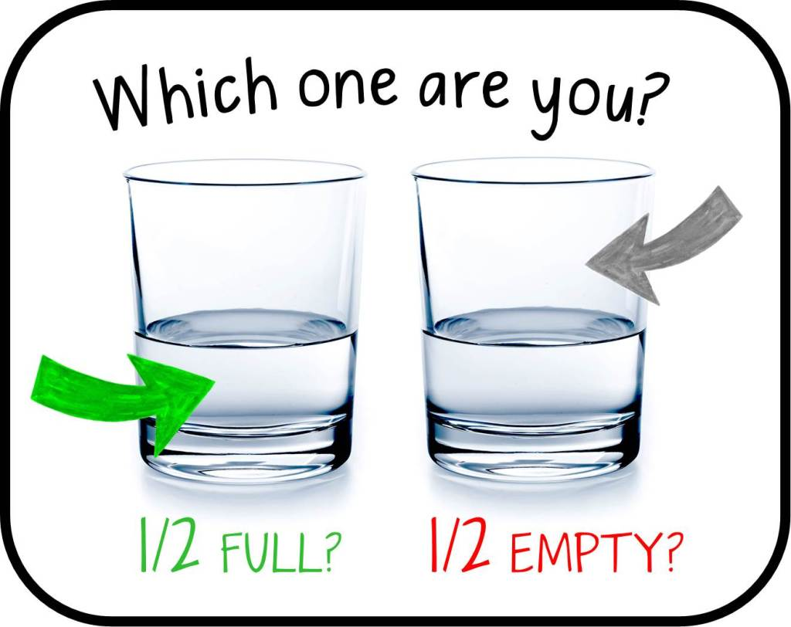
How to make stress your friend
Notes:
Historie: Najbardziej wyluzowany czlowiek w firmie,
Zamilowanie do pracy, praca po 80h tygodniowo,
Praca z Geniuszami! Postrzeganie stresu, Zrobienie minimum ktore spelni wymagania
Rutyna

