Slide 1


Python in a .NET world
How to use the best scripting language ;)

Slide 2
Who am I, why Python etc...
I've been working as a software enginner for the last ~10 years
I love Python since started learning it in 2009
used it for 14 months, building distributed system
designing
developing
testing
deploying
conducting administrative tasks

Slide 3
...but
I am NOT an expert in programming in Python!

Slide 4
Agenda
Pythonidae
Python
Python on VMs:
Jython
Python in .Net (there’s more than just IronPython)
Tools
Learning Python

Slide 5
Before we start…

Slide 6
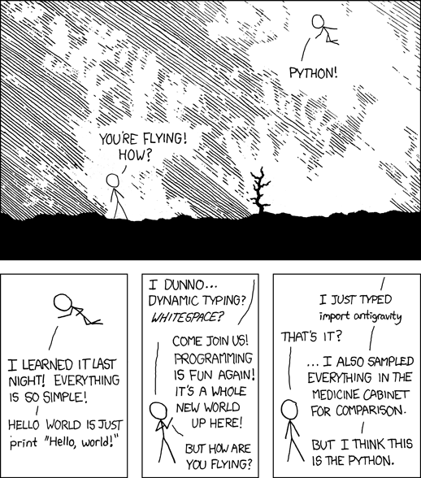
xkcd on P y t h o n

Slide 7
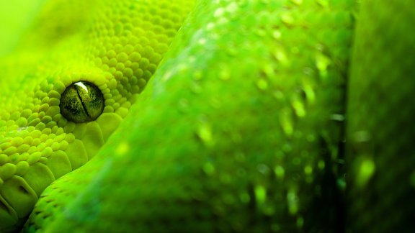
Pythonidae

Slide 8
Pythonidae (pythons)
snakes
~26 species
nonvenomus
oviparous
interesting facts:
available to buy on the market
sometimes do consume their owners!
Burmeses Pythons were introduced to Everglades, Florida by humans
Notes:
oviparous = lay eggs
Genera: Children Pythons, Papuan Pythons, Shield Pythons, Bismark Ring Pythons, White Lipped Pythons, Water Pythons, Tree Pythons, True Pythons
Lenght: 30cm up to 10m
Asphyxation, back curled teeth (4 rows in upper jaw, 2 rows in the bottom jaw)
Large Pythons are able to eat animals as huge as pig or even a deer
Closely related to 'boids' (boa constrictor)
Fun fact: as so many things in the Python universe seems to be connected with pythonidae, one of the IDEs for Python was named ‘boa constructor’ (boa constrictor!)

Slide 9
Python is...
(...programming language :)

Slide 10
Python introduction
Python is adult (18+)
Born in December (during Christmas)
Born in the Netherlands
Python's father is...
Notes:
Python concept - created late 1980's. Python itself was created in 1989.
Python was influenced by ABC language, and this one was created for scientists.
Python was created December, 1989 during the Christmas break.
Name was given to this project as Guido was (is?) a fan of "The Monty Python"

Slide 11
Guido van Rossum
creator of Python - holds BDFL title
created Python when working at CWI, Netherlands
worked on Python while working for Google
currently Guido works for Dropbox
awards:
2001: Advancement of OS Software
2003: NLUUG

Slide 12
Benevolent Dictator For Life
open source development leader
originates from...
other BDFLs:
Richard Stallman - GNU
Linus Torvalds - Linux
Yukihiro Matsumoto - Ruby
Chris Lattner - LLVM, Clang

Slide 13
Python Software Foundation
“The mission of the Python Software Foundation is to promote, protect, and advance the Python programming language, and to support and facilitate the growth of a diverse and international community of Python programmers.”
—from the Mission Statement page

Slide 14
Python is (programming language)
high-level
scripting
dynamic/ dynamically-typed
strongly typed
object oriented
imperative
multi-paradigm:
functional
structural
object oriented
OpenSource
general purpose
Notes:
http://pythonconquerstheuniverse.wordpress.com/2009/10/03/static-vs-dynamic-typing-of-programming-languages/

Slide 15
The Zen of Python
(a bit on Python's philosophy... and what does it mean 'pythonic'?)

Slide 16
The Zen of Python
Beautiful is better than ugly.
Notes:
How to have 'Zen of Python' displayed? it's simple:
in any interactive shell type in: "import this"

Slide 17
The Zen of Python
Explicit is better than implicit.

Slide 18
The Zen of Python
Simple is better than complex.

Slide 19
The Zen of Python
Complex is better than complicated.

Slide 20
The Zen of Python
Flat is better than nested.

Slide 21
The Zen of Python
Sparse is better than dense.

Slide 22
The Zen of Python
Readability counts.

Slide 23
The Zen of Python
Special cases aren't special enough to break the rules.

Slide 24
The Zen of Python
Errors should never pass silently.

Slide 25
The Zen of Python
Unless explicitly silenced.

Slide 26
The Zen of Python
In the face of ambiguity, refuse the temptation to guess.

Slide 27
The Zen of Python
There should be one-- and preferably only one --obvious way to do it.
Notes:
this refers to so called 'pythonic way' of doing things. language was designed (as well as libraries) to be easy to use if a developer is taking a 'pythonic' approach
Pythonic.py example

Slide 28
The Zen of Python
Although that way may not be obvious at first unless you're Dutch.

Slide 29
The Zen of Python
Now is better than never.

Slide 30
The Zen of Python
Although never is often better than *right* now.

Slide 31
The Zen of Python
If the implementation is hard to explain, it's a bad idea.

Slide 32
The Zen of Python
If the implementation is easy to explain, it may be a good idea.

Slide 33
The Zen of Python
Namespaces are one honking great idea -- let's do more of those!
Notes:
using namespaces helps avoiding errors

Slide 34
Easter egg no.1
Notes:
import this = shows the Zen of Python

Slide 35
Python for developers

Slide 36
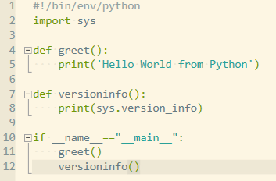
Hello World in Python

Slide 37
Eeaster egg no. 2
Notes:
import __hello__
OR
import __phello__

Slide 38
Whitespace DOES matter!
Proper indentations are defined by language itself
Tabs and spaces can’t be mixed!
All mistakes above lead to… code NOT working!
Configuring your editor is THE important thing- spaces and tabs can NOT be mixed! (well…)
Notes:
Demo block of code:
How ugly it is when not using braces in C/C++/C#/Java
How easy it is to make a mistake when having a one-line block in if and then an indentation
That’s why in many coding standards it is suggested to enclose even a single line of code in braces
Most important settings for your editor:
Tabs vs spaces (are spaces really better? Maybe not…)
PEP8 recommends spaces over tabs
Wouldn’t that be better to actually use tabs and change your editor configuration so that it displays tab as 2, 3, 4 spaces…?

Slide 39
Duck typing? U joking?
What is duck typing?
if something quack like a duck... it should be a duck!
so how does that work?
magic methods!

Slide 40
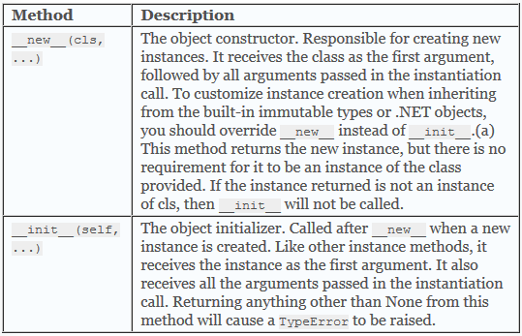
Magic methods
Notes:
Taken from: http://www.ironpythoninaction.com/magic-methods.html#table-b-1-object-creation

Slide 41
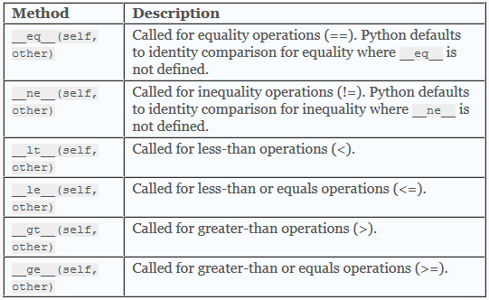
Magic methods - equality

Slide 42
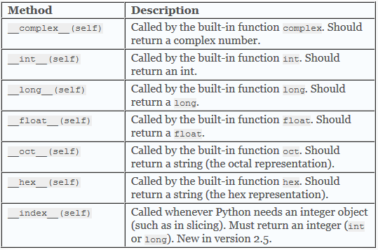
Magic… type conversion

Slide 43
Magic methods - DEMO

Slide 44
Memory management
Garbage collector
reference counting
this could be tricky in modules written in C
Collection thresholds
gc.collect()
Notes:
http://www.digi.com/wiki/developer/index.php/Python_Garbage_Collection
Collection takes time! Running gc.collect() too frequently costs time, and may significantly slow down application.
Gc.collect should NOT be called more that just several times. Per day.
Good idea: call gc.collect() after app is initialized (all config files are parsed, internal structures are built etc.)

Slide 45
Decorators
@staticmethod
@property
@classmethod
DEMO
Notes:
Static – doesn’t take any additional parameter, neither class, nor instance
Classmethod – first parameter is class. Could be called against class or an instance. Usage: inheritable constructors
Property – something

Slide 46
Functional Python?
NO!
Python does offer some functional capabilities:
lambdas
itertools module (map-reduce)
What is missing?
tail-call
pattern matching
Notes:
It was not intended by Guido to create another functional language. Guido wanted to create a language easy to learn by non-programmers, with easy to figure-out syntax. Python is quite flexible, but it just can’t morph into any kind of language and pretend it is the best in every field.

Slide 47
Python – the only language*…
…which broke the “Hello World” example when introducing new version of the language
Current versions of Python available:
2.7.x
3.x
what's the difference?
which version to use?
Notes:
Which break it’s Hello World example.

Slide 48
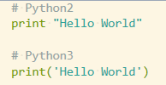
Hello World in 2 flavors

Slide 49
One Python to rule them all!
Is there only one Python out there?
CPython (a.k.a "the Python")
major implementations:
IronPython
Jython
Pypy
Dialects:
Cython, Stackless [Python]...
Python.Net
… probably many other
Notes:
CPython is the main, default implementation of Python
Cython - superset of Python, designed for interfacing with C/C++ code; has additional mechanisms to control behavior of GIL
Pypy - Python written in Python; interpreter + just in time compiler; Pypy is capable of turning Python program to native code during run-time
Stackless - does not use C call stack; adds micro-threads; introduces concept of 'green-threads' (maintained by VM, not OS, and in user instead of kernel space) this result in green threads being available in environment not having support for classic threads
Python is widely adopted – available on servers, desktops, embedded devices (RaspberryPi – which I *have* used for Xmass tree controller/server)

Slide 50
Python vs Ruby (rant!)
There are more similarities than differences between the two
Say Ruby, think RoR (yes, I’ve heard of Sinatra!)
Say Python, think… Python!
Is Python bad at *everything*?
Python IS general purpose
What non-web projects made in Ruby do you know?
Notes:
Sinatra = "in the end you will end up rewritting ROR..."

Slide 51
More rant on Python, Ruby, .Net and... Java?
choice of libraries/frameworks:
Python & Java are a bit similar:
lot of different frameworks
very active community
effort of the community is huge
Ruby is more similar to .Net ecosystem
community focuses on delivering their projects, not reinventing something (is it true, really?)
there is usually "the best choice"

Slide 52
PEP
PEP= Python Enhancement Proposal
each PEP needs to be accepted by community
PEP may be deferred
~3200 PEPs at the moment
PEP20: "Zen of Python"

Slide 53
Example: PEP8
preferred indentation: spaces
max lenght of line of code (79)
blank lines
additional indentation
source code character encoding (ASCII/UTF-8)
organization of imports
whitespaces in expressions
comments, inline comments
naming conventions
... you don't have to manually check against code being compatible with PEP8!
Notes:
ASCII - Python2, UTF-8 - Python3
organization of imports: having import on separate lines, rather than: "import os, sys"
link: http://legacy.python.org/dev/peps/pep-0008/

Slide 54
Package management
package vs module
why egg?
dependency resolving
binary packages
https:/pypi.org - packages repository
Notes:
egg as a name = most propable is rather from a "Spam" sqetch by Monthy Python than a relation to a Python as a snake

Slide 55
Package management - tools
easy_install
pip
which one to choose?
how does this compare to AssemblyCache + nuget?

Slide 56
GIL – Python’s biggest problem
Is multithreading in Python broken? What is GIL?
Global Interpreter Lock
Why have GIL at all?
Green threads / pthreads
Python’s crap! I will use Ruby instead!
Ruby uses... Global VM Lock ☺
Notes:
GIL, Global Interpreter Lock

Slide 57
.pyc files
"interpreted language" is a lie
.pyc - file containing bytecode
.pyc files is NOT automatically generated for each file when running it!

Slide 58
Jython

Slide 59
Origins of Jython
Jim Hugunin - creator of Jython
gradutate of MIT
not happy with his current tech-stack:
Matlab, C, Python
work started spring 1997
Jim finishes his work on Jython early 1999
Jython gets released as OpenSource...
...and is still alive!
Notes:
Sikuli – why it was not possible to have it installed/used without having Jython first?

Slide 60
Python+.NET=IronPython

Slide 61
IronPython - origins
work on IronPython started ~2003
it was started by...
Jim Hugunin
Why?
he heard CLR was 'crap' and Python couldn't run on top of it
he wanted to spend just a couple of weeks on it
..."unfortunately" first version of IronPython run 1.7 times as fast as CPython ;)
Notes:
http://blogs.msdn.com/b/hugunin/archive/2006/09/05/741605.aspx

Slide 62
IronPython - origins (continued)
Jim joined Microsoft...
made Microsoft release IronPython under OSI compliant OpenSource licence
...Jim worked for Google…
…and now works for Dropbox
IronPython is no longer maintained by Microsoft
...if you like dynamic OR DLR - thank Jim Hugunin :)

Slide 63
Iron* - origin of the name
because "It Runs On .Net" :)
no...
it was actually called IronPython because:
it sounded cool
nPython, Python.Net, Python# were already taken
Notes:
http://geekswithblogs.net/brians/archive/2008/06/14/122861.aspx

Slide 64
IronPython - current state
Bringing Python to .Net world (similar to Jython)
IronPython is free to use (works well under Mono)
Can call .Net code
Can use Python modules written in Python
Notes:
there is a project (voidspace) to make IronPython work with Python "C" modules as well

Slide 65
Python libraries & .NET
Is it possible to use Python packages (.egg) with IronPython or Python.Net
Anatomy of the python package
Mix of C + Python

Slide 66
IronPython, Python.NET & GIL
Do both suffer from the threading model in standard Python?
IronPython’s & Python.NET’s threading models are different!
Forget about GIL when using IronPython!
Be aware of GIL when using Python.NET!

Slide 67
Who uses Python
Google (youtube)
NASA
Resolver – they use IronPython, but well…
Michel Foord works for them!
Scientists (provide links here)

Slide 68
DLR
Created specifically for IronPython
Other languages used that: IronRuby
(have a look at rake!)
...or psake

Slide 69
C# yield vs Python yield
Almost the same as in C#
yield break (C#) == return (Python)

Slide 70
Linq in Python
Python is capable of consuming .Net code, so you can write:

Slide 71
List Comprehension
new_list = [expression(i) for i in old_list if filter(i)]

Slide 72

Linq in Python
Pynq:

Slide 73
DLR hosting API
Notes:
http://www.voidspace.org.uk/ironpython/hosting_api.shtml

Slide 74
Easter egg 3
Notes:
How about braces in Python? Any PEP for that?
from __future__ import braces

Slide 75
Development tools, frameworks, libraries

Slide 76
What is Python used for?
Servers (backends)
Scripting
Games (but LUA is used more often) – this is very important for XNA+.NET developers
Enhancing currently operating solutions (workflow engine etc.)
Console applications (Mercurial)
Desktop applications with UI (Spyder)
Web applications (many frameworks: Django, Flask...)

Slide 77
Software written in Python
BitTorent
Blender
Dropbox
Mercurial
Biggest Python projects
YouTube
Reddit
Eve Online
Python is also used by LucasFilms, NASA, CalTech...

Slide 78
What is Python good at?
string/text processing
internal scripting language (Blender!)
gamedev: Lua
artificial intelligence
language processing (text/string manipulation)
important part of many Linux distrubutions (package managers)

Slide 79
Python on the backend
Is scripting’s language performance good enough to be used on the server-side?
Is Python good choice for building distributed systems?
Wariety of libraries:
PyPy
Twisted
Celery

Slide 80
Tools
Full blown-IDEs:
PyCharm (Community Edition also available), requires Java Runtime
Visual Studio + Python Tools (Windows only)
Spyder (Linux/Windows)
Eclipse + PyDev / Aptana Studio
Editors:
IDLE
SublimeText + PyLint/Anaconda/PythonAutocomplete…
VIM + PyLint + PEP…
PythonScriptEditor

Slide 81
Interactive Python shells
python.exe is REPL
Alternatives to python.exe REPL:
Ipython (also used by Spyder)
code completion
saving code to file
info on members (namespaces, classes, methods)
BPython
code completion
advanced features: code rewind
info on members (namespaces, classes, methods)
Notes:
REPL stands for Read-Eval-Print-Loop

Slide 82
OpenSource development
Github, BitBucket…
Travis! Python has a full support with that! (unfortunately no support for .Net project, so no IronPython, Python.NET)

Slide 83
Libraries that you should have a look at
Math: Numpy (scientist do love Python!)
ORM: SQL Alchemy
Web: Django
Servers: Tornado, Flask,
Games: PyGame

Slide 84
Summary
Couple of things I would like all of you remember after the talk

Slide 85
DEMO

Slide 86
Fiddler as Python code generator?

Slide 87
#Develop & IronPython
Supports development using IronPython
Allows to convert code to IronPython [DEMO]

Slide 88
Python (CPython)
.pyc generation
IPython

Slide 89
IronPython
Using standard CPython library
Compiling to .exe / .dll (VS / #Dev)
Consuming .net code in IronPython
Consuming IronPython in C#

Slide 90
Sample – simple web server in Python
Provide a sample with the simplest web-server written in Python
Notes:
https://gist.github.com/bradmontgomery/2219997

Slide 91
Easter egg 4
So… you would like to fly, huh?
Notes:
import antigravity

Slide 92
Questions & answers
Contact me:
maciektalaska // twitter
maciek.talaska@gmail.com
maciek.talaska@outlook.com

