Slide 1

Making world statically typed with F# type providers
https://www.flickr.com/photos/vincentcoey/9451953129
Michał Łusiak | @mlusiak | mlusiak.com

Slide 2

http://earthobservatory.nasa.gov/IOTD/view.php?id=84047

Slide 3

CREATING VALUE BY SHARING KNOWLEDGE

Slide 4


Slide 5

F# The language
Born in 2005 (Don Syme, Microsot Research, Cambridge)
Officialy released in 2010
Statically typed
Functional first
Object oriented
Open source
.NET language
First class citizen in Visual Studio & Xamarin Studio

Slide 6
Type Providers
Compile time component that injects type into compiler
No code generation
More like compiler plugin with access to external world
Provides signature and implementation for accessing external data source
Intelisense
Provide types „on demand”

Slide 7

Demo time
https://www.flickr.com/photos/daniel_gies/5067196924
let’s see some code

Slide 8
Other Type Providers
WorldBank
XML
Odata
Hadoop
R
WSDL
TypeScript
...

Slide 9
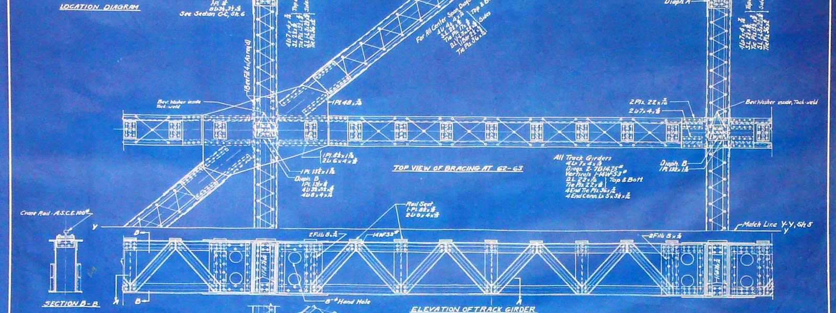
Learning Resources
stuff to get you started

Slide 10
Tutorials & Knowledge
Try F#
F# koans
F# for fun and profit
F# Software Foundation
Type provider whitepaper
12 type providers in action
Sergey Tihon’s type providers list
#fsharp on twitter

Slide 11
Talks
Introduction to F#, Don Syme, Channel 9 Lectures
Getting Started with F#, Rachel Reese, Community for F#
Understanding the World with F#, Tomas Petricek, Channel 9

Slide 12

Thank you
now go and build something
Michał Łusiak | @mlusiak | mlusiak.com

