Slide 1

Do IT right - what (not) to put on your resume

Slide 2
|At the beginning.. How to find work you love?
Why are you doing the work that you're doing?
You need to understand yourself, because if you don't know what you're looking for, you're never going to find it.
Find out what your unique strengths are. What are the things that you wake up loving to do no matter what.
And then the next step is your experience.

Slide 3
|What is resume and why is so important?
A résumé is a tool used to market your skills, experiences, education and accomplishments to employers.
Your résumé will assist you in getting an interview and making the important first impression.
Your CV is your offer letter The aim is building confidence in stakeholders = being invited at interview.
Tailor your résumé to the kind of job (s) you are seeking
There is no strict rules how to build it.

Slide 4
|Three types of Resume
Chronological – career development
Functional - skills
Mixed - career development + skills

Slide 5
|Few rules to increase your CV’ visibility
Think like investor – building strategy, showing potential
Keep it LEAN
User experience
Keep it real
Keywords

Slide 6
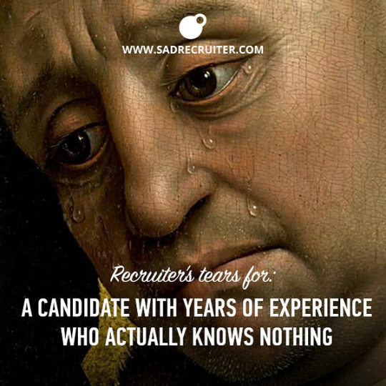
|What happened when Recruiter
is screening your resume?
What are key words?
Why those are the keys for success?
Why you should not lie in your CV?

Slide 7
| What (not) to put in resume? - Structure & Graphics
No of pages: ideally 2 (LEAN)
Font: e.g. Calibri, Arial, Verdana, Trebuchet MS, Helvetica, Univers, Futura.
Colours: limited (Nice if company colours)
Experience in bullet points
Links: Portfolio, Github, Stack overflow, LinkedIn, etc.

Slide 8
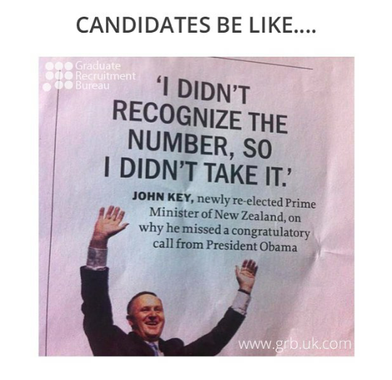
|Personal data & contact information (Current!)
This section should include your name, telephone number and E-mail address.
Only*

Slide 9
Source
|Objectives or summary:
Include a statement which discusses your skills and how you can add value to the organization.

Slide 10
|Experience
List your work experience in reverse chronological* order - most recent first.
For each position, list your employer's name. Tab over and indicate the dates of employment to the right and on the next line write your job title.
Include clear and specific bullet of your responsibilities. Describe the skills you used, and what you did.
Start with your most responsible job duty and work down to the more routine part of your job.
Begin each sentence with a powerful action verb to catch the employer's attention.

Slide 11
|Education:
All Universities from which you attended and received a degree must be listed in this area in reverse chronological order - with most recent listed first.

Slide 12
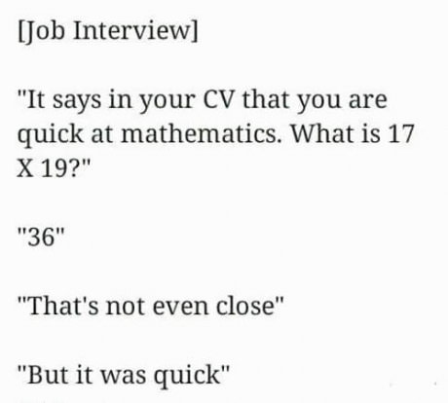
| Key strenghts/Skills
Make sure to include skills that relate to the job to which you are applying for

Slide 13
| Trainings/ Courses / Certificates
List four or five courses by name which are relevant to your major or the position which you are applying for.

Slide 14

|Profile photo & why not
Profile photo & why not

Slide 15
| Questions?

Slide 16


| Thank you!
Ewelina Dańczuk
@ewelinadanczuk
Recruitment Specialist
ewelina.danczuk@volvo.com

