Slide 1
MVC6. Awesomeness is here!
ASP.NET MVC6 essentials and why it’s awesome. At long last!

Slide 2
Author
Piotr Kamiński
Developer
Working for PGS for 2+ years

Slide 3
Agenda
How to start?
What has changed?
What’s new to the actual MVC?
What about the identity model and stuff?

Slide 4
Previously
app.UseMVC()

Slide 5
1. How to start?

Slide 6
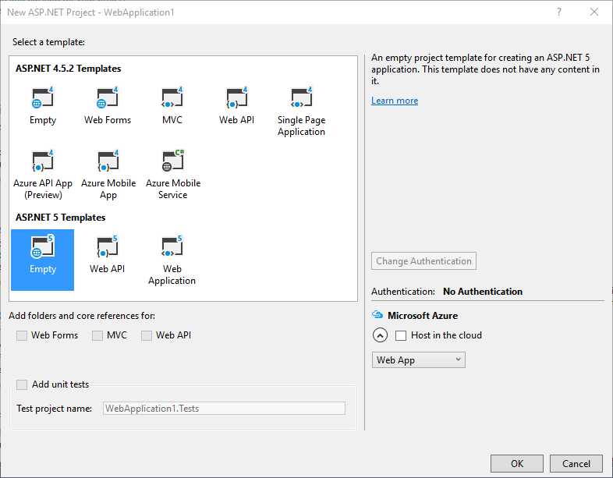
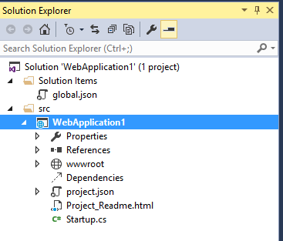
Let’s get started
1. How to start?
File, new project...
...wait, what?

Slide 7
„Panta rhei”
1. How to start?
Solution structure was changed drasticaly
Old components were replaced with new ones, i.e.:
web.config global.json
project.json
*.json
global.asax Startup.cs
Build process was reworked

Slide 8

What should I do?
1. How to start?
Hit F5...
...and it works, wow!
public class Startup
{
public void ConfigureServices(
IServiceCollection services)
{
}
public void Configure(IApplicationBuilder app, IHostingEnvironment env, ILoggerFactory loggerFactory)
{
app.UseIISPlatformHandler(options =>
{
options.AuthenticationDescriptions.Clear();
});
app.Run(async (context) =>
{
await context.Response.WriteAsync("Hello, Wolrd!");
});
}
public static void Main(string[] args) => WebApplication.Run<Startup>(args);
}

Slide 9

Wow wow wow wow
1. How to start?

Slide 10
Did I see „public static void Main”?
1. How to start?
Correct!
Reworked model of application building
You tell the application where the entry point is
New approach: you get what you want
Previously: you got everything out of the box and had to deal with it

Slide 11
How do I get MVC?
1. How to start?
public void ConfigureServices(IServiceCollection services)
{
services.AddMvc();
}
public void Configure(IApplicationBuilder app, HostingEnvironment env,
ILoggerFactory loggerFactory)
{
app.UseIISPlatformHandler(options =>
{
options.AuthenticationDescriptions.Clear();
});
app.UseMvc(routes =>
{
routes
.MapRoute("error",
"Error/{statusCode}", new
{
controller = "Error",
action = "Index"
})
.MapRoute(name: "default",
template: "{controller=Home}/{action=Index}/{id?}");
});
}
It’s easy ☺
Install MVC package
Tell the app to use MVC service
Tell the app to use MVC Middleware
Ready, steady, go!

Slide 12
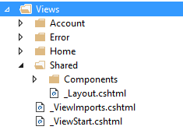
Give me more MVC!
1. How to start?
V for View
C for Controller
Not so many changes, right?
<!DOCTYPE html>
<html>
<head>
<meta charset="utf-8" />
<meta name="viewport" content="width=device-width, initial-scale=1.0" />
<title>My app</title>
<link rel="stylesheet" href="~/css/App.css" />
</head>
<body>
<div class="section">
<div class="wrapper wrapper--wide">
@RenderBody()
</div>
</div>
@RenderSection("scripts", required: false)
</body>
</html>
public class HomeController : Controller
{
private readonly UserManager<User> userManager;
public HomeController(UserManager<User> userManager)
{
this.userManager = userManager;
}
public IActionResult Index()
{
return View();
}
public IActionResult Users()
{
return View();
}
}

Slide 13
1. How to start?
Create new project
Register services
Add selected components
Hit F5

Slide 14
2. What has changed?

Slide 15
Breaking changes
2. What has changed?
Use contract instead of concrete
Task, async, await...
No reference to System.Web
No Request, HttpContext, Session, Application global static objects
Tag helpers
View components

Slide 16
Friend of yours is DI
2. What has changed?
Built-in dependency resolver
You can add dependency resolver of your choice
public void ConfigureServices(IServiceCollection services)
{
services
.AddIdentity<User, Role>();
services.AddMvc();
services.AddScoped<IUserRepository, UserRepository>();
services.AddTransient<IUserStore<User>, AppUserStore>();
services.AddTransient<IRoleStore<Role>, AppRoleStore>();
services.AddTransient<SignInManager<User>, AppSignInManager>();
services.AddTransient<UserManager<User>, AppUserManager>();
services.AddTransient<IQueryableUserStore<User>, AppUserStore>();
}

Slide 17

2. What has changed?

Slide 18
2. What has changed?
No more statics
Use abstraction instead of concrete
Task, async, await

Slide 19
3. What’s new to the actual MVC?

Slide 20
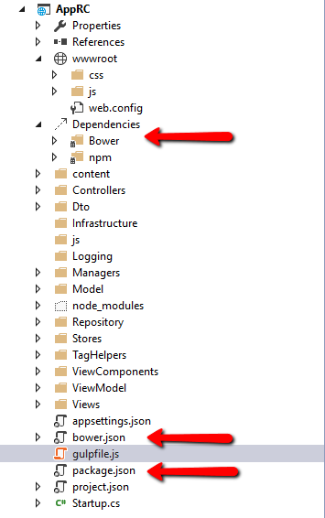
Separation of concerns in frontend
3. What’s new to the actual MVC?
Support for modern front end tools
Bower and NPM as standard tools for obtaining FE packages
Gulp, Grunt as task runners for FE related operations
No more BundleConfig.cs!

Slide 21

3. What’s new to the actual MVC?
Front end, so much front end...

Slide 22
Tag helpers
3. What’s new to the actual MVC?
Alternative approach to bind model to view called Tag Helpers
Uses standard, legit, HTML5 tags
Get access to context
Several built-in helpers, i.e.: anchor, input, label...
Easy to create own one
Notice: old Razor syntax works as well

Slide 23
Tag helpers example
3. What’s new to the actual MVC?
@using System.Threading.Tasks
@using AppRC.ViewModel
@model RegisterViewModel
<form class="box box--huge"
asp-controller="Account" asp-action="Register" method="post" role="form">
<div asp-validation-summary="ValidationSummary.All" class="text-danger"></div>
<alert class="mb" message="This is an alert!"></alert>
<div>
<div class="layout">
<div class="layout__item u-1/8">
<label class="delta" asp-for="Name"></label>
</div>
<div class="layout__item u-2/4">
<input class="delta--regular" type="text" asp-for="Name" />
</div>
</div>
<div class="layout">
<div class="layout__item u-1/8">
<label class="delta" asp-for="Password"></label>
</div>
<div class="layout__item u-2/4">
<input class="delta--regular" type="password" asp-for="Password" />
</div>
</div>
</div>
<div>
<button type="submit" class="btn">Register</button>
</div>
</form>
M for Model (bound to View)

Slide 24
Custom tag helper
3. What’s new to the actual MVC?
It’s easy to create own tag helper
We are given context of whole helper!
[HtmlTargetElement("alert")]
public class CustomAlertTagHelper : TagHelper
{
[HtmlAttributeName("message")]
public string Message { get; set; }
public override void Process(TagHelperContext context, TagHelperOutput output)
{
output.TagName = "div";
output.Attributes.Add("class", "danger");
output.Content.SetContent(Message);
}
}

Slide 25
View components
3. What’s new to the actual MVC?
More powerful than partial views as they have own, separate controller
Can work as async (but you should have assumed it by this time)
Can be invoked with many parameters from view
Designed as a response for urge to have reusable component
No longer new SomeFancyViewModel() in view, yay! ☺

Slide 26
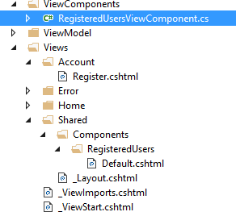
View components example
3. What’s new to the actual MVC?
public class RegisteredUsersViewComponent : ViewComponent
{
private readonly UserManager<User> userStore;
public RegisteredUsersViewComponent(UserManager<User> userStore)
{
this.userStore = userStore;
}
public IViewComponentResult Invoke(int limitTo)
{
var users = this.userStore
.Users.Take(limitTo).ToList();
return View(users);
}
}
@model List<AppRC.Model.Authentication.User>
@foreach (var user in Model)
{
<div>
<span>@user.Name</span>
</div>
}

Slide 27
Injecting service into a view
3. What’s new to the actual MVC?
ASP.NET MVC 6 now supports injection into a view from a class
Can be useful in some scenarios, i.e. translations
@using AppRC.Services
@inject ILocalization Localization
<h2>
@Localization.Translate("Hello, world!")
</h2>

Slide 28
3. What’s new to the actual MVC?
New folder and files structure
NPM, Bower, Gulp, Grunt
Tag Helpers
View components

Slide 29
4. What about the identity model and stuff?

Slide 30
Identity model
4. What about the identity model and stuff
No more Forms Authentication
Identity was replaced with a new identity model
Three separate stores
Users store
Roles store
Claims store
Implemented out of the box with EF
Easy to implement on your own

Slide 31
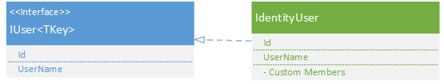
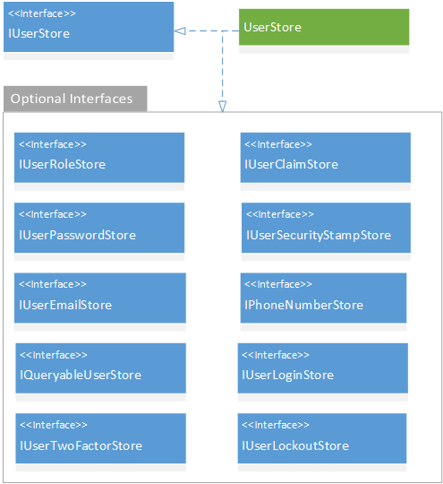
Identity model diagram
4. What about the identity model and stuff
Images source:
http://www.asp.net/identity/overview/extensibility/overview-of-custom-storage-providers-for-aspnet-identity#architecture

Slide 32
4. What about the identity model and stuff?
No more Forms Authentication
New identity model with separation of: authentication, authorization and roles

Slide 33
Bonus: where is the Session?
Additional features
If statics were removed, where is the session then?
You have to tell your infrastructure that you do want the session
First commit: 9 May 2014
services.AddCaching();
services.AddSession();
app.UseSession();

Slide 34
Bonus: CORS
Additional features
Used to be pain
Now you add it in a similar way as the session:
app.UseCors(builder => builder.WithOrigins("pgs-soft.com", "ipgs-soft.com").Build());

Slide 35
Demo

Slide 36
Summary
How to start?
What has changed?
What’s new to the actual MVC?
What about the identity model and stuff?

