Slide 1
Living on the Edge Survive and Thrive with JavaScript and .NET running in-process
Rafał Legiędź

Slide 2



abb.pl/isdeliverycenter
devday.pl
@abbdevday
Rafał Legiędź
rafal.legiedz@gmail.com
@rafek

Slide 3


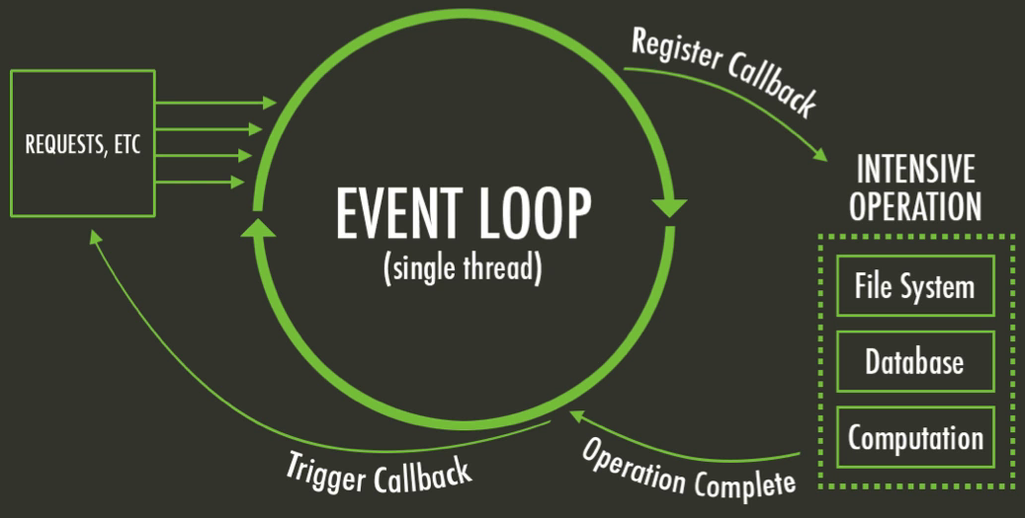

Node.js
Platform built on Chrome’s V8 JavaScript engine that provides an event-driven architecture and a non-blocking I/O API that optimizes an apllication’s throughput and scalability.

Slide 4
Node.js
„[..] the only developer community that was built from day one around asynchronous, event-driven application logic as a core principle.”
~Node.js is taking over the Enterprise

Slide 5






Node.js

Slide 6


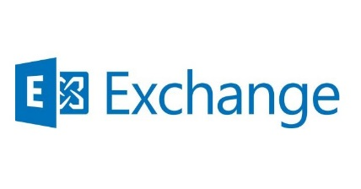
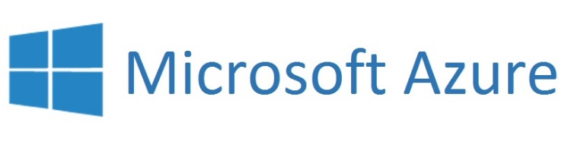


.NET
Advantages over Node.js:

Slide 7
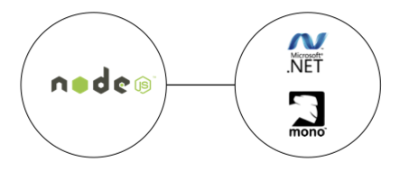
Edge.js
„[..] provides an asynchronous, in-process mechanism for interoperability between Node.js and .NET”
…on Windows, Linux and Mac OS X

Slide 8
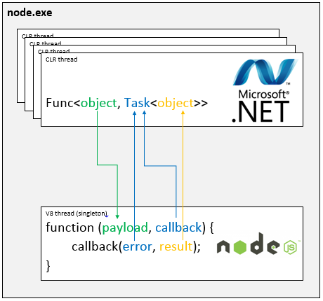
Edge.js – interop model

Slide 9
Edge.js – possibilities
Enables or simplifies application scenarios which are hard or impossible to achieve with Node.js alone:
implementing CPU-bound workloads in-process
simplifying access to Windows specific functionality
extending Node.js in .NET instead of native C
In any CLR language using inline code, separate files or assemblies.

Slide 10
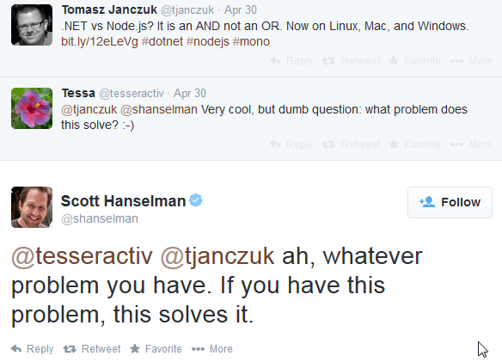
What problem does it solve?

Slide 11
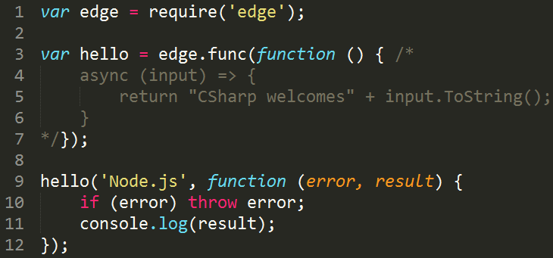
Edge.js - code

Slide 12
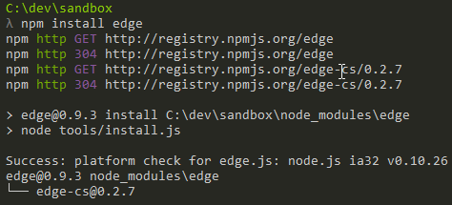
Installing Edge.js
>= Node.js 0.8.x
.NET Framework 4.5 or Mono 3.4.0

Slide 13
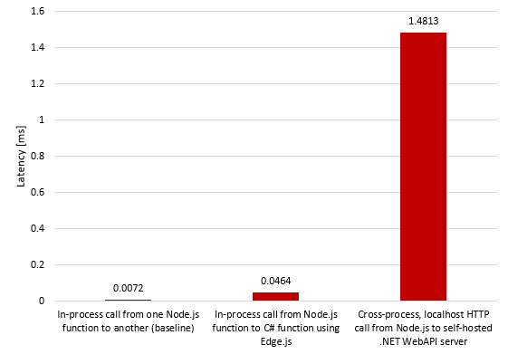
Benchmark
Edge.js call’s latency is 32x smaller than localhost, cross-process call over HTTP
http://tjanczuk.github.io/edge

Slide 14
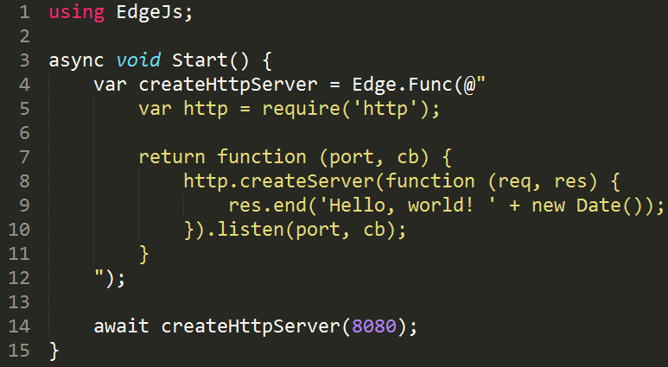
.NET that scripts Node.js in-process

Slide 15
Tips
External class/assembly over inline code
Separate modules
Stay async
Benchmark
Node.js Tools for Visual Studio (Windows only)

Slide 16
Alternatives
Stick with Node.js if possible
Process invocation (Node.js’s process api)
WebService (local/remote)
*MQ

Slide 17
Resources
Edge.js presentation
Source code
This presentation
The Birth & Death of JavaScript (Gary Bernhardt)
Node.js is taking over the Enterprise
Why Node.js is becoming the go-to technology in the enterprise

