Slide 1
Knock the jQuery out!
Bartosz Lenar
@bartoszlenar

Slide 2
Knock the jQuery out!
jquery – what is all about?
knockoutjs – beyond the forms
aspnet mvc – the standard approach
aspnet mvc – the mvvm approach
spa – the goal

Slide 3
JQUERY what is all about?
locate the DOM node
manipulate nodes
ajax calls
and plenty of javascript helpers
plugins! (both backend & frontend)
do we need to knock it out?

Slide 4
ASP.NET MVC VIEW
Database
Repositories, Wrappers, Services, Mappers, Controllers…
@
$

Slide 5
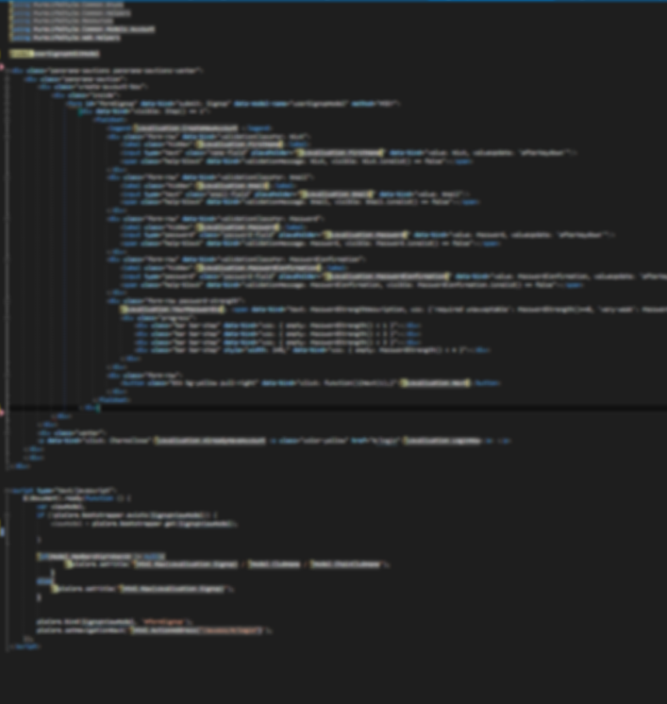
WEB VIEW standard approach
couple of usings
model declaration
html
script tag
js code
immortal "document ready"

Slide 6
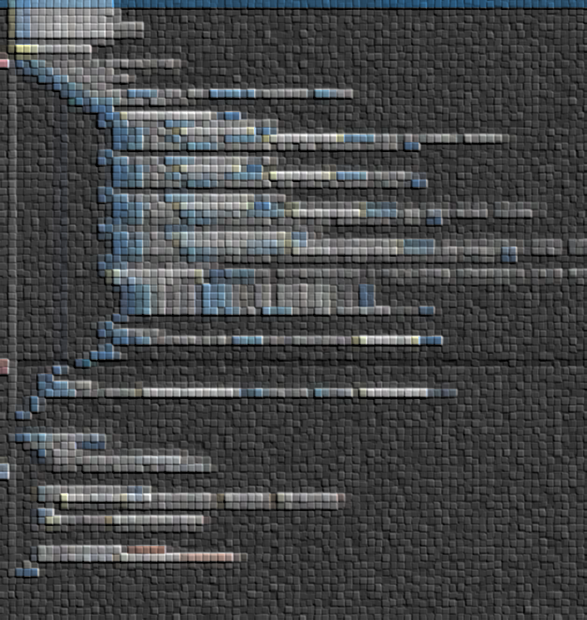
WEB VIEW standard approach
<div> ... </div>
<input> ... </input >
<p> ... </p>
locate nodes
react
$(document).ready(function () {
$('div').on( ... );
$('input').on( ... );
$('p').on( ... );
});

Slide 7

FORMS standard approach
<div id="superForm">
<div>
<span>Name:</span>
<input type="text" />
</div>
<div>
<span>Remember me:</span>
<input type="checkbox" />
</div>
<div>
<a href="#">Login!</a>
</div>
</div>

Slide 8

FORMS standard approach
Case
#superForm
need to modify the form
$('#superForm [type="text"]').val('Bartosz');

Slide 9
KNOCK OUT what to?
c#-driven html
static html and c#-driven jquery
@if (Model.IsCool)
{
@: <span class="cool">this is cool</span>
}
$(function () {
@if (Model.IsCool) {
@: $('.cool').show();
} else {
@: $('.cool').hide();
}
});

Slide 10
KNOCK OUT what to?
building js code with c#
mapping c#-to-js
$(function () {
$('.cool').toogle(
@Model.IsCool.ToString().ToLowerInvariant()
);
});
var isCool = @Model.IsCool.ToString().ToLowerInvariant();
$(function () {
$('.cool').toogle(isCool);
});

Slide 11
KNOCK OUT what to?
split into js files + mix of all mentioned
view:
super.js:
<script>
var superSettings = {
isCool: '@Model.IsCool.ToString().ToLowerInvariant()' === 'true'
};
</script>
@Scripts.Render("../Scripts/super.js")
$(function () {
$('.cool').toogle(superSettings.IsCool);
});

Slide 12
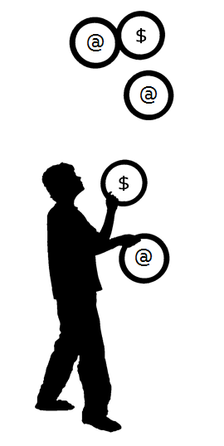
JUGGLING with razor and jquery
difficult to read
difficult to test
difficult to maintain

Slide 13
MVVM
MODEL
Read/Write
VIEW MODEL
Model Data
VIEW
ASP.NET MVC Controller
ajax calls
initial render
html
nodes modifications
push notifications (signalr?)
javascript object
Changes
BINDING
Changes
UI Events
TESTS
unit testing
(qUnit)
event handling

Slide 14
MVVM in web app
Case
#superForm
need to modify the form
ViewModel
var LoginViewModel = function () {
this.Name = ☺
this.RememberMe = ☺
};
View
Binding!
<input type="text" value=" ☺ " />
<input type="checkbox" value=" ☺ " />

Slide 15
FORMS mvvm approach
Case
#superForm
need to modify the form
ViewModel
var LoginViewModel = function () {
var self = this;
self.Name = function(name) {
if (!name && name !== '') {
return $('#superForm [type="text"]').val();
} else {
$('#superForm [type="text"]').val(name);
}
};
self.RememberMe = ☺
self.LoginClicked = function() { /* ajax */ }
$('#superForm a').on('click', self.LoginClicked);
};

Slide 16


FORMS mvvm approach
Is this a viewmodel?
Why the functions are wrapped in the object?
Code reusage? Isn’t it strongly related to dom tree?
Hmm… how about "varify" the root selector?
It’s still über-related to the dom tree!
What about more complex stuff (e.g. collections?)
Is this two-way binding?
$('#superForm [type="text"]').val(name);
var loginViewModel = new LoginViewModel("#superForm");
$(rootSelector + ' a').on('click', self.LoginClicked);

Slide 17

FORMS mvvm approach
imagine that:
DOM & CSSes made by another team/company
you have only the mockups…
and DOM & CSS are going to be made later…
I’ve just finished the ViewModel for login page!
Cool. I’ve updated the layout. Now there is <button> instead of <a>, and <p> instead of <div>.

Slide 18

MVVM so far
The facts:
EASY: ViewModel - objects, properties, functions
!EASY: Universal ViewModel-View binding mechanism
The solution: knockoutjs
MIT licence
no 3rd-party dependencies
~46kb size
supports even IE6+
BINDINGS!

Slide 19
BINDING PATTERN
Pattern:
bindingName - self-explanatory
expression - name of the observable property:
expression - expression rooted in the komodel:
<span data-bind="bindingName: expression"></a>
<span data-bind="text: Name"></a>
<span data-bind="text: Name().length"></a>

Slide 20
KNOCKOUT!
komodel = knockout view-model
var LoginKOModel = function () {
var self = this;
self.Name = ko.observable("");
self.RememberMe = ko.observable(false);
self.LoginClicked = function() {
/* ajax calls */
};
};

Slide 21
KNOCKOUT!
View
<div id="superForm">
<div>
<span>Name:</span>
<input type="text" data-bind="value: Name" />
</div>
<div>
<span>Remember me:</span>
<input type="checkbox"
data-bind="checked: RememberMe" />
</div>
<div>
<a href="javascript:void(0)"
data-bind="click: LoginClicked">Login!</a>
</div>
</div>

Slide 22
KNOCKOUT!
Usage:
var loginKOModel = new LoginKOModel();
loginKOModel.Name('Bartosz'); // set
loginKOModel.RememberMe(true); // set
var name = loginKOModel.Name(); // read
ko.applyBindings(loginKOModel);
ko.applyBindings(loginKOModel, $('#superForm')[0]);

Slide 23
KNOCKOUT!
Real two-way binding:
on changed
loginKOModel.Name();
on set
loginKOModel.Name('Bartosz');
<input type="text" data-bind="value: Name, valueUpdate:'afterkeydown'" />

Slide 24
LOGICS view & dom
Bindings should:
make ViewModel not aware about the dom tree
allow ViewModel to care only about the view-logic
provide automatic updates (both sides)
force View to handle dom-logic
should it be displayed?
if no, set display: none
style

Slide 25
LOGICS view & dom
view-logic in ViewModel:
dom-logic in View:
var LoginKOModel = function () {
var self = this;
self.Name = ko.observable();
self.Name.subscribe(function (newValue) {
self.IsLoginButtonVisible(!!newValue);
});
self.IsLoginButtonVisible = ko.observable(false);
self.LoginClicked = function() {/*ajax calls*/};
};
view-logic =
should it be displayed?
dom-logic =
if no, append display: none
<a href="javascript:void(0)"
data-bind="visible: IsLoginButtonVisible,
click: LoginClicked"> Login!
</a>

Slide 26
LOGICS view & dom
clean KOModel:
view-logic & dom-logic in View:
var LoginKOModel = function () {
var self = this;
self.Name = ko.observable("");
self.RememberMe = ko.observable(false);
self.LoginClicked = function() { /* ajax */ };
};
view-logic =
should it be displayed?
dom-logic =
if no, append display: none
<div data-bind="visible: !!Name()">
<a href="javascript:void(0)"
data-bind="click: LoginClicked">Login!</a>
</div>

Slide 27
LOGICS view & dom
Don’t push too much view-logic to view:
Use computed observables:
And even inheritance if you would like to keep komodels clean
<span data-bind="visible: RememberMe() && !!Name() && Name().length > 3 && Password().length < 25"></span>
self.IsLoginButtonVisible = ko.computed(function () {
return self.RememberMe() &&
!!self.Name() &&
self.Name().length > 3 &&
self.Password().length < 25;
}, self);
view-logic =
should it be displayed?
dom-logic =
if no, append display: none

Slide 28
BINDINGS forms
click
event (mouseover, etc.)
submit
enable/disable
hasFocus
checked
options

Slide 29
BINDINGS appearance
visible
text
html
css
style
attr
data-bind="css: { 'error': Email().length < 3 }">
data-bind="style:
{ color: Email().length < 3 ? 'red' : 'black' }"
data-bind="attr: { 'data-product-id': Id }"

Slide 30
BINDINGS flow
foreach
if
ifnot
with

Slide 31

NESTING
Menu
SearchBox
Stage
Banners

Slide 32
NESTING komodel
var MainPageKOModel = function() {
var self = this;
self.Title = ko.observable('Super blog!');
self.Menu = new MenuKOModel();
self.SearchBox = new SearchBoxKOModel();
self.Banners = new BannersKOModel();
};

Slide 33
NESTING view
<div id="layout">
<h1 data-bind="text: Title"></h1>
<div data-bind="with: SearchBox">
<input type="text" data-bind="value: QueryString" />
</div>
</div>

Slide 34
NESTING parent & root
<h1 data-bind="text: Title"></h1>
<div data-bind="with: Banners">
<h2 data-bind="text: $parent.Title"></h2>
</div>
MainPage
$parent
Menu
$parent
$root
MenuItem

Slide 35

NESTING
View that is using $parent and $root is in fact a part of its own container
It isn’t kosher!

Slide 36
ENCAPSULATION delegatish
<div id="layout">
<div data-bind="with: SearchBox">
<button data-bind="click: SearchClicked" />
</div>
</div>
var SearchBoxKOModel = function () {
var self = this;
self.SearchClicked = function () {
/* empty */
};
};
var MainPageKOModel = function () {
var self = this;
self.SearchBox = new SearchBoxKOModel();
self.SearchBox.SearchClicked = function() {
/* action */
};
};

Slide 37
ENCAPSULATION eventish
RootObject with events!
Emitting:
Subscribing:
self.Emit("Foo");
self.Emit("Foo", { Key: "Bar" });
exampleObject.Subscribe("Foo");
exampleObject.Subscribe("Foo", function (eventArgs) {
console.log(eventArgs.Key);
});

Slide 38
ENCAPSULATION eventish
var SearchBoxKOModel = function () {
var self = this;
self.SearchClicked = function () {
self.Emit("SearchClicked", self.Phrase);
};
};
var MainPageKOModel = function () {
var self = this;
self.InfoBox = new InfoBoxKOModel();
self.InfoBox.Subscribe('MoreInfoClicked', function (phrase) { /* action */ }
);
};

Slide 39

LAYERING basic questions
what to do in c#?
what to do in js?
how join these worlds?
how to build the view and bind it to viewmodel?
User
Country

Slide 40
LAYERING steps
C#
Model
the db entity
ViewModel
model wrapped into object with all the data required on page
Transform ViewModel
into js-readable structure
KoModel
based on selected properties of ViewModel
View
bound to KoModel
RAZOR
JS

Slide 41
LAYERING model viewmodel
model
viewmodel
public class LoginModel
{
public string Name { get; set; }
public string Password { get; set; }
public int CountryId { get; set; }
}
public class LoginViewModel
{
public LoginModel LoginModel { get; set; }
public IEnumerable<ValueTextPair<int>> Countries { get; set; }
}

Slide 42

LAYERING transport viewmodel
JSON.NET
public static IHtmlString ToJson(this HtmlHelper helper,
object model)
{
return new HtmlString(JsonConvert.SerializeObject(model));
}
@Html.ToJson(Model)
JSON.NET
http://james.newtonking.com/json

Slide 43
LAYERING komodel #1
knockout viewmodel
{
Name : "Bartek"
}
to observable
{
Name: ko.observable("Bartek")
}
var LoginKOModel = (function () {
function LoginKOModel(viewModel) {
var self = this;
self.Password = ko.observable(viewModel.Password || "");
self.PasswordStrenght = ko.computed(function () {
return !!self.Password() ? self.Password().length : 0;
}, self);
}
return LoginKOModel;
})();
KNOCKOUT VIEWMODEL
http://coderenaissance.github.io/ knockout.viewmodel/

Slide 44
LAYERING komodel #2
knockout viewmodel
also available:
fromModel
toModel
updateFromModel
{
Name : "Bartek"
}
to observable
{
Name: ko.observable("Bartek")
}
var loginViewModel = @Html.ToJson(Model);
var loginKOModel = ko.viewmodel.fromModel(loginViewModel);
KNOCKOUT VIEWMODEL
http://coderenaissance.github.io/ knockout.viewmodel/

Slide 45
LAYERING mapping options
var LoginMappingOptions = {
extend: { "{root}": function (loginModel) {
loginModel.PasswordStrength = ko.computed(function () {
return !!self.Password() ? self.Password().length : 0; }, loginModel);
}}
};
var loginViewModel = @Html.ToJson(Model);
var loginKOModel =
ko.viewmodel.fromModel(loginViewModel, LoginMappingOptions );
<input type="text" data-bind="value: Name" />
<input type="password" data-bind="value: Password" />
<span data-bind="text: PasswordStrength"></span>

Slide 46
LAYERING mapping options
"{root}.Days[i]": function (day) {
// ...
},
"{root}.Days[i].Hours[i]": function (hour) {
// ...
}

Slide 47
LAYERING view
<div data-bind="with: LoginModel">
<input type="text" data-bind="value: Name" />
<input type="password" data-bind="value: Password" />
<select data-bind="
value: CountryId,
options: $root.Countries,
optionsValue: 'Value',
optionsText: 'Text'">
</select>
</div>

Slide 48
LAYERING reusage
Server-side layers
Login
- CountryId
Cache
Countries
Settings
- CountryId
Profile
- CountryId

Slide 49
SPA "kocontroller"
Cached:
templates
komodels
settings
dictionaries
phrases
Role:
delivering cached stuff
interaction between komodels

Slide 50
STAGE komodel
function RootContentKOModel() {
var self = this;
self.PreRender = function() {
// get data & init variables
};
self.PostRender = function () {
// do jquery stuff
};
self.PreDelete = function() {
// clean & save progress
};
};

Slide 51
STAGE "kocontroller"
function MainPageKOModel() {
var self = this;
self.ActiveModel = ko.observableArray();
self.ActiveTemplate = ko.observable("");
self.ActiveAfterRender = function () {
self.ActiveModel()[0].PostRender();
};
};

Slide 52
STAGE view
Template
Binding:
<script type="text/html"
id="EditArticleKOTemplate">
</script>
<div data-bind='template: {
name: ActiveTemplate,
foreach: ActiveModel,
afterRender: ActiveAfterRender }'>
</div>

Slide 53
STAGE hack
function MainPageKOModel() {
self.ToStage = function (model, template) {
var self = this;
self.ActiveModel()[0].PreDelete();
self.ActiveModel.removeAll();
model.PreRender();
self.ActiveTemplate(template);
self.ActiveModel.push(model);
};
};

Slide 54
TRICKS ninja binding
<div>
<span>Title</span>
<span>Option A</span>
<span>Option B</span>
<span>Option C</span>
</div>
<div>
<span data-bind="text: Title" ></span>
<!-- ko foreach: Options -->
<span data-bind="text: Name"></span>
<!-- /ko -->
</div>

Slide 55
TRICKS datatables
ko.bindingHandlers.dataTable = {
init: function (element, valueAccessor) {
// init with jquery
},
update: function (element, valueAccessor) {
// update the jquery
}
};
<span
data-bind="dataTable: config"> </span>

Slide 56
ADDITIONAL stuff
validation
phrases
lazy loading
modules
phrases
dictionaries
tests
qunit
casperjs

Slide 57
Knock the Questions out!
@bartoszlenar (twitter)
bartoszlenar@gmail.com (mail, hangouts, g+)
bartoszlenar@outlook.com (mail, skype)
Notes:
budować większość modeli w C# czy JS?
walidacja danych w KO
sammy
dostęp
CSRF

