Slide 1
Code Crime Scene version 1.1
Paweł Klimczyk
Gemotial 2016

Slide 2



About me
Software engineer
Running Gemotial Software Studio
Co-organizer of WrocNET
Blog: http://blog.klimczyk.pl
Contact:
Twitter @pwlklm
Mail: pawel@klimczyk.pl

Slide 3
What is a crime scene? (1)
Duplicate Code
Long Method
Comments
Long Parameter List
Large Class
Switch Statements
Parallel Inheritance Hierarchies
Conditional Complexity
Combinitorial Explosion
Uncommunicative Name
Dead Code
Inconsistent Names
Temporary Field

Slide 4
What is a crime scene? (2)
Alternative Classes with Different Interfaces
Primitive ObsessionData Class
Data Clumps
Refused Bequest
Inappropriate Intimacy
Indecent Exposure
Feature Envy
Lazy Class
Message Chains
Middle Man
Divergent Change
Shotgun Surgery
Parallel Inheritance Hierarchies
Incomplete Library Class
Solution Sprawl

Slide 5
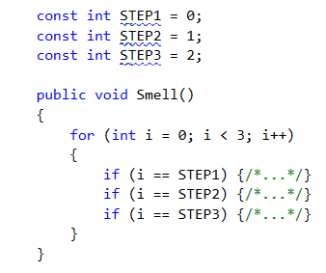
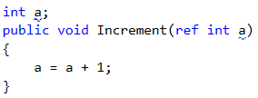
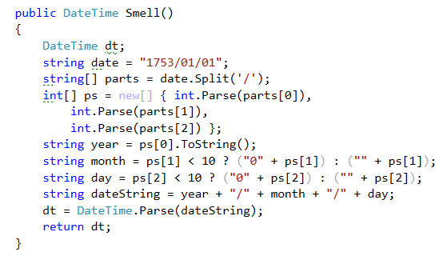
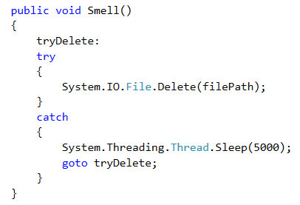
Crime scene samples – code level

Slide 6
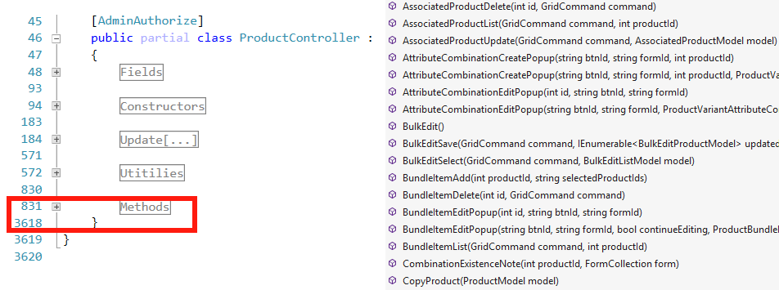
Crime scene samples – class level

Slide 7
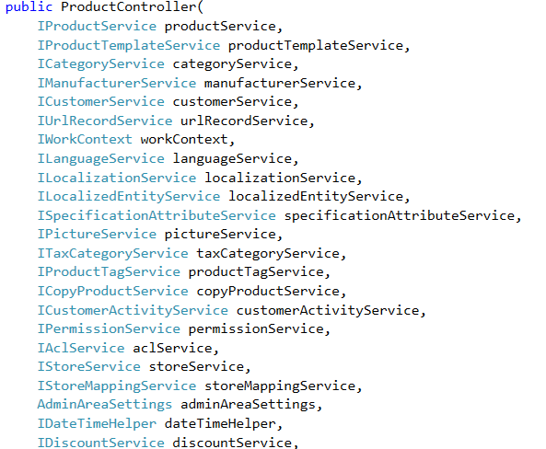
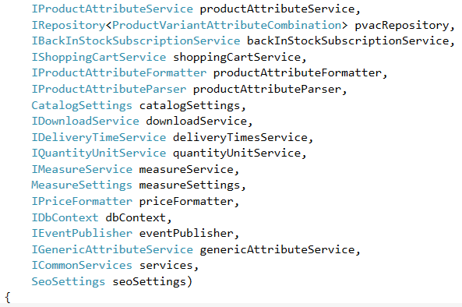
Crime scene samples – SOLID violation

Slide 8
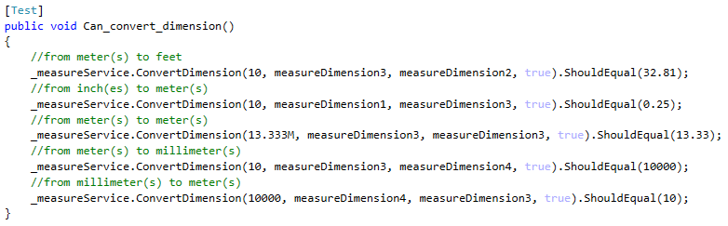
Crime scene samples – multiple test assertions

Slide 9
SmartStore.NET introduction
SmartStore.NET is a free, open source, full-featured e-commerce solution for companies of any size. It is web standards compliant and incorporates the newest Microsoft web technology stack.
SmartStore.NET includes all essential features to create multilingual and multi-currency stores targeting desktop or mobile devices and enabling SEO optimized rich product catalogs with support for an unlimited number of products and categories, variants, bundles, datasheets, ESD, discounts, coupons and many more.
The state-of-the-art architecture of SmartStore.NET - with ASP.NET 4.5 + MVC 5, Entity Framework 6 and Domain Driven Design approach - makes it easy to extend, extremely flexible and essentially fun to work with ;-)
https://github.com/smartstoreag/SmartStoreNET

Slide 10
SmartStore.NET production deployments
trendspro.builtwith.com
+500 online stores
http://2stonedshop.de/
http://indo-divers.de/
http://www.adr-shop.com/
http://www.mobilesat.co.uk/

Slide 11
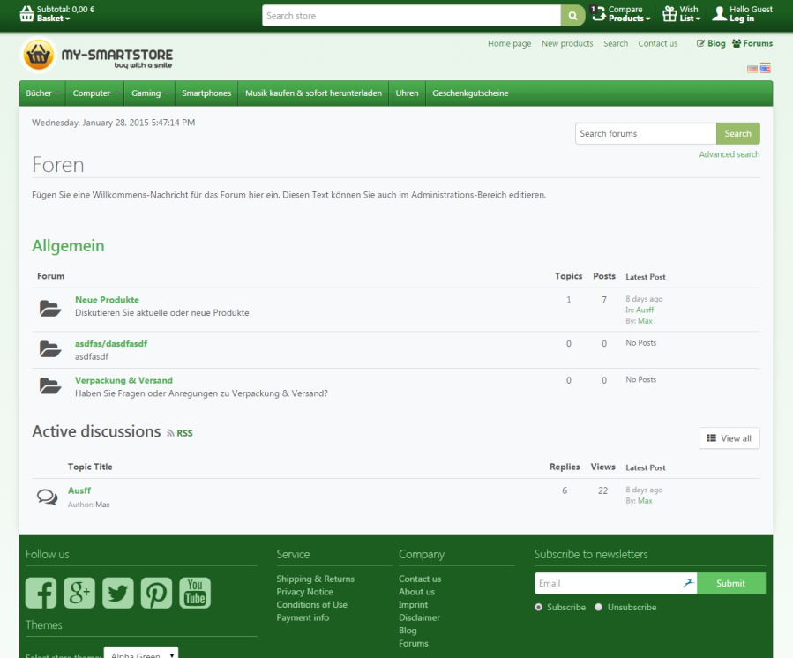
SmartStore.NET Screen (1)

Slide 12
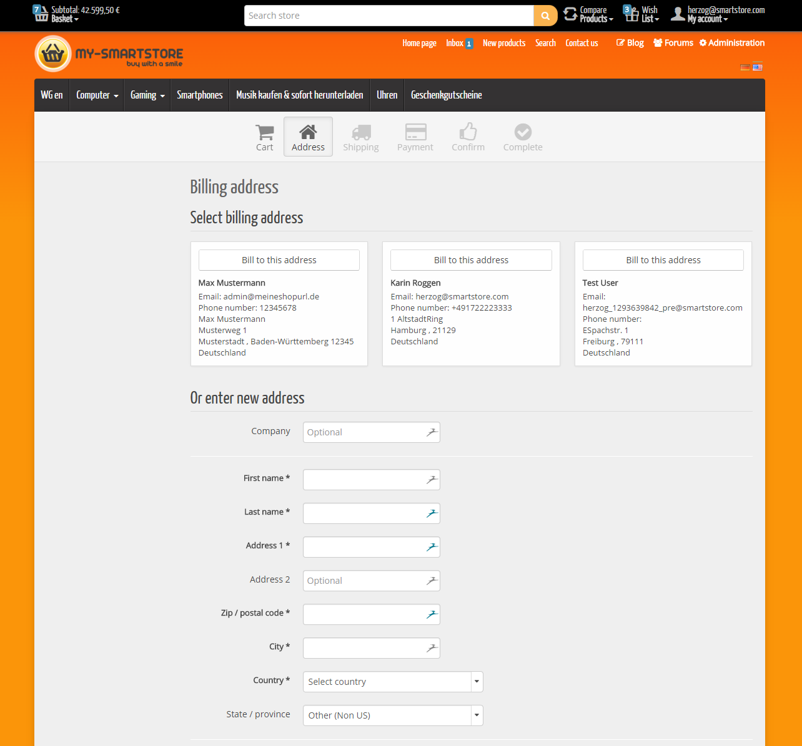
SmartStore.NET Screen (2)

Slide 13
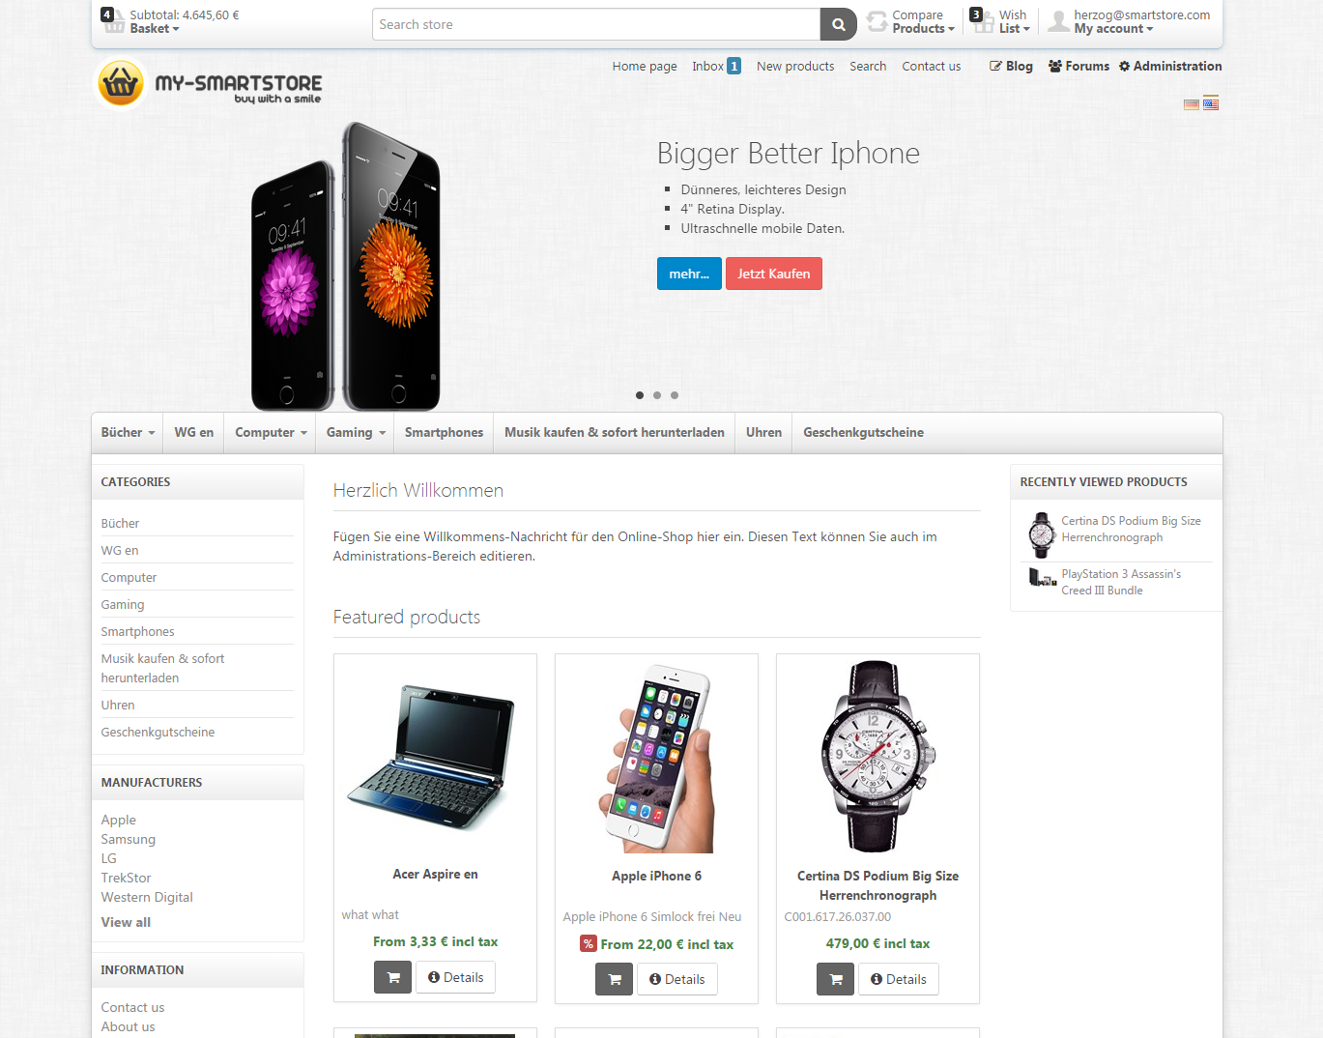
SmartStore.NET Screen (3)

Slide 14
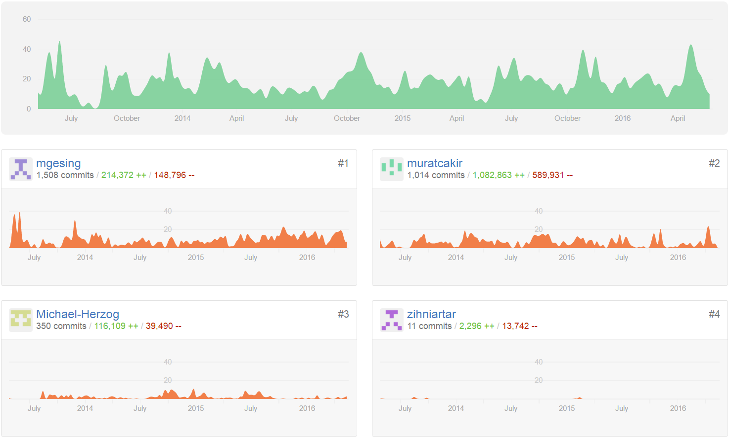
CodeBase Stats (June 2016)

Slide 15

Finding the crime
How to find code crime in project ?

Slide 16

Code crime scene (Ndepend)
Dependency graph
Dependency matrix
LINQ queries
Code quality metrics (+custom)
More…

Slide 17
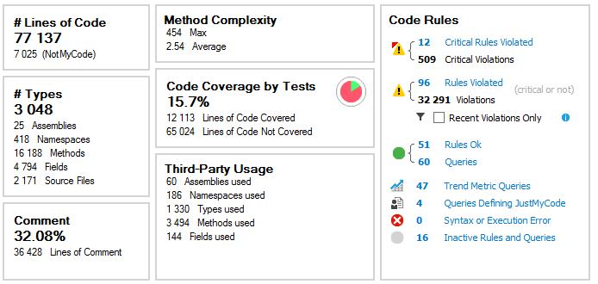
NDepend – Project overview

Slide 18
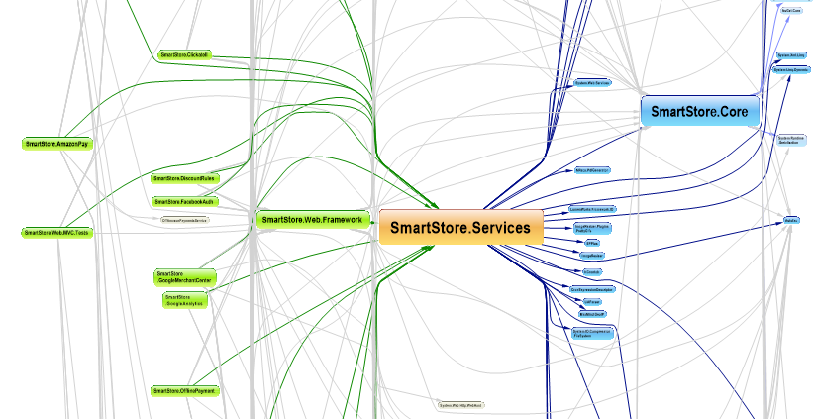
NDepend – Dependency diagram

Slide 19
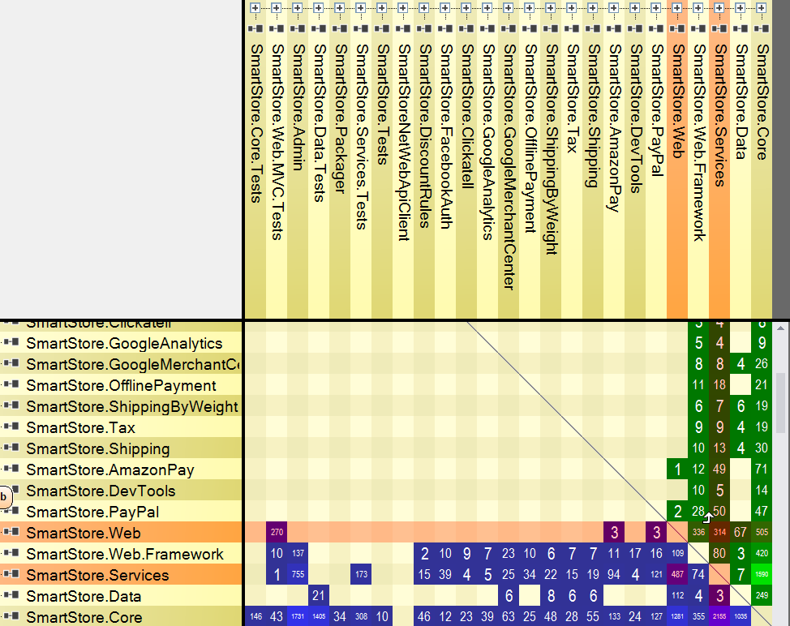
NDepend – Dependency matrix

Slide 20
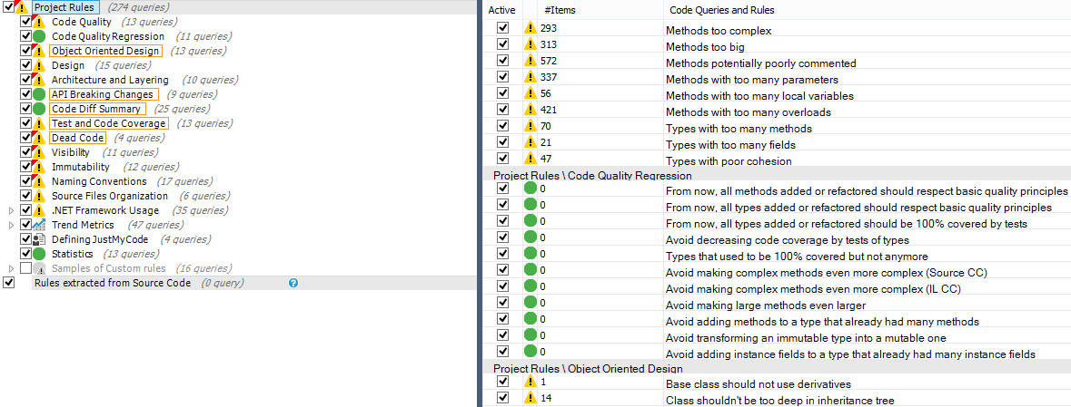
NDepend – Metricts

Slide 21
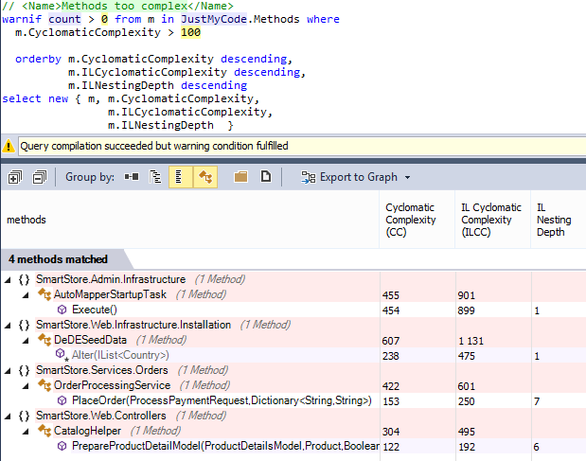
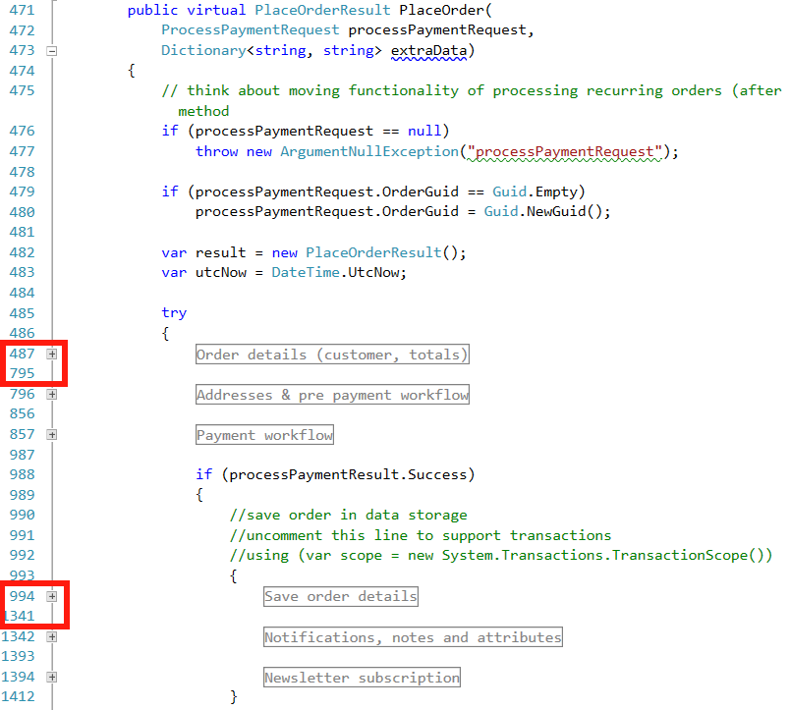
NDepend – Cyclomatic complexity

Slide 22
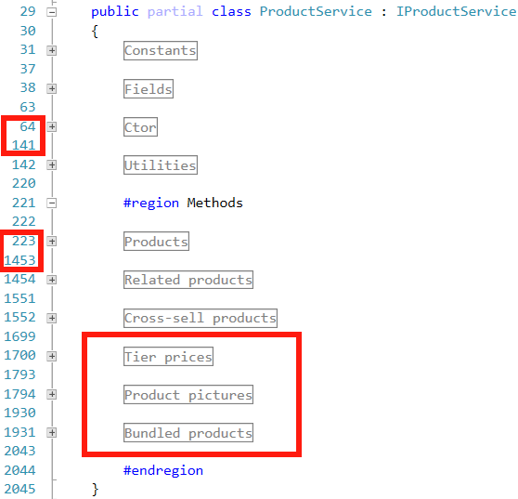
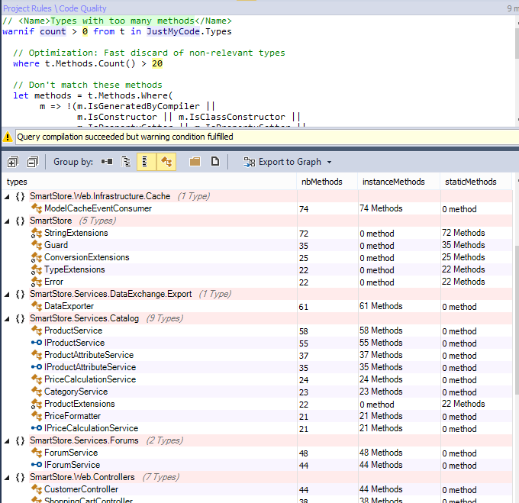
NDepend – SOLID violation (S)

Slide 23
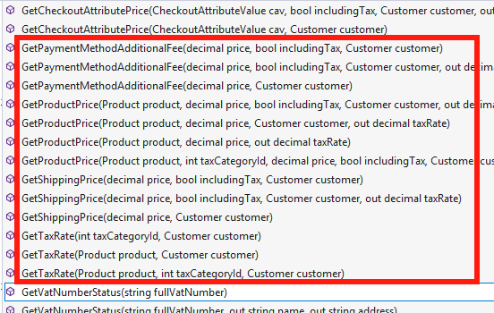
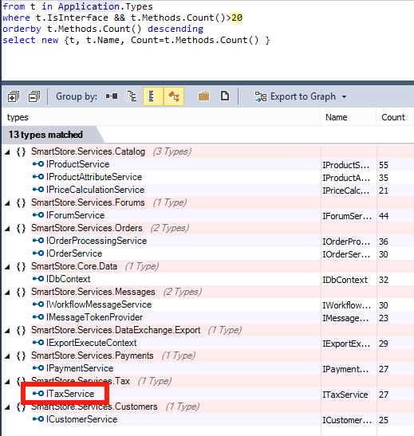
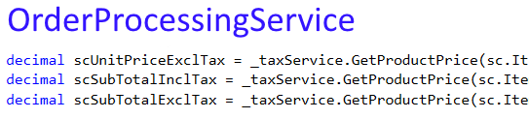
NDepend – SOLID violation (I)

Slide 24
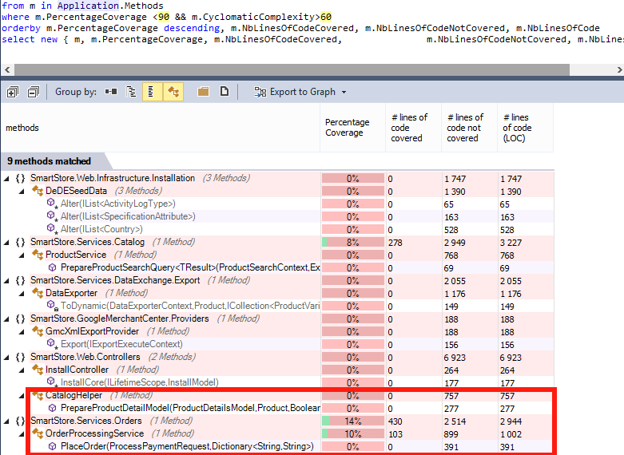
NDepend – Code coverage

Slide 25
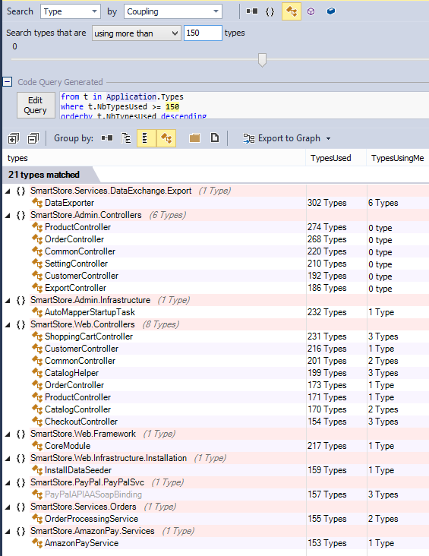
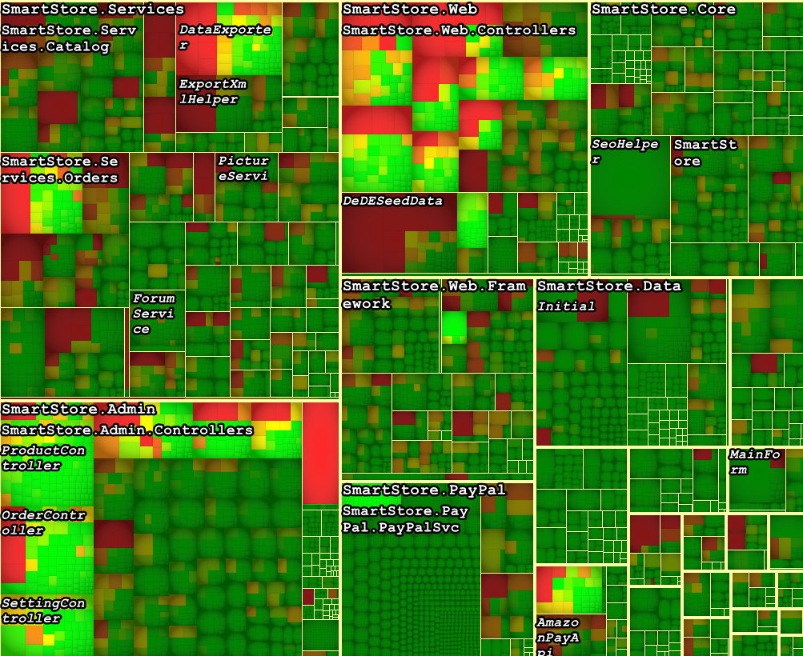
NDepend – Coupling

Slide 26
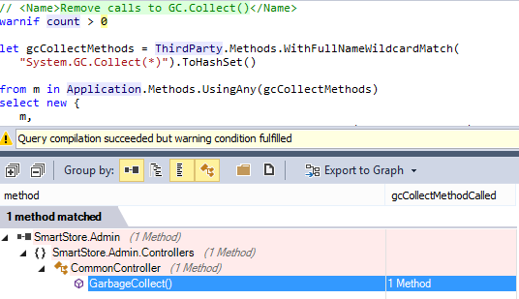
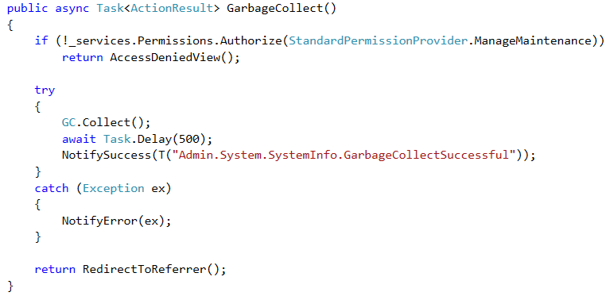
NDepend – GC.Collect

Slide 27
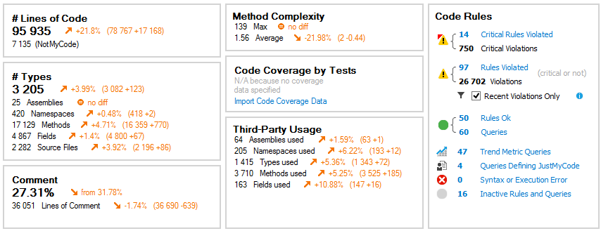
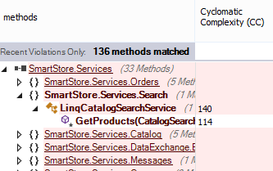
June – October 2016 compare

Slide 28
Source control systems – measure behavior
* 1a660f0 | (HEAD -> master, origin/master, origin/HEAD) dd (Fri May 13 17:03:40 2016) [User1]
* dfcd431 | screenshots attepmt 2 (Fri May 13 16:59:35 2016) [User1]
* f29f63e | Apropriate screenshotting added (Fri May 13 16:54:46 2016) [User1]
* 9203bdb | disabled native events for IE (Fri May 13 16:38:44 2016) [User1]
* 45a6f12 | More setting for screenshots (Fri May 13 15:13:36 2016) [User1]
* 690180c | IE only (Fri May 13 15:01:22 2016) [User1]
* b687d21 | ScreenShots added (Fri May 13 15:00:51 2016) [User1]
* f98748f | Added waiting for page fully loaded (Fri May 13 14:44:48 2016) [User1]
* 2f15015 | Wait till page fully loaded for IE (Fri May 13 11:46:25 2016) [User1]
* 46dafc1 | Enabled IE and Chrome (Fri May 13 11:23:21 2016) [User1]
* 4faa96c | eliminated reposting form twice (Fri May 13 11:13:15 2016) [User1]
* ea6e879 | Improved user profile edit tests (Fri May 13 10:53:38 2016) [User1]
* 83f2f28 | removed retry for TestLauncher (Fri May 13 10:32:31 2016) [User1]
* ff0e1ff | Changed retry count and added message text for asserts (Fri May 13 10:25:13 2016) [User1]
* 2f27e2a | Temporary disabled most of the tests to (Fri May 13 10:08:46 2016) [User1]
* b6dcb02 | FireFox enabled for tests (Thu May 12 14:02:29 2016) [User1]
* 04c5596 | Better Handling of an alerts missing situations (Thu May 12 14:00:41 2016) [User1]

Slide 29
Code maat - introduction
Features:
Analize GIT/SVN history
Command line tool
Various analizers
CSV output
Open source
Work flow:
Git log….
Parse log with code maat
Generate graph from csv

Slide 30
Code maat – sample
java -jar code-maat-0.8.5-standalone.jar -l log_file.log -c git -a authors
entity,n-authors,n-revs
src/Presentation/SmartStore.Web/Controllers/ShoppingCartController.cs,4,14
src/Plugins/SmartStore.PayPal/Providers/PayPalExpressProvider.cs,4,6
src/Libraries/SmartStore.Services/Catalog/Importer/ProductImporter.cs,3,48
src/Presentation/SmartStore.Web/Administration/Controllers/ImportController.cs,3,38
src/Libraries/SmartStore.Services/Catalog/Importer/CategoryImporter.cs,3,35
src/Presentation/SmartStore.Web/Administration/Controllers/ExportController.cs,3,31
src/Libraries/SmartStore.Data/Migrations/201601262000441_ImportFramework1.cs,3,30
src/Libraries/SmartStore.Services/Customers/Importer/CustomerImporter.cs,3,29

Slide 31
Code maat – hot files
entity | n.authors | n.revs
src/Libraries/SmartStore.Services/Catalog/Importer/ProductImporter.cs | 3 | 48
src/Presentation/SmartStore.Web/Administration/Controllers/ImportController.cs | 3 | 38
src/Libraries/SmartStore.Services/Catalog/Importer/CategoryImporter.cs | 3 | 35
src/Presentation/SmartStore.Web/Administration/Controllers/ExportController.cs | 3 | 31
src/Libraries/SmartStore.Data/Migrations/201601262000441_ImportFramework1.cs | 3 | 30
src/Libraries/SmartStore.Services/Customers/Importer/CustomerImporter.cs | 3 | 29
src/Libraries/SmartStore.Data/Migrations/201512151526290_ImportFramework.cs | 2 | 28
src/Libraries/SmartStore.Data/Migrations/201603121451066_ThirdPartyEmailHandOver.cs | 2 | 21
src/Plugins/SmartStore.PayPal/Localization/resources.en-us.xml | 3 | 20
src/Plugins/SmartStore.PayPal/Localization/resources.de-de.xml | 3 | 20
src/Plugins/SmartStore.PayPal/Services/PayPalService.cs | 1 | 20
src/Libraries/SmartStore.Services/DataExchange/Export/DataExporter.cs | 3 | 19
src/Libraries/SmartStore.Services/DataExchange/Import/DataImporter.cs | 3 | 19
src/Libraries/SmartStore.Services/DataExchange/Import/ImportRow.cs | 3 | 18
src/Presentation/SmartStore.Web/Administration/Views/Import/_ColumnMappings.cshtml | 3 | 18
src/Presentation/SmartStore.Web/Administration/Views/Import/_CreateOrUpdate.cshtml | 1 | 18
src/Presentation/SmartStore.Web/Administration/Controllers/ProductController.cs | 2 | 16
src/Presentation/SmartStore.Web/Administration/Models/DataExchange/ImportProfileModel.cs | 2 | 16
src/Presentation/SmartStore.Web/Controllers/CommonController.cs | 2 | 15
src/Presentation/SmartStore.Web/Scripts/smartstore.entityPicker.js | 2 | 15

Slide 32
Code maat – Author importance

Slide 33
Code maat – module ownership

Slide 34
Code maat – module ownership core

Slide 35
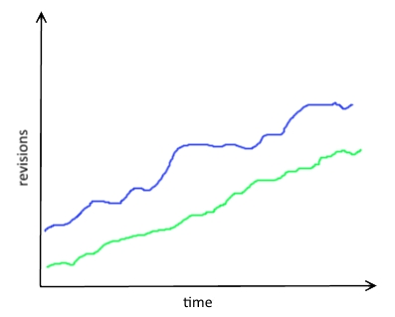
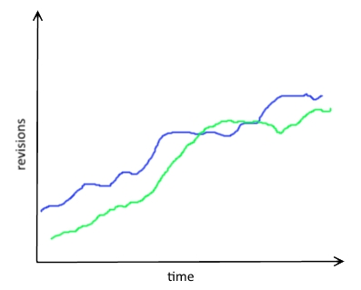
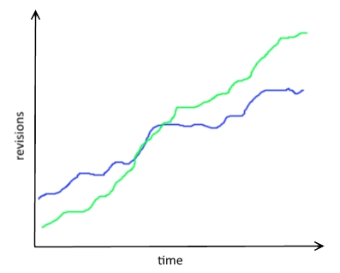
Code maat – code relations
A
B
C
Functional code
Tests code

Slide 36
Other tools
FxCop
StyleCop
R#

Slide 37

Arguments for boss
Hard data provided by engineering tools speaks for itself

Slide 38
Key outcome
Everything can be measured
Use suitable tools
Provide hard data
Programming triangle: correctness, readability, performance

Slide 39
References
NDepend http://www.ndepend.com/
Code Maat https://github.com/adamtornhill/code-maat
Book https://pragprog.com/book/atcrime/your-code-as-a-crime-scene
FxCop https://msdn.microsoft.com/en-us/library/bb429476(v=vs.80).aspx
R# https://www.jetbrains.com/resharper/ (and other similar VS plugins)

Slide 40
Thank you!

