Slide 1
SPA
bartosz lenar
Notes:
NEXT: PLAN!

Slide 2
the plan
what is spa?
how it works?
how to start building one?

Slide 3

RELOADING
Notes:
Main problem

Slide 4



TRADITIONAL BROWSING
GET example.org/users
HTML
GET example.org/users/bartek
HTML

Slide 5

SPA AGAINST RELOADING
GET example.org/#/users
HTML
GET example.org/#/users/bartek
JSON
Notes:
# obsolete

Slide 6

SPA PHILOSOPHY
views = htmls
logic = javascripts
media = images & csses
gui api = browser
Notes:
Mobile app

Slide 7
PACKAGE LOADING
first call
app package
Notes:
Browser agnostic

Slide 8
PACKAGE WORKING
GET example.org/users/bartek
200 OK … { UserName: "Bartek", … }
POST example.org/users/bartek
403 FORBIDDEN
Notes:
REST API

Slide 9
WHY
web app goes restfull
full control over the app
data amount reduction
easy conversion to offline
and mobile!
much more stuff to take care about
first-loading time
heavy client-side logic

Slide 10
PACKAGE

Slide 11
SPA PACKAGE
root app model

Slide 12

DOES IT SOUND TOO 2005?

Slide 13

NAVIGATION

Slide 14

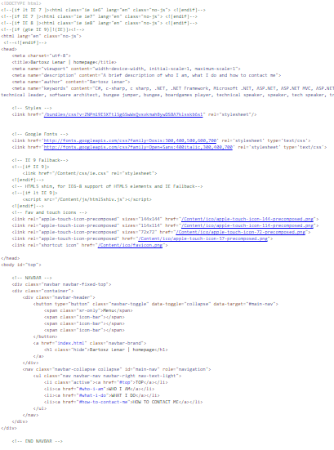
H#SH ROUTING
<a href="#about">About</a>
<a name="about"/>
<a name="contact"/>

Slide 15

HISTORY API
pushState
window.onpopstate
Notes:
stateObject
Title (future!)
url

Slide 16
ARCHITECTURE

Slide 17
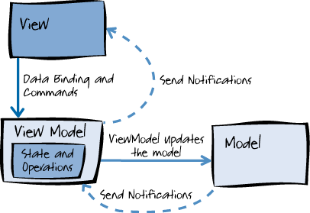
MVVM
HTML
MVVM-framework binding & notifications
backend
system
javascript object
REST
communication

Slide 18
CLIENT SIDE MVVM (knockout style)
user: {
id: ko.observable(666),
name: ko.observable("bartek")
}
<div id="userForm">
<span data-bind="text: id"> </span>
<input data-bind="value: name"/>
</div>

Slide 19
SPA PACKAGE PARTS
views and viewmodels repository
dependency injection
USER
MENU
LOGIN

Slide 20
MODEL FLOW

Slide 21
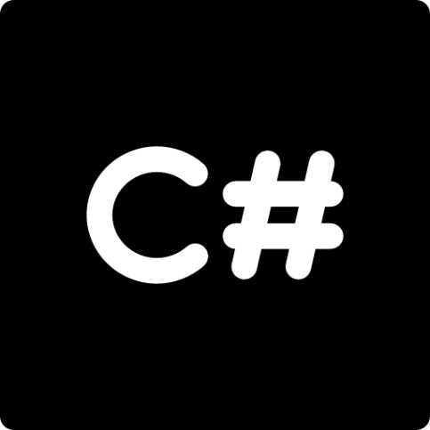
BACKEND
[dbo].[users]
(
[id] [uniqueidentifier] NOT NULL,
[name] [nvarchar](256) NOT NULL,
[countryId] [int] NULL
)
public class User
{
public Guid Id { get; set; }
public string Name { get; set; }
public int CountryId { get; set; }
public Country Country { get; set; }
}
Notes:
Entity framework

Slide 22
BACKEND SCHEMA
[dbo].[users]
User.cs
DATA REPOSITORIES
SERVICES

Slide 23
FRONTEND
var UserViewModel = (function () {
function UserViewModel() {
this.Id = ko.observable();
this.Name = ko.observable();
this.CountryId = ko.observable();
}
return UserViewModel;
})();
public class UserModel
{
public Guid? Id { get; set; }
public string Name { get; set; }
public int? CountryId { get; set; } }

Slide 24
FRONTEND SCHEMA
[dbo].[users]
User.cs
UserModel.cs
UserViewModel.js
User.html
DATA REPOSITORIES
SERVICES
CONTROLER
VIEWMODEL (client)
VIEW

Slide 25

VIEW
<div id="userForm">
<span data-bind="text: id"> </span>
<input data-bind="value: name"/>
</div>
how to do a selectable item?

Slide 26
PAGE MODELS
everything we need to handle a page logic and view
server-side contains:
models
dictionaries & used values
all additional data & user context
client-side contains:
events emition
all actions and view logic

Slide 27
PAGE MODELS SCHEMA
[dbo].[users]
User.cs
UserModel.cs
UserViewModel.js
User.html
UserPageModel.cs
UserPageViewModel.js

Slide 28
MODEL FLOW CHAPTER 3 : PAGE MODELS
var UserPageViewModel = (function () {
function UserPageViewModel() {
this.User = new UserViewModel();
this.Countries = ko.observableArray();
this.SaveChanges = function() { ... }
}
return UserPageViewModel;
})();
public class UserPageModel
{
public UserModel User { get; set; }
public Country[] Countries { get; set; } public bool WithEditRights { get; set; } }

Slide 29
SELECTABLE ITEM
<div id="userForm">
<span data-bind="text: id"> </span>
<input data-bind="value: name"/>
<select data-bind="options: $parent.Countries,
optionsText: 'Name',
optionsValue: 'Id',
value: CountryId" ></select>
</div>

Slide 30
MAPPING OBJECTS
making pure json ready to bind (observables)
validation
creates additional methods & properties
reversing the whole process!
UserModel.cs
UserViewModel.js
SERIALIZING: json
MAPPING: observables & additional stuff

Slide 31


FLOW
example.org/users/666
GET api/users/666
{ id: 666, name: "bartek" }
render html +
bind
insert + map data
User.html
User.js

Slide 32
PRELOADING

Slide 33
PRELOADING
bundle javascripts into modules-packs
check which are available to the logged in user
load scripts & structures
HTML5 async
require.js
separate areas
login!

Slide 34

DICTIONARIES
Countries = [
{ Id: '0', Name: 'Poland'},
{ Id: '1', Name: 'England'},
{ Id: '2', Name: 'USA'},
{ Id: '3', Name: 'New Zealand'},
]

Slide 35
SELECTABLE ITEM
<div id="userForm">
<span data-bind="text: id"> </span>
<input data-bind="value: name"/>
<select data-bind="options: Values.Countries,
optionsText: 'Name',
optionsValue: 'Id',
value: CountryId" ></select>
</div>

Slide 36
LOCALIZATION
Phrases = {}
Phrases['Poland'] = 'Polska';
Phrases['England'] = 'Anglia';
Phrases['USA'] = 'USA';
Phrases['New Zealand'] = 'Nowa Zelandia';

Slide 37
LOCALIZATION HELPER
<td>
<div class="well well-sm">
<span data-bind="text: PhrasesHelper.Get['Countries', CountryId]"></span>
</div>
</td>

Slide 38
API WRAPPER
spinner
common settings for all calls
cache
content-type
common reactions for all responses
400, 401, 403, etc.
validation
handle CSRF validation
api.Put('users', userModel)
.success(function() {
alert(Phrases['Success']);
})
.fail(function() {
alert(Phrases['Error']);
});

Slide 39
OTHER STUFF
interaction between sites
ioc container
unit tests
no browser required
model validation
online to offline
disable lazy loading
inject different api wrapper?

Slide 40
BARTOSZ LENAR
flaticon.com
freepik.com
SPA

