Slide 1
My awesome journey with Open Source
Adam Sitnik

Slide 2

About myself
Open Source:
BenchmarkDotNet (contributor => maintainer)
Core CLR (contributor)
corefxlab (contributor)
& more

Slide 3
Agenda
The only thing that matters
Open your eyes!
Confession
How to start
Common mistakes
Don’t give up!
Free tools
Writing libraries
Advantage for the employer
Challenges
Part of daily job routine
Bulding the network
Being a maintainer
Afraid to ask
The best moments

Slide 4
The History of Open Source
You can make your own history!

Slide 5
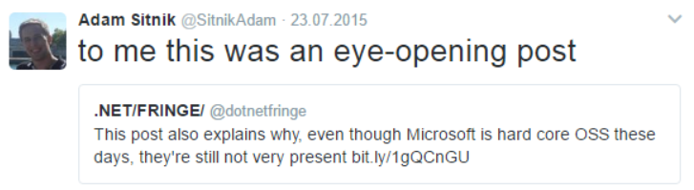
Open your eyes!

Slide 6
What small startup did for .NET OSS to develop a single app?
Added full CQL3 collisions support to FluentCasandra
Invented Helios, a high performance server-side socket library
Ported Akka to .NET
Implemented Marmur3 and HyperLogLog algorithms in C#

Slide 7
Some good questions
„in the ~15 year history of .NET, no one built a reactive, server-side socket library that’s actively maintained?”
(it was 2014)
„Why in the hell did it fall on one developer working at a startup in LA and one independent developer in Sweden to port one of the major, major cornerstones of distributed computing to .NET?”
(it was before Orleans)

Slide 8
We are capable of so much more than this
„The shortcomings of .NET’s open source ecosystem are your fault and my fault, not Microsoft’s”
„the truth is that it’s our own intellectual laziness that created a ghetto of our OSS ecosystem”
„There are brilliant developers like the Akka.NET contributors, the Mono team, Chris Patterson, and others who work on solving hard problems with .NET. YOU CAN BE ONE OF THEM.”
„You don’t need Ruby, Node.JS, or even Java to build amazing products. You can do it in .NET.”

Slide 9
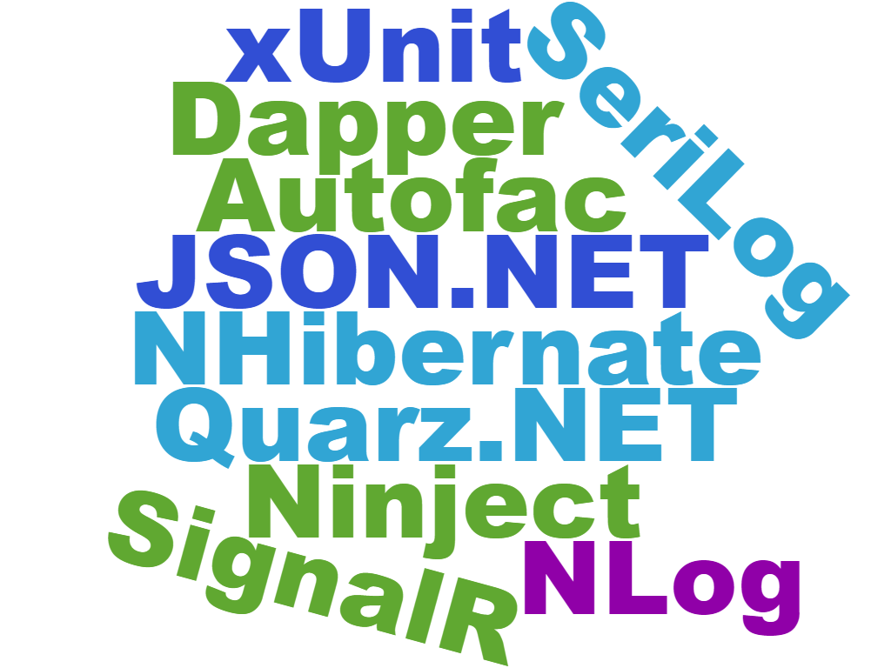
Are you using any OSS?

Slide 10
Have you ever…
Maintained OSS project?
Implemented a new feature?
Fixed a bug?
Improved the performance?
Improved the docs?
Reported a bug? with a nice repro case?
Suggested a fix or a feature?

Slide 11
At this point of time
I was anonymous .NET developer
I knew I wanted to contribute to make a difference
I had no idea how to start
I did not know any contributors
I was burning out as a developer (too many integration projects)
I wasn’t even dreaming about speaking at the Big Conferences…
Not to speak about drinking a beer with my Gurus!

Slide 12
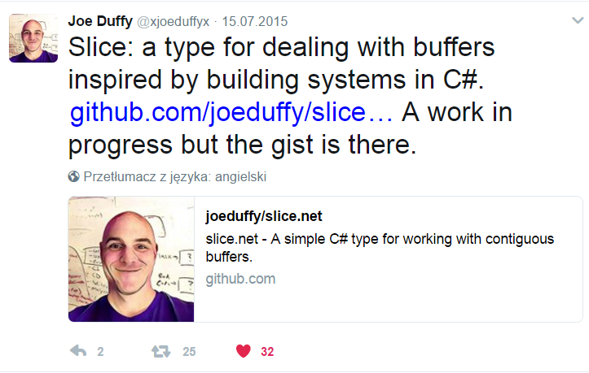
When your Guru starts a new project..

Slide 13
My first contribution: what it was
Build the benchmark in the Release mode
Cleanup the memory after every iteration
Perform the Jit Warmup
One micro optimization

Slide 14
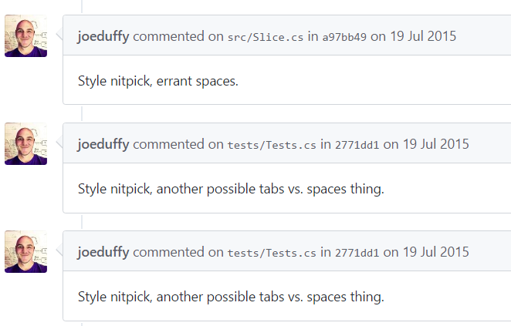
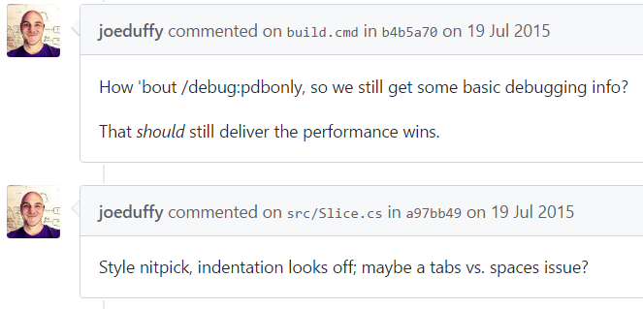
Follow the coding standards (CONTRIBUTING.md)
You can get a code review from your Guru!!!
Notes:
Include time zones when communicating with people around the globe

Slide 15
Choose the right Project
Look for something that excites you!
Prefer tools that you are familiar with
Make sure they are looking for help!
Make sure it’s active!
Make sure you are ok with the license!
Your own? Make sure you don’t duplicate popular, existing project!

Slide 16
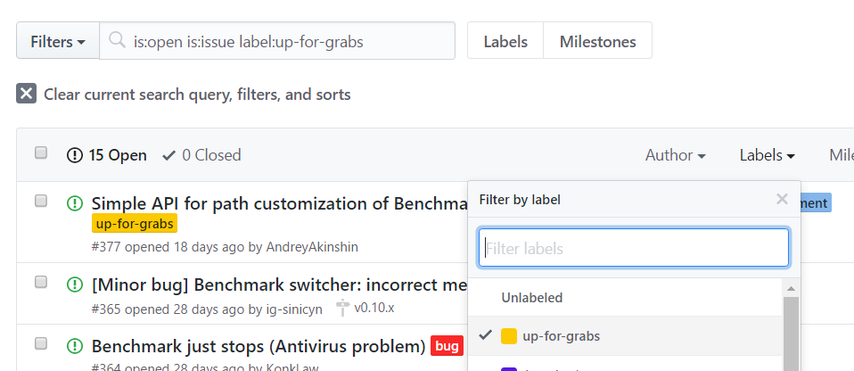
How to grab an issue?
Notes:
Search for the „up for grabs” label. Ask if this is still valid.
Too shy? Don’t ask, just fork and do your job. When you are done, pull a PR

Slide 17
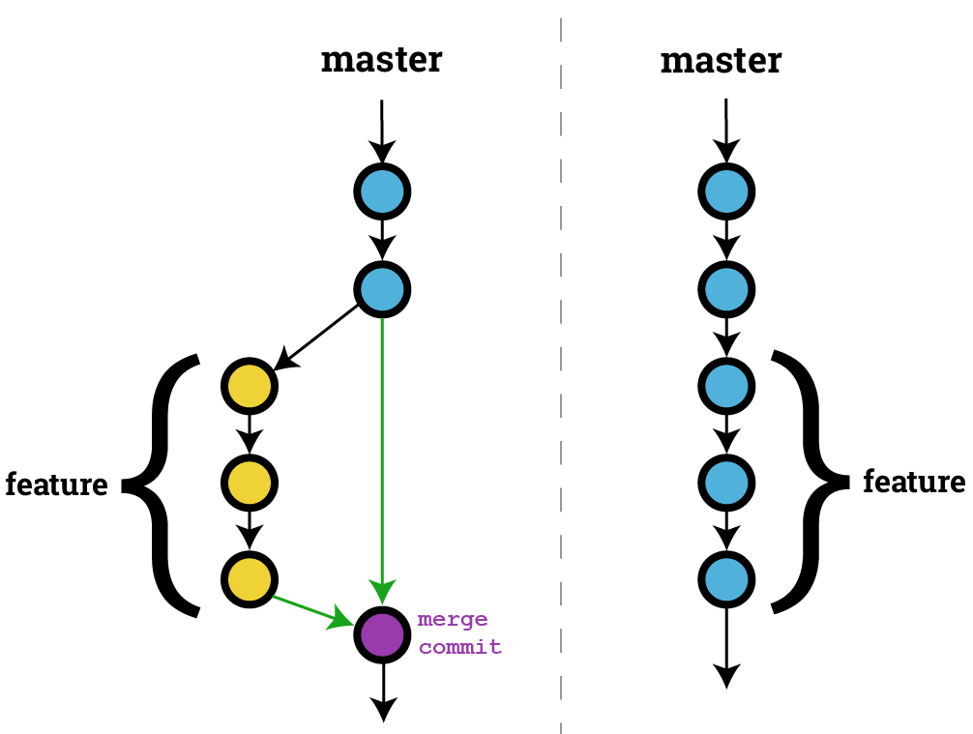
Common GIT mistakes: Working without branches
Image from http://stackoverflow.com/a/21717431/5852046

Slide 18
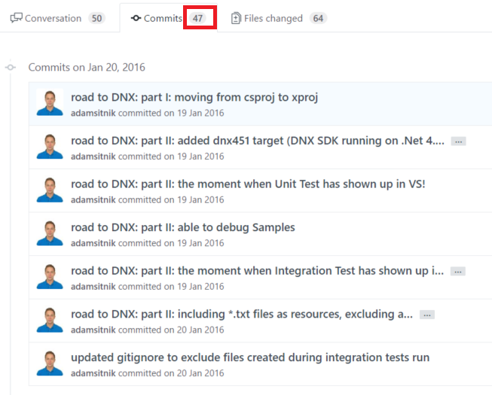
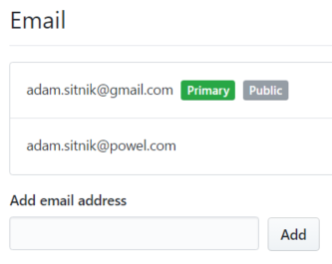
Other common GIT mistakes
Wrong email address
(contributions will not count)
Too many/few commits
$ git config user.name „Your Name"
$ git config user.email your@github.email

Slide 19
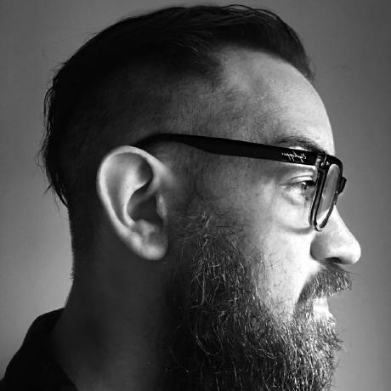



Don’t give up!
Ben Adams contributions to Kestrel HTTP Server (as of 2017-04-13 16:20 CET)
3
109
115

Slide 20











Use the tools that are free for the Contributors

Slide 21
Writing libraries for other developers
Backward compatibility
Supporting .NET/Mono/.NET Core
Supporting Linux/MacOS
Versioning
Release notes
Docs. Good docs ;)

Slide 22
Believe in yourself
How do you know if you are good or not?
Would you like to get a dream job?
Fork a project of your dream job company, pick up an issue and just solve it!

Slide 23
Advantages for the employer
You learn new things all the time
You use new things at work to do better job
You build a network which helps you when you are in need
You can promote your company by doing great things in public
People want to work with the „Big Names”

Slide 24
Challenge yourself!
I ported BenchmarkDotNet to .NET Core
At the begining I had no idea what .NET Core really was
I had to become dnx/dotnet cli/msbuild expert
There was litteraly no resources available
Contributing to Core CLR
How to build the Virtual Machine?
Use C++ to generate CIL to make C# better language ;)
How to debug CLR?
How to build .NET program that uses local CLR build?

Slide 25

Be the Worst!
I had the pleasure to learn from:
Joe Duffy – Concurrency Guru
Vladimir Sadov – Core Engineer at Roslyn team
Krzysztof Cwalina – Principal Architect at Microsoft
Andrey Akinshin – Software Engineer at Jetbrains
Jan Kotas – Core Engineer at CLR team
& more!
What if you are the average of the five people you spend the most time with?
Notes:
OSS gives you the opportunity to work with the best in the word. Your code reviews will be extremelly detailed. Be opened for comments! Don’t give up!

Slide 26
Part of a daily job routine
Report a bug, provide a repro case
Is it blocking your job?
If so, can you fix it?
Just do it. Eventually appologise later ;)

Slide 27
Bulding the Network
Conferences – you get invited to speak!
Lunch or beer with your Guru? No problem!
Pair programming with the best

Slide 28
When you become the maintainer
Never be an asshole
Respond fast
Fix the bugs first
Write the docs
Don’t forget about the release notes

Slide 29
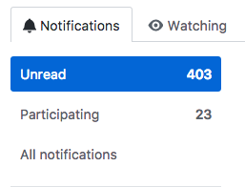
The bad part of being the maintainer
Expectations
Responsibility
Public failures
The „special” users
Insomnia

Slide 30
Afraid To Ask
Do contributors loose motivation for the boring tasks at work?
Do contributors do OSS at work?
Do contributors get a lot of job offers?
Will you get a MVP award?
Will it be easier to get a better job?
Will you get paid for OSS?
Notes:
Or alternative name: Afraid to Ask

Slide 31
The best moments ?!?!
Geting write access to your favourite’s tool repository
Seeing your Gurus use the feature you implemented
Seeing your big impact
Being recognized by your Guru

Slide 32
Sources
The Profound Weakness of the .NET OSS Ecosystem
Free Services & Tools for Open Source .NET Projects
All Pull Requests by Ben Adams to Kestrel
What it feels like to be an open-source maintainer

Slide 33
Questions?
Contact:
@SitnikAdam
Adam.Sitnik@gmail.com
https://github.com/adamsitnik

