Slide 1
《系统设计与开发实践》结对项目
开发经验分享
Lucky Server - a Toy Web Server

Slide 2
Summary
The technologies we used
Epoll
Reactor Pattern
Our engineering experience
Use GitHub for version management
Use Valgrind to check memory leak
Use Google's C++ code style guide to standardize coding

Slide 3
Technology: Epoll
a tiny web server pseudo code, from CSAPP
What’s the disadvantage of simple synchronous blocking network I/O ?
Just one connection can block our process!
int main(int argc, char **argv) {
int listenfd, connfd;
socklen_t clientlen;
struct sockaddr_storage clientaddr;
listenfd = Open_listenfd(argv[1]);
while (1) {
clientlen = sizeof(clientaddr);
connfd = Accept(listenfd, &clientaddr, &clientlen);
doit(connfd);
Close(connfd);
}
}

Slide 4
Technology: Epoll
a pseudo code of how to use epoll in web server
int sockfd = socket();
int epoll = epoll_create();
// bind and listen...
epoll.add(sockfd);
while(true) {
auto events = epoll_wait(epfd...);
for(auto cur_event& : events){
// server socket accepts new connection
if(cur_event.fd == sockfd){
int client_sockfd = accept(sockfd);
epoll.add(sockfd);
}
// new data is sent to some connection
else {
handleEvent(cur_event);
}
}
}
epoll is a scalable I/O event notification mechanism provided since Linux kernel 2.5.
How to use it in a web server program?
How does it work?

Slide 5
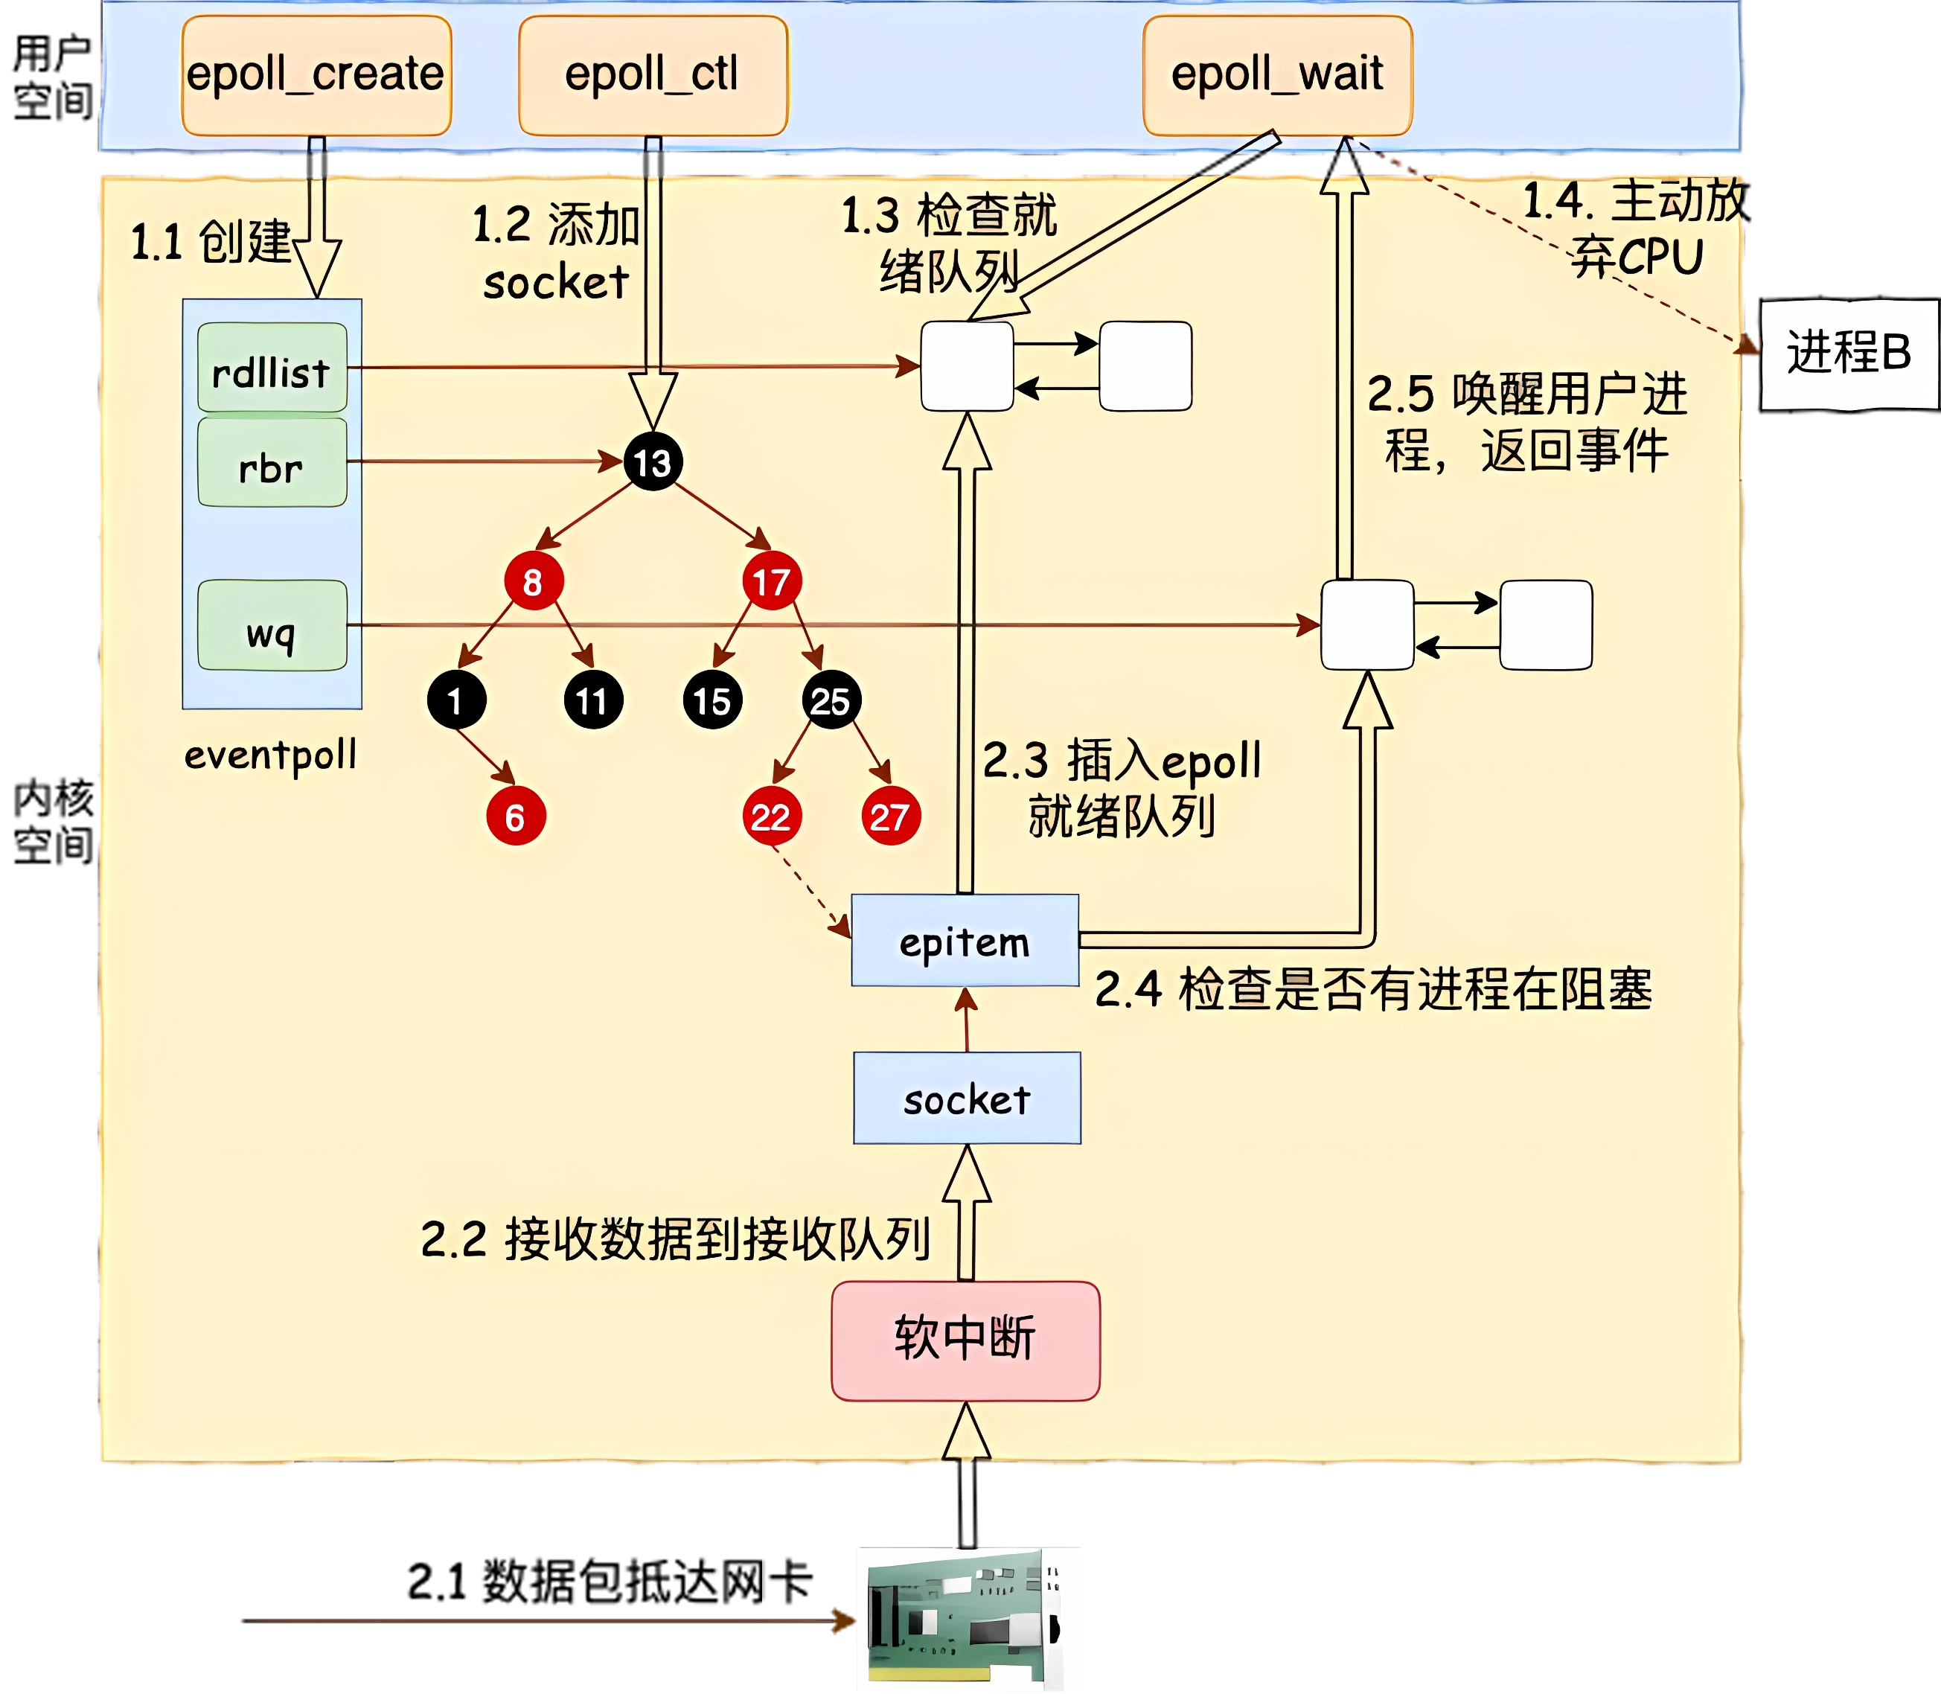
Technology: Epoll
Epoll takes over all the sockets of web server itself and the client connections.
Epoll treats the socket receiving new data as an event and stores the events in a private queue.
Epoll provides all collected events through epoll_wait function, so that we can know which sockets to read data from at once.

Slide 6

Technology: Reactor Pattern
Modern CPUs are multi-core architectures.
More than one thread can execute concurrently at the same time.
The software architecture of Lucky Server:
Sub Thread 1
(sub reactor)
Event Loop
Main Process
(main reactor)
Browser
Server::OnConnect
New Connection
Event Loop
Randomly select an EventLoop to take over it.
Acceptor::AcceptConnection
...
Event Loop
Server::OnConnect
* In Lucky Server, Event Loop is a further abstraction of the epoll interface.
Sub Thread n
(sub reactor)

Slide 7
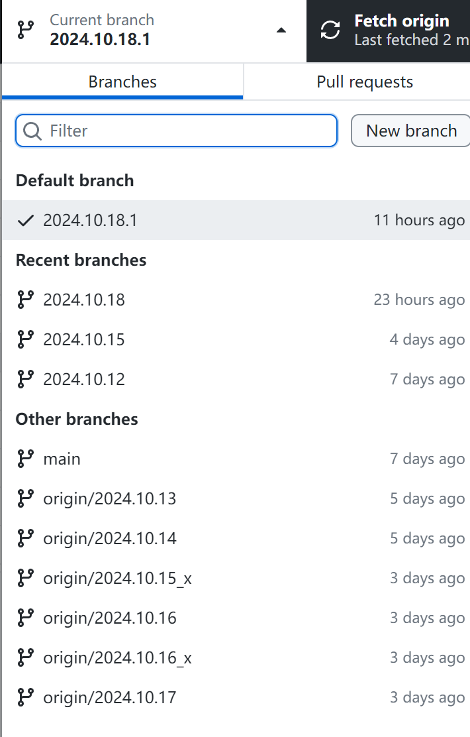
Project Progress Management
Managing Project Progress with Git
  Tracking changes and commits
  Branching and merging strategies
  Collaborating with team members
  through pull requests

Slide 8
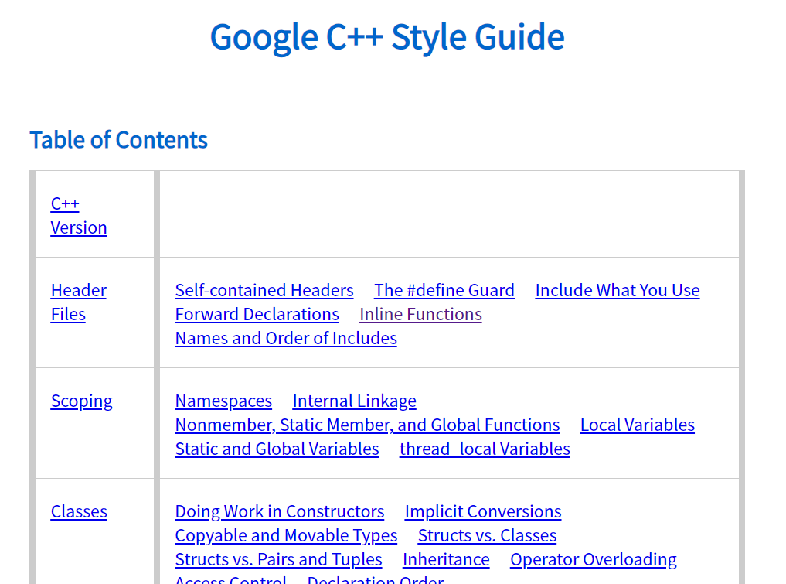
Code Review: Google C++ Style Guide
Header Files and Scoping
Class Design and Function Best Practices
Naming, Commenting, and Formatting Guidelines

Slide 9
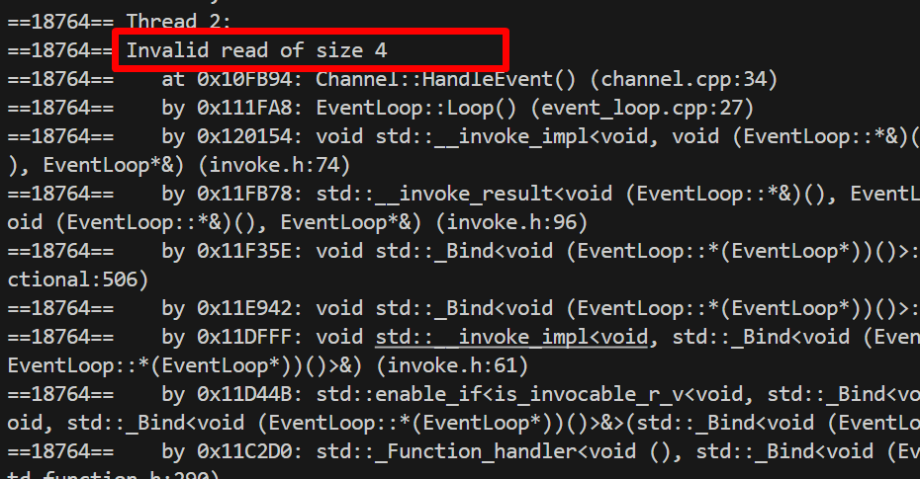
Code Review: Memory Leak Detection
Running Valgrind on the C++ project
Interpreting the results and identifying leak sources
Fixing memory leaks based on Valgrind's reports

