Slide 1
《软件工程》期末大作业开发验收汇报
WinPython - a Simple Python Interpreter
WU-SUNFLOWER

Slide 2
Summary
I will share our exploration experiences about making Python better on the following topics:
Introduce Oop-Klass Model to Python
Introduce Small Integers(Smis) to Python
Introduce Copy Garbage Collection Algorithm to Python

Slide 3
Oop-Klass Model——bring up problem
To implement polymorphism, virtual function tables are a commonly used method.
CPython does indeed do this.
python/cpython/Objects/dictobject.c
PyTypeObject PyDict_Type = {
PyVarObject_HEAD_INIT(&PyType_Type, 0)
"dict",
sizeof(PyDictObject),
PyObject_HashNotImplemented, /* tp_hash */
0, /* tp_call */
0, /* tp_str */
dict_traverse, /* tp_traverse */
dict_richcompare, /* tp_richcompare */
dict_iter, /* tp_iter */
mapp_methods, /* tp_methods */
// ...
};
PyDictObject 0x1aa31ce7440
PyTypeObject *ob_type;
...
vtable pointer

Slide 4
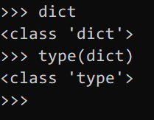
Oop-Klass Model——bring up problem
However, what about 'dict' itself in CPython?
So, PyDict_Type serves as both the vtable for dictionary objects within the interpreter and the type object (what we refer to as the class object for dictionaries) in the Python ecosystem.
python/cpython/Python/bltinmodule.c
//...
SETBUILTIN("False", Py_False);
SETBUILTIN("True", Py_True);
SETBUILTIN("bool", &PyBool_Type);
SETBUILTIN("dict", &PyDict_Type);
SETBUILTIN("float", &PyFloat_Type);
SETBUILTIN("int", &PyLong_Type);
SETBUILTIN("list", &PyList_Type);
// ...
PyDict_Type
(vtable for dict objects)

Slide 5
Oop-Klass Model——improvement
Since I think this design can easily lead to confusion and is difficult to maintain, I try to introduce the Oop-Klass model into WinPython.
<class 'type'>
TypeKlass
C++ World
Python World
instance
derive
(super)
<class 'object'>
ObjectKlass
virtual void print(PyObject*, int);
virtual PyObject* len(PyObject*);
virtual PyObject* subscr(PyObject*, PyObject*);
virtual void store_subscr(PyObject*, PyObject* , PyObject*);
virtual void delete_subscr(PyObject*, PyObject*);
instance
derive
(super)
two-way
binding
d = {'a':1,'b':2,'c':3}
instance
<class 'dict'>
DictKlass
Ordinary Object Pointer
virtual function table

Slide 6
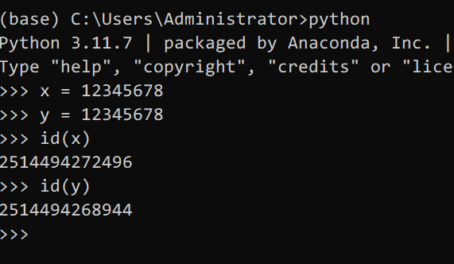
Small Integers
python/cpython/Objects/longobject.c
PyLongObject * _PyLong_New(Py_ssize_t size) {
assert(size >= 0);
PyLongObject *result;
if (size > (Py_ssize_t)MAX_LONG_DIGITS) {
PyErr_SetString(PyExc_OverflowError,
"too many digits in integer");
return NULL;
}
Py_ssize_t ndigits = size ? size : 1;
result = PyObject_Malloc(offsetof(PyLongObject, long_value.ob_digit) +
ndigits*sizeof(digit));
if (!result) {
PyErr_NoMemory();
return NULL;
}
// ...
As we know, CPython treats integers as Python objects, and they have to be allocated in heap...

Slide 7
Small Integer——bring up problem
This has led to at least two issues in CPython:
1. During the process of performing mathematical calculations, a large number of temporary integer objects will be created, which costs much time.
2. For some data structures(like List in Python), CPU's data cache is difficult to function effectively.

Slide 8
Small Integer——bring up problem
✔friendly with CPU data cache
/* In C/C++ */
int my_vector[] = {1, 2, 3, ...};
for (int i = 0; i < n; ++i) {
// do something with my_vector[i]
}
# In CPython
my_vector = [1, 2, 3, ...]
for i in range(len(my_vector)):
// do something with my_vector[i]
×unfriendly with CPU data cache

Slide 9
Small Integer——improvement
To solve this problem, I proposed the concept of small integers (Smis), which are signed integers that occupy 63bits, to replace traditional integer objects in CPython.
In WinPython, objects are allocated in the heap at addresses aligned by 8 bytes, which allows we to use its 3 least bits for tagging.
So I decided to use the least significant bit to distinguish Smis from heap object pointers.
|----- 64 bits -----|
Heap Pointer: |_____address______0|
Small Integer: |___int63_value____1|

Slide 10
Small Integer——implementation & disadvantage
WinPython/framework/Universe.hpp
#define isPyInteger(x) ((uintptr_t)(x) & 1)
#define toRawInteger(x) ((int64_t)((int64_t)(x) >> 1))
#define toPyInteger(x) ((PyObject*)(((uintptr_t)(x) << 1) | 1))
WinPython/framework/interpreter.cpp
case ByteCode::Binary_Multiply:
rhs = POP();
lhs = POP();
// deal with the situation of multiply two integer.
if (isPyInteger(lhs) && isPyInteger(rhs)) {
PUSH(toPyInteger(toRawInteger(lhs) * toRawInteger(rhs)));
}
// deal with other situations like [1,2,3]*3
else {
PUSH(lhs->mul(rhs));
}
break;

Slide 11
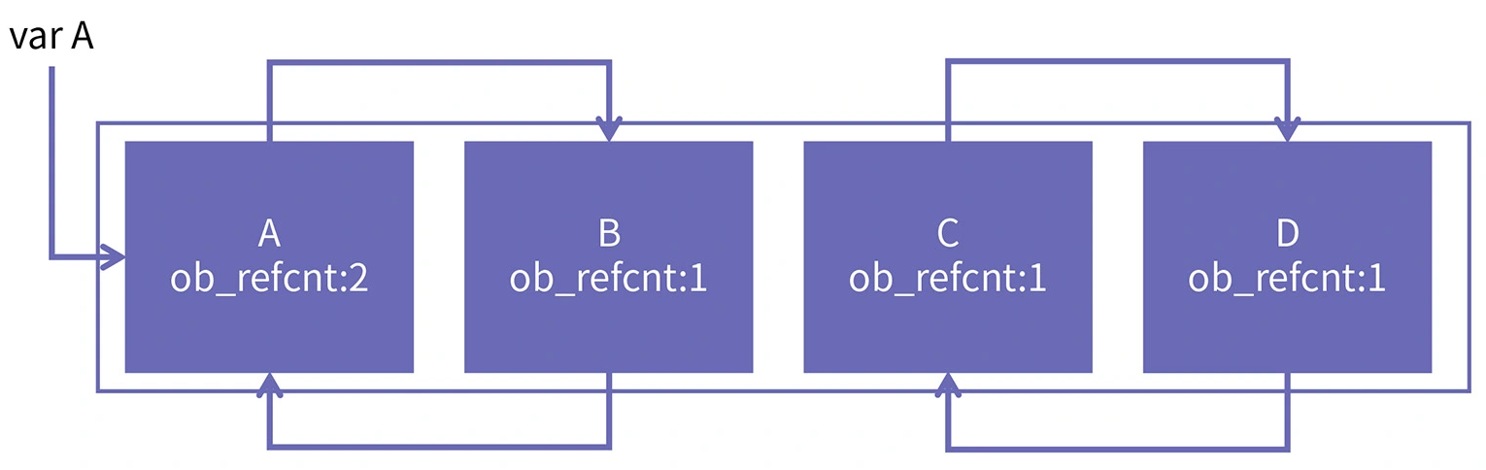
Copy Garbage Collection——bring up problem
As we know, CPython uses reference counting internally to implement automatic memory management. And it has a large flaw...
While the latest version of CPython has effective means of handling cyclic references, I still want to explore if there is a method to eradicate this issue.
class Base:
pass
A = Base(); B = Base()
C = Base(); D = Base()
var_A = A
A.ref = B; B.ref = A
C.ref = D; D.ref = C

Slide 12
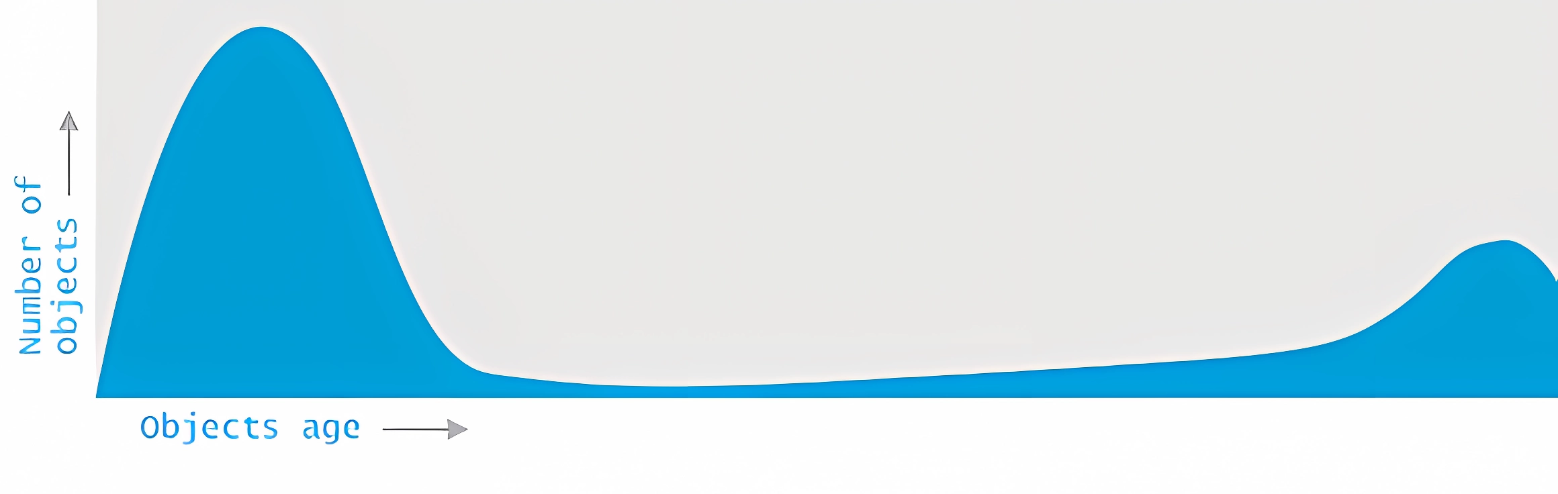
Copy Garbage Collection——idea
The Generational Hypothesis: Most objects in memory tend to die young, meaning they are short-lived and are often collected soon after being allocated.

Slide 13
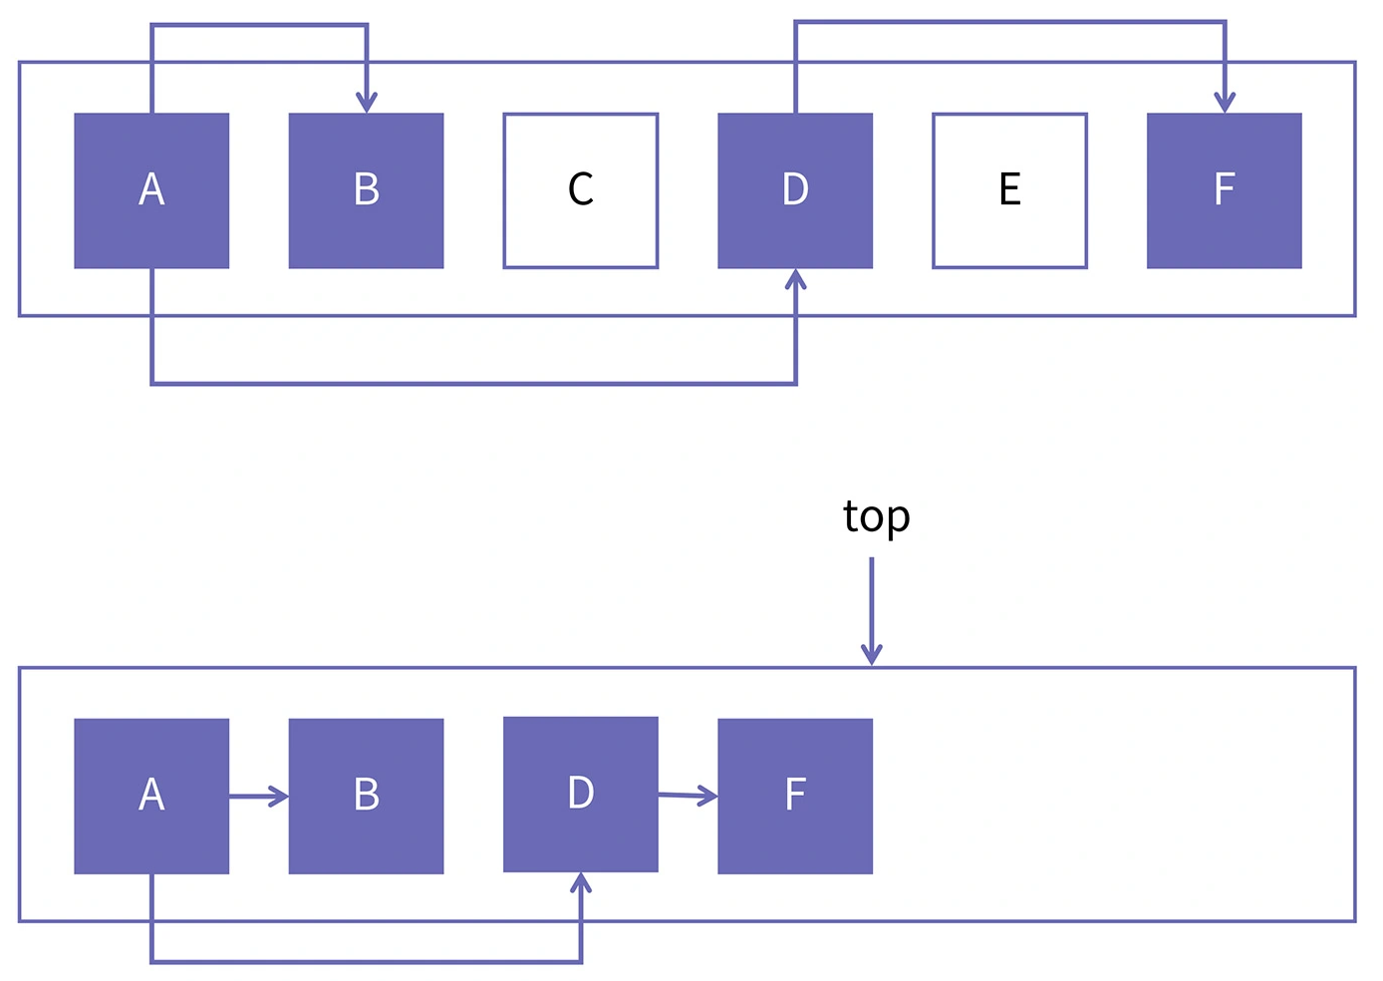
Copy Garbage Collection——idea
Split the heap space into the eden space and the survivor space.
We allocate Python objects in the eden space.
When the eden space is full, we just copy all the accessible objects into the survivor space, and turn it into the new eden space.
Finally, we clear the old eden space, and turn it into the new survivor space.
Repeat the above...

Slide 14
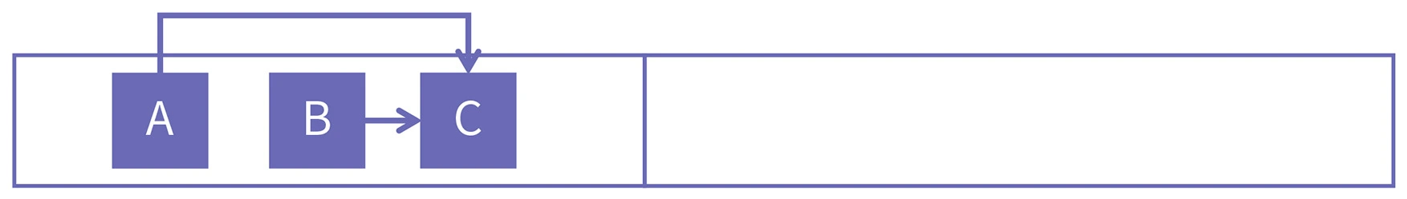
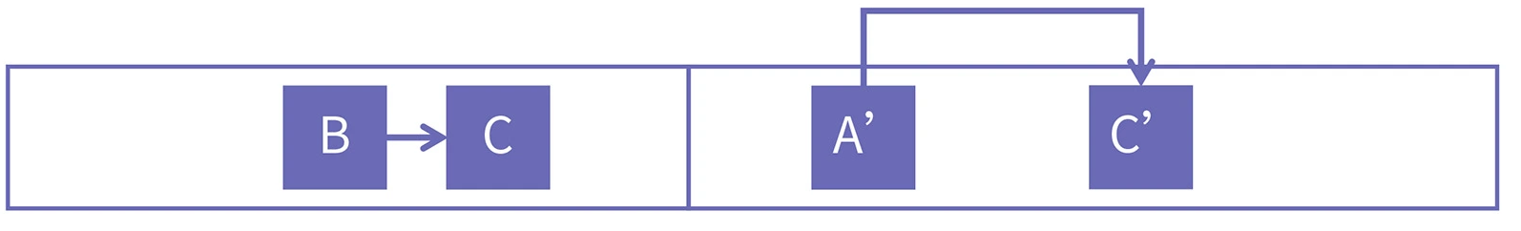
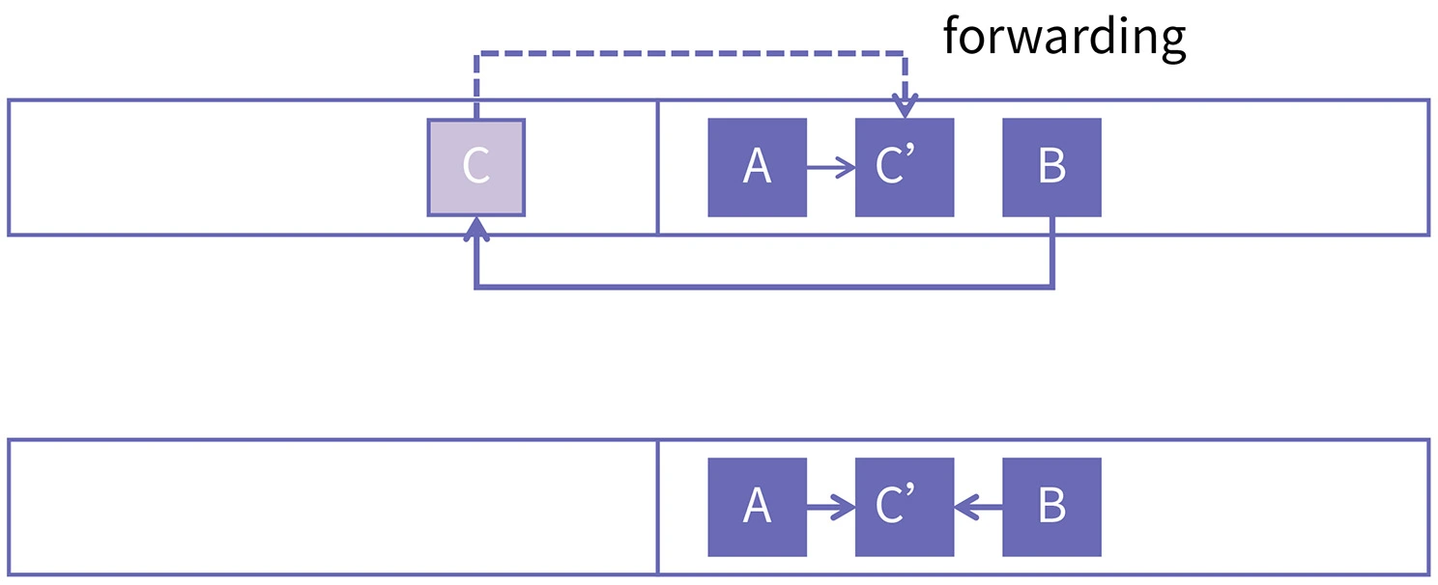
Copy Garbage Collection——implement
class PyObject {
// store forwarding pointer here
uintptr_t _mark_word;
// get/set forwarding pointer
void* getNewAddr();
void setNewAddr(void*);
// get the size of python object
size_t getSize();
GC Root
void ScavengeOopClosure::scavenge() {
process_roots();
while (!_oop_stack->isEmpty()) {
PyObject* object = _oop_stack->pop();
if (...) object->oops_do(this);
}
}
void ScavengeOopClosure::process_roots() {
Universe::oops_do(this);
Interpreter::getInstance()->oops_do(this);
}

Slide 15
Copy Garbage Collection——disadvantages
After completing the development of WinPython, I reflected and realized that my Copy GC algorithm still has the following shortcomings, which are obvious in recursive programs:
1. Old generation objects generated during the user program's execution will be repeatedly copied.
2. For complex user programs, the time taken for DFS search during each copy operation will be lengthy, leading to "world pause" in the user program.

Slide 16
What's more
One of the main goals for developing WinPython is to provide a powerful platform for undergraduate computer science students to explore and learn the basic principles of how Python language work.
Therefore, after the end of this semester, I will publish the source code of the WinPython project.
Welcome to follow
https://github.com/WU-SUNFLOWER

Slide 17
