Slide 1
Decentralized Formation Tracking Control of Multiple Homogeneous Agents
김상훈 (2006-23150)
제어 및 동역학 연구실 전기공학부
2008.5.30

Slide 2
Goal
Contents
Formation Representation
Formation Tracking Prob.
Feedback Linearization
Repres. of Multiple System
Error Dynamics
Characteristic Eq.
Tracking Stability
Permutation of Agents
Weighted Graph Matching
Example of Mobile Robots
Simulation Results
Formation
of
Multiple Agents
Permutation of Agents
Nonlinear Systems
Homogeneous
Output Tracking
Input-Output Feedback Linearization
Variation of Output Tracking Control for a Single Agent
Decentralized Controller
Each agent refers to the outputs of only its neighborhoods

Slide 3
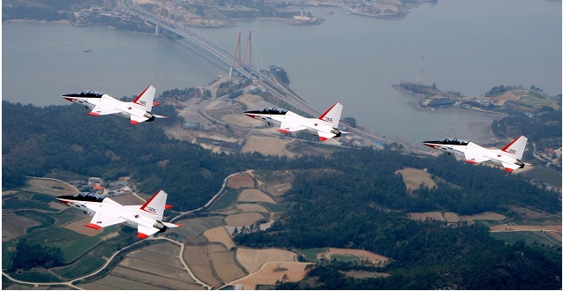
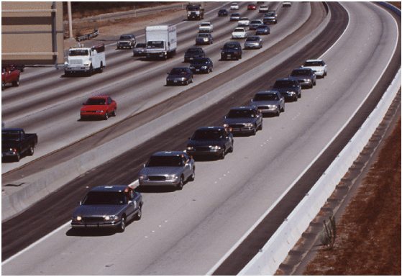
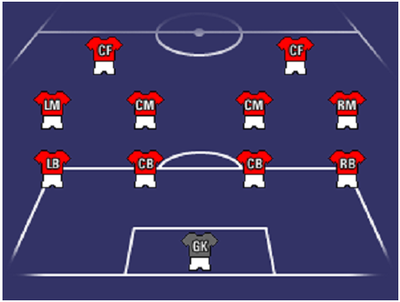
Formation
Formation commonly indicates a configuration of some agents in the sense of position or location while aiming to coordinate a shared operation among the agents.
Notes:
일반적으로 생각하는 formation이란 이런 것…
수학적으로 정확하게 표현해보자.

Slide 4
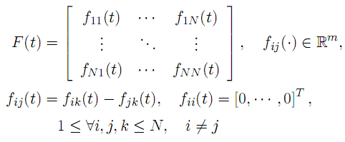

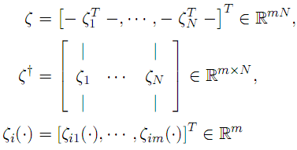
Mathematically, Formation is
Formation Matrix
Formation Vector
mN × N matrix
mN –dim vector
Notes:
Formation은 여러 Agent간에 Matrix 또는 Vector 형태로 표현된 위치에 관한 상대적 출력을 만족하는 상태를 가리킴

Slide 5
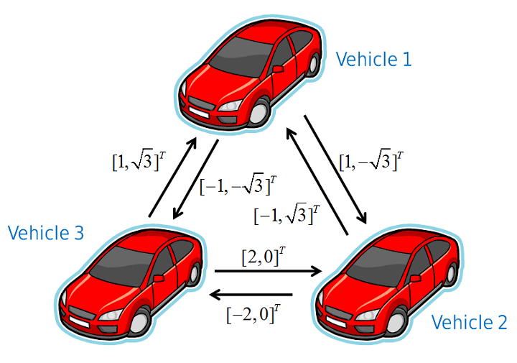
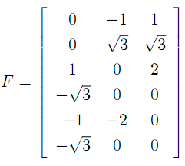
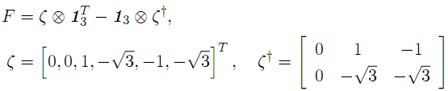
Example Formation Matrix and Vector

Slide 6
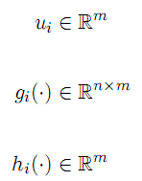
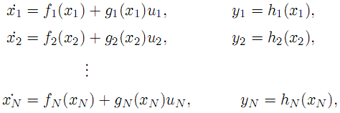
Formation Tracking Problem
For the collection of agents
Formation tracking problem is to design a controller with the property that the outputs of the agents satisfy
Notes:
우리는 dynamics가 동일한 homogeneous한 경우만 다루겠다.

Slide 7



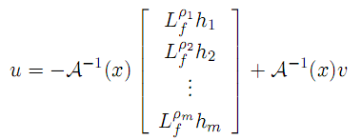
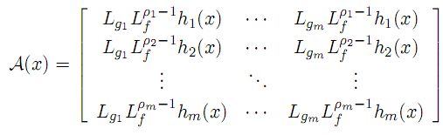

State Feedback Input-Output Linearization
when the vector relative degree
is well defined.
Notes:
Relative degree/ zero dynamics/ A B C의 형태 언급

Slide 8
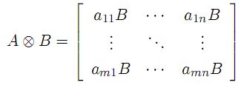
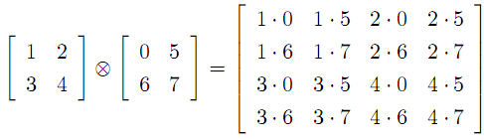




Representation of Multiple Agents Kronecker Product
The Collection of N systems
Output manipulation among N systems

Slide 9
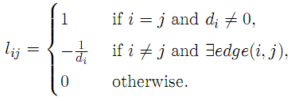
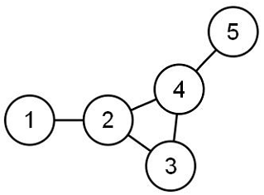
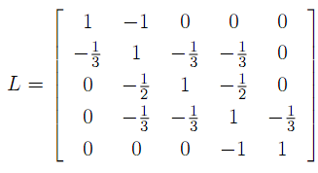
Representation of Multiple Agents Laplacian Matrix
Laplacian Matrix

Slide 10

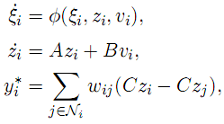
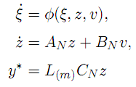
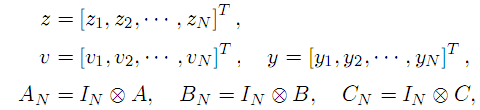

Representation of Multiple Agents For our system (THM3.22)

Slide 11

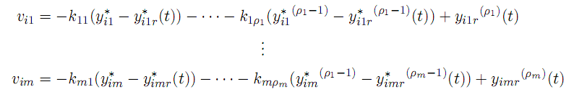
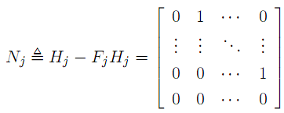



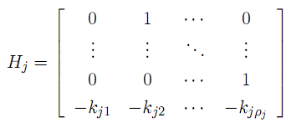
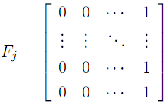
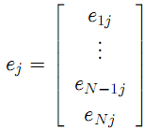
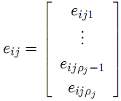
Error Dynamics
Page 32-33
Notes:
i : agent index, j : output index, k : relative degree

Slide 12

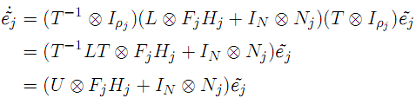

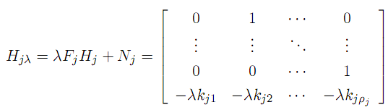
Characteristic Equation
Schur’s Triangularization
T - real orthogonal
U - upper triangular with the same λ(L)
Similarity Transformation
Characteristic Equation
Notes:
Stability를 알아보기 위하여 Characteristic Equation을 구한다.
(U… Nj) 행렬을 정리하면 Hjlambda 의 블록대각행렬이다.
이것의 고유다항식을 구하면 각 블록의 행렬식의 곱으로 표현되고 각 블록의 행렬식은 슬라이드 중앙 오른쪽과 같다.

Slide 13

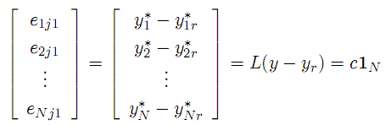

Formation Tracking Stability
1) 2)
Hurwitz Polynomials
, Invariant points of system → Origin only
Asymptotically Stable
To find the invariant points
→ Assumption
→ Assumption

Slide 14

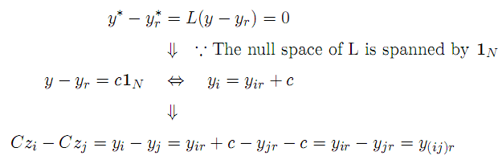

Formation Tracking Stability
So far,
Therefore,

Slide 15
Connectivity of Agents Null space of L and its Dimension
Theorem 3.18
Strongly Connected Graph → Null space of its L is spanned by a single positive vector.
Theorem 3.19
Graph which has a Single Leader Component → Left null space of its L includes a nonnegative vector except the zero.

Slide 16
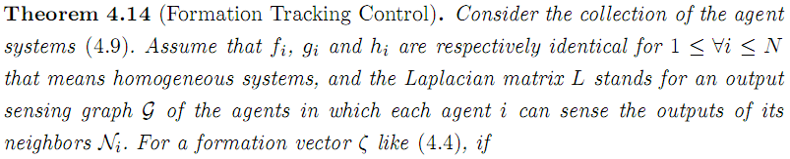
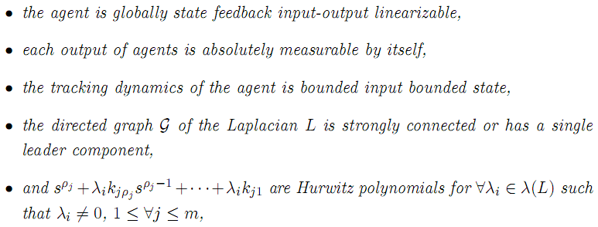
Formation Tracking Theorem

Slide 17

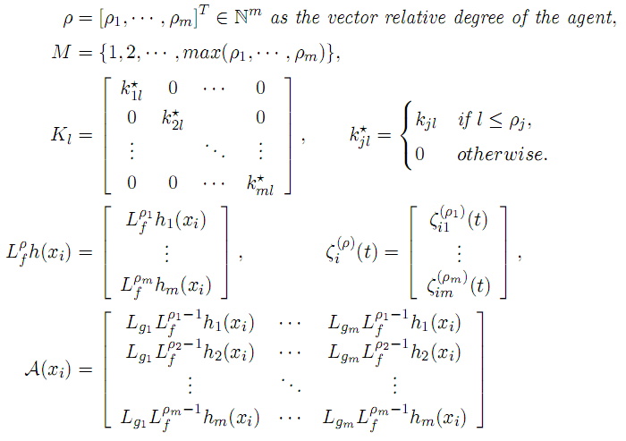

Slide 18
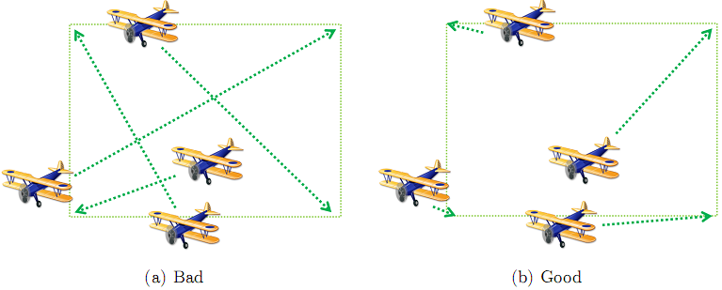
Permutation of Agents
Permutation invariant formation tracking problem is to design a controller with the property that the outputs of the agents satisfy
where the function p is bijective from [1,N] to [1,N].

Slide 19
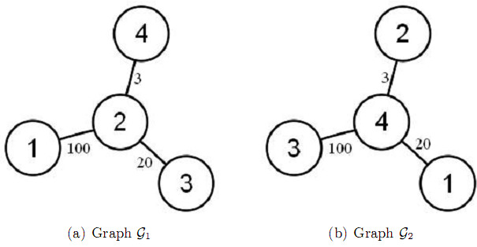


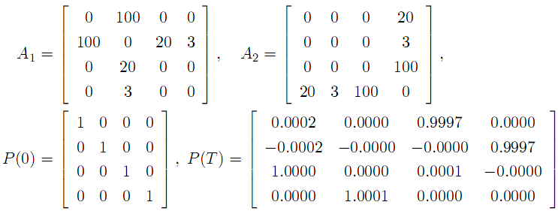
How to get a permutation function p Weighted Graph Matching Problem
Weighted Graph Matching Problem
Find P s.t.
Variation (Theorem 3.9 in [34])
Dynamically Find approximated P s.t.
Ex.

Slide 20
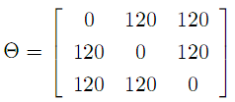

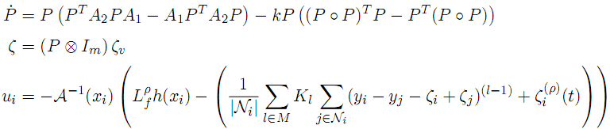
Graph Configuration Nearness in the sense of the included-angle matching
Ex.
A1
A2
Permutation Invariant Formation Tracking (Theorem 4.29)
Notes:
A1 원하는 Formation이 되었을 때 Included Angle Matrix
A2 초기 위치에서 만든 Included Angle Matrix

Slide 21
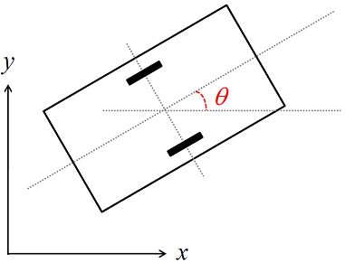


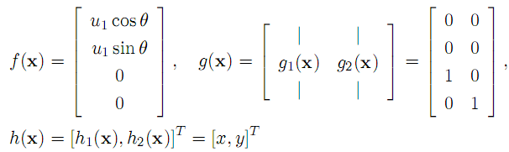

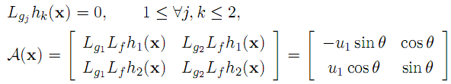
Example Model of Mobile Robot
u1 : Velocity of the wheels
u2 : Velocity of the angle
Model of Mobile Robot
Well Defined Relative Degree

Slide 22
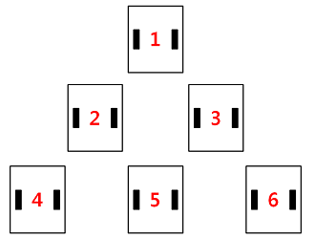

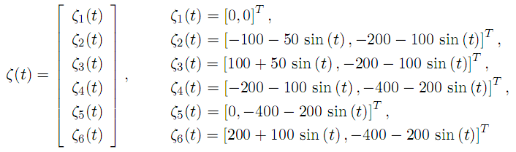
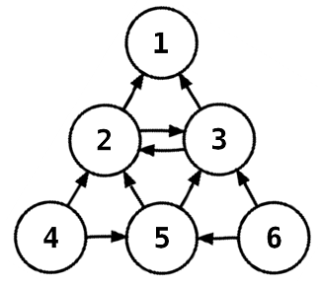

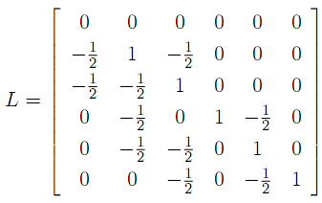

Example Formation Configuration
Triangular Formation
Connectivity of Agents

Slide 23


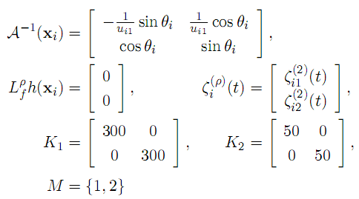
Example Decentralized Formation Tracking Control
such that
Hurwitz Polynomials

Slide 24
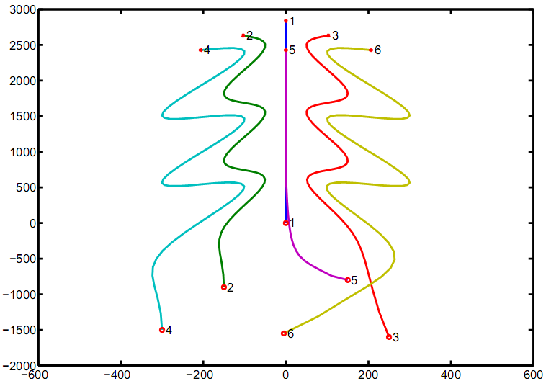
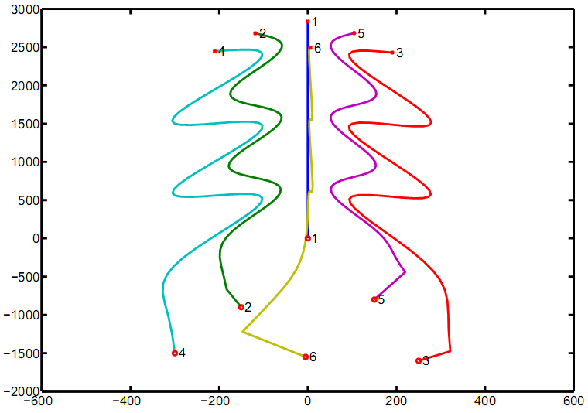
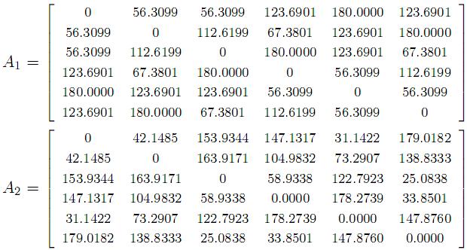
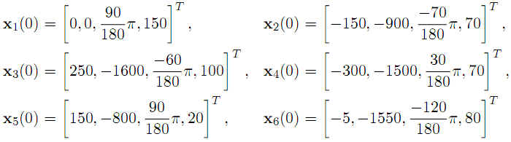
Example Simulation Results

Slide 25


Example Simulation Results 2

Slide 26
Conclusion
We’ve studied a formation tracking of multiple homogeneous nonlinear systems.
Formation Representation
State Feedback Input-Output Linearization
Dealing with Multiple Agents
Stability Condition
Decentralized Controller
Permutation of Agents
Verification via Simulation of Mobile Robots

Slide 27


FAQ
Rotation of Formation
Limitation of a Weighted Graph Matching
Trajectory of an assignment dynamics P

Slide 28






Theorem 3.22 Proof

