Slide 1
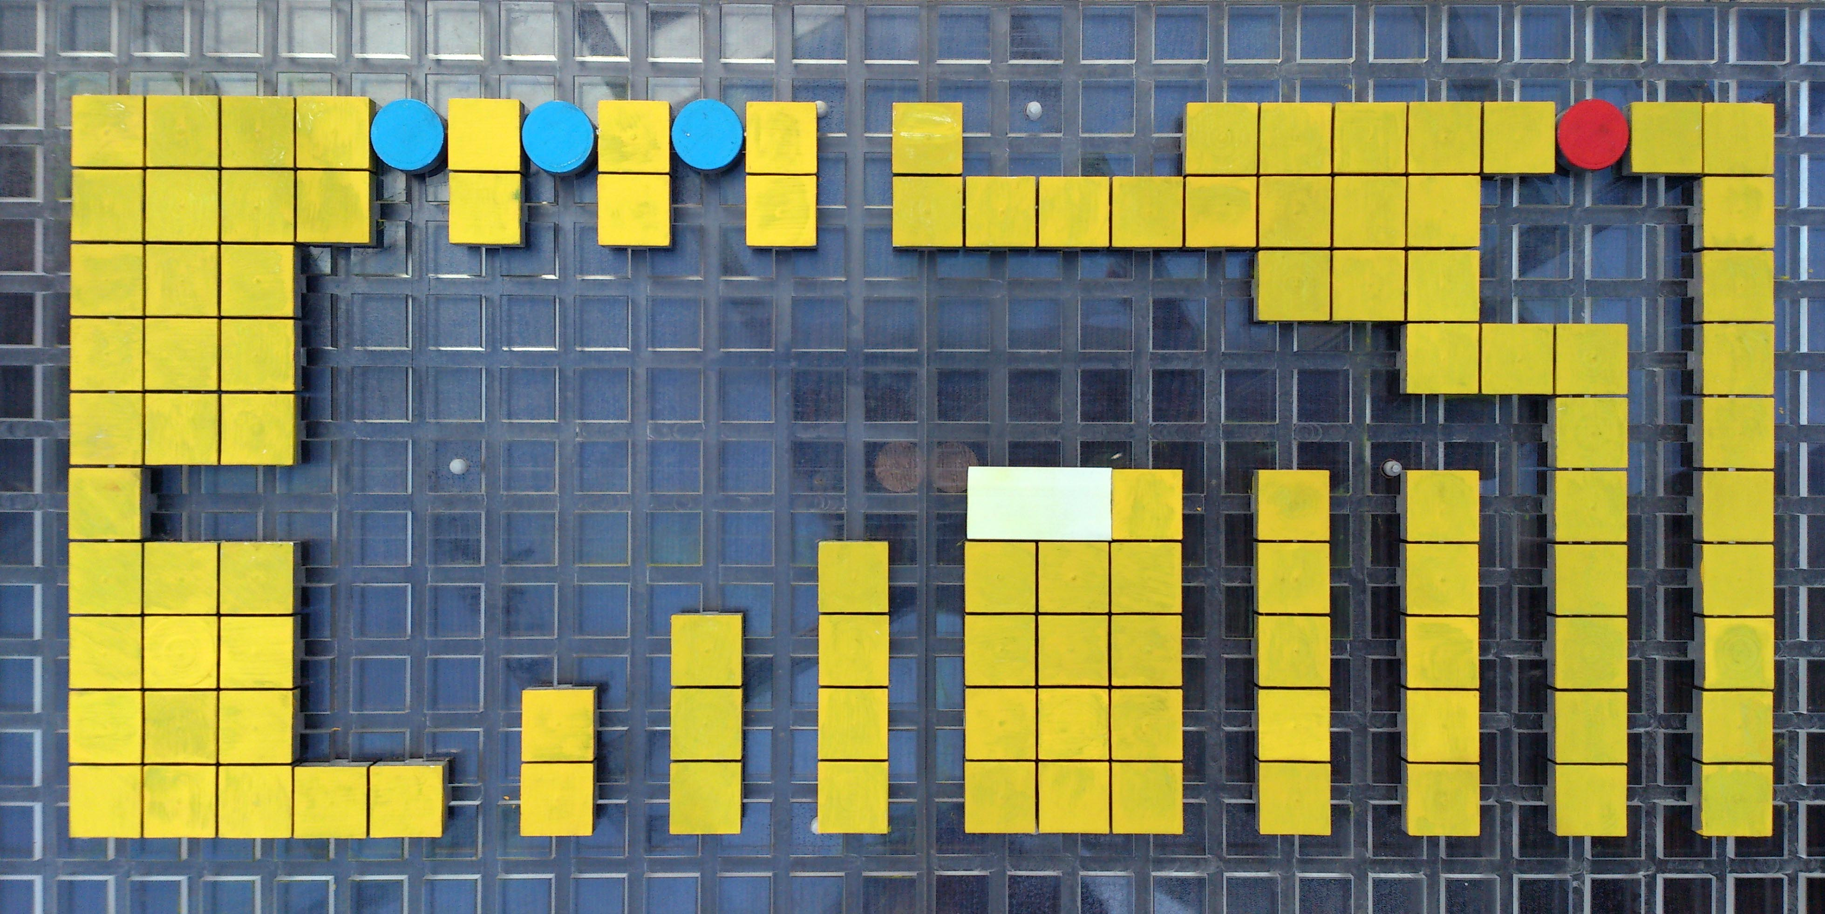
_
1
1
1
A
A
_
_
_
_
A
A
A
A
A
A
A
A

