Slide 1
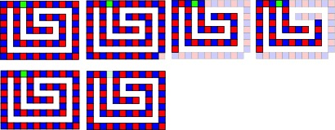
Initial
A.1
Initial
B.1
B.26
B.30
Deconstruction order matters. In the top row, the green tile is removed first, resulting in a polyomino that cannot be decomposed. However, if the bottom right tile is removed first, deconstruction is possible

