Slide 1
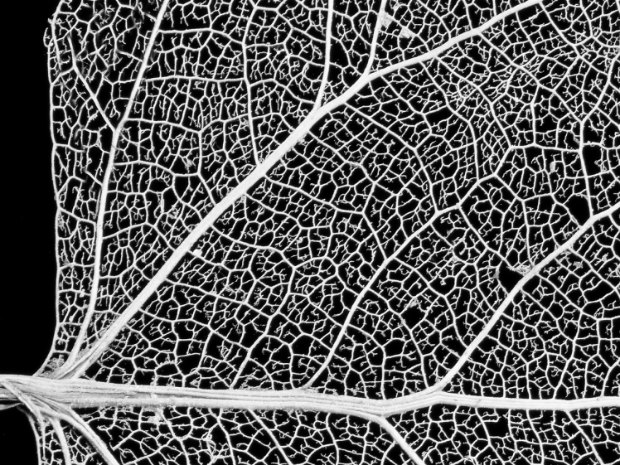
Tumor
Notes:
Start with filled in circles spread out
Make goal in upper left (a tumor shape)

