Slide 1
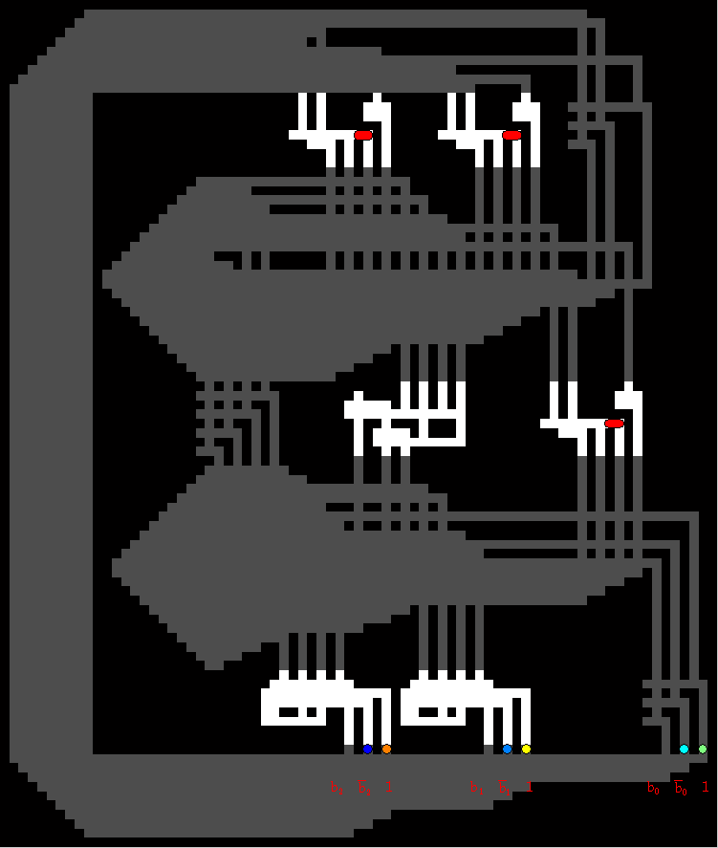
Fan-Out gates (3)
2x1 sliders (3)
Wire buses
Carry gate (1)
Summer gate (2)
1x1 particles (4)

