Slide 1
GIFT LANE / MINI-PROJECT 01
Customers
Like You
Retail recommendations and customer groups
using PCA and Truncated SVD
THE DECISION
Keep best sellers until personalization improves.
Sparse purchases → latent factors
Individual project • 13 October 2026

Slide 2
STAKEHOLDER REQUEST
MINI-PROJECT 01 / 02
Two business questions, one measurement-driven pilot
01 Product recommendations
02 Marketing segments
Can a compact customer–product representation generate useful “customers also bought” suggestions?
Can customer purchase patterns be summarized in a simple map with understandable groups?
Success means more than a smaller model
SMALLER
FASTER
MORE ACCURATE
ACTIONABLE
Yes
Promising
Not yet
Exploratory
1.83 MB factors
0.129 s compute*
24.05% vs 26.87%
4 customer groups
* Model fit + neighbor refresh + test-customer scoring; excludes Excel reading and disk I/O.
UCI Online Retail II (Chen, 2012) • Train-only model, future-purchase holdout
2 / 8

Slide 3
DATA ENGINEERING
MINI-PROJECT 01 / 03
From transactions to a leak-free purchase matrix
RAW LOG
CLEAN SALES
TRAIN MATRIX
FINAL HOLDOUT
1,067,371
801,559
5,473 × 3,684
1,913
›
›
›
invoice lines
valid invoice lines
customers × products
eligible customers
2 annual sheets
non-purchases excluded
97.95% zeros
44,714 novel item pairs
Cleaning rules
No future leakage
Remove cancellations, nonpositive quantities/prices, non-product codes, and missing customer IDs. Keep only paid, identifiable product purchases.
Last two months held out before fitting. Test targets are products each eligible customer had not previously bought.
Training cutoff: 9 Oct 2011, 12:50 • Purchase value: binary (ever bought)
UCI Online Retail II (Chen, 2012) • Train-only model, future-purchase holdout
3 / 8

Slide 4
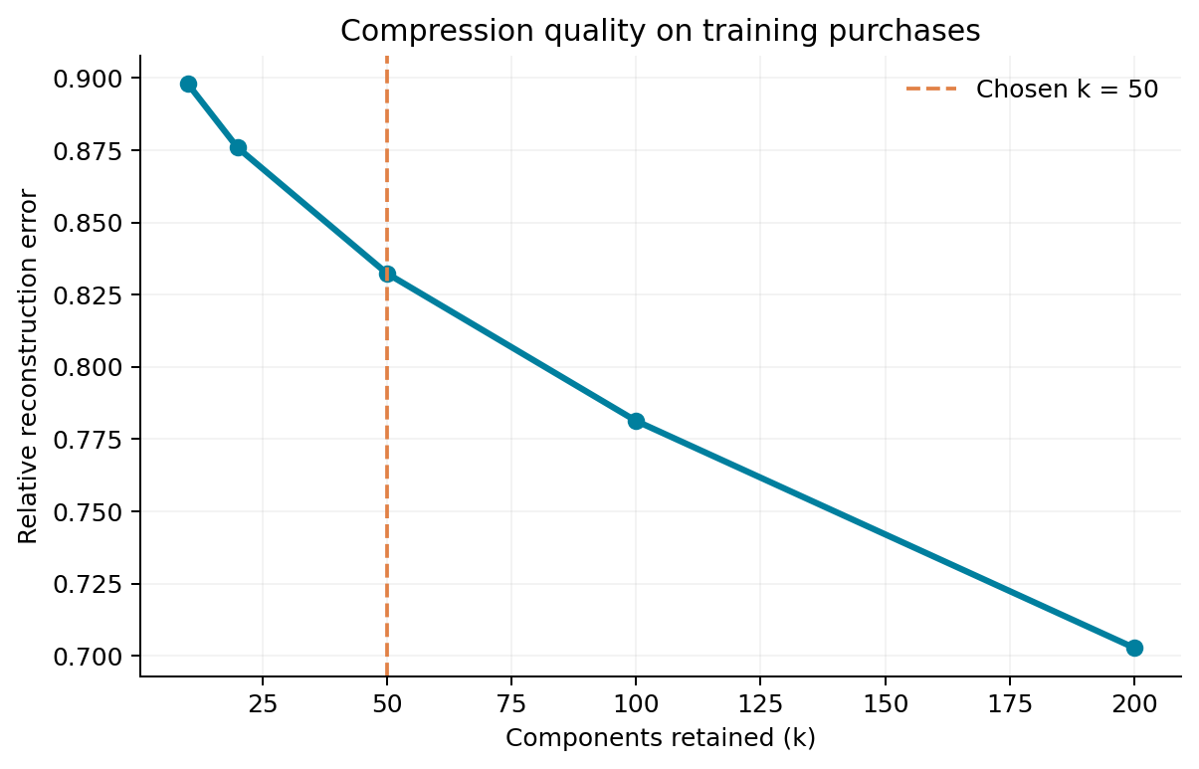
METHOD CHOICE
MINI-PROJECT 01 / 04
Why Truncated SVD, and why 50 components?
MAIN MODEL: SVD
Sparse by design
SVD operates on the original sparse purchase matrix without subtracting product means.
k = 50
Relative reconstruction error 0.832
More components reduce information loss but require greater storage and computation.
Rank chosen as a fixed compact setting, not a validation-optimized parameter.
UCI Online Retail II (Chen, 2012) • Train-only model, future-purchase holdout
4 / 8

Slide 5
PCA VS SVD
MINI-PROJECT 01 / 05
SVD is slightly leaner; PCA is marginally more accurate
Metric
Truncated SVD
PCA
Stored data size
Fit time (seconds)
0.0569
0.0853
Dense matrix
161.30 MB
Observed peak process RSS
448.84 MB
467.89 MB
Factor storage (float32)
1.831 MB
1.846 MB
Sparse matrix
3.33 MB
Relative reconstruction error
0.8323
0.8316
SVD factors
1.83 MB
Explained variance
27.30%
27.41%
Hit rate @ 10
24.05%
24.10%
88× smaller
than a dense float64 matrix
“Peak memory” is process-wide RSS, not method-only memory.
UCI Online Retail II (Chen, 2012) • Train-only model, future-purchase holdout
5 / 8

Slide 6
RECOMMENDATION EVALUATION
MINI-PROJECT 01 / 06
The best-seller baseline wins on future purchases
Test: 1,913 eligible customers · Success = at least one held-out new product in top 10 · Purchased items excluded
30%
26.87%
−2.82 pp
24.05%
24.10%
SVD vs. baseline
20%
10%
0%
Best sellers
Truncated SVD
PCA
514 customers hit
460 customers hit
461 customers hit
No replacement recommendation: model does not improve Hit@10 on this holdout.
UCI Online Retail II (Chen, 2012) • Train-only model, future-purchase holdout
6 / 8

Slide 7
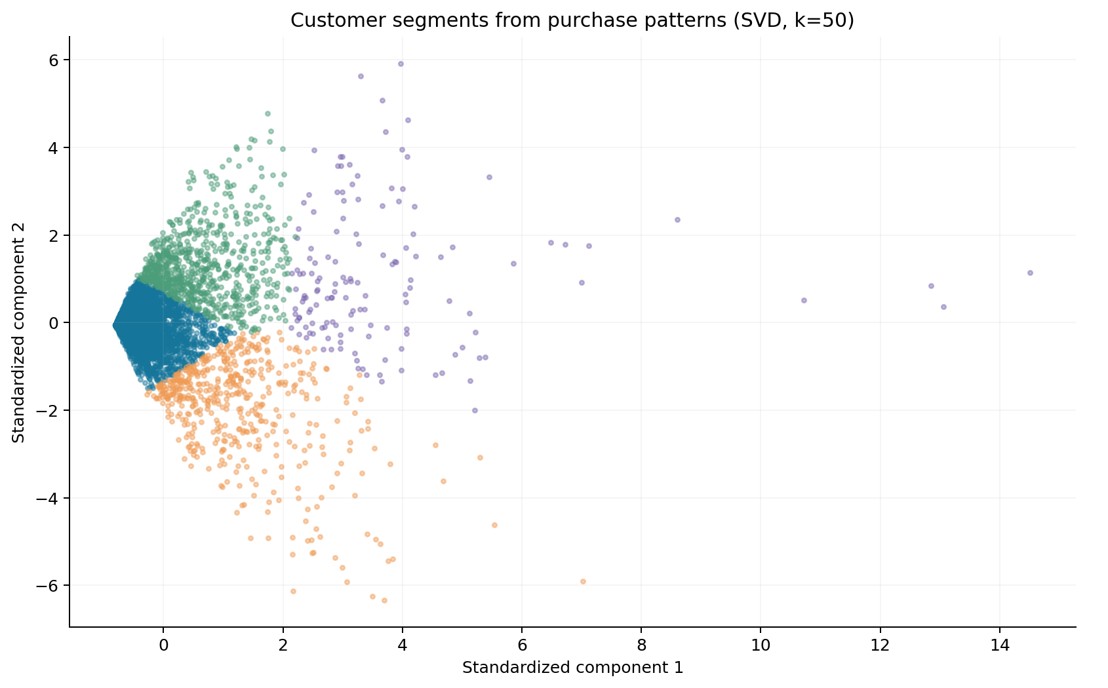
CUSTOMER SEGMENTS
MINI-PROJECT 01 / 07
Four exploratory customer groups for marketing
Occasional mixed-gift
4,026 · 73.6%
Heart holders • gift assortment
Lunch-bag & partyware
510 · 9.3%
Lunch bags • party supplies
Broad-catalog gifts
145 · 2.6%
Wide variety of product types
Home decor regulars
792 · 14.5%
Wicker hearts • home accents
Segment names are hypotheses based on training purchases; the majority of each group is UK-based.
UCI Online Retail II (Chen, 2012) • Train-only model, future-purchase holdout
7 / 8

Slide 8
DECISION & NEXT STEPS
MINI-PROJECT 01 / 08
Keep the baseline; use SVD as a research foundation
RECOMMENDATION
Do not deploy SVD recommendations as a replacement yet.
WHAT WORKED
WHAT DID NOT
WHAT COULD GO WRONG
Compact representation: 1.83 MB factors; SVD fits quickly on this sparse matrix. Four interpretable cluster hypotheses.
Hit@10 fell from 26.87% (best sellers) to 24.05% (SVD). Relative reconstruction error 0.832 signals lost detail.
Cold-start customers/products; nonrandom missing IDs; seasonal timing; historical 2009–2011 data; weak cluster validation.
NEXT EXPERIMENT
Tune with a separate validation period; test a popularity–similarity hybrid and time-aware ranking.
Integrity: no customer IDs in this deck. Benchmarked compute excludes file loading and disk I/O.
UCI Online Retail II (Chen, 2012) • Train-only model, future-purchase holdout
8 / 8

