Slide 1
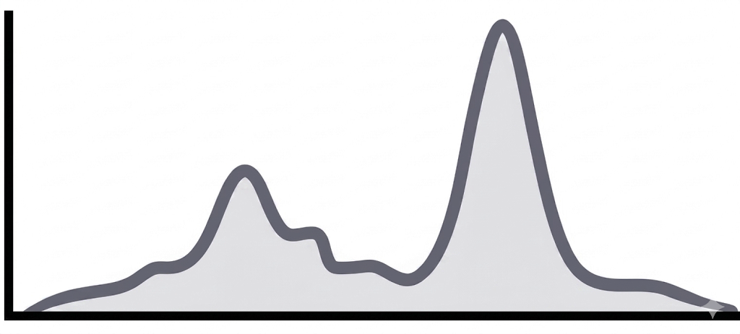
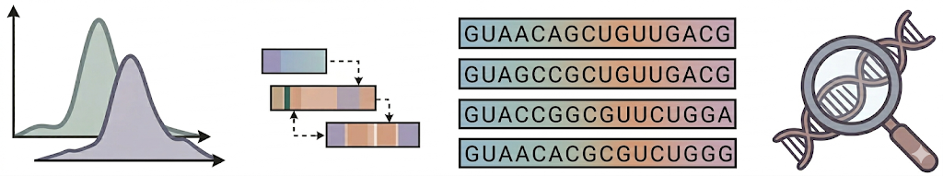
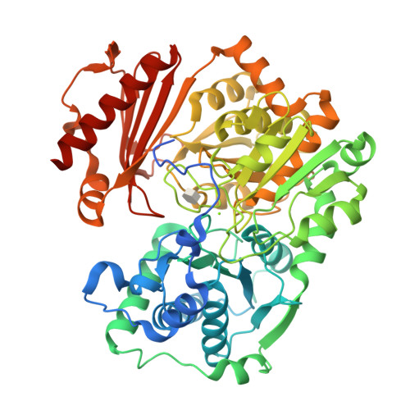
a
Input Data
Input Feature Encoding
Multi-Scale Motif & Context
Dual Output Heads
Predicted RBP
Binding Profile
Sequence
One-Hot
Profile Head
A
A
C
G
T
A
A
C
T
Bidirectional
GRU
5′
A
A
C
G
T
A
A
C
T
3′
1
1
0
0
0
1
1
0
0
0
0
1
0
0
0
0
1
0
3
Binding Profile
Logits
101 nt
0
0
0
1
0
0
0
0
0
3
Softmax × exp(z)
0
0
0
0
1
0
0
0
1
+
Concatenate
1×1 fusion
5
SE attention
5
LayerNorm
Count Head
7
Dropout
score
7
z
PhyloP Conservation Signal
5-Channel Feature
Log Total Count
b
c
Kernel size
SE attention
Bidirectional GRU
Profile Head · 1×1 conv
size = 3
Global mean pooling
1×1 · 96→64
128→64
64→32
32→1
1×1 96→24 · ReLU
Binding Profile Logits
size = 5
Concatenate
1×1 fusion · 96→96
Concat · 128
1×1 24→96 · Sigmoid
+
1×1
96→128
+
Count Head
size = 7
×
LayerNorm
Global
Mean
Pooling
128→32
32→1
Log Total Count
1×1 projection · 5→96
Dropout
d
e
Select high-IG
windows
Motif Logos
Profile Shape
Loss
α
GUAACAGCUGUUGACG
CWM
GUAGCCGCUGUUGACG
PPM
GUACCGGCGUUCUGGA
Predicted
profile
GUAACACGCGUCUGGG
enriched motif
segments
TF-MoDISCO
Ground Truth
Squared-CDF
Loss
β
Total
Loss
f
αL_{Shape}​+βL_{Jitter}​+γL_{Count}​
Identify important
motif-centered bases
Re-run prediction
γ
Ground Truth
CAUGCACAGAU
Count Loss
Enriched motif
segments
Predictions
...
Predictions
CAUGCUCAGAU
Δ mutated

