Slide 1

Fan Modeling and Controller
24th Oct 2025
Hao WU

Slide 2
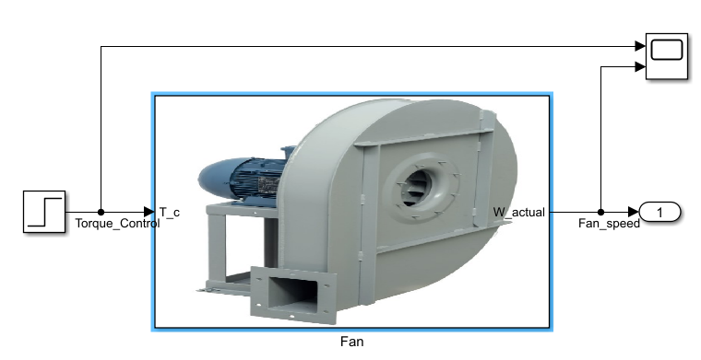
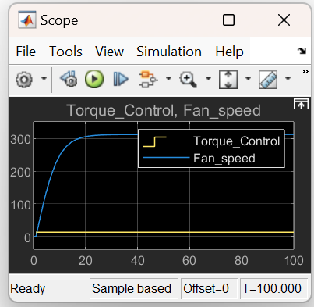
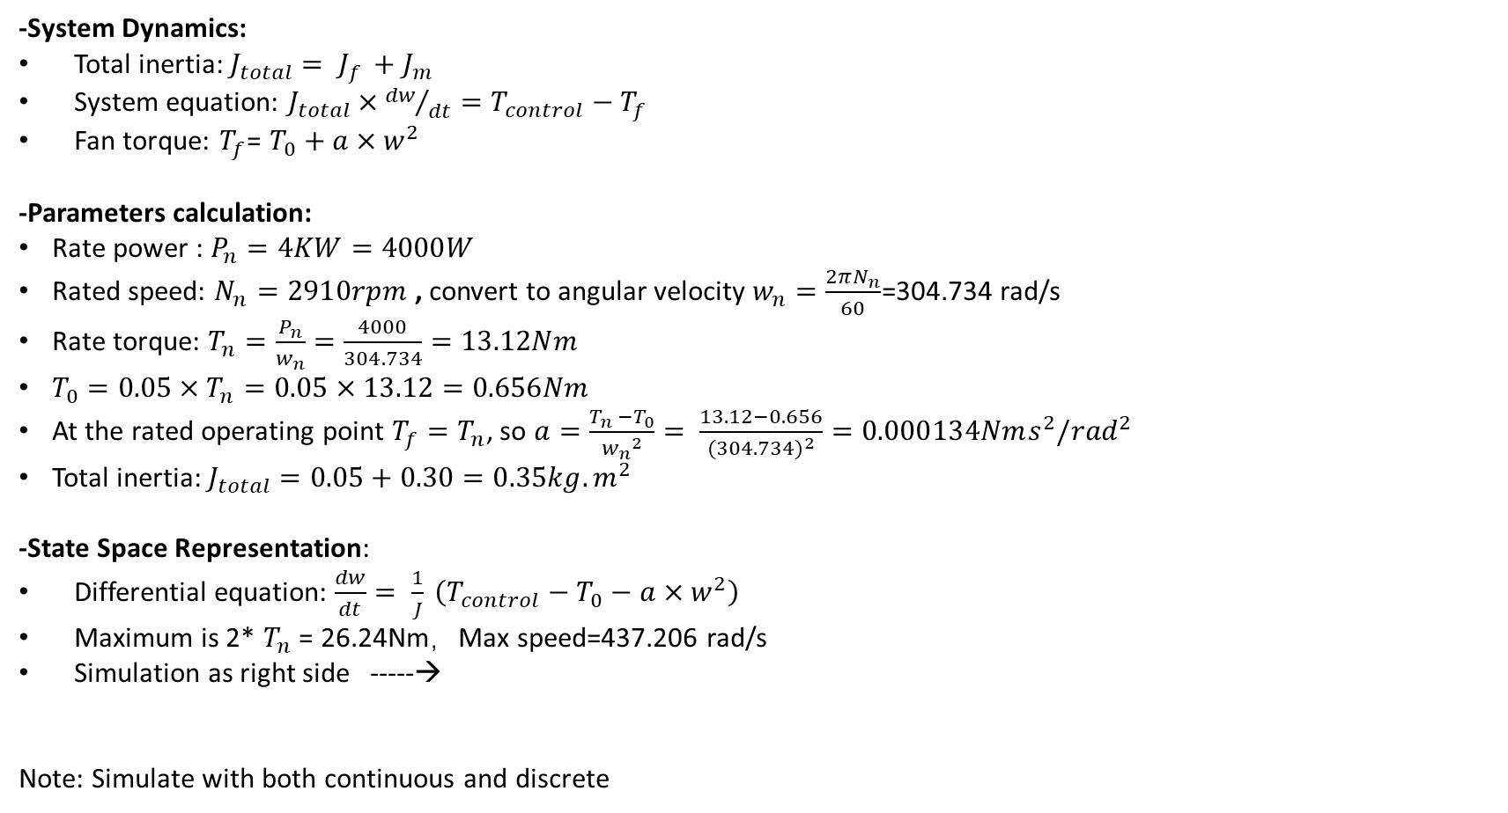
1. Fan Modeling
-System Dynamics:
Total inertia: $J_{total}= J_{f }+J_{m}$
System equation: $J_{total}×{dw}/{dt}=T_{control}−T_{f}$
Fan torque: $T_{f}$= $T_{0}+a×w^{2}$
-Parameters calculation:
Rate power : $P_{n}=4KW=4000W$
Rated speed: $N_{n}=2910rpm$ , convert to angular velocity $w_{n}=\frac{2πN_{n}}{60}$=304.734 rad/s
Rate torque: $T_{n}=\frac{P_{n}}{w_{n}}=\frac{4000}{304.734}=13.12Nm$
$T_{0}=0.05×T_{n}=0.05×13.12=0.656Nm$
At the rated operating point $T_{f}=T_{n}$, so $a=\frac{T_{n} −T_{0}}{{w_{n}}^{2}}= \frac{13.12−0.656}{{(304.734)}^{2}}=0.000134Nms^{2}/{rad}^{2}$
Total inertia: $J_{total}=0.05+0.30=0.35kg.m^{2}$
-State Space Representation:
Differential equation: $\frac{dw}{dt}= \frac{1}{J} \left(T_{control}−T_{0}−a×w^{2}\right)$
Maximum is 2* $T_{n}$ = 26.24Nm，Max speed=437.206 rad/s
Simulation as right side -----→
Note: Simulate with both continuous and discrete
- Differential equation Simulation

Slide 3
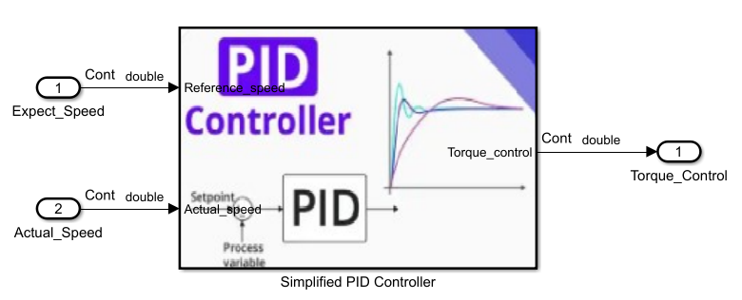
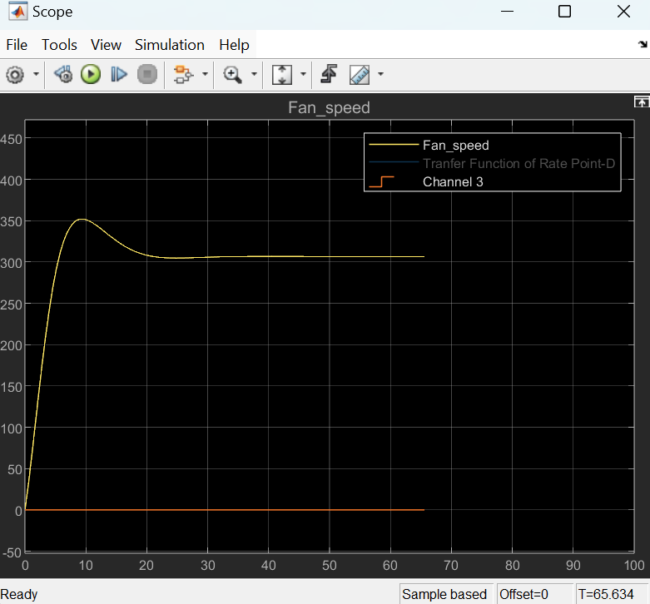
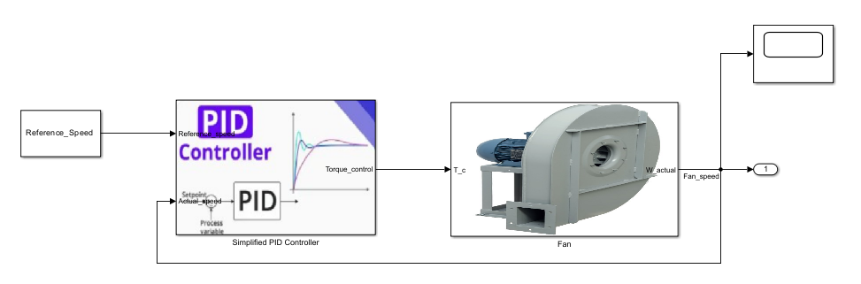

2. Fan Control
-PID Controller Design (Simplified):
Start with PI controller which should be enough at the beginning
$T_{control=}K_{p}e+ K_{i}\int{edt}$ and the ${e=w}_{ref −}w_{actual}$
Fan Control:

Slide 4
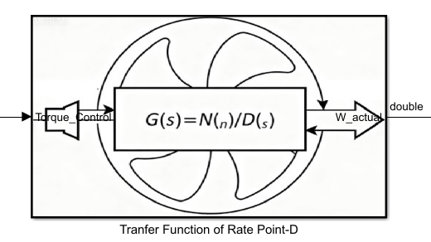

3. Fan Transfer Function
-Transfer Function:
Linearization around operating point, w0= 304.734 rad/s , T0= $13.12Nm$
Speed deviation:$δw$ = w- w0, torque deviation:$δTm=Tm −T0$
$\frac{d_{(w0+δw)}}{d_{t}}=\frac{1}{J}\left(\left(T_{0}+δT_{m}\right)−T_{0} −a{\left(w0+δw\right)}^{2}\right)$
$≫ \frac{d_{\left(δw\right)}}{d_{t}}=cδw+dδT_{m}$ , and $c=−\frac{2aw0}{J}$ , and b= $\frac{1}{J}$
Perform Laplace transform on both sides, and get below transfer function
G(s) = $\frac{b}{S−C}$ = $\frac{2.857}{S+0.2334}$
Modeling

Slide 5
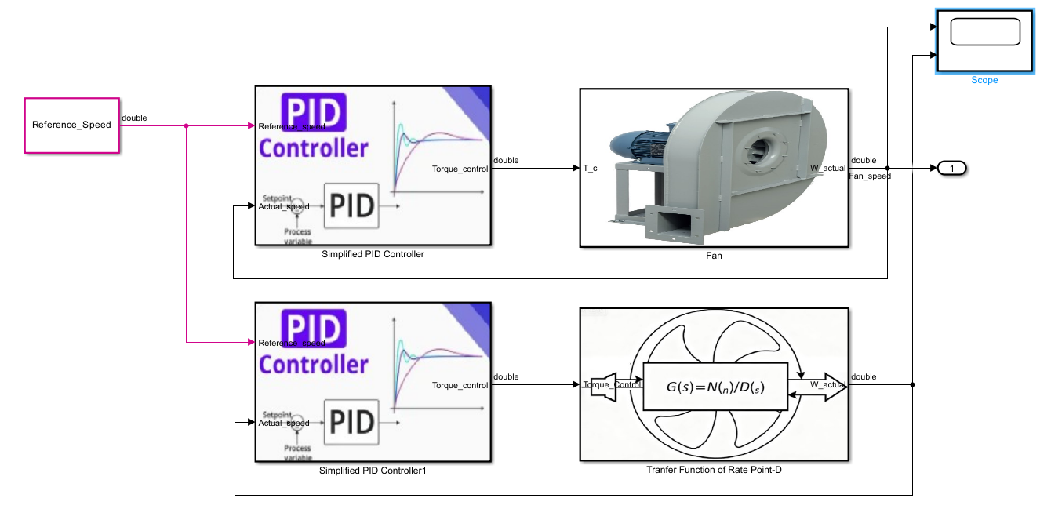
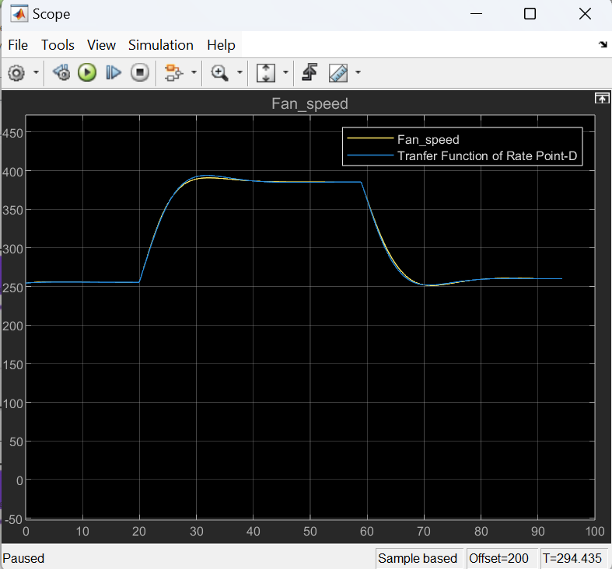
4. Fan Control with Differential Equation and Transfer Function
-Validation with differential equation:
Make modeling and compare output
Result as right graph shows

Slide 6
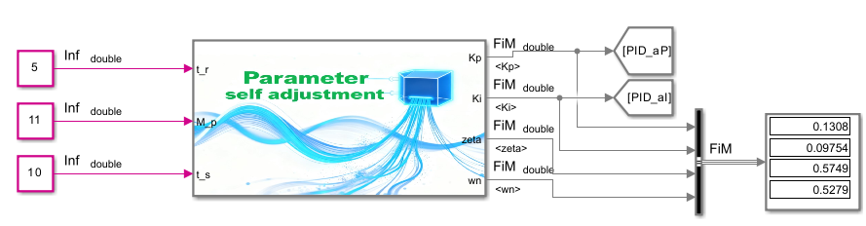

5. Controller Performance
-PI Controller + Fan Model:
PI: G1(s) = $K_{p}$ + $\frac{1}{K_{i}}S$
Fan: G2(s) = $\frac{b}{S−C}$ = $\frac{2.857}{S+0.2334}$
$G_{Open}$(S) = G1*G2
$G_{Close}$(S) = $\frac{G_{Open}}{1+G_{Open}}$ = = $\frac{bK_{p}S+bK_{i}}{S^{2}+\left(a+bK_{p}\right)S+bK_{i}}$ = $\frac{2.857K_{p}S+2.857K_{i}}{S^{2}+\left(0.2334+2.857K_{p}\right)S+2.857K_{i}}$
Frequency fn = sqrt($2.857∗K_{i}$), damping dp= (0.2334+2.857*Kp) / (2*fn)
- Target performance setting:
Rising time: RT= 1.8 /fn
Overshoot: OS=exp(-dp * pi/sqrt(1-dp*dp)) * 100%
Stable time: ST= 4/(dp * fn)
PI parameters (Simplified with limitation)
$K_{p}$ = (2 * dp * fn-0.2334)/2.857
$K_{i}$ = (fn * fn) / 2.857

Slide 7
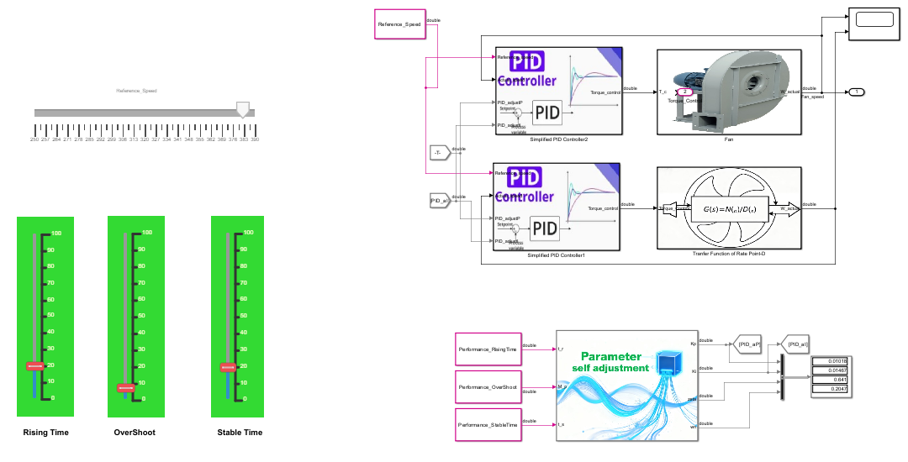
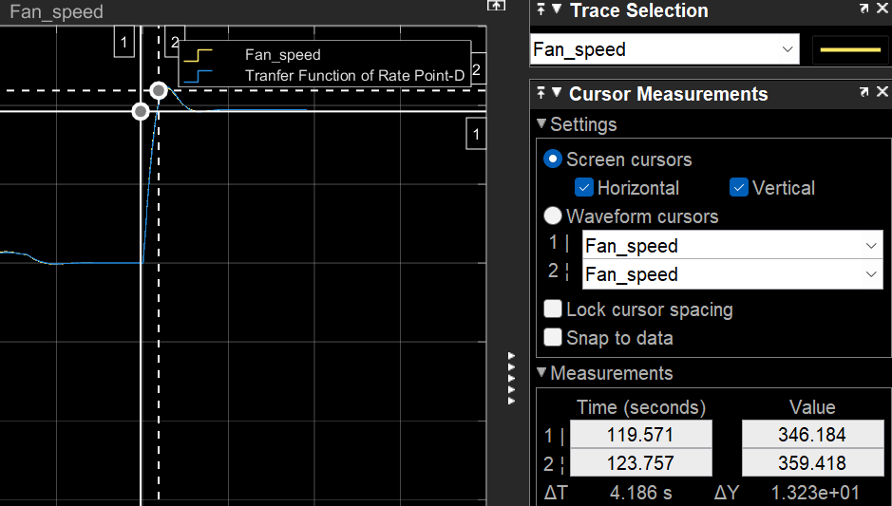
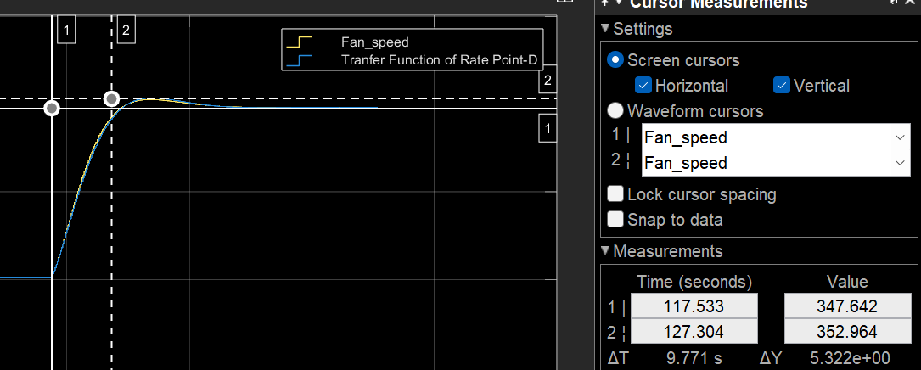
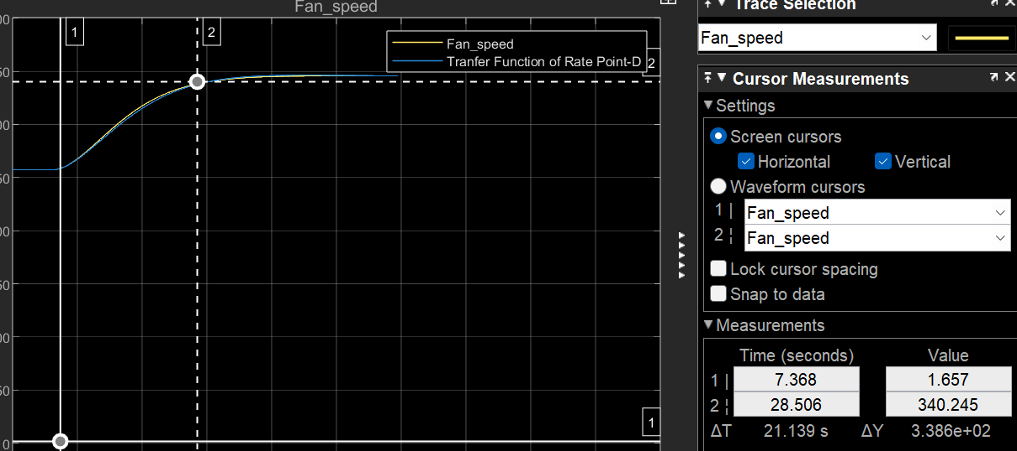
6. Controller Performance Test
1. Rising time=5s, Overshoot=10%, Stable time =10s
Result: Rising time=4.2s, Overshoot=14%， Stable time=10s
2. Rising time=10S, Overshoot=5%, Stable time =20s 3. Rising time=20S, Overshoot=5%, Stable time =30s
Result: Rising time=9.7s, Overshoot=5.3%， Stable time=22s Result: Rising time=21s, Overshoot=3.3%， Stable time=30s

Slide 8
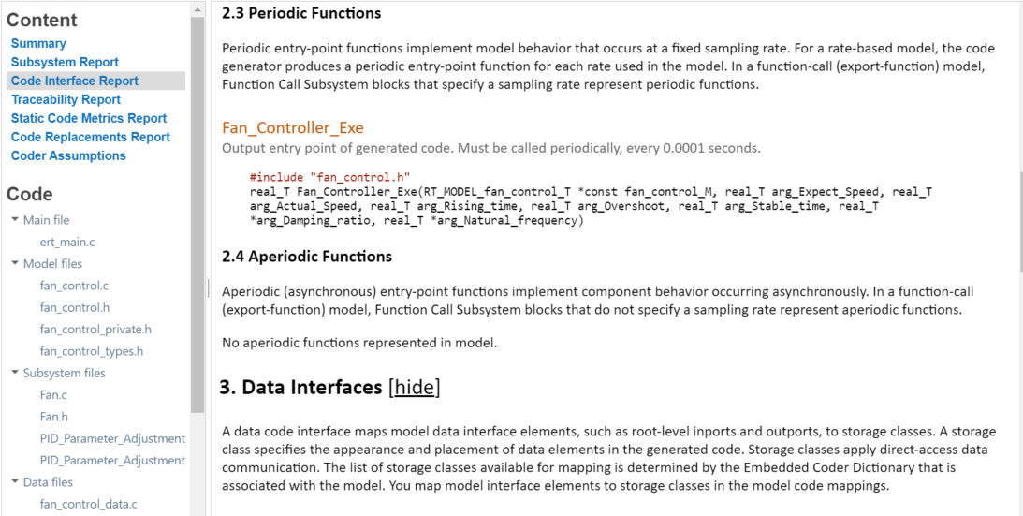
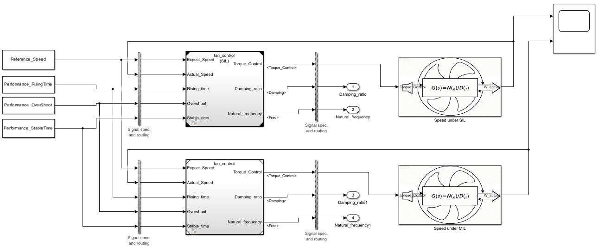
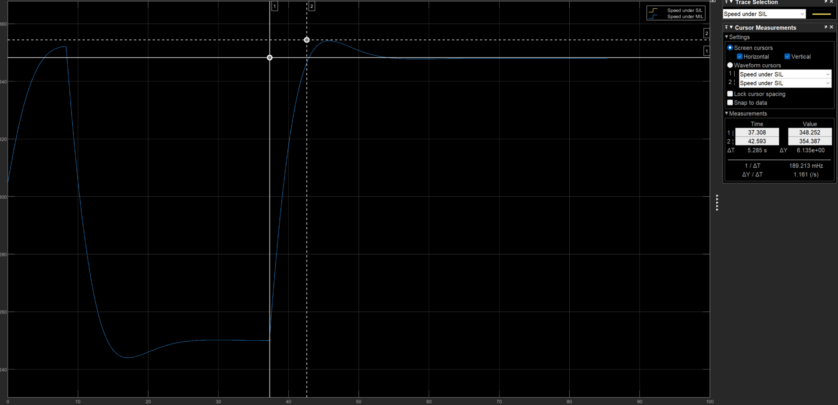
7. Code Generation
-Model Level:
Three interface functions:
real_T Fan_Controller_Exe();
void Fan_Controller_Init()
void Fan_Controller_terminate()
- Subsystem Level:
Three interface functions:
void PID_Parameter_Adjustment()
real_T Fan_Control_PID()
void Fan_Control_PID_Init()
-SIL

Slide 9
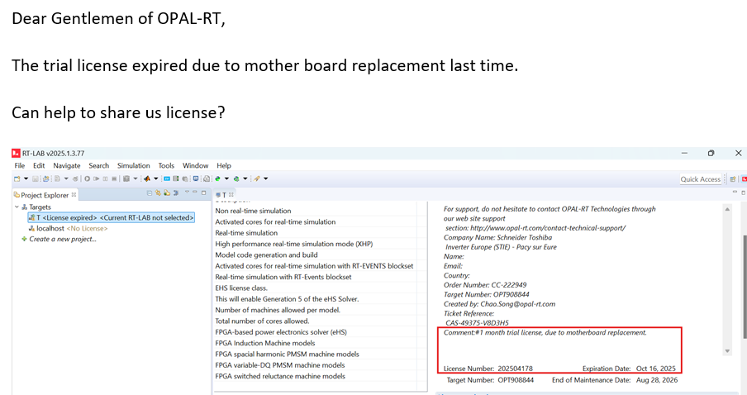
8. HIL
- HIL License expired, and get new licenseing
- :

Slide 10

Summary
Fan Modeling
Fan Control
Fan Transfer Function
Fan Control with Differential Equation and Transfer Function
Controller Performance
Controller Performance Test
Code Generation
HIL

