Slide 1

Temperaments and Tastes: Horoscopes-based Art Exploration
Team GSPIA
Graduate School of Public and International Affairs
University of Pittsburgh
Contact: linardi@pitt.edu

Slide 2
Why Horoscopes?
Horoscopes / zodiac provides guidance on how people live their lives
Egyptian, Celtic, Indian, Persian,
Most popular: Western and Chinese
Western horoscope is based on months
Chinese horoscope is based on years (useful when you only have birth year of artists)

Slide 3
The importance of Chinese horoscope
Based on a cycle of twelve years, each matched to an animal.
Extremely influential and widespread: in China, Korea, Vietnam, Thailand, and Japan when asked for your age you may give your “animal” instead.
Chinese horoscope used to this day to explain people’s fates including: personalities, marriage partners, success of projects and business ventures. In the Taoist beliefs, a person’s future is determine by constellations and space.

Slide 4





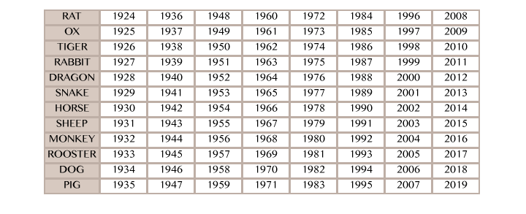






The Twelve Animals

Slide 5
The race
The twelve animals of the Chinese zodiac were selected through a race: the order in which they arrive showed their personality.
Jade Emperor decreed that the years on the calendar would be named for each animal in the order they arrived to a meeting place.
There could only be twelve winners and in order to win, the animals had to cross a rapid current river and reach the finish line on the shore.
The Cat and the Rat sweet-talked the naïve, good natured Ox to carry them across, but in the middle of the river the Rat pushed the Cat overboard. Right before they reached land, the Rat jumped over the Ox and won.

Slide 6

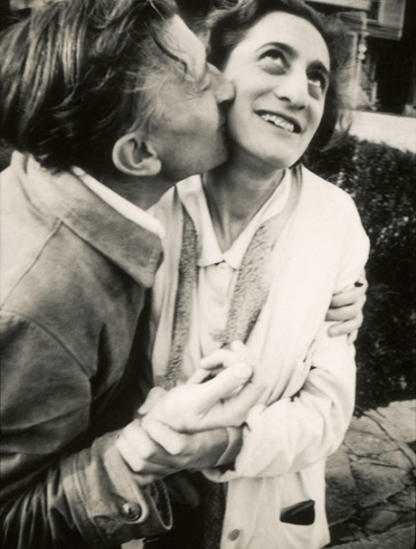
Top CMOA Year of the Rat artist: Josef Albers (1888-1976)
instinctive, acute and alert, brilliant businessmen, sophisticated in social interaction

Slide 7
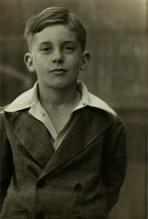
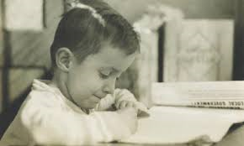
Top CMOA Year of the Ox artist: Walter Munhall (1901–1993)
contemplative, simple, not easily affected by one's surroundings, honest to concept and ability

Slide 8
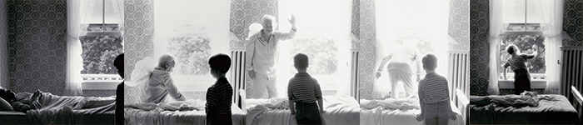
Top CMOA Year of the Monkey artist: Duane Michals (1932)
Duane Michals, Grandpa Goes to Heaven, 1989, The Henry L. Hillman Fund
Quick-witted and versatile, innovative and lively. Has an impetuous temper and a slight tendency to look down upon others.
Notes:
Duane Michals McKeessport one of the great photographic innovators of the last century..Above is Grandpa Goes To Heaven
Actual top artist samuel Rosenberg (Pittsburgh) (1896-1972)
Duane Michals , very mischevious, this series is called
He describes his photographic skills as "completely self-taught” After two years in the Army, in 1956 he went on to study at the Parsons School of Design with a plan to become a graphic designer; however, he did not complete his studies.^{[3]}
Michals's work makes innovative use of photo-sequences, often incorporating text to examine emotion and philosophy

Slide 9
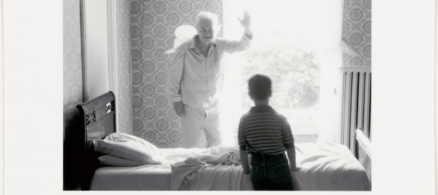
“I don’t trust reality. So all of the writing on and painting on the photographs is born out of the frustration to express what you do not see.” –Duane Michals

Slide 10
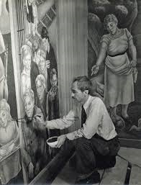
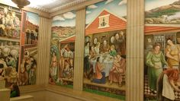
Top CMOA Year of the Rooster artist: George Biddle (1885-1973)
bright, communicative and ambitious. Good looking and prefer to dress up. Often starts out enthusiastic, but need persistence to complete projects.
Notes:
Muralist George Biddle social realism and combat art.
A childhood friend of President Franklin D. Roosevelt, he played a major role in establishing the Federal Art Project (1935-43), which employed artists under the Works Progress Administration.
Here he is wearing a tie.

Slide 11
Results of some of our horoscopes based analysis
 | (1) | (2) | (3) | (4) | (5) | (6) | (7) | (8)
VARIABLES | contempart | decoart | film | fineart | archit | photo | yearacquired | logarea
creationyear | 0.008*** | -0.000 | 0.000*** | -0.006*** | -0.002*** | -0.002*** | 0.172*** | 0.006***
 | (0.000) | (0.000) | (0.000) | (0.001) | (0.001) | (0.000) | (0.0348) | (0.002)
ox | 0.077 | -0.019 | -0.010 | 0.070 | -0.084 | -0.033 | 0.960 | 0.022
 | (0.066) | (0.037) | (0.015) | (0.053) | (0.085) | (0.072) | (3.000) | (0.236)
tiger | -0.066 | -0.033 | 0.003 | -0.018 | -0.162** | 0.276 | -2.155 | -0.500
 | (0.087) | (0.046) | (0.019) | (0.082) | (0.077) | (0.207) | (2.519) | (0.428)
rabbit | -0.013 | -0.052 | 0.025 | 0.025 | 0.053 | -0.038 | -3.025 | 0.089
 | (0.088) | (0.035) | (0.035) | (0.059) | (0.148) | (0.066) | (3.040) | (0.228)
dragon | 0.005 | 0.005 | -0.020 | 0.098* | -0.006 | -0.084* | -3.970 | 0.089
 | (0.077) | (0.040) | (0.013) | (0.053) | (0.095) | (0.050) | (4.730) | (0.187)
snake | 0.114 | 0.012 | -0.013 | -0.043 | -0.018 | -0.053 | 0.424 | -0.055
 | (0.080) | (0.046) | (0.013) | (0.062) | (0.102) | (0.065) | (3.472) | (0.265)
horse | 0.116 | -0.019 | -0.011 | -0.012 | -0.117 | 0.044 | -3.688 | -0.697
 | (0.113) | (0.056) | (0.015) | (0.065) | (0.086) | (0.067) | (2.922) | (0.444)
goat | -0.015 | 0.077 | 0.005 | 0.204** | -0.207*** | -0.063 | -4.844 | -0.153
 | (0.061) | (0.072) | (0.015) | (0.082) | (0.070) | (0.069) | (3.280) | (0.205)
monkey | 0.079 | -0.048 | -0.015 | 0.115 | -0.076 | -0.055 | -2.794 | -0.430
 | (0.076) | (0.042) | (0.014) | (0.074) | (0.101) | (0.060) | (4.523) | (0.283)
rooster | 0.003 | -0.023 | 0.008 | 0.192** | -0.173** | -0.007 | -13.54** | 0.341*
 | (0.063) | (0.046) | (0.020) | (0.085) | (0.074) | (0.078) | (6.489) | (0.199)
dog | 0.024 | 0.017 | -0.025* | 0.074 | -0.075 | -0.015 | -1.515 | -0.342
 | (0.066) | (0.047) | (0.014) | (0.050) | (0.079) | (0.056) | (2.859) | (0.378)
pig | -0.009 | -0.000 | -0.013 | 0.028 | 0.059 | -0.065 | -1.917 | -0.142
 | (0.068) | (0.040) | (0.014) | (0.057) | (0.108) | (0.058) | (2.985) | (0.232)
Constant | -16.183*** | 0.190 | -0.835*** | 10.958*** | 3.746*** | 3.124*** | 1,651*** | -6.288
 | (0.950) | (0.609) | (0.238) | (1.171) | (1.371) | (0.900) | (68.36) | (4.494)
Observations | 14,262 | 14,262 | 14,262 | 14,262 | 14,262 | 14,262 | 10,760 | 12,674
R-squared | 0.255 | 0.012 | 0.016 | 0.197 | 0.067 | 0.093 | 0.122 | 0.059
The Carnegie fine arts Dept is 20% more likely to collect art from people born in the year of goats and roosters.
The Architecture Dept is 16-21% less likely to collect art from people born in the year of tigers, goats and roosters.
Artwork from artists born from the year of Rooster are 13.5 years older and 34.1% larger than artwork from people born in other years. Has the museum moved away from larger pieces and hence stopped collecting Roosters?

Slide 12
Age at Creation by Horoscope

Slide 13
Our web application
Provide viewers a breakdown of Carnegie collection by “temperament” (as determined by the horoscope) and timeline of when they are acquired.
Translate viewers birth year into horoscope and suggest top artists with similar temperament.
Can be adapted to personalize the recommendation even more.
http://www.pitt.edu/~haw65/Hackathon/ChineseHoroscope/ChineseHoroscope.html
Demo currently works for Rat, Ox, Monkey, and Rooster.

Slide 14
Team GSPIA
Webmaster: Hao Wu
Text preprocessing: Tian Tian, Le Yang, Ziqiao Chen
Tableau: Joe Hackett & Nhung Nguyen
STATA: Jia Yang, Zhu Yang
Other research: Shuning Tong, Shanlu Xue, Cesar Cedeno, Yi Yao
Faculty advisor: Sera Linardi

