Slide 1

Climate-Resilient School Infrastructure Toolkit (CRIT)
Training for District Engineers, Education Planners & Implementing Partners
Pilot Implementation Readiness Session
WUM Advisory Services
UNICEF Climate Ventures 2026 (Application)
Slide 1 of 37 | CRIT – Climate-Resilient School Infrastructure Toolkit | WUM Advisory Services

Slide 2
Training Objectives
By the end of this training, participants will be able to:
Understand climate risks affecting school infrastructure in Pakistan
Apply CRIT risk screening and vulnerability scoring tools
Identify and select appropriate retrofitting packages
Use CRIT costing and planning templates
Apply implementation and monitoring workflows aligned with UNICEF standards
Strengthen community participation and sustainability planning
Slide 2 of 37 | CRIT – Climate-Resilient School Infrastructure Toolkit | WUM Advisory Services

Slide 3
Why Climate-Resilient Schools Matter
Climate shocks increasingly disrupt education systems through:
Flood damage and waterlogging
Heatwaves affecting classroom safety and attendance
Storms causing structural damage
WASH system breakdowns during emergencies
Result: school closures, learning loss, increased dropout risk, higher reconstruction costs.
Slide 3 of 37 | CRIT – Climate-Resilient School Infrastructure Toolkit | WUM Advisory Services

Slide 4
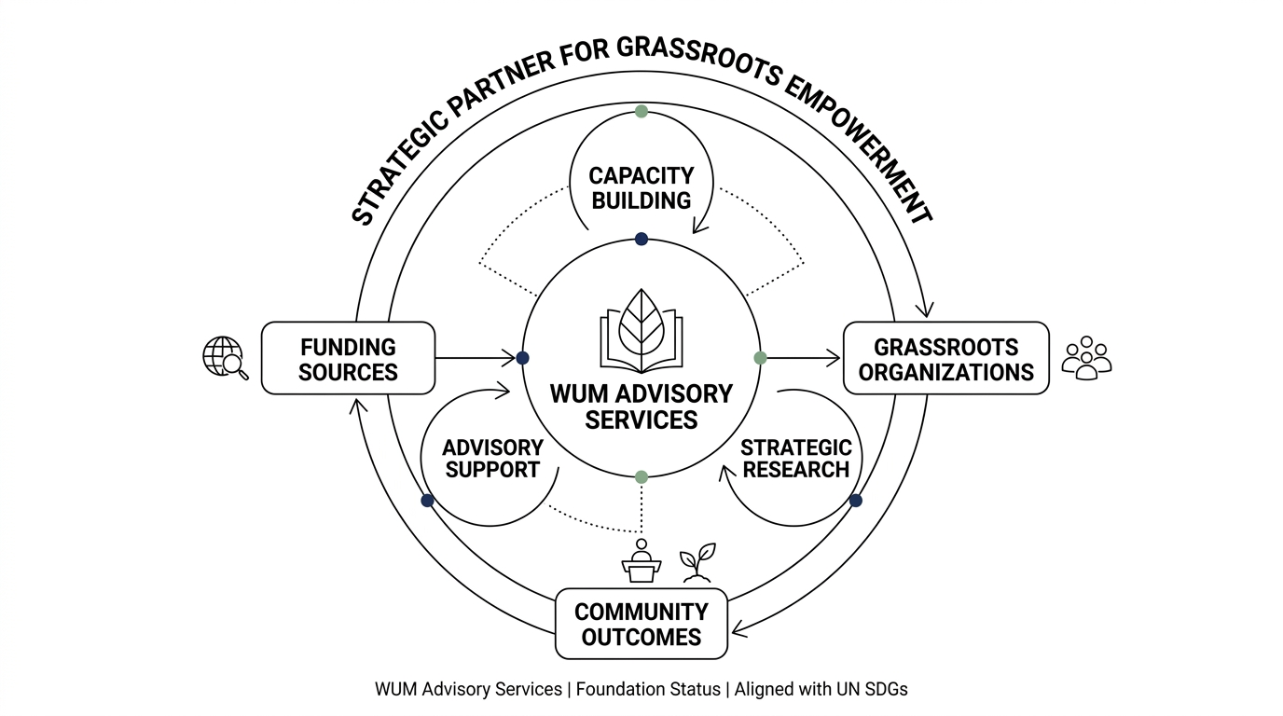
Pakistan Context – Key Risks
Major infrastructure threats include:
Monsoon flooding (river and flash floods)
Extreme heat and urban heat stress
Poor drainage and waterlogging
Weak roofing and boundary structures
Limited climate-resilient design standards in public schools
Most affected: rural, low-income, and disaster-prone districts.
Slide 4 of 37 | CRIT – Climate-Resilient School Infrastructure Toolkit | WUM Advisory Services

Slide 5
UNICEF Approach – Safe Schools
CRIT aligns with UNICEF’s Safe Schools approach:
Safe Learning Environments
Risk-informed planning
Resilient infrastructure
WASH continuity
Preparedness and response
Equity and inclusion
Slide 5 of 37 | CRIT – Climate-Resilient School Infrastructure Toolkit | WUM Advisory Services

Slide 6
What is CRIT?
CRIT is an open-source toolkit providing:
Climate risk screening tools
Vulnerability scoring templates
Modular design standards
Retrofitting guidance
Costing and BOQ templates
Implementation SOPs
Monitoring & evaluation indicators
Community engagement tools
Goal: ensure safe learning continuity during climate shocks.
Slide 6 of 37 | CRIT – Climate-Resilient School Infrastructure Toolkit | WUM Advisory Services

Slide 7
CRIT Modules Overview
CRIT consists of 7 modules:
1. Risk Assessment & Prioritization
2. Climate-Resilient Design Templates
3. Retrofitting Guidelines
4. Costing Tools & Cost-Benefit Planning
5. Training & Capacity Building
6. Pilot Implementation & Governance
7. Sample Data & Demonstration Resources
Slide 7 of 37 | CRIT – Climate-Resilient School Infrastructure Toolkit | WUM Advisory Services

Slide 8
CRIT Implementation Flow
CRIT follows a structured process:
1. Identify hazard exposure areas
2. Assess schools using CRIT tool
3. Score and rank risk levels
4. Select retrofit package(s)
5. Prepare BOQ and budget
6. Implement with quality monitoring
7. Engage community and ensure maintenance
8. Track outcomes and learning continuity
Slide 8 of 37 | CRIT – Climate-Resilient School Infrastructure Toolkit | WUM Advisory Services

Slide 9
Module 01 – Risk Screening
Module 01 helps answer:
Which schools are at highest risk?
Which hazards are most dangerous?
Which infrastructure elements are weakest?
Which communities are most vulnerable?
Outputs:
Composite risk score
Risk classification (Low–Critical)
Priority ranking list
Slide 9 of 37 | CRIT – Climate-Resilient School Infrastructure Toolkit | WUM Advisory Services

Slide 10
Hazard Exposure Scoring (0–3)
Hazards assessed include:
Flooding
Waterlogging
Heatwaves
Storms / high winds
Drought / water scarcity
Landslides (if applicable)
Earthquake risk (if applicable)
Score Meaning:
0 = no exposure
1 = low
2 = medium
3 = high
Slide 10 of 37 | CRIT – Climate-Resilient School Infrastructure Toolkit | WUM Advisory Services

Slide 11
Infrastructure Vulnerability Scoring
Infrastructure components scored include:
Foundation/plinth height
Roof condition
Wall cracks/stability
Drainage system
Ventilation and heat protection
WASH resilience
Electrical safety
Boundary wall safety
Emergency exits / assembly areas
Slide 11 of 37 | CRIT – Climate-Resilient School Infrastructure Toolkit | WUM Advisory Services

Slide 12
Social Vulnerability Scoring
Social risk indicators include:
Poverty vulnerability
Remoteness / no alternative schools
Girls’ dependency on local school
Disability access barriers
Dropout history during shocks
Weak coping capacity
Equity lens is mandatory.
Slide 12 of 37 | CRIT – Climate-Resilient School Infrastructure Toolkit | WUM Advisory Services

Slide 13
Composite Risk Score
Composite Risk Score = Hazard Exposure + Infrastructure Vulnerability + Social Vulnerability
Risk Classification:
0–10 = Low
11–20 = Medium
21–30 = High
31+ = Critical
Slide 13 of 37 | CRIT – Climate-Resilient School Infrastructure Toolkit | WUM Advisory Services

Slide 14
Exercise 1 – Risk Screening Practice
Group activity:
Review a sample school profile
Assign hazard exposure scores
Assign vulnerability scores
Calculate composite score
Identify risk level
Recommend CRIT response package
Slide 14 of 37 | CRIT – Climate-Resilient School Infrastructure Toolkit | WUM Advisory Services

Slide 15
Module 02 – Climate-Resilient Design Standards
Guidance for:
Flood protection
Heat mitigation and passive cooling
Storm/wind strengthening
Inclusive design
Resilient WASH infrastructure
Safe emergency evacuation design
Slide 15 of 37 | CRIT – Climate-Resilient School Infrastructure Toolkit | WUM Advisory Services

Slide 16
Flood-Resilient Design Features
Key design features:
Raised plinth above flood line
Perimeter drainage and slope control
Water-resistant flooring
Elevated storage for learning materials
Safe access routes during flood season
Strengthened boundary walls where needed
Slide 16 of 37 | CRIT – Climate-Resilient School Infrastructure Toolkit | WUM Advisory Services

Slide 17
Heat Mitigation Design Features
Heat-resilient schools should include:
Cross ventilation
High ceilings for airflow
Reflective cool roofs
Veranda shading and overhangs
Shade trees and courtyard design
Hydration and drinking water points
Slide 17 of 37 | CRIT – Climate-Resilient School Infrastructure Toolkit | WUM Advisory Services

Slide 18
Storm and Wind Resilience
Storm safety improvements include:
Roof anchoring reinforcement
Strong truss systems
Safe windows and doors
Removal of unsafe external structures
Protective boundary design
Slide 18 of 37 | CRIT – Climate-Resilient School Infrastructure Toolkit | WUM Advisory Services

Slide 19
WASH Resilience and Safety
Resilient WASH systems include:
Flood-protected toilets
Gender-segregated toilets with privacy
Handwashing stations with drainage
Water storage for drought/heat
Accessible toilets for children with disabilities
Slide 19 of 37 | CRIT – Climate-Resilient School Infrastructure Toolkit | WUM Advisory Services

Slide 20
Inclusion and Accessibility
Minimum inclusive standards:
Ramps to classrooms
Safe pathways and handrails
Accessible toilets
Privacy for girls
Lighting and safety signage
CRIT prioritizes equity and child rights.
Slide 20 of 37 | CRIT – Climate-Resilient School Infrastructure Toolkit | WUM Advisory Services

Slide 21
Module 03 – Retrofitting Packages
CRIT retrofitting provides modular solutions:
Flood retrofitting package
Heat mitigation package
Storm strengthening package
WASH resilience package
Electrical safety package
Disability inclusion package
Slide 21 of 37 | CRIT – Climate-Resilient School Infrastructure Toolkit | WUM Advisory Services

Slide 22
Retrofitting Package Selection
Selection depends on:
Hazard exposure scores
Infrastructure weakness points
Community needs
Budget constraints
Urgency (safety risk)
Critical schools must be prioritized first.
Slide 22 of 37 | CRIT – Climate-Resilient School Infrastructure Toolkit | WUM Advisory Services

Slide 23
Module 04 – Costing Tools
CRIT costing tools support:
BOQ preparation
Module-based costing
Cost per child estimation
Retrofitting vs rebuilding comparisons
Cost-benefit analysis for donor reporting
Slide 23 of 37 | CRIT – Climate-Resilient School Infrastructure Toolkit | WUM Advisory Services

Slide 24
Costing Example
Example costing outputs:
Total retrofit cost per school
Cost per classroom
Cost per child beneficiary
Estimated reduction in rehabilitation costs over 5 years
Supervision + contingency budget planning
Slide 24 of 37 | CRIT – Climate-Resilient School Infrastructure Toolkit | WUM Advisory Services

Slide 25
Module 05 – Capacity Building
CRIT supports training for:
District engineers and planners
Head teachers and SMC members
Community volunteers
Contractors and site supervisors
Capacity building is essential for sustainability.
Slide 25 of 37 | CRIT – Climate-Resilient School Infrastructure Toolkit | WUM Advisory Services

Slide 26
Module 06 – Pilot Implementation
Pilot approach includes:
District selection criteria
Baseline assessment
Retrofitting demonstration works
Governance and coordination SOP
Monitoring and reporting
Endline evaluation and toolkit refinement
Slide 26 of 37 | CRIT – Climate-Resilient School Infrastructure Toolkit | WUM Advisory Services

Slide 27
Pilot Governance Structure
Suggested pilot governance:
Provincial Steering Committee
District Implementation Unit
Technical Quality Assurance Team
School Management Committee
Community Oversight Mechanism
Slide 27 of 37 | CRIT – Climate-Resilient School Infrastructure Toolkit | WUM Advisory Services

Slide 28
Safeguarding and Child Protection
All CRIT implementation must comply with:
Child safeguarding principles
Contractor code of conduct
Safe construction zones
Complaint and reporting mechanisms
Gender-sensitive implementation protocols
No compromise on child safety.
Slide 28 of 37 | CRIT – Climate-Resilient School Infrastructure Toolkit | WUM Advisory Services

Slide 29
Monitoring & Evaluation Framework
CRIT M&E includes:
Schools assessed
Schools retrofitted
Resilience score improvement
Reduction in closure days
Improved thermal comfort
WASH continuity improvement
Community participation indicators
Slide 29 of 37 | CRIT – Climate-Resilient School Infrastructure Toolkit | WUM Advisory Services

Slide 30
Evidence and Documentation
Minimum evidence required:
Before/after photos
BOQ and completion certificates
Safety inspection checklist
Community maintenance plan
Attendance records (training + engagement)
Baseline and endline scoring sheets
Slide 30 of 37 | CRIT – Climate-Resilient School Infrastructure Toolkit | WUM Advisory Services

Slide 31
Sustainability Planning
CRIT sustainability is ensured through:
Government ownership
Integration into routine planning cycles
Community maintenance committees
Low-cost preventive upgrades
Training and capacity building
Local materials and constructability
Slide 31 of 37 | CRIT – Climate-Resilient School Infrastructure Toolkit | WUM Advisory Services

Slide 32
Equity and Climate Justice
CRIT prioritizes:
Rural and marginalized districts
Girls’ schools and gender-sensitive infrastructure
Children with disabilities
Communities with limited access to alternative schools
Resilient schools = equitable learning continuity.
Slide 32 of 37 | CRIT – Climate-Resilient School Infrastructure Toolkit | WUM Advisory Services

Slide 33
Key Risks and Mitigation
Common risks:
Delayed procurement
Contractor quality issues
Lack of maintenance capacity
Insufficient budget allocation
Community disengagement
Mitigation:
Quality assurance SOP
Training and supervision
Phased implementation
Community ownership models
Slide 33 of 37 | CRIT – Climate-Resilient School Infrastructure Toolkit | WUM Advisory Services

Slide 34
Exercise 2 – Retrofitting Plan Development
Group activity:
Select one sample school
Identify hazard risks
Choose retrofitting packages
Estimate costs using CRIT costing sheet
Present plan and expected outcomes
Slide 34 of 37 | CRIT – Climate-Resilient School Infrastructure Toolkit | WUM Advisory Services

Slide 35
Summary – What CRIT Delivers
CRIT enables:
Standardized school risk assessment
Climate-resilient design solutions
Affordable retrofitting options
Improved WASH resilience
Scalable implementation planning
Measurable outcomes and learning continuity
Slide 35 of 37 | CRIT – Climate-Resilient School Infrastructure Toolkit | WUM Advisory Services

Slide 36
Next Steps
After training, participants should:
Apply CRIT assessment tool in target schools
Compile risk prioritization list
Develop BOQ and budgets
Coordinate with district education authorities
Begin pilot retrofitting implementation
Report progress through CRIT M&E framework
Slide 36 of 37 | CRIT – Climate-Resilient School Infrastructure Toolkit | WUM Advisory Services

Slide 37
Closing
Thank You
For collaboration on safe, resilient learning environments.
Contact: WUM Advisory Services
Project: CRIT – Climate-Resilient School Infrastructure Toolkit
Slide 37 of 37 | CRIT – Climate-Resilient School Infrastructure Toolkit | WUM Advisory Services

