Slide 1
高等電腦視覺期末
報告人：111C52016 吳佩霖

Slide 2
Outline
01
Flowchart
03
Evaluation Results
02
Key Methods
04
Reference

Slide 3
01
Flowchart

Slide 4
Flowchart

Slide 5
Flowchart

Slide 6
02
Key Methods

Slide 7
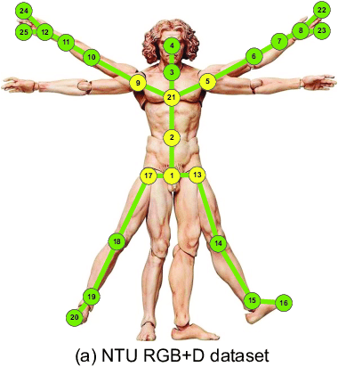
Key Methods

Slide 8
03
Evaluation Results

Slide 9
Evaluation Results
 | Level 1 | Level 2 | Level 3 | Ratio without Level 3 | Ratio
Accurate videos in testing data | 4/4 | 4/4 | ~/6 | 8/8 （100%) | 8/14 （57.14%)
Time （ms） | 0.5 | 0.5 | ~ | 0.5 | ~
Accurate videos in 1/12 data | 6/6 | 5/6 | ~/9 | 11/12 （91.66%) | 11/21（52.38%)

Slide 10
Reference
https://www.researchgate.net/figure/Configuration-of-body-joints-in-the-NTU-RGB-D-dataset-29-and-UTKinect-Action-dataset_fig2_314142763

Slide 11
Thank you for listening

