Slide 1

NeuroDOT
Running a General Linear Model in NeuroDOT

Slide 2
The GLM in NeuroDOT
The function name in your distribution may be slightly different based on the version of NeuroDOT you are running…
function [b,e,DM,EDM,keep, r_sqrd] = GLM_181206(data,hrf,info,params)
%
% This code creates a general linear model (GLM) based on a model of the
% hemodynamic response function (hrf) and a set of stimulus times
% (info.paradigm.synchpts).
% The GLM is then applied to the data to generate Beta maps and residuals.
% It is assumed that the data is [voxels X time].
% The hrf is a modelled hemodynamic response.
A basic GLM function is included with NeuroDOT
• Understands NeuroDOT data structures
• Offers data filtering, custom HRF, GVTD frame censoring
• Fast

Slide 3
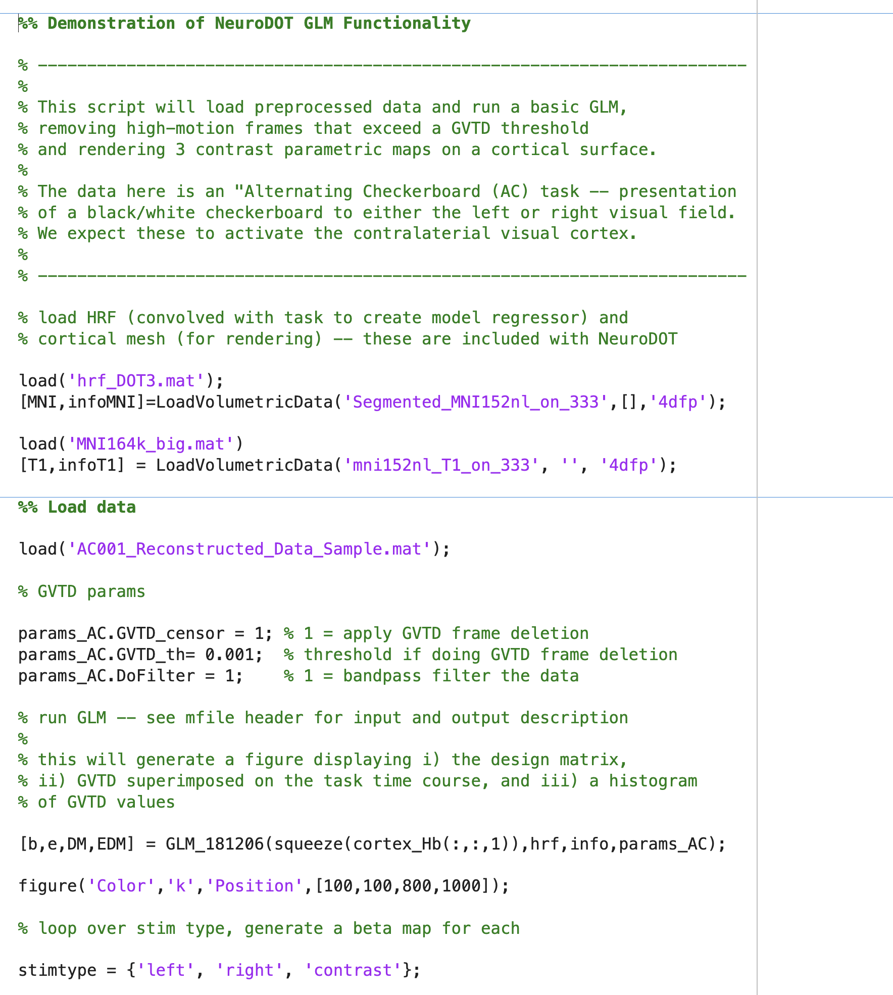
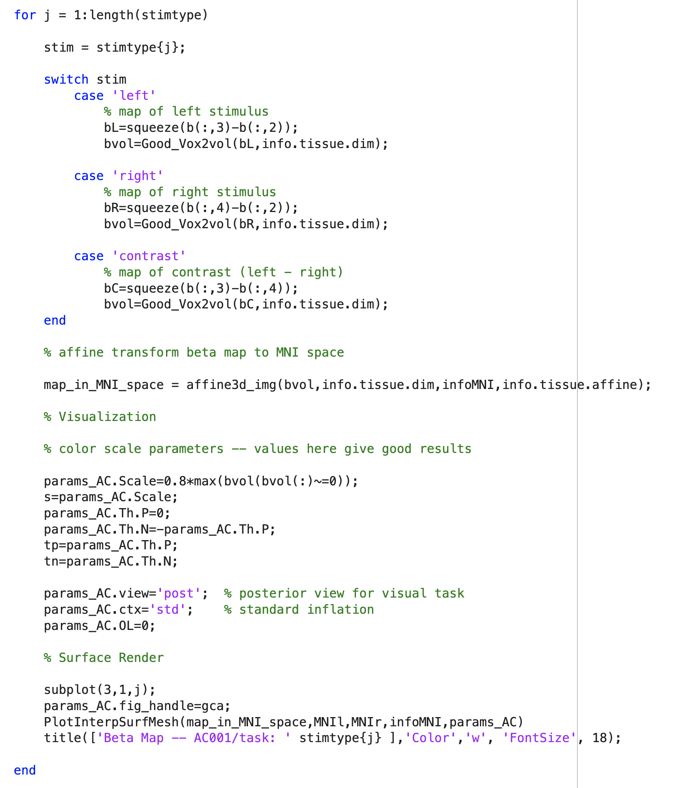
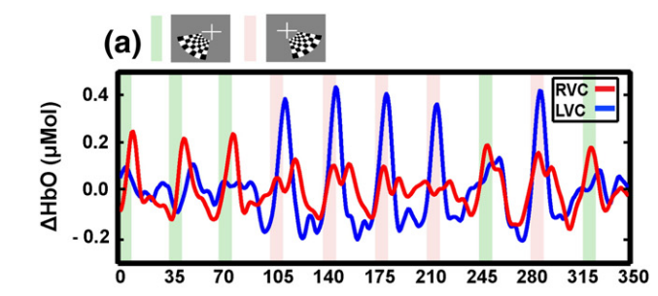
Example Use
To illustrate use of the NeuroDOT GLM function, a simple example script is provided that sets up the inputs, runs the GLM, then renders the fitted model on the cortical surface.
The experimental paradigm consists of presenting a flickering checkerboard in either the left or right visual hemifield:
The following slides explain the code section by section.
} stimulus
representative reconstructed VI responses
example script

Slide 4
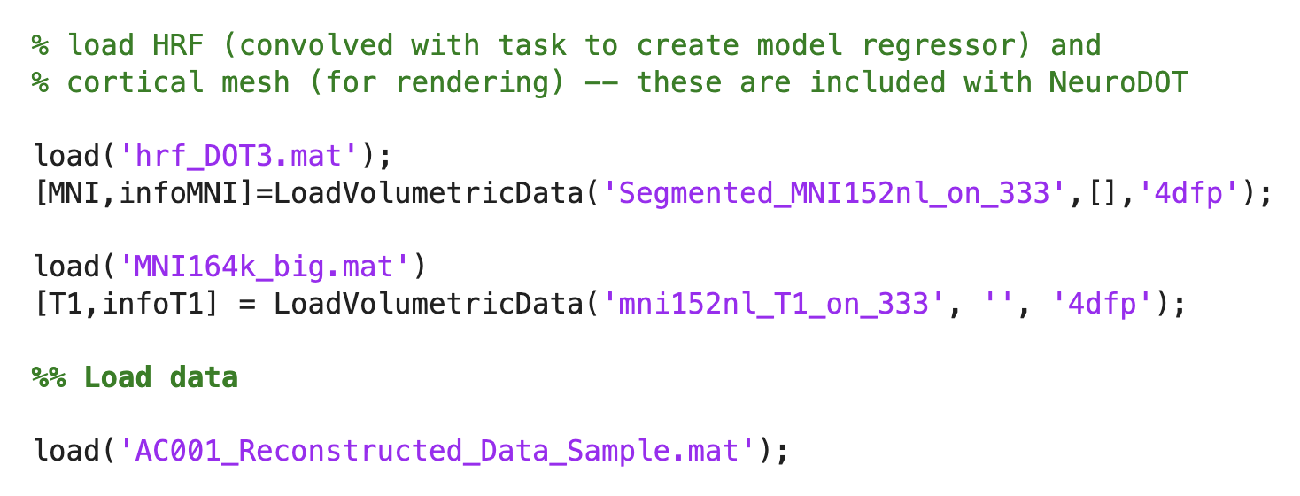
Running the Example Code (1/5)
The first section loads the HRF, a cortical mesh (used later to render the beta maps), and sample data that was prepared for this example.

Slide 5
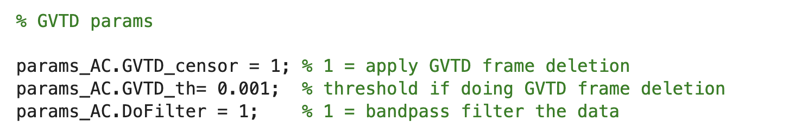
Running the Example Code (2/5)
The next section specifies that GVTD frame censoring should be applied (including a threshold of 0.001) and that the data should be bandpass filtered. Default lowpass and highpass cutoffs of 0.02 and 0.05 Hz are used, although custom values can be passed.

Slide 6
Running the Example Code (3/5)
Next, the NeuroDOT GLM function is called, passing the data, HRF, and info and params structs. The function will use entries in the info struct that describe the experimental paradigm to automatically generate the model regressors (see next slide).

Slide 7
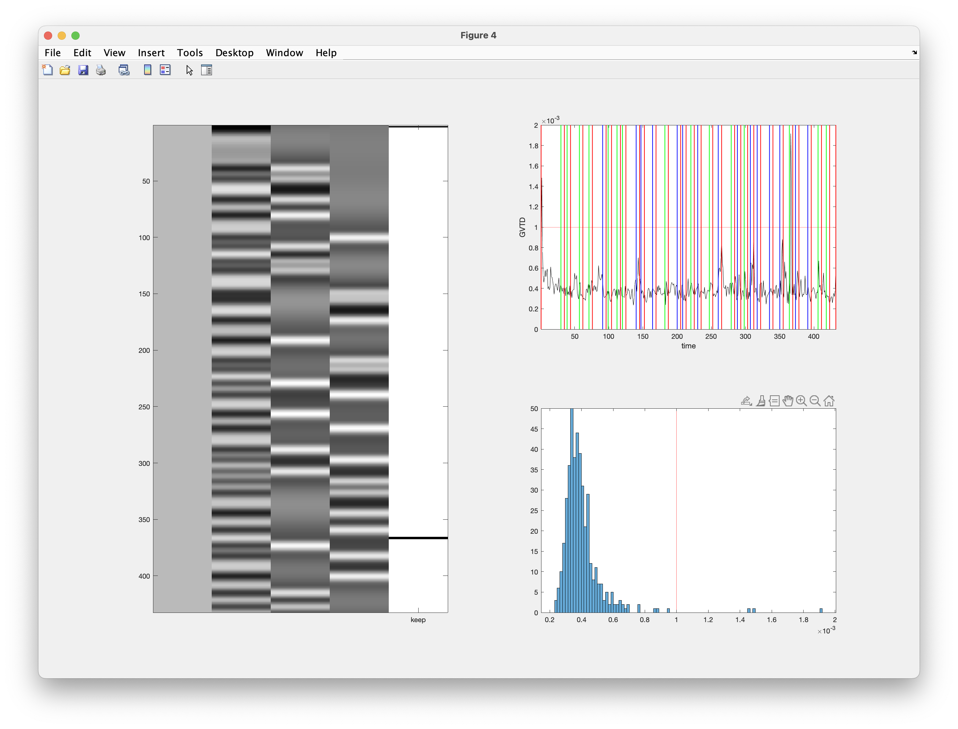
NeuroDOT GLM – Summary Figure
The NeuroDOT GLM function will generate a summary figure that includes: 1) a graphical display of the design matrix, 2) data GVTD (black trace) superimposed on the task events (the latter are taken from info.paradigm), and 3) a histogram of GVTD values.
The columns in the design matix represent (from left to right) a constant term, rest events, left checkerboard events¹, and right checkerboard events. The final column (“keep”) is not a regressor, but rather shows the results of GVTD frame censoring indicating which frames (if any) were removed.
1
2
3
1. “left event” = presentation of the checkerboard in the left visual hemifield.

Slide 8
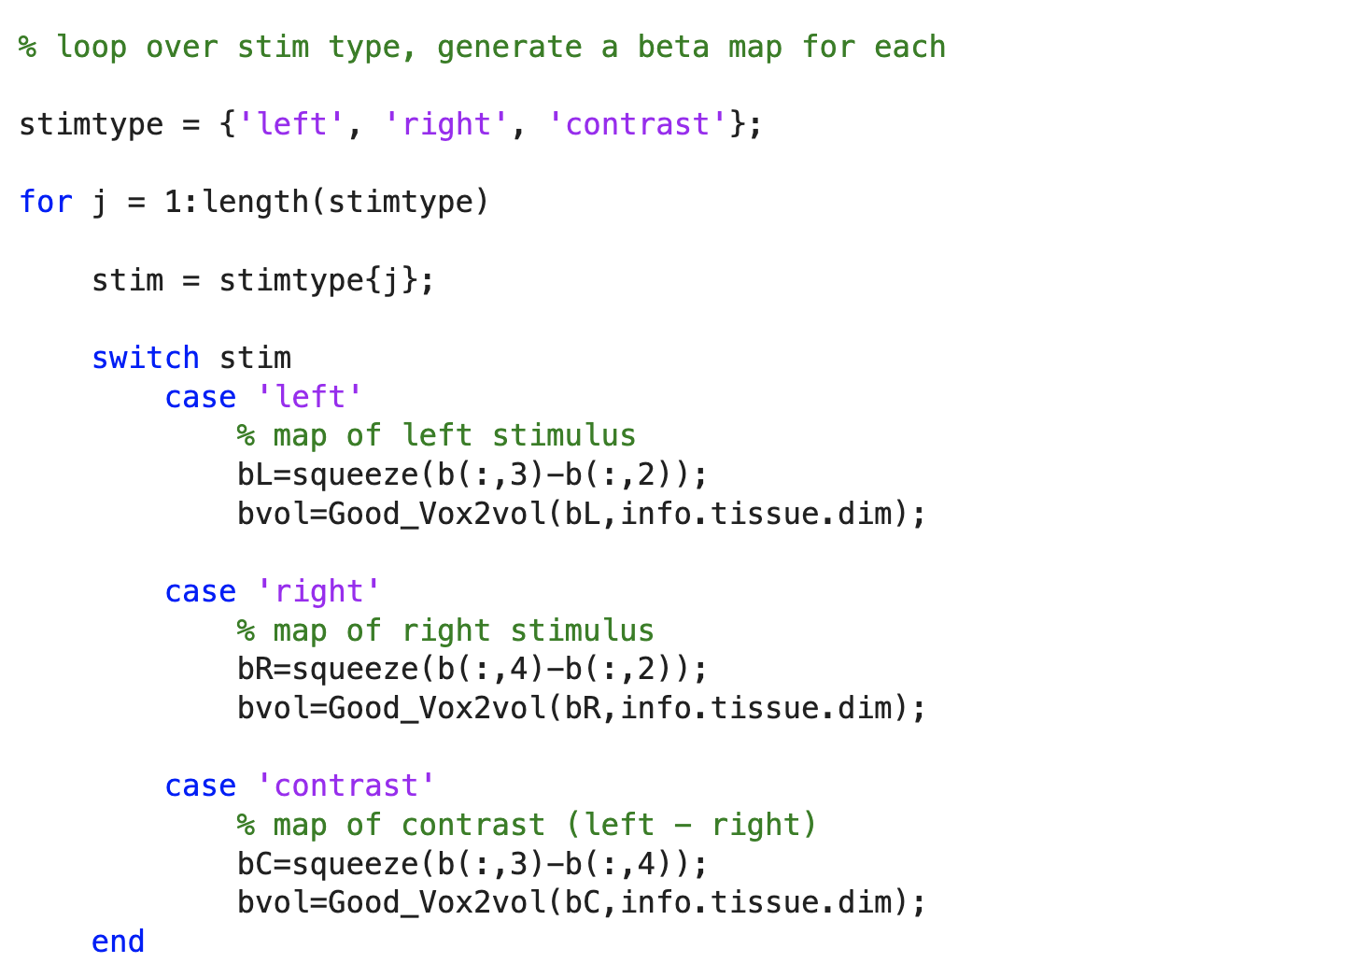
Running the Example Code (4/5)
The code then loops over the beta values (returned in the variable “b”) and creates three contrasts for display (left > rest, right > rest, and left > right).

Slide 9
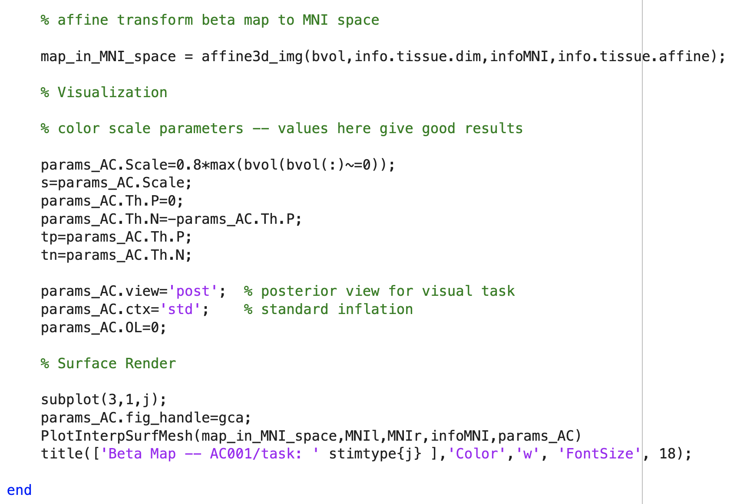
Running the Example Code (5/5)
The remainder of the code in the loop first transforms the data to the template’s MNI space, then sets rendering options (view, cortical inflation, color scaling) and finally renders the three contrast maps (see next slide).

Slide 10
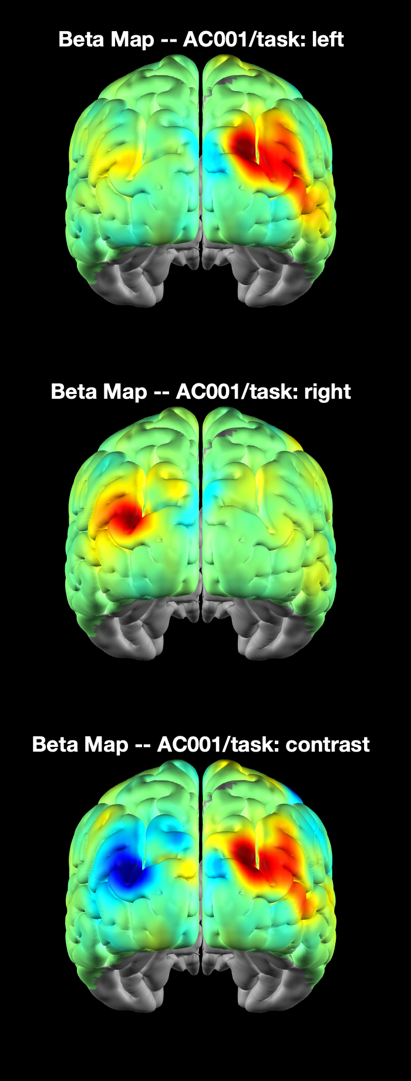
Example Code – Rendered Contrast Maps
The three generated renders show activation of right visual cortex during presentation of the checkerboard in the left visual hemifield (top), activation of left visual cortex by presentation in the right visual hemifield (center), and the difference in these activations (bottom).

