Slide 1

NeuroDOT
Exploring Functional Connectivity in NeuroDOT

Slide 2
FC in NeuroDOT
function [fcMaps,fcMatrix,ParcelTT] = ParcelBased_fc(data,Parcels,dim,params)
%
% This function calculates Parcel Based functional connectivity between a
% volumetric data set (data) and a set of volumetrically defined parcels.
% To increase computational efficiency, the data are assumed to be in
% 2 dimensions with time in the 2nd dimension. If data are not in 2D,
% data are reshaped to be in 2D.
% Parcels are assumed to be in the same space, with both data and Parcels
% described by the dim structure.
% Parcels are assumed to be a volume of zeros (background) and integers
% defining parcel locations. The Parcel labels need not be contiguous.
% The outputs are the Fisher-z transformed maps (fcMaps),
% the Fisher-z transformed fc matrix (fcMatrix),
% and the ROI timecourses (seedTT).
% A temporal mask delineating time points to keep may also be passed in as
% params.tMask.
NeuroDOT includes the function ParcelBased_fc that will generate a cortical map summarizing how recorded activity relates to a given atlas of parcel-based functional connectivity.

Slide 3
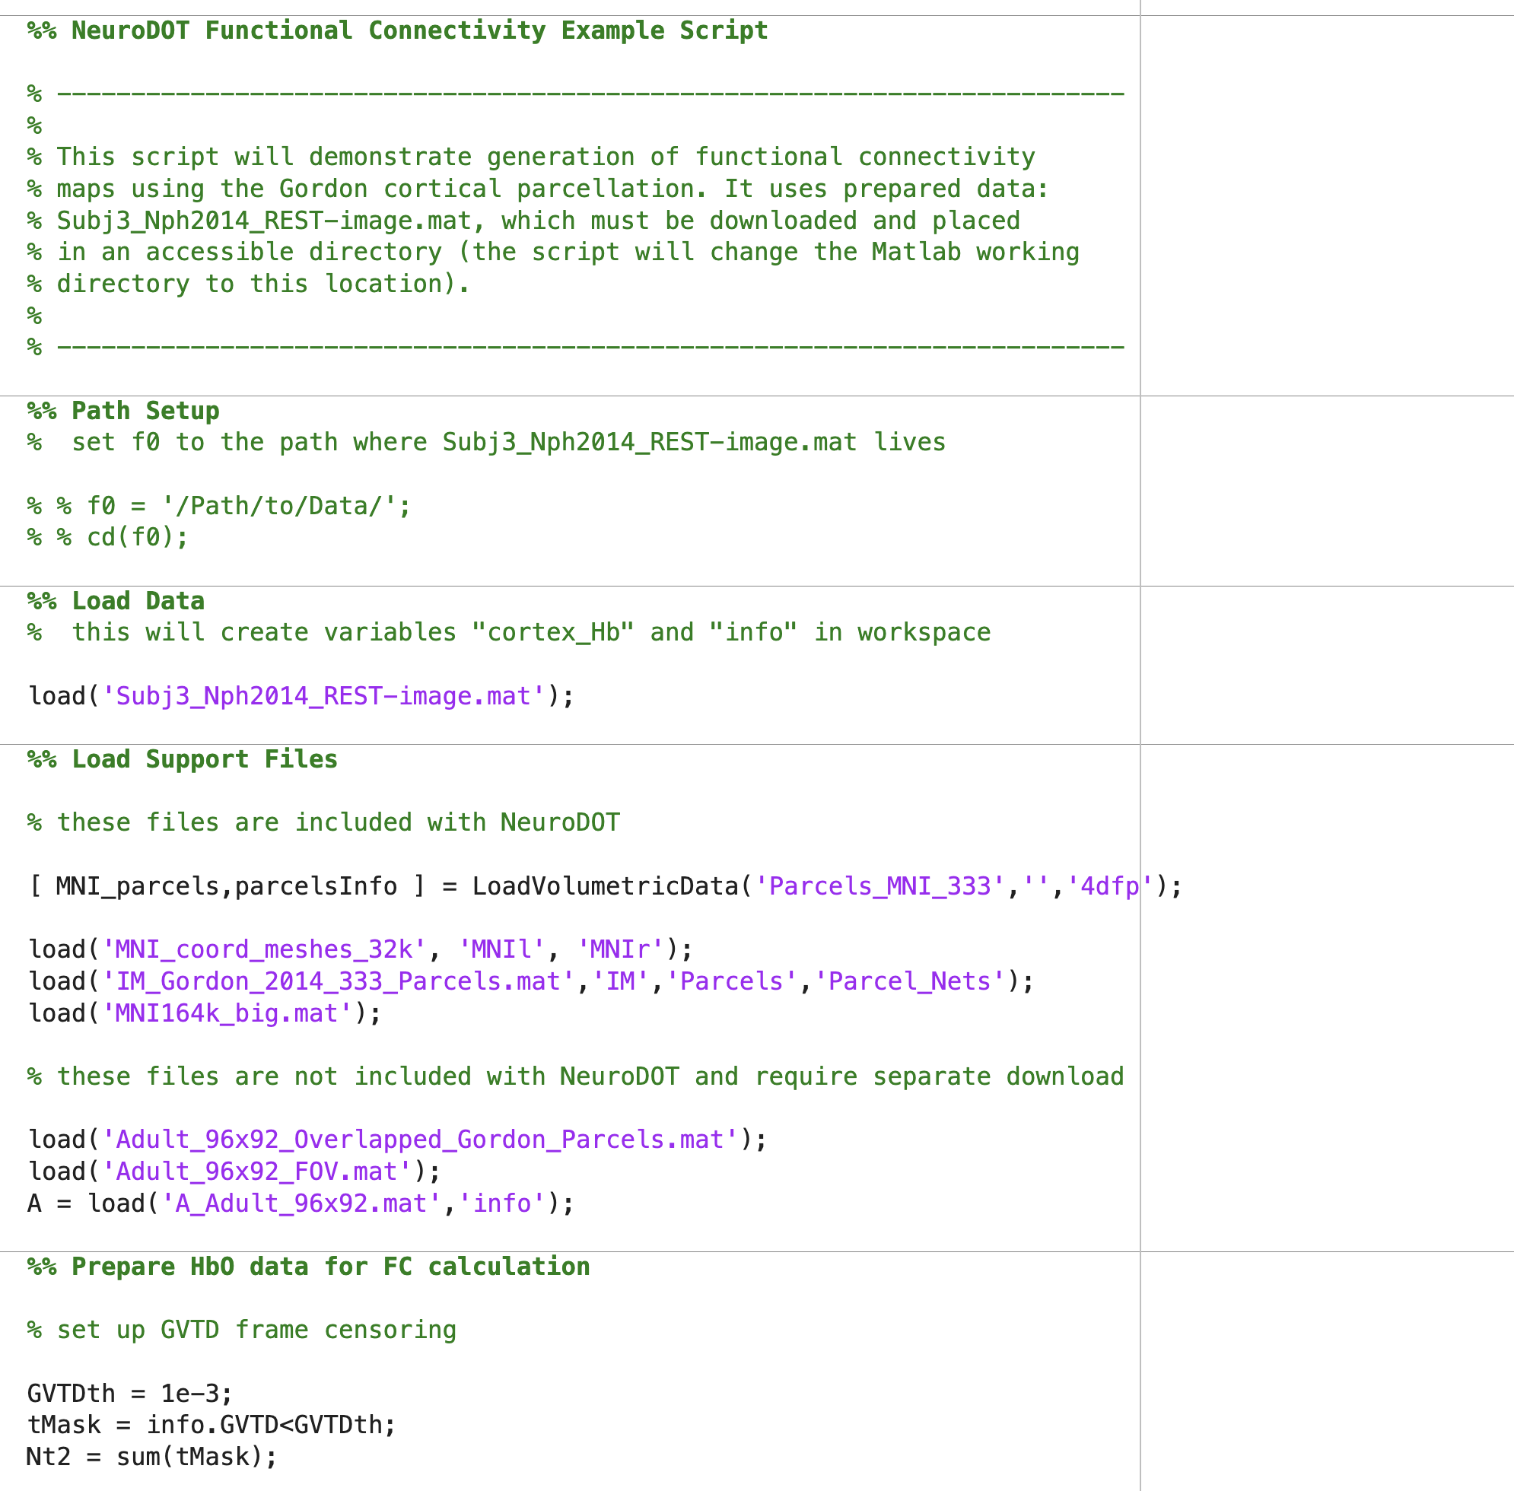
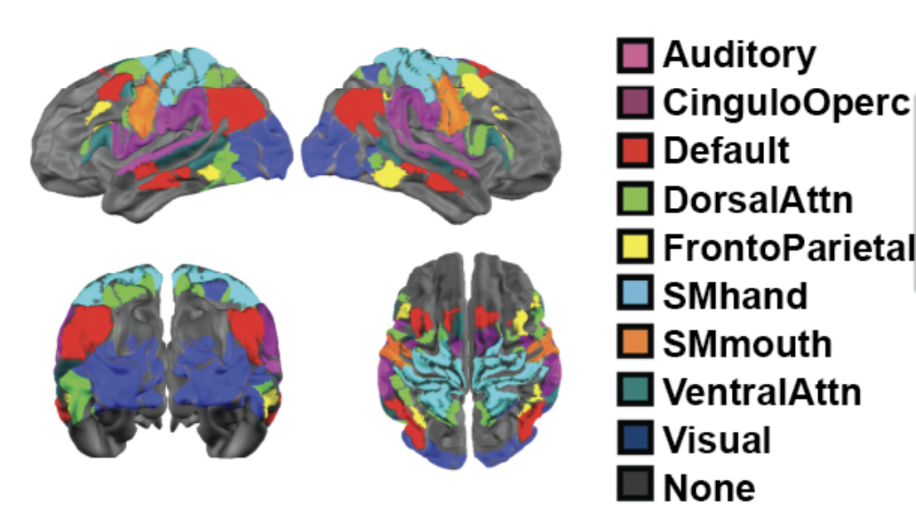
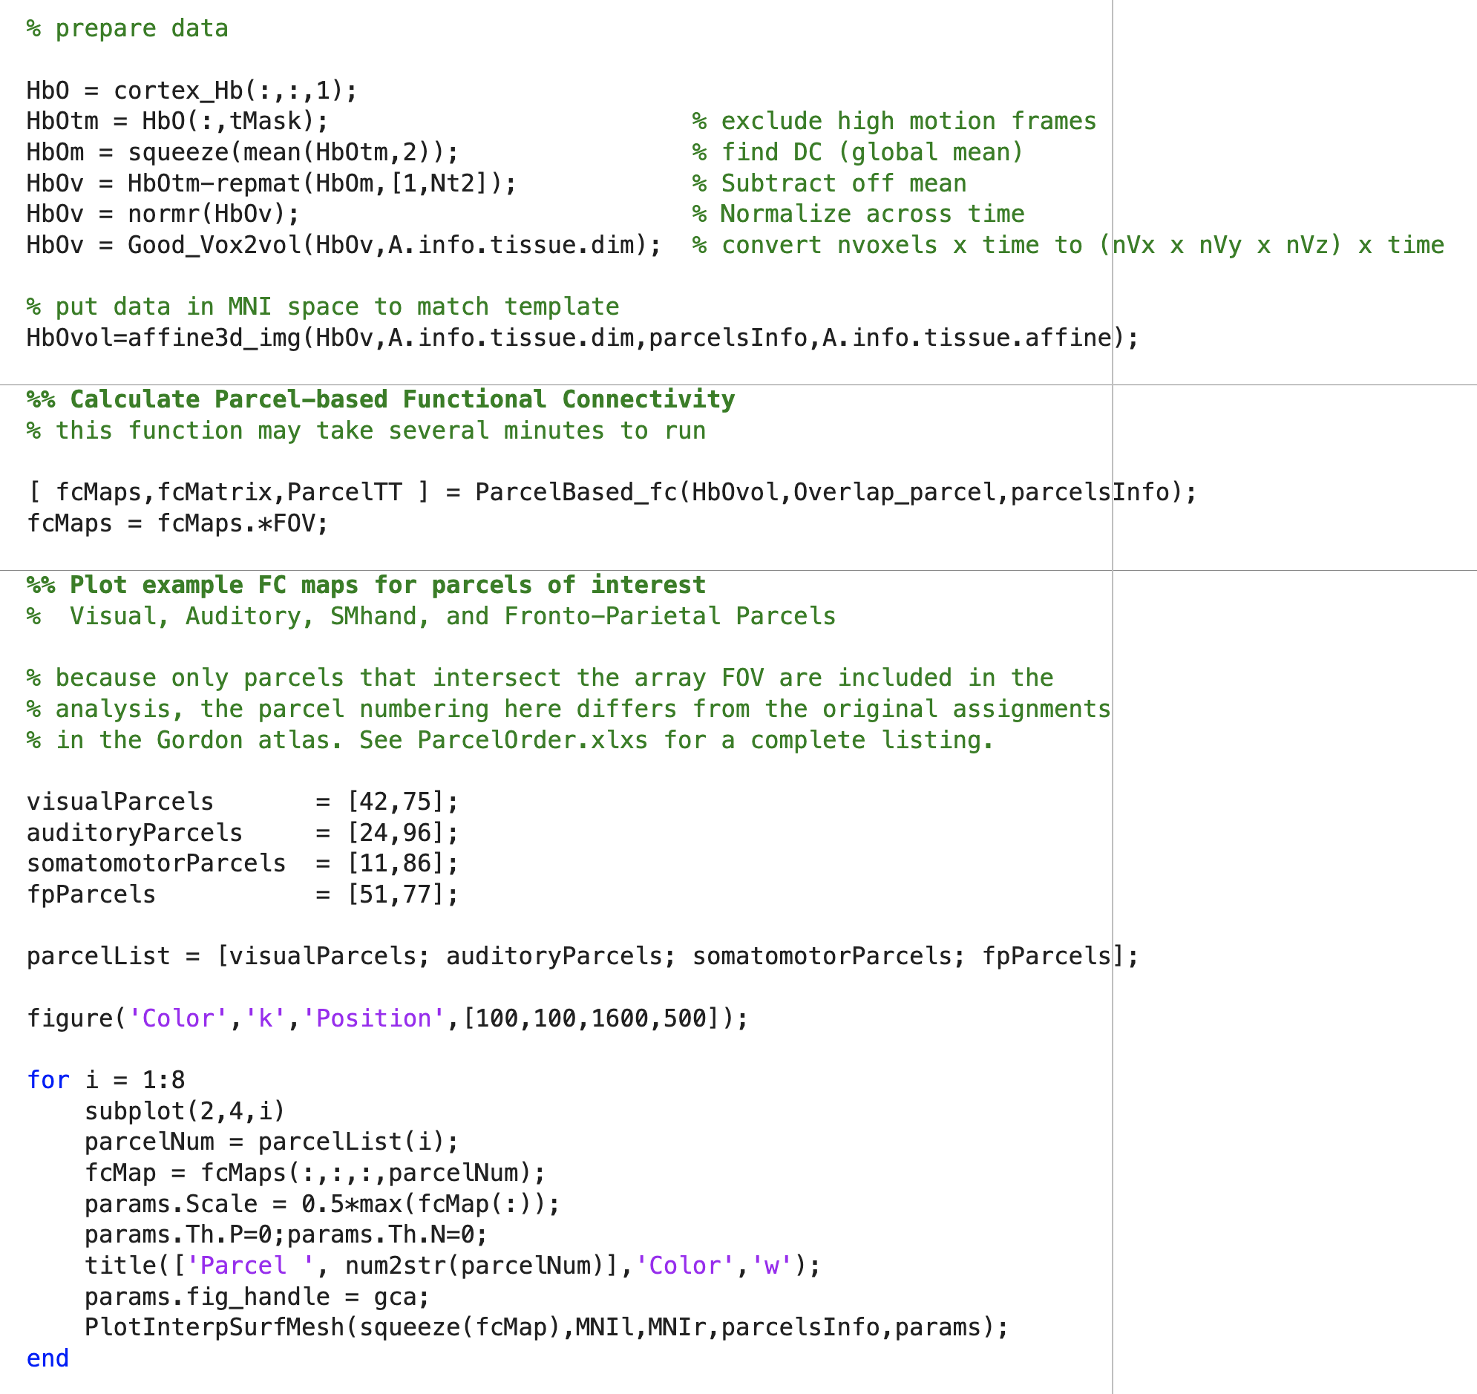
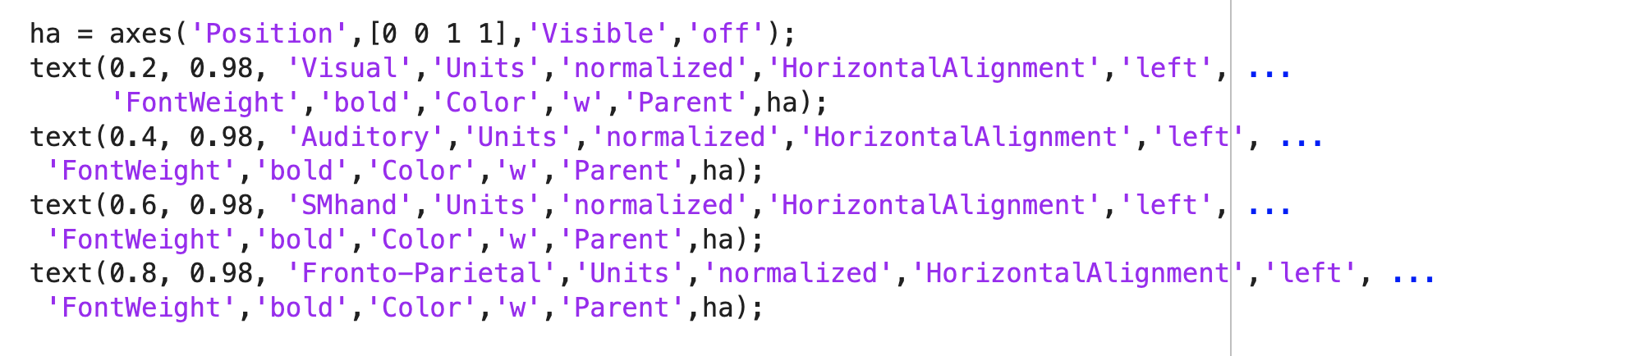
Example Use
An example script is provided that demonstrates use of ParcelBased_fc. The analysis is based on the Gordon cortical atlas, which defines 333 cortical parcels comprising 13 functional networks. Because not all of these parcels intersect the field of view of the data, only a subset (of 142) is used.
The following slides explain the code section by section.
example script

Slide 4
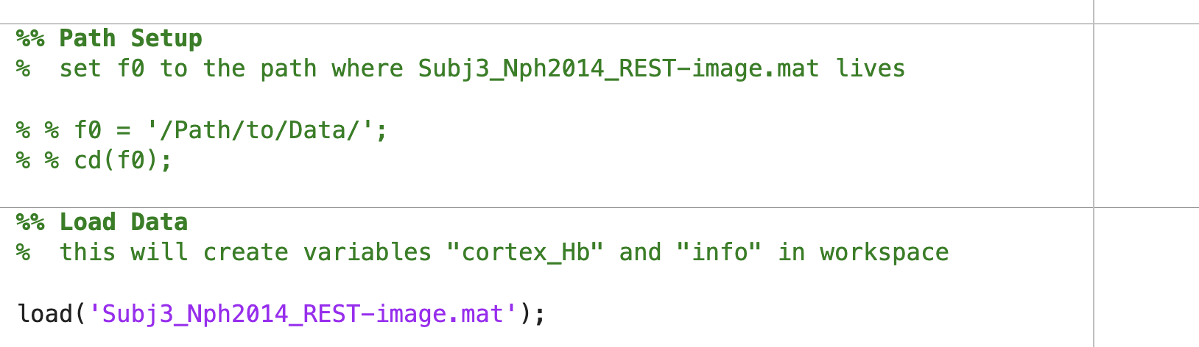
Example Script Details (1/5)
The script requires the location of the data directory (you may leave these lines commented if you move the data to the Matlab current working directory).
The script then loads the example data, which is assumed to have been downloaded and moved to the specified directory.

Slide 5
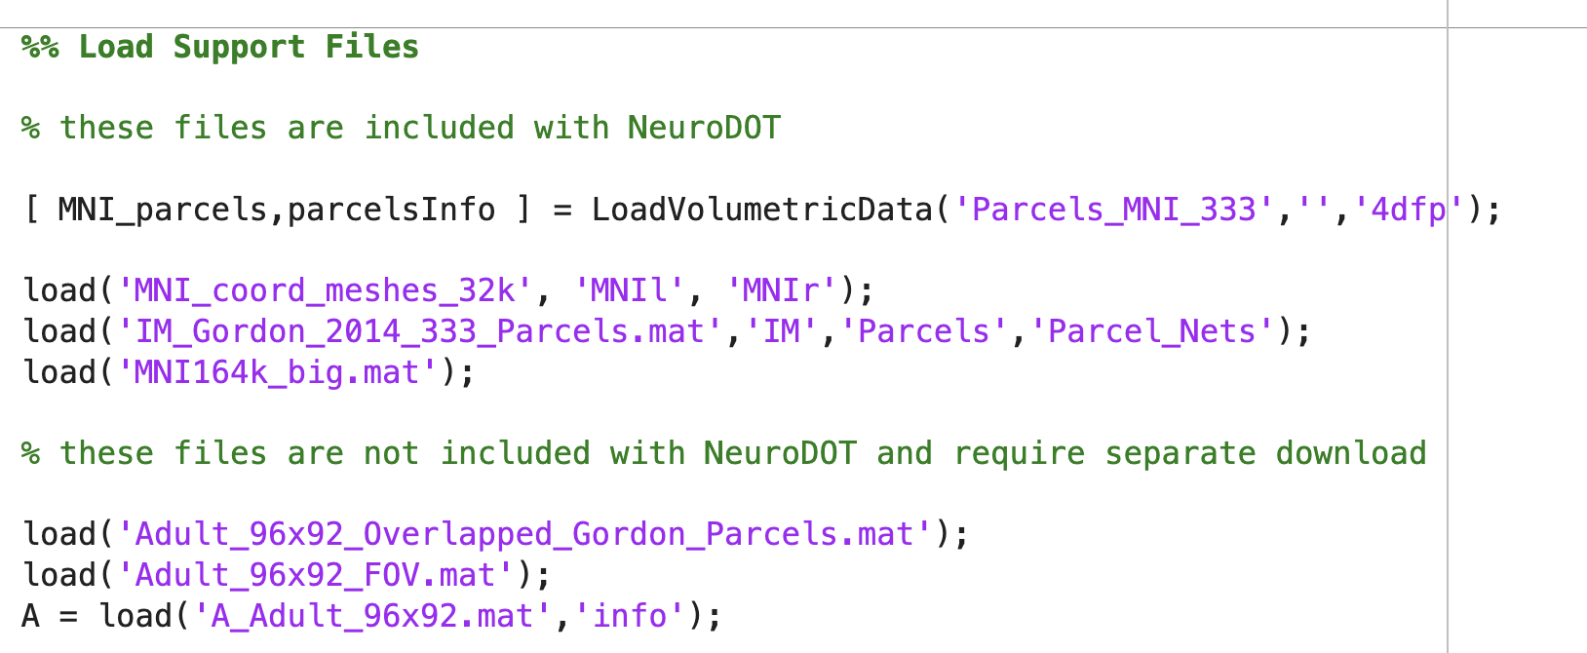
Example Script Details (2/5)
Additionally, a number of support files are required for the analysis.
The first group shown here are included with NeuroDOT and so should already be on the Matlab search path. The second group is not included with NeuroDOT. You will likely need to download these files and move them to the data directory specified in the previous slide.

Slide 6
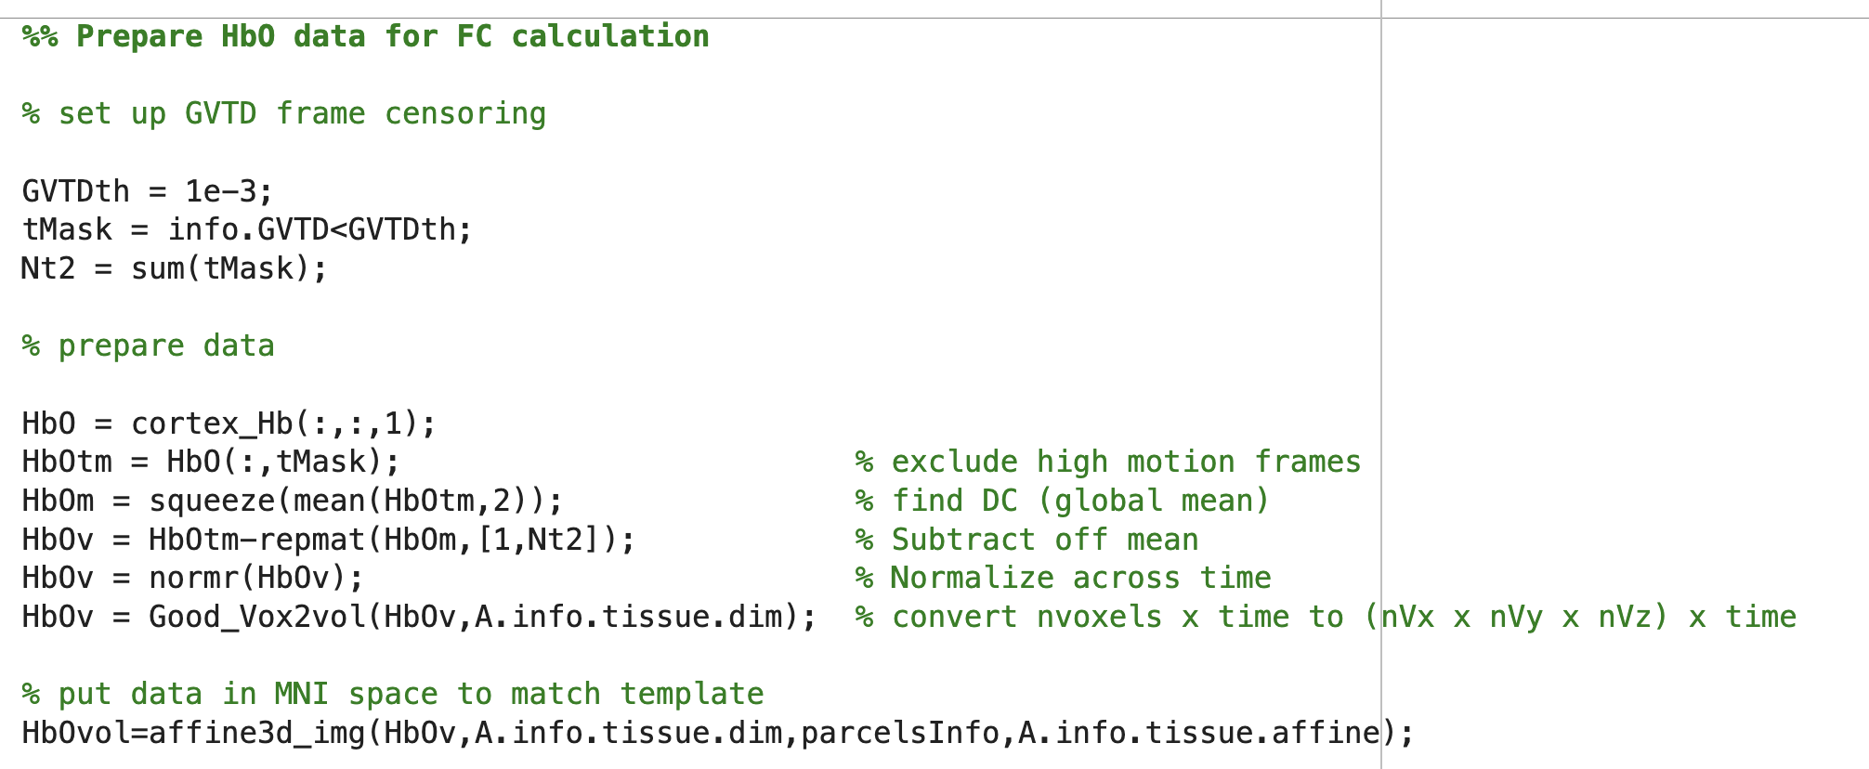
Example Script Details (3/5)
Next, the data is prepared for analysis. The variable cortex_Hb includes HbO and HbR – the former is extracted here, and any frames that exceed a GVTD threshold are deleted as high motion frames can introduce spurious correlations. The data is then demeaned, normalized, coverted to a volumetric format, and transformed into MNI space.

Slide 7
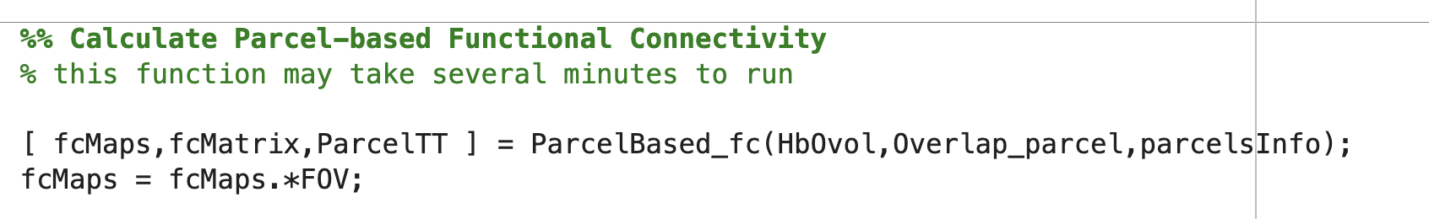
Example Script Details (4/5)
The processed data is passed to ParcelBased_fc for analysis.
The main result is returned in fcMaps, which for this data holds 142 3D arrays of correlation coefficients. The k-th array corresponds to the k-th parcel and the array values are the correlation of activity recorded in the k-th parcel to that recorded in every other parcel included in the analysis.
Cortical renders for eight selected parcels are generated in the final code section (see next slide).

Slide 8
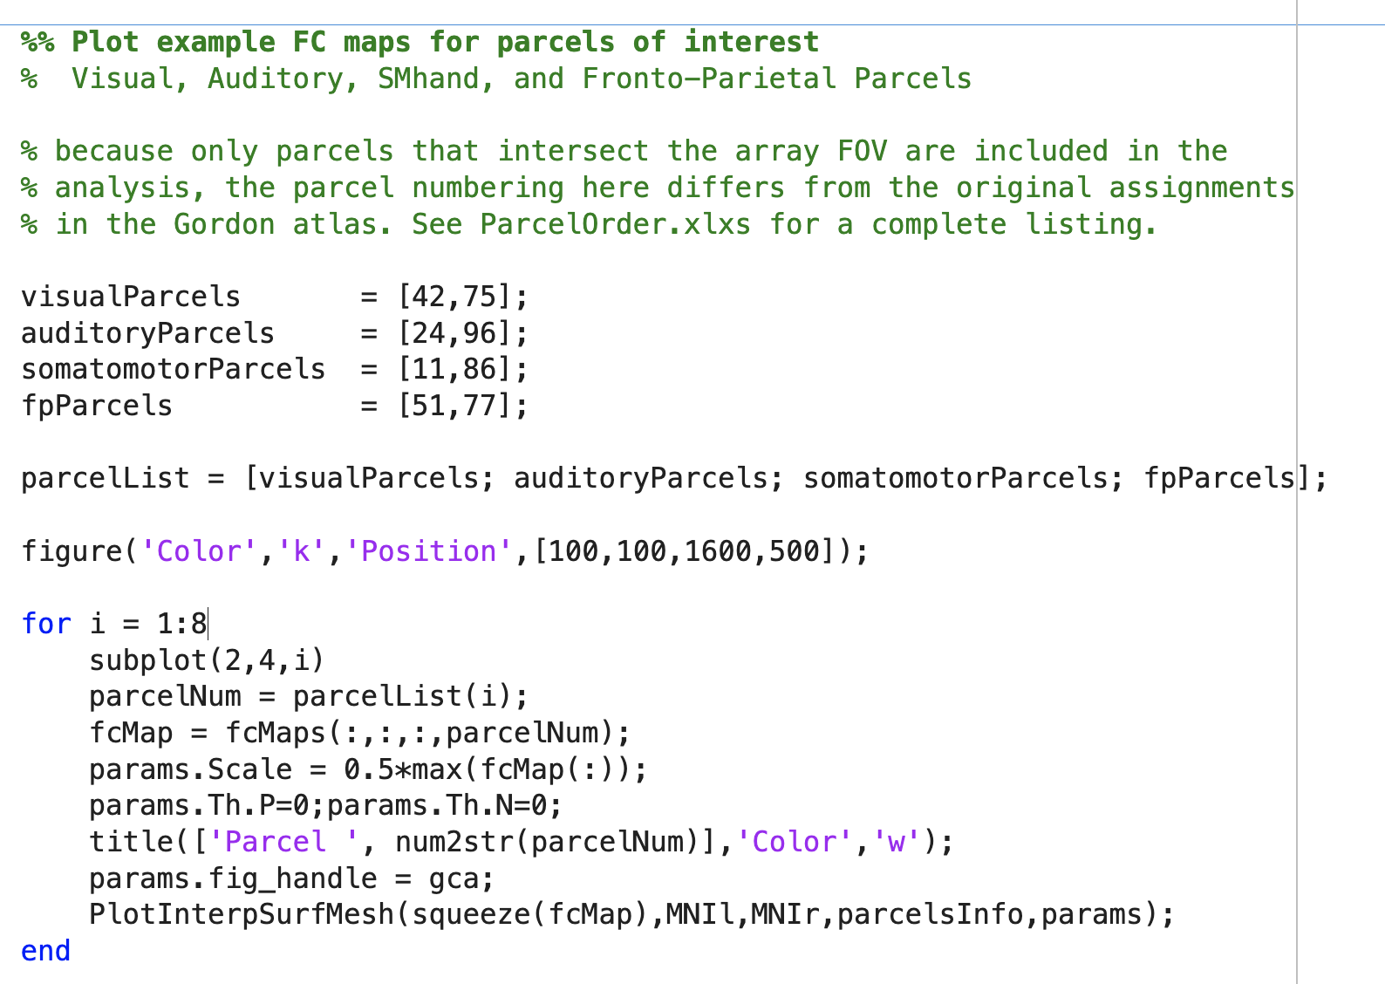
Example Script Details (5/5)
Eight maps are chosen for display, which includes parcels in the visual, auditory, somatomotor, and frontal-parietal networks. The code loop extracts the appropriate data from fcMaps, then renders the map using the NeuroDOT function PlotInterpSurfMesh. The final code block in the script (not shown enlarged) add titles to the plots. See the next slide for results.

Slide 9
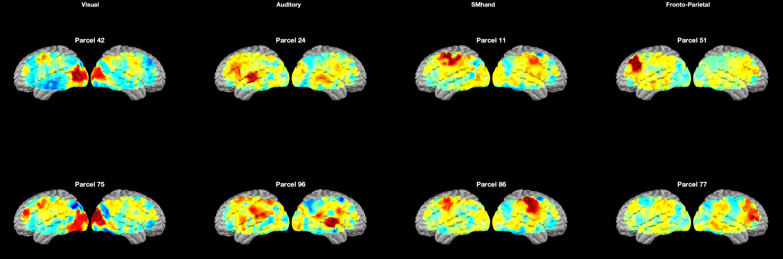
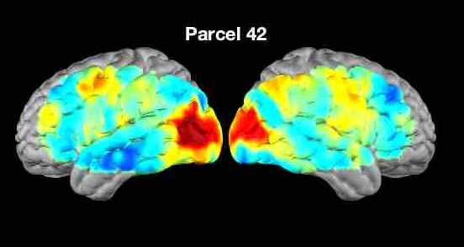
Example Script – Rendered FC Maps
Correlation maps of eight representative parcels are shown here rendered on the cortical surface.
The network for Parcel 42 (upper left panel in top figure) is shown enlarged at bottom. This parcel is located in the left occipital lobe. There is positive correlation in both ipsilateral and contralateral visual cortex, as well as weaker positive correlation in anterior regions bilaterally. Negative correlation values are observed in the left temporal and right prefrontal cortex.

