Slide 1

NeuroDOT
Spatial Transforms using affine3d_img

Slide 2
Table of Contents
3. Motivation : Why spatial transforms?
affine3d_img Usage
8. Basic usage
13. Including an explicit transform matrix
17. Specifying the interpolation method
Example Applications
21. The NeuroDOT reconstruction script
23. Visualizing a Flat Field Reconstruction
32. Mapping to Subject-specific Anatomy
Appendices
39. A1: The info struct
42. A2: A gallery of transforms defined using the info struct
50. A3: A gallery of transforms defined using the t4 matrix

Slide 3
Motivation:
Why do we need spatial transforms in NeuroDOT?

Slide 4
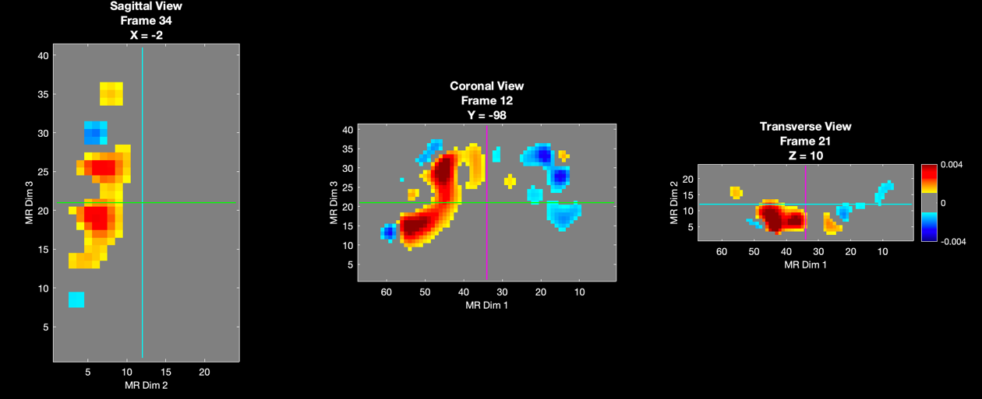
NeuroDOT provides tools for visualizing activation maps.
>> PlotSlices(my_activation)

Slide 5
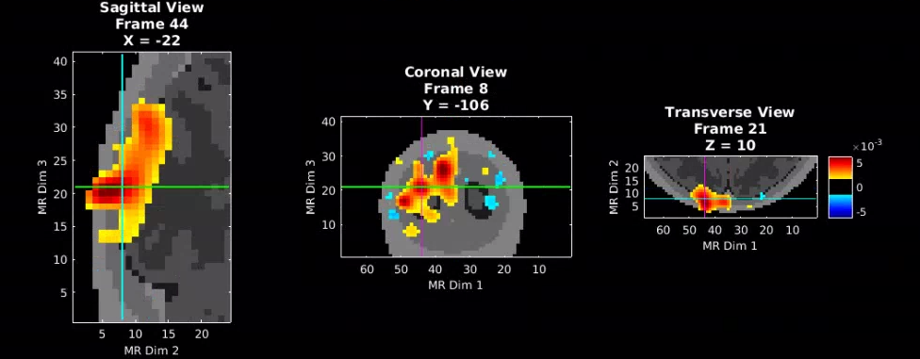
We would like to overlay these results on an anatomical template, like so:
This figure is taken from the Visualizaton tutorial included with NeuroDOT
color = activation; greyscale image = anatomical template

Slide 6
This requires passing our data and a template to Plotslices:
/NeuroDOT/Functions/Visualizations/PlotSlices.m
PlotSlices(template,[],[],my_activation)
(optional parameters are omitted here for clarity)

Slide 7
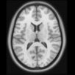

However, in this example, we need to extract the region of the template that is inside the bounding box of the data, and change the voxel size of the template to match the voxel size of the overlay.
Sometimes we may also need to scale, translate, and/or rotate the template to match the orientation of the overlay.
That is, we “affine transform the template into the space of the target image.”
anatomical template
(one of many included with NeuroDOT)
our data (and its bounding box)
Such transformations are performed in NeuroDOT using the function affine3d_img

Slide 8
affine3d_img : Basic usage
transformed_image = affine3d_img(image,image_info,target_info)
In words: Match image to target and return as transformed_image
The image may be an anatomical atlas and the target functional data to be superimposed on the atlas. Or, the functional data might be the image and the anatomical atlas the target. The goal is to align data that is in one space (image) with data that is in a different space (target) – which data we pass as ”image” and which as “target” depends on the application (examples to come).
Conceptually, we can think of the operation as proceeding in two steps…

Slide 9



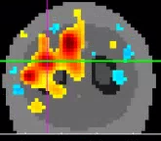
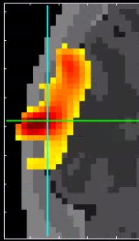
Step 1: Extract the region of the image inside the bounding box of the target.
in this example, the anatomical template is the IMAGE and the functional data is the TARGET (this will not always be the case).

Slide 10
Step 1: Extract the region of the image inside the bounding box of the target.

Slide 11

Step 1: Extract the region of the image inside the bounding box of the target.

Slide 12



Step 1: Extract the region of the image inside the bounding box of the target.
Step 2: Change the voxel size of the transformed image to match the target (this may require resampling / interpolation).
The transformed image can now be used for visualization.

Slide 13
affine3d_img : Including an explicit transform matrix
transformed_image = affine3d_img(image,image_info,target_info,t4)
In addition to clipping the image to the bounding box of the target and matching the voxel size, it may be necessary to scale, translate, rotate, and/or shear the image.
These operations can be included by passing an optional¹ 4x4 matrix t4 to affine3d_img that defines an affine transform to be applied as part of processing.
1. A transform is always applied in affine3d_img – however, the default t4 is simply an identity matrix.

Slide 14
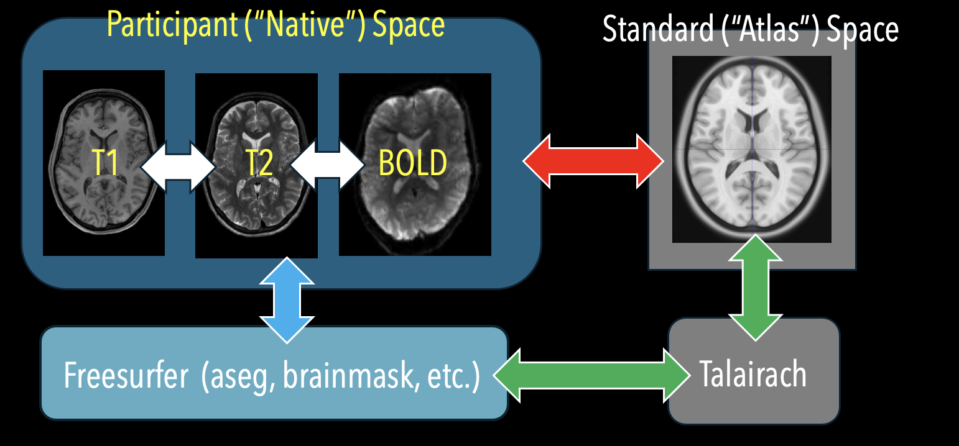
Common Affine Transforms Used in NeuroDOT
Each double arrow in this figure represents a 4x4 affine transform matrix (and its inverse). The WHITE arrows represent coregistration of native space data from different modalities, such as the participant’s T1, T2, and functional data. The RED arrow represents an affine transform between native space and atlas space¹. This can be calculated using a tool such as FSL FLIRT, although the matrix returned may need to be modified for use with affine3d_img. The CYAN arrow represents a transform of native space data applied by Freesurfer² in preparation for processing. Freesurfer results are transformed into atlas space first by transforming into Talairach space³ followed by a second transform into MNI space⁴ (GREEN arrows).
1. NeuroDOT includes several anatomical atlases based on the MNI152nl template. See …/Support_Files/Atlases in your distribution.
2. FreeSurfer is used to generate participant-specific head models. See: NeuroDOT_Tutorial_Participant_Specific_Head_Modeling.pptx.
3. This t4 matrix is generated by Freesurfer as …/mri/transforms/talairach.xfm.
4. This t4 matrix is included in the NeuroDOT distribution as …/Support_Files/Atlases/TT_to_MNI152_t4.

Slide 15
Usage details
transformed_image = affine3d_img(image,image_info,target_info,t4)
The parameter t4 is a 4x4 matrix:
• The diagonal elements (s•) define xyz scaling
• The off-diagonal elements (r••) define rotations (= combinations of direction cosines)
• The off-diagonal elements (r••) may define shearing (in certain combinations)
• Entries in the final column (t•) define xyz translations of the origin
• [0 0 0 1] is the standard fourth row of a 4X4 affine transform matrix
s_{x} r_{xy} r_{xz} t_{x}
r_{yx} s_{y} r_{yz} t_{y}
r_{zx} r_{zy} s_{z} t_{z}
(mnemonic: “t4” for “affine trans4orm”)
t4 =
0 0 0 1

Slide 16
Usage details (cont.)
• A common point of confusion is that the t4 matrix acts on the space not the data. Conceptually, think of it as transforming the target to the image (not the image to the target). If application of a transform produces unexpected results, you may need to apply the inverse transform instead (i.e., t4 = inv(t4)).
• A gallery of elementary transforms is provided in Appendix A3 that demonstrate how scaling, translation, rotation, and shearing are related to the t4 matrix entries. In practice, you usually do not create a t4 matrix by hand (except in some instances where a simple adjustment of the data is required). Instead, a t4 matrix is typically generated via image co-registration using software such as Freesurfer (example shown later).

Slide 17
affine3d_img : Specifying the interpolation method
transformed_image = affine3d_img(image,image_info,target_info,t4,interp)
affine3d_img allows you to explicitly specify an interpolation method as the final parameter.
The default is 'linear', but 'nearest' is recommended when working with some types of data, such as a segmented structural image (i.e., a structural image having integer voxel values indicating tissue class) or a binary mask (voxels values are either zero or one).
The next slide explains why.

Slide 18
inside-brain outside
This depicts a boundary at the edge of a binary mask that is to be transformed.
1 0
Depending on the relative voxel sizes of the input and target images, some voxels in the output image might straddle the boundary following transformation as indicated here.
1 1 1 0 0 0
Linear interpolation will assign an intermediate value to the voxel, which is not meaningful in this application.
1 1 1 0 0 0
0.5
0.5 is not a valid mask value
Instead, nearest interpolation is recommended as it will assign a valid value (i.e., 0 or 1) to the voxel. The same argument applies to a segmented image in which voxel values are integer tissue classes.
1 1 1 1 0 0 0

Slide 19
Summary: affine3d_img
Basic usage:
transformed_image = affine3d_img(image,image_info,target_info)
Including an explicit transform:
transformed_image = affine3d_img(image,image_info,target_info,t4)
Explicitly specifying the interpolation method:
transformed_image = affine3d_img(image,image_info,target_info,[],interp)
Specifying a transform and interpolation method:
transformed_image = affine3d_img(image,image_info,target_info,t4,interp)

Slide 20
Example Applications

Slide 21
Example 1
NeuroDOT_Visualization_Script.m

Slide 22
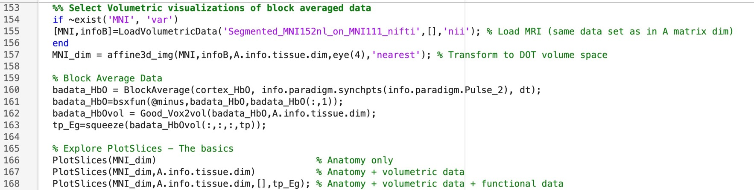
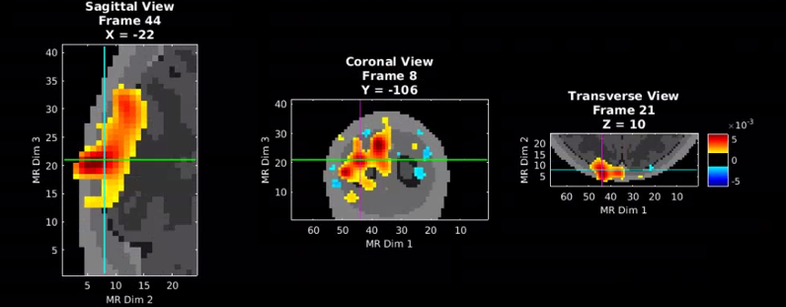
File: ~/NeuroDOT/Documentation/Scripts/NeuroDOT_Visualization_Script.m
Load the template
Transform the template to the data
Additional processing of the
data (data is generated
earlier in the script)
Plot the data on the template
A.info is the info struct for the A matrix
used in the analysis and is loaded
earlier in the script.

Slide 23
Example 2
Visualizing a Flat Field Reconstruction

Slide 24


Creating the FFR
>> load('A_AdultV24x28.mat','info','A’);
>> keep = (info.pairs.WL==2) & (info.pairs.r3d<40);
>> A = squeeze(A(keep,:));
>> iA = Tikhonov_invert_Amat(A,0.01,0.1);
>> iA = smooth_Amat(iA,info.tissue.dim,5);
>> FFR = makeFlatFieldRecon(A,iA);
>> FFR_as_vol = Good_Vox2vol(FFR,info.tissue.dim);
Matlab command window
See the video tutorial shown here for more information on creating a flat field reconstruction in NeuroDOT

Slide 25
Preparing for Visualization
>> template_fname = 'Segmented_MNI152nl_on_MNI111_nifti.nii';
>> [template,template_info] = LoadVolumetricData(template_fname);
>> % transform the template to the data space
>> template_clipped = affine3d_img(template, template_info, ...
info.tissue.dim, [], 'nearest');
>> % transform the data to the template space
>> FFR_in_wholebrainspace = affine3d_img(FFR_as_vol, info.tissue.dim, ...
template_info);
Results are plotted individually in the following slides for comparison...

Slide 26
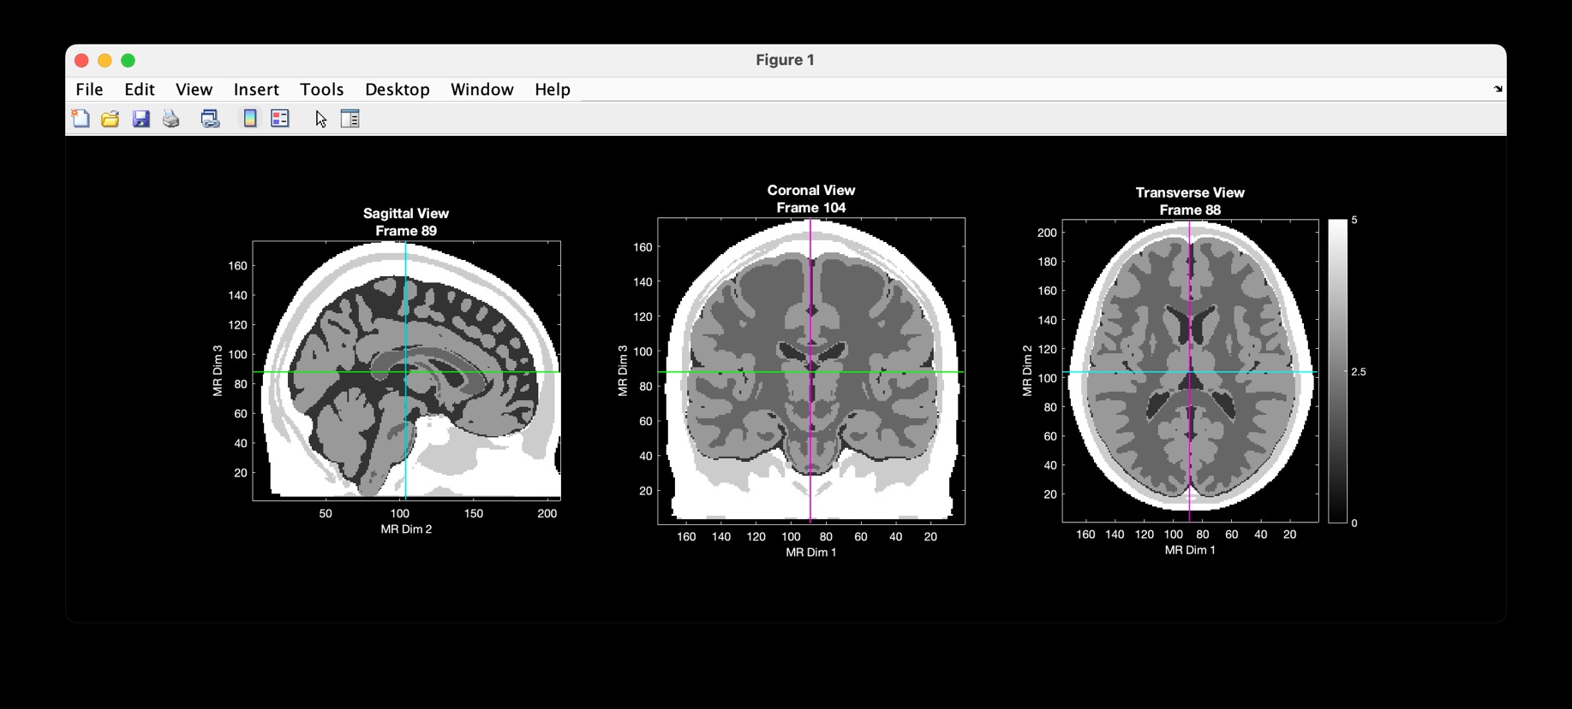
PlotSlices(template)

Slide 27
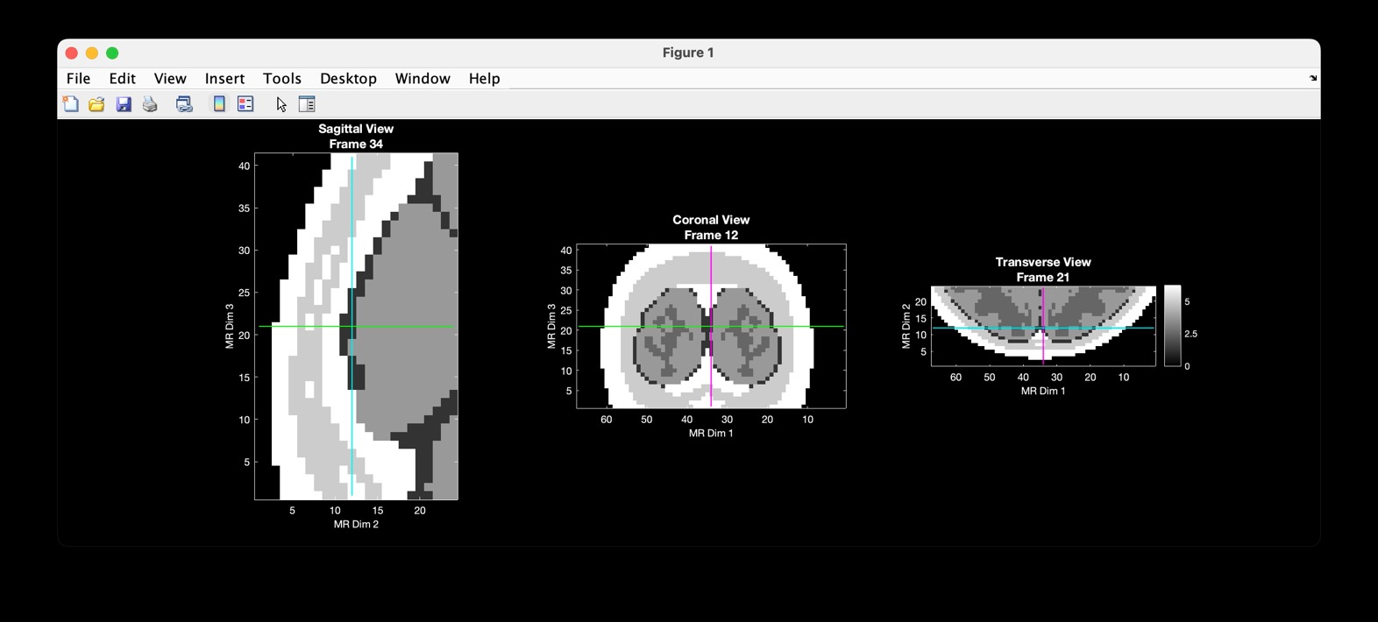
PlotSlices(template_clipped)

Slide 28
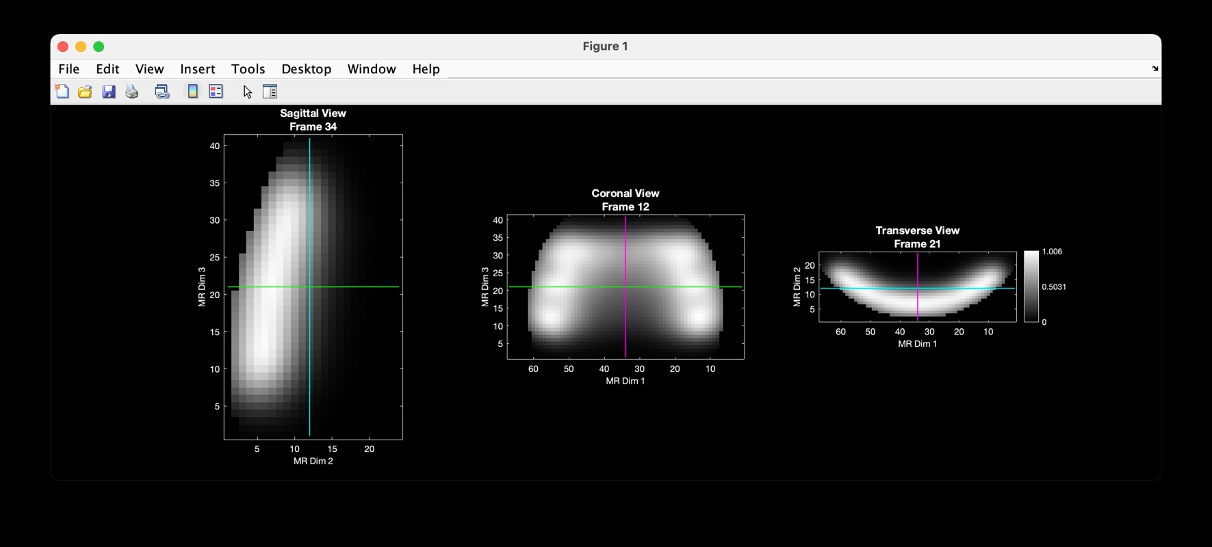
PlotSlices(FFR_as_vol)

Slide 29
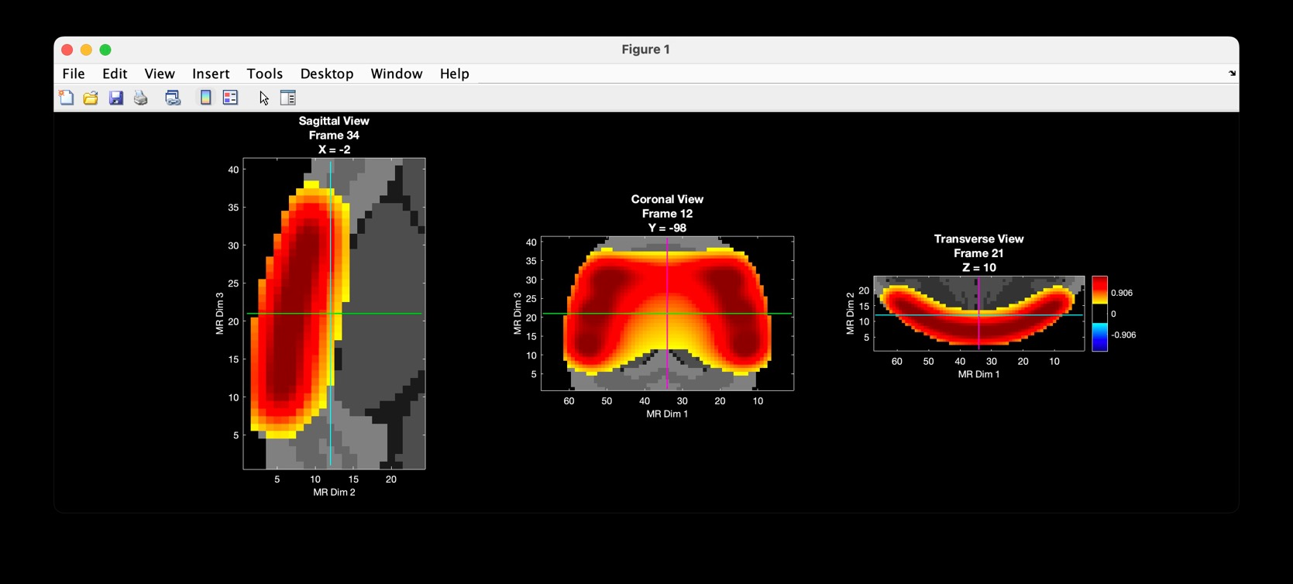
PlotSlices(template_clipped,info.tissue.dim,[],FFR_as_vol)

Slide 30
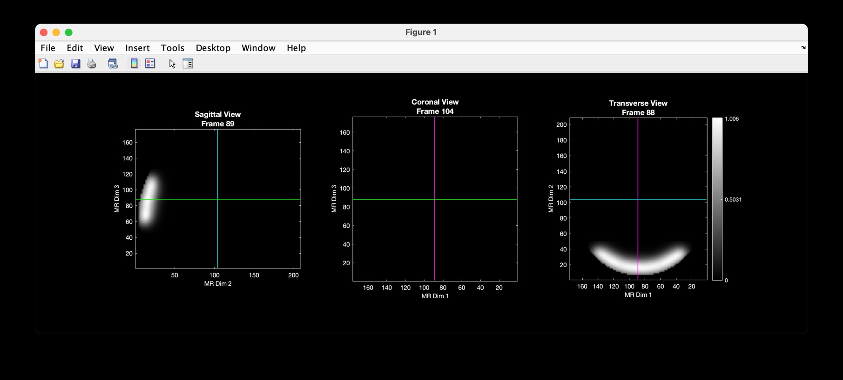
PlotSlices(FFR_in_wholebrainspace)

Slide 31
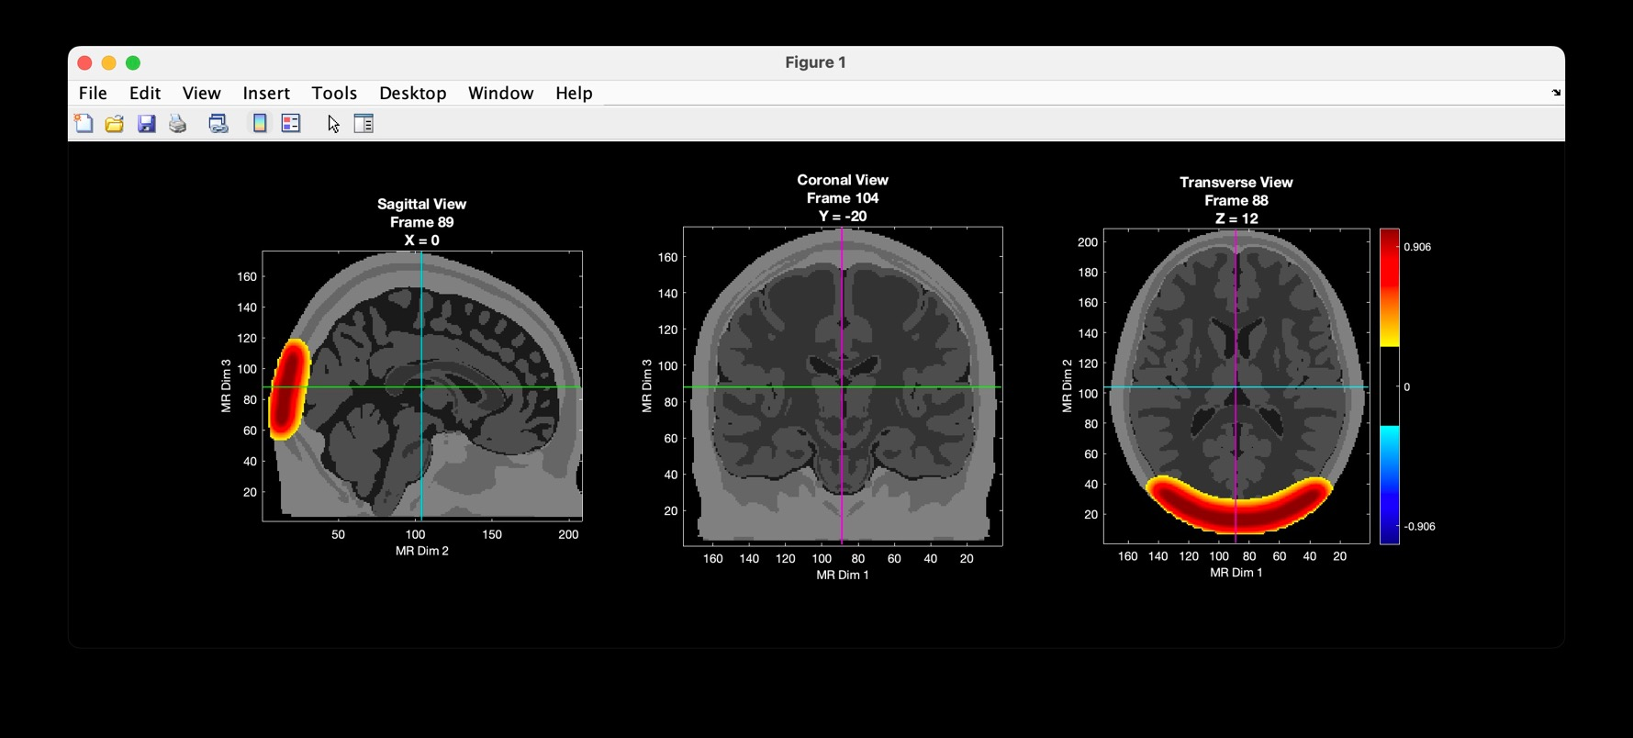
PlotSlices(template,template_info,[],FFR_in_wholebrainspace)

Slide 32
Example 3
Mapping to subject-specific anatomy
In this example, we load a subject T1 and use it to view the FFR. Because the head model used to create the FFR was based on the MNI atlas, we must transform the FFR into the T1 space.

Slide 33
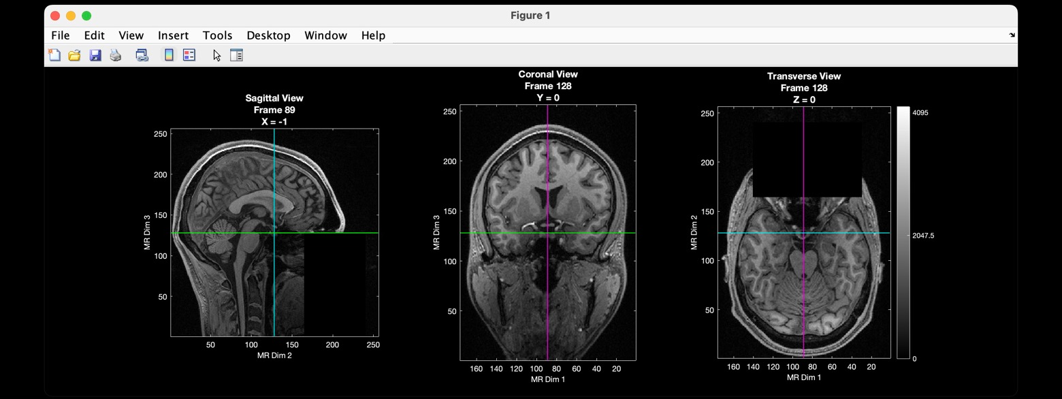
[ T1,T1_info ] = LoadVolumetricData('NeuroDOT_Example_T1.nii');
PlotSlices(T1,T1_info)
included in the NeuroDOT distribution

Slide 34
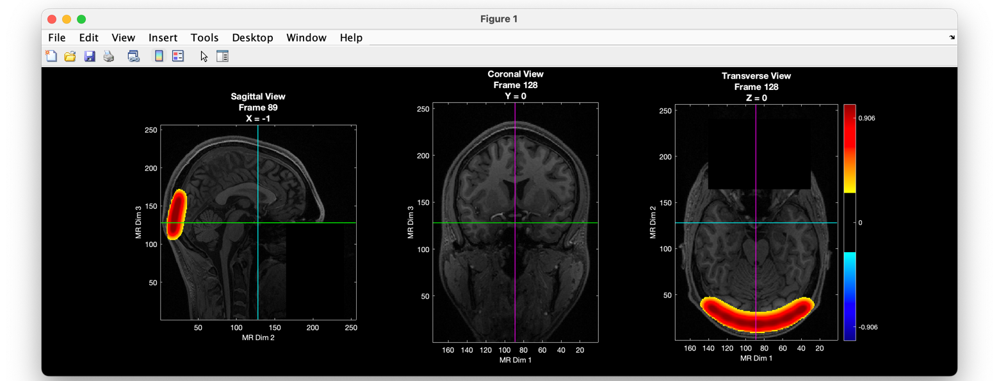
Here we match the bounding box and voxel size of the FFR to the subject T1 using affine3d_img:
FFR_in_subjectspace = affine3d_img(FFR_as_vol,info.tissue.dim,T1_info);
PlotSlices(T1,T1_info,[], FFR_in_subjectspace)

Slide 35
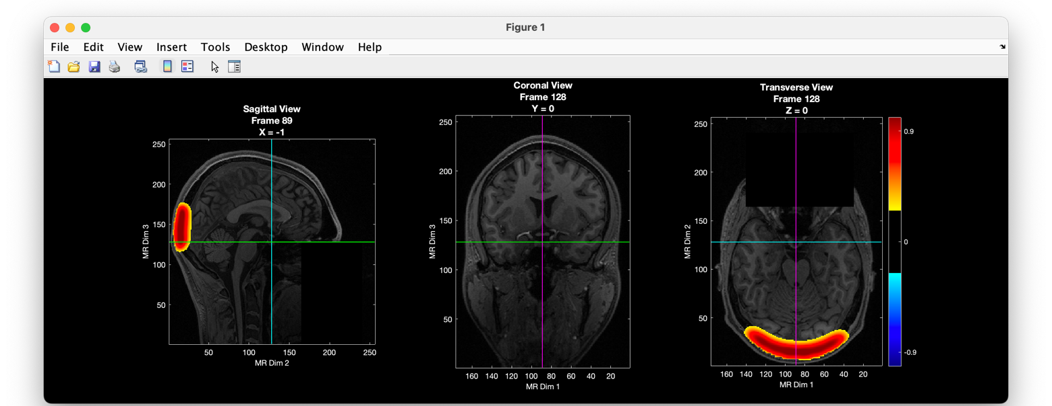
We can improve the FFR fit by adding an affine transform generated specifically for this subject.
See: NeuroDOT_Tutorial_Participant_Specific_Head_Modeling.pptx in the NeuroDOT distribution.
% t4 is from the head modeling tutorial listed above
FFR_in_subjectspace = affine3d_img(FFR_as_vol,info.tissue.dim,T1_info,t4);
PlotSlices(T1,T1_info,[], FFR_in_subjectspace)

Slide 36
That’s It (For Now)
Congratulations! You have finished the NeuroDOT Tutorial Spatial Transformations tutorial
You are now ready to start the other NeuroDOT Tutorials
Recommended order for the tutorials is:
  Preprocessing
  Image Reconstruction
  Generating a Light Model
  Full Data Processing
  Generating a Light Model PAD Adult 96x92
If you have any questions about the material presented in this tutorial, please consult the WUSTL Bio-photonics Research Center (BRC) GitHub page https://github.com/WUSTL-ORL/NeuroDOT in the documentation folder, or contact NeuroDOT Support: neurodot-support@wustl.edu

Slide 37
Help Expand NeuroDOT’s Utility!
Please fill out the NeuroDOT registration form to help us better develop the NeuroDOT toolbox and expand its utility to address your fNIRS/DOT data analysis needs:
  https://forms.gle/8QNGnx7ZbKuUHg3bA
Additionally, please provide specific feedback, or ask questions to the development team:
  https://forms.gle/jv6RkX5s784LgQC89
Note: you will not be contacted by the NeuroDOT development team unless you opt-in to receiving communications.

Slide 38
Appendices
A1 – The info struct
A2 – Example transforms defined using the info struct
A3 – Example transforms defined using the t4 matrix

Slide 39
A1: The “info” struct -- a closer look
.nVx
.nVy
.nVz
.mmppix
.center
the image dimensions in voxels
mmppix: change in image mm for a unit change in voxel index (sign indicates direction)
center: the image center
in mm
These five fields appear in several different structures that are generated in a typical NeuroDOT pipeline (see next two slides for examples). However, any structure can be passed to affine3d_img as image_info or target_info as long it contains these five fields. This slide lists the meaning of these data.
See NeuroDOT_Tutorial_Data_Organization.pptx to learn more about NeuroDOT data structures.

Slide 40
The info struct
returned by
LoadVolumetricData
version_of_keys: '3.3'
format: 'single'
conversion_program: 'NeuroDOT_LoadVolumetricData'
filename: 'Segmented_MNI152nl_on_MNI111_nifti.nii'
bytes_per_pixel: 4
byte: 'l'
acq: 'transverse'
nDim: 4
nVx: 176
nVy: 208
nVz: 176
nVt: 1
mmx: 1
mmy: 1
mmz: 1
mmppix: [1 -1 -1]
center: [89 -85 -101]
orientation: 2
original_header: [1×1 struct]

Slide 41
The info struct
xmin: -66
xmax: 67
ymin: -119
ymax: -72
zmin: -29
zmax: 52
xv: [67 65 63 61 59 57 55 53 … ] (1×67 double)
yv: [-119 -117 -115 -113 -111 … ] (1×24 double)
zv: [-29 -27 -25 -23 -21 -19 … ] (1×41 double)
center: [66 72 -52]
nVx: 67
nVy: 24
nVz: 41
nVt: 65928
sV: 2
acq: 'transverse'
mmppix: [2 -2 -2]
Good_Vox: [41496×1 double]
Ngv: 41496
tpos: [52×3 double]
saved with an A matrix
(A.info.tissue.dim)

Slide 42
A2: Example transforms defined using the info structure
This appendix contains a gallery of elementary transforms defined by setting individual fields in the info structure. This is not something you will likely do in practice; rather, these examples are provided to illustrate how the info structure fields relate to the transform applied to the image.
Optional parameters are omitted in function calls whenever possible to simplify the code.
An overlay is not used in these examples. The goal is to illustrate the effect of the transformation on the image.

Slide 43
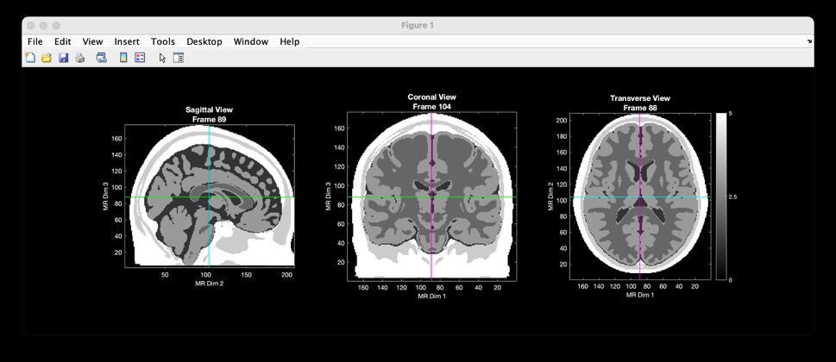
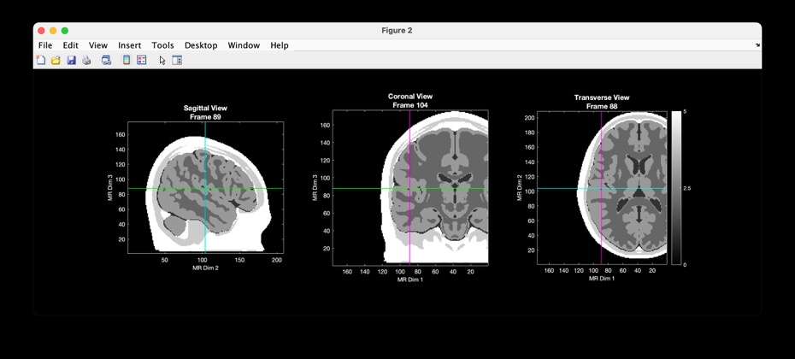
Example 1: Translate the x-origin
% load and plot template
[imgA,infoA] = LoadVolumetricData('Segmented_MNI152nl_on_MNI111_nifti.nii');
PlotSlices(imgA);
infoB = infoA; % initialize infoB
infoB.center(1) = infoB.center(1) + 50; % change the relevant field
imgB = affine3d_img(imgA,infoA,infoB); % generate the new image data
PlotSlices(imgB); % plot the transformed template
imgA
imgB

Slide 44
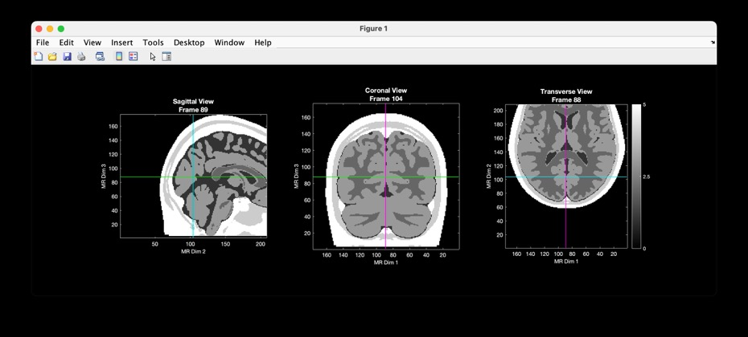
Example 2: Translate the y-origin
% load and plot template
[imgA,infoA] = LoadVolumetricData('Segmented_MNI152nl_on_MNI111_nifti.nii');
PlotSlices(imgA);
infoB = infoA; % initialize infoB
infoB.center(2) = infoB.center(2) + 50; % change the relevant field
imgB = affine3d_img(imgA,infoA,infoB); % generate the new image data
PlotSlices(imgB); % plot the transformed template
imgA
imgB

Slide 45
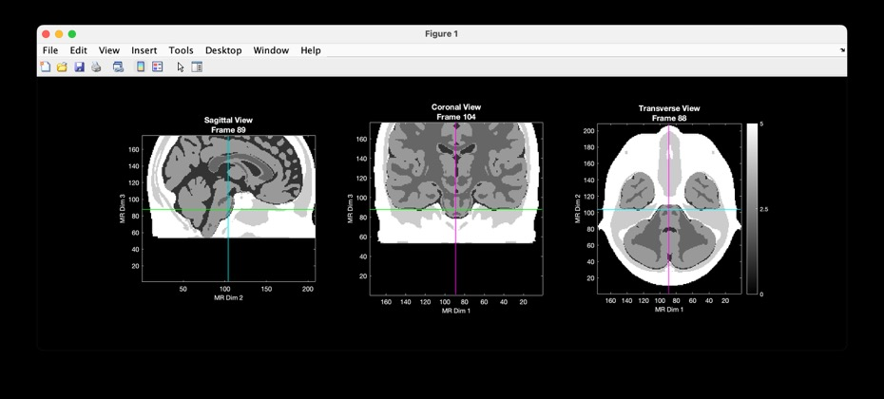
Example 3: Translate the z-origin
% load and plot template
[imgA,infoA] = LoadVolumetricData('Segmented_MNI152nl_on_MNI111_nifti.nii');
PlotSlices(imgA);
infoB = infoA; % initialize infoB
infoB.center(3) = infoB.center(3) + 50; % change the relevant field
imgB = affine3d_img(imgA,infoA,infoB); % generate the new image data
PlotSlices(imgB); % plot the transformed template
imgA
imgB

Slide 46
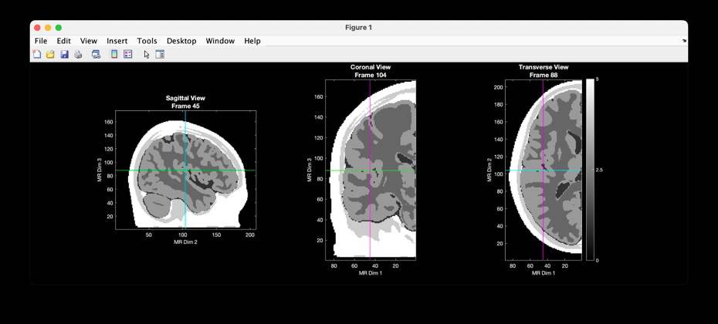
Example 4: Change the image width
% load and plot template
[imgA,infoA] = LoadVolumetricData('Segmented_MNI152nl_on_MNI111_nifti.nii');
PlotSlices(imgA);
infoB = infoA; % initialize infoB
infoB.nVx = infoA.nVx / 2; % change the relevant field
imgB = affine3d_img(imgA,infoA,infoB); % generate the new image data
PlotSlices(imgB); % plot the transformed template
imgA
imgB

Slide 47
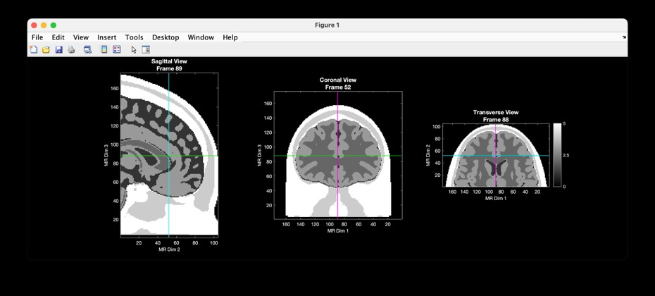
Example 5: Change the image depth
% load and plot template
[imgA,infoA] = LoadVolumetricData('Segmented_MNI152nl_on_MNI111_nifti.nii');
PlotSlices(imgA);
infoB = infoA; % initialize infoB
infoB.nVy = infoA.nVy / 2; % change the relevant field
imgB = affine3d_img(imgA,infoA,infoB); % generate the new image data
PlotSlices(imgB); % plot the transformed template
imgA
imgB

Slide 48
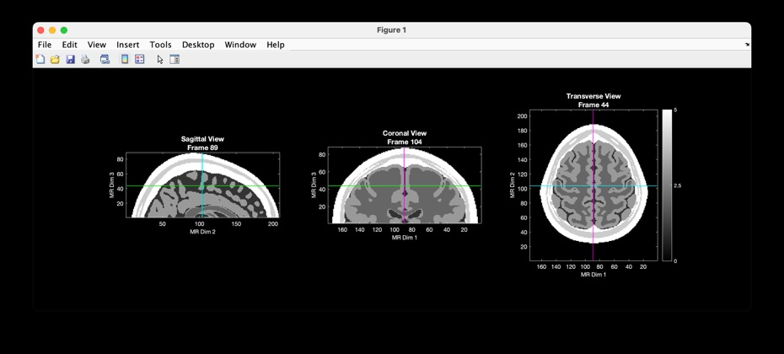
Example 6: Change the image height
% load and plot template
[imgA,infoA] = LoadVolumetricData('Segmented_MNI152nl_on_MNI111_nifti.nii');
PlotSlices(imgA);
infoB = infoA; % initialize infoB
infoB.nVz = infoA.nVz / 2; % change the relevant field
imgB = affine3d_img(imgA,infoA,infoB); % generate the new image data
PlotSlices(imgB); % plot the transformed template
imgA
imgB

Slide 49
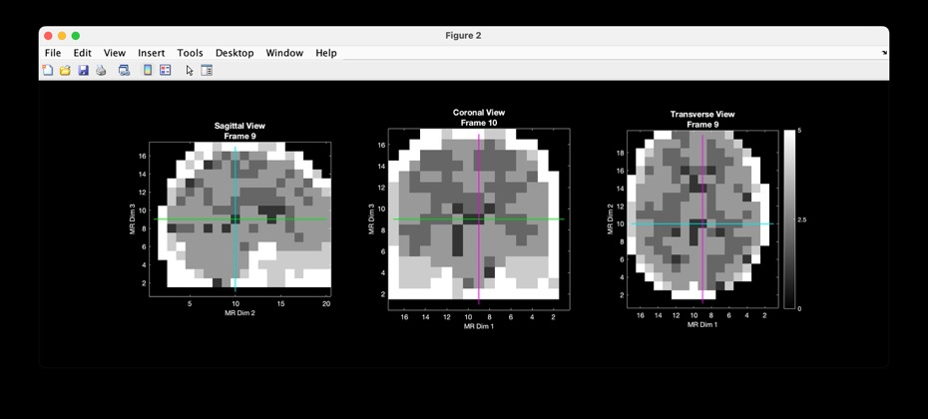
Example 7: Change voxel resolution
% load and plot template
[imgA,infoA] = LoadVolumetricData('Segmented_MNI152nl_on_MNI111_nifti.nii');
PlotSlices(imgA);
infoB = infoA; % initialize infoB
infoB.nVx=infoA.nVx/10;infoB.nVy=infoA.nVy/10;infoB.nVz=infoA.nVz/10;
infoB.mmppix=10*infoA.mmppix; % change the relevant field
imgB = affine3d_img(imgA,infoA,infoB); % generate the new image data
PlotSlices(imgB); % plot the transformed template
imgA
imgB

Slide 50
A3: Example transforms defined using the t4 matrix
This appendix contains a gallery of elementary transforms defined by setting entries in the t4 matrix. This is not something you will likely do in practice; rather, these examples are provided to illustrate how the matrix entries relate to the transform applied to the image.
Optional parameters are omitted in function calls whenever possible to simplify the code.
An overlay is not used in these examples. The goal is to illustrate the effect of the transformation on the image.

Slide 51
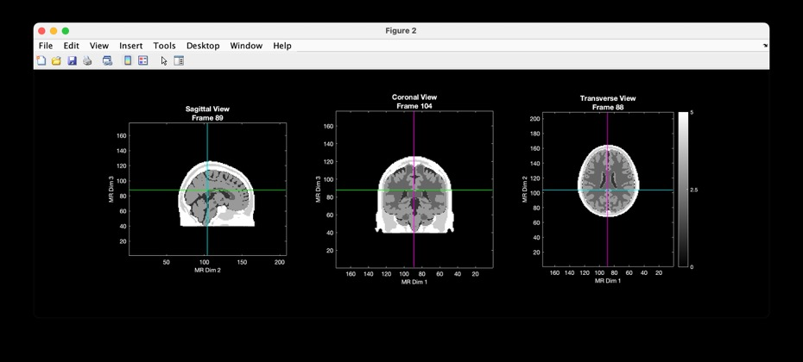
Example 8: Scale by 1/2
% load and plot template
[imgA,infoA] = LoadVolumetricData('Segmented_MNI152nl_on_MNI111_nifti.nii');
PlotSlices(imgA);
infoB = infoA; % initialize infoB
t4 = [2 0 0 0; 0 2 0 0; 0 0 2 0; 0 0 0 1]; % scale x 0.5¹
imgB = affine3d_img(imgA,infoA,infoB,t4); % generate the new image data
PlotSlices(imgB); % plot the transformed template
imgA
imgB

Slide 52
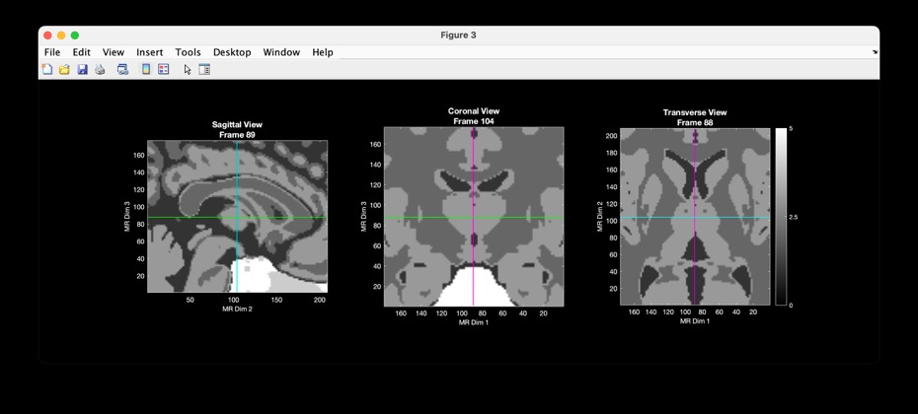
Example 9: Scale by 2
% load and plot template
[imgA,infoA] = LoadVolumetricData('Segmented_MNI152nl_on_MNI111_nifti.nii');
PlotSlices(imgA);
infoB = infoA; % initialize infoB
t4 = [.5 0 0 0; 0 .5 0 0; 0 0 .5 0; 0 0 0 1]; % scale x 2
imgB = affine3d_img(imgA,infoA,infoB,t4); % generate the new image data
PlotSlices(imgB); % plot the transformed template
imgA
imgB

Slide 53
Note the convention used by affine3d_img is FROM the output TO the input* :
diagonal entries > 1 make the output SMALLER
t4 = [2 0 0 0; 0 2 0 0; 0 0 2 0; 0 0 0 1];
diagonal entries < 1 make the output LARGER
t4 = [.5 0 0 0; 0 .5 0 0; 0 0 .5 0; 0 0 0 1];
* technically, this is because the transform matrix acts on the space not the data,
but it’s easier to describe the effect in terms of how the data is changed

Slide 54
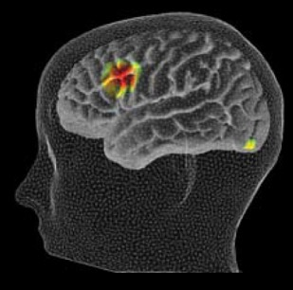
Rotation Overview
z
y
1 0 0 0
0 C S 0
0 -S C 0
0 0 0 1
about x:
x
C 0 -S 0
0 1 0 0
S 0 C 0
0 0 0 1
C -S 0 0
S C 0 0
0 0 1 0
0 0 0 1
about y:
about z:
C = cos(angle) S = sin(angle)

Slide 55
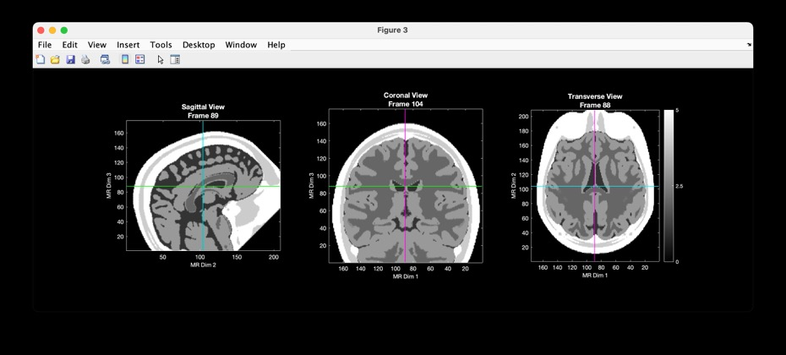
Example 10: Rotate about x-axis
% load and plot template
[imgA,infoA] = LoadVolumetricData('Segmented_MNI152nl_on_MNI111_nifti.nii');
PlotSlices(imgA);
infoB = infoA; % initialize infoB
theta = pi/4; c = cos(theta); s = sin(theta); % rotate by 45 degrees
t4 = [ 1 0 0 0 ; 0 c s 0 ; 0 -s c 0; 0 0 0 1];
imgB = affine3d_img(imgA,infoA,infoB,t4); % generate the new image data
PlotSlices(imgB); % plot the transformed template
imgA
imgB

Slide 56
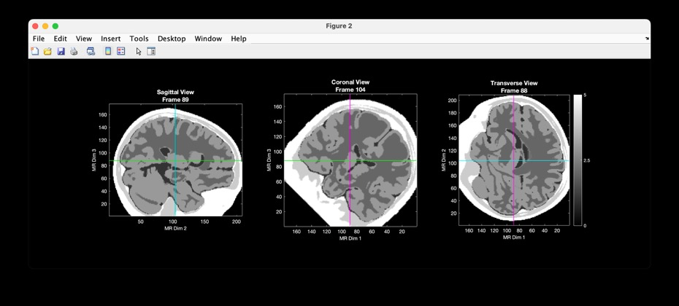
Example 11: Rotate about y-axis
% load and plot template
[imgA,infoA] = LoadVolumetricData('Segmented_MNI152nl_on_MNI111_nifti.nii');
PlotSlices(imgA);
infoB = infoA; % initialize infoB
theta = pi/4; c = cos(theta); s = sin(theta); % rotate by 45 degrees
t4 = [ c 0 -s 0; 0 1 0 0; s 0 c 0; 0 0 0 1 ];
imgB = affine3d_img(imgA,infoA,infoB,t4); % generate the new image data
PlotSlices(imgB); % plot the transformed template
imgA
imgB

Slide 57
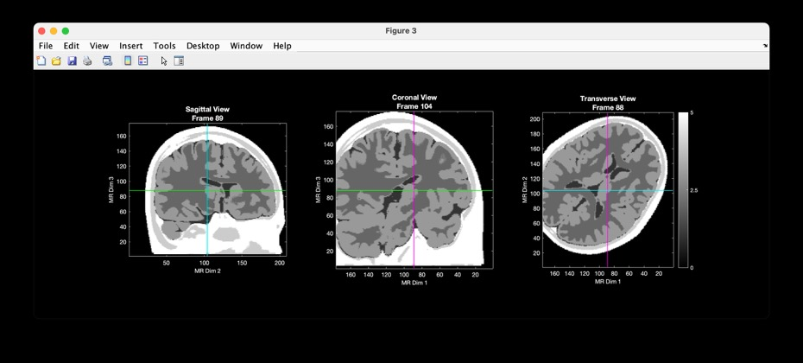
Example 12: Rotate about z-axis
% load and plot template
[imgA,infoA] = LoadVolumetricData('Segmented_MNI152nl_on_MNI111_nifti.nii');
PlotSlices(imgA);
infoB = infoA; % initialize infoB
theta = pi/4; c = cos(theta); s = sin(theta); % rotate by 45 degrees
t4 = [ c -s 0 0; s c 0 0; 0 0 1 0; 0 0 0 1 ];
imgB = affine3d_img(imgA,infoA,infoB,t4); % generate the new image data
PlotSlices(imgB); % plot the transformed template
imgA
imgB

Slide 58
Shear Overview
s_{x} r_{xy} r_{xz} t_{x}
r_{yx} s_{y} r_{yz} t_{y}
r_{zx} r_{zy} s_{z} t_{z}
0 0 0 1
• r_{xy} and r_{yx} define shear in the xy plane (z is unchanged)
• r_{xz} and r_{zy} define shear in the xz plane (y is unchanged)
• r_{yz} and r_{zy} define shear in the yz plane (x is unchanged)
Note these matrix entries are also used to define rotations,
albeit constraining their relative values (to sine and cosine).

Slide 59
Example: xy shear
y
y’
m
1 0 0
0 1 0 0
0 0 1 0
x’= x + my
y’= y
z’= z
:
0 0 0 1
x
x’
y
y’
1 0 0 0
1 0 0
0 0 1 0
x’= x
y’= y + mx
z’= z
m
:
0 0 0 1
x
x’

Slide 60
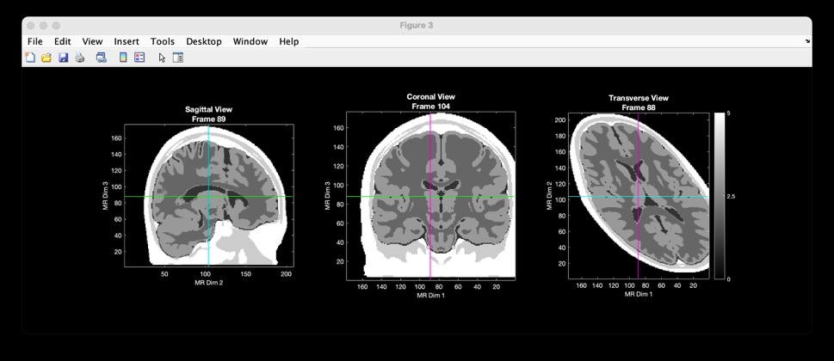
Example 13: Shear along x
% load and plot template
[imgA,infoA] = LoadVolumetricData('Segmented_MNI152nl_on_MNI111_nifti.nii');
PlotSlices(imgA);
infoB = infoA; % initialize infoB
t4 = [1 .5 0 0 ; 0 1 0 0; 0 0 1 0; 0 0 0 1]; % Sxy = 0.5
imgB = affine3d_img(imgA,infoA,infoB,t4); % generate the new image data
PlotSlices(imgB); % plot the transformed template
imgA
imgB

Slide 61
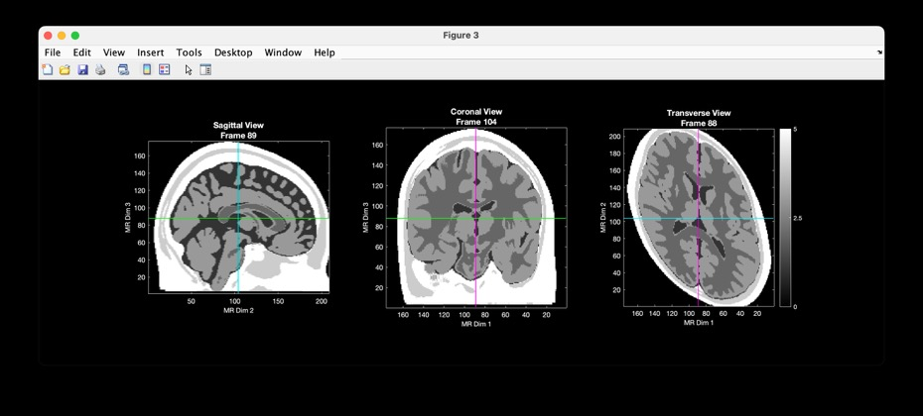
Example 14: Shear along y
% load and plot template
[imgA,infoA] = LoadVolumetricData('Segmented_MNI152nl_on_MNI111_nifti.nii');
PlotSlices(imgA);
infoB = infoA; % initialize infoB
t4 = [1 0 0 0 ; .5 1 0 0; 0 0 1 0; 0 0 0 1]; % Syx = 0.5
imgB = affine3d_img(imgA,infoA,infoB,t4); % generate the new image data
PlotSlices(imgB); % plot the transformed template
imgA
imgB

Slide 62
Translation Overview
s_{x} r_{xy} r_{xz} t_{x}
r_{yx} s_{y} r_{yz} t_{y}
r_{zx} r_{zy} s_{z} t_{z}
0 0 0 1
Translation of the origin in the x, y, and/or z direction can be performed using the t4 matrix as an alternative to setting values in the .center field of the info struct.

Slide 63

Example 15: Translate the x origin
% load and plot template
[imgA,infoA] = LoadVolumetricData('Segmented_MNI152nl_on_MNI111_nifti.nii');
PlotSlices(imgA);
infoB = infoA; % initialize infoB
t4 = [1 0 0 -50; 0 1 0 0; 0 0 1 0; 0 0 0 1]; % tx = 50
imgB = affine3d_img(imgA,infoA,infoB,t4); % generate the new image data
PlotSlices(imgB); % plot the transformed template
imgA
imgB

Slide 64
Example 1: Translate the x-origin
Example 15: Translate the x-origin
infoB.center(1) = infoB.center(1) + 50;
t4 = [1 0 0 -50; 0 1 0 0; 0 0 1 0; 0 0 0 1]
Footnote: Example 15 implements the same transformation demonstrated in Example 1. However, when using the t4 matrix, the translation is negative. Technically, this is because the t4 matrix acts on the space not the data. However, a simple mnemonic is that the t4 matrix transforms the output to the input, not input to output (this has been true in all of the examples, but it becomes obvious when applying translations).
As such, t4(1,4) here must be negative.

Slide 65
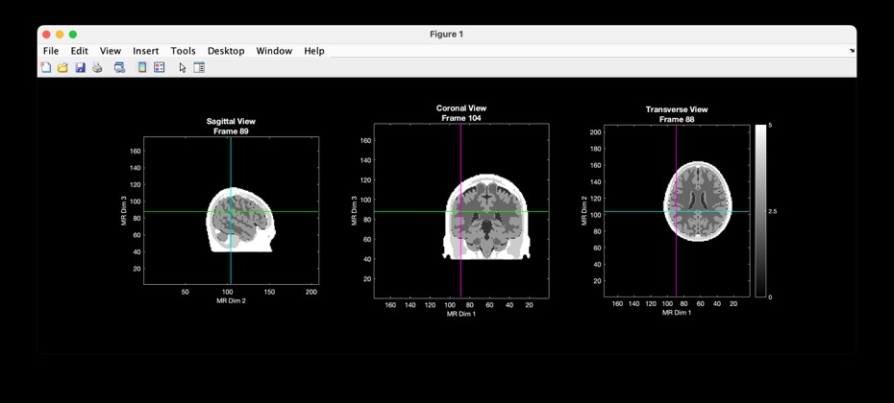
Example 16: Scale and translate
% load and plot template
[imgA,infoA] = LoadVolumetricData('Segmented_MNI152nl_on_MNI111_nifti.nii');
PlotSlices(imgA);
infoB = infoA; % initialize infoB
t4 = [2 0 0 -50; 0 2 0 0; 0 0 2 0; 0 0 0 1]; % scale *and* translate
imgB = affine3d_img(imgA,infoA,infoB,t4); % generate the new image data
PlotSlices(imgB); % plot the transformed template
Multiple transforms can be combined into a single matrix, as this example demonstrates.
imgA
imgB

Slide 66
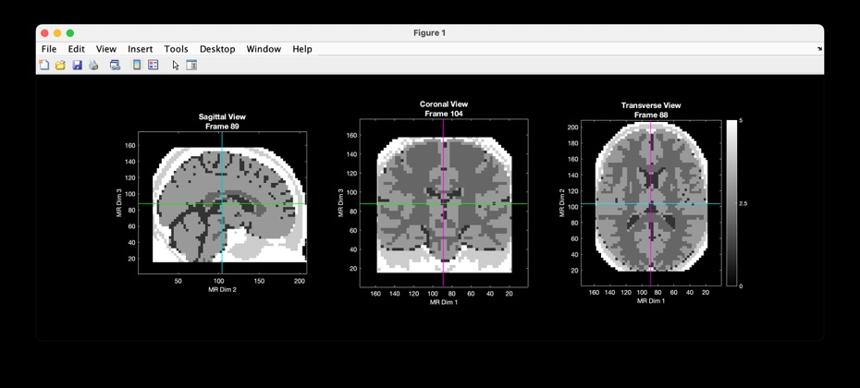
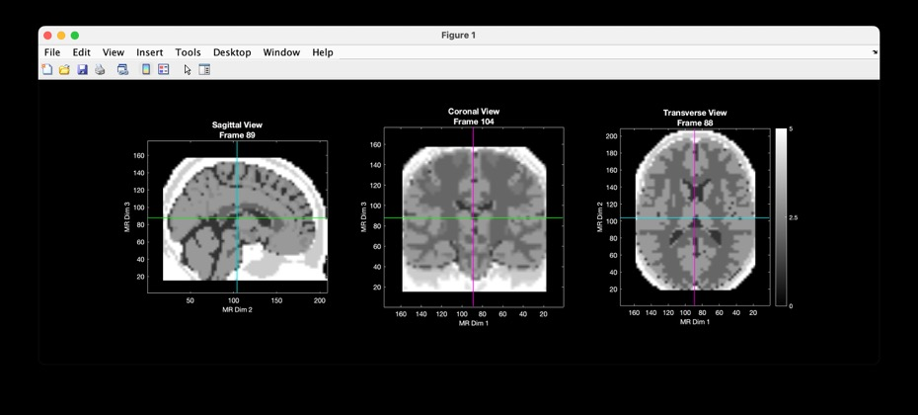
Example 17: Demonstrating interpolation effects
[~,info111] = LoadVolumetricData('Segmented_MNI152nl_on_MNI111_nifti.nii');
[img333,info333] = LoadVolumetricData('Segmented_MNI152nl_on_333_nifti.nii');
imgA = affine3d_img(img333,info333,info111,[],'nearest');
PlotSlices(imgA);
imgB = affine3d_img(img333,info333,info111,[],'linear’);
PlotSlices(imgB);
imgA
imgB – note blurring at tissue boundaries

