Slide 1

NeuroDOT
Tutorial:
Getting Started

Slide 2
Welcome to NeuroDOT
This tutorial will cover the following topics:
Installing software dependencies
Setting a path in MATLAB
Via Toolbar
Via Command Window
Via Current Folder Window
The difference between PowerPoint tutorials and tutorial scripts
How to run through a PowerPoint tutorial and its associated script
Line by line evaluation
Setting and using breakpoints
Potential Issue
Closing figures

Slide 3
Install Software Dependencies
Before you start, you must install the following dependencies to successfully run NeuroDOT.
Matlab 2020b and add-on toolboxes:
Signal Processing Toolbox
Deep Learning Toolbox
Image Processing Toolbox
Statistics and Machine Learning Toolbox
Parallel Computing Toolbox
NIRFASTer (https://github.com/nirfaster/NIRFASTer)
SNIRF (https://github.com/fNIRS/snirf)
easyh5 (https://github.com/NeuroJSON/easyh5)
jsnirfy (https://github.com/NeuroJSON/jsnirfy)
GIFTI (https://github.com/gllmflndn/gifti)
FreeSurfer 7.2 (https://surfer.nmr.mgh.harvard.edu/fswiki/rel7downloads)
Connectome Workbench (https://humanconnectome.org/software/get-connectome-workbench)

Slide 4
MATLAB Tips: Setting the path
What is a path?
It is the set of folders, subfolders, and contents thereof that MATLAB has access to during your session
When should I set my path?
This should be the first thing you do after opening matlab
How do I set my path? – 3 methods
Via the “add to path” option on the MATLAB toolbar
Via the command window: addpath(genpath(‘put your file path here’)
Via the current folder window in MATLAB
Note: each of the above 3 methods will give you the same end result

Slide 5
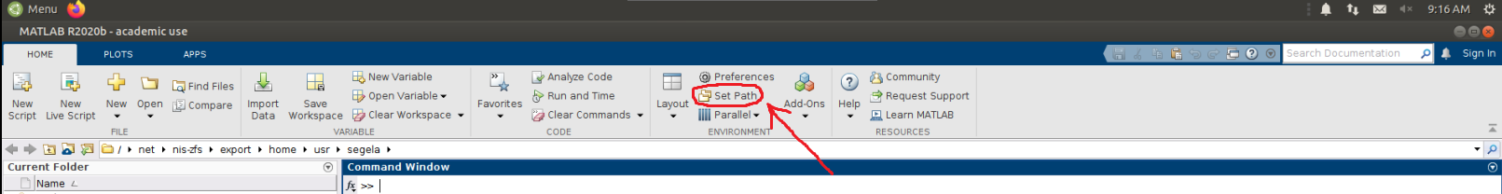
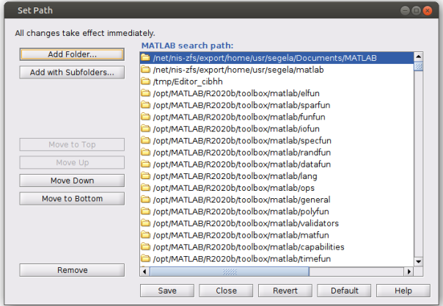
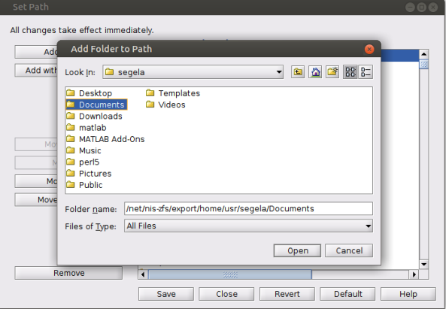
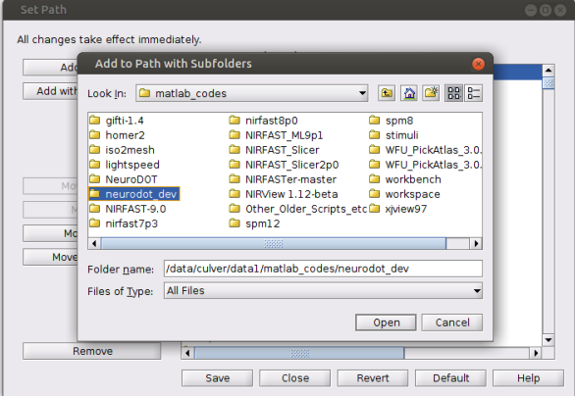
How to Set the Path - Toolbar
Via the toolbar
Instructions:
Click on the set path button
in the home tab of the MATLAB toolbar (circled in red on the right)
Box 1 will open up
Click add folder
Browse the folders that you can add to your path
Example 1: adding only the documents folder
Click on documents, and then open (box 2)
Example 2: adding the entire neuroDOT toolbox
Click “Add with Subfolders…” (box 1) and then “neurodot_dev” (box 3)
Disclaimer: file paths and folder names shown in these slides may not be exactly what you will see on your own device
Note: box 2 and box 3 file paths will not be the same as the ones you see on your device
Note: This method will give you the same result as the following two methods
Box 1
Box 2
Box 3

Slide 6
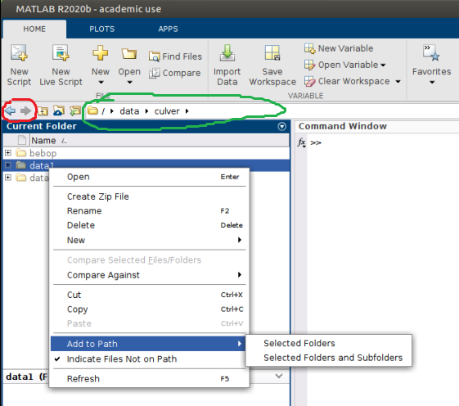
How to Set the Path - Current Folder
Instructions:
In the current folder window, navigate to the folder that you want to add to your path using:
The arrows (circled in red)
Copy and pasting your desired path in the search bar (circled in green)
Right click on the folder you want to add
Hover over the “Add to Path” option
Click either “Selected Folders” or “Selected Folders and Subfolders” depending on your needs
Note: “Selected Folders and Subfolders” will ad everything located downstream of that folder

Slide 7
How to Load Data: Overview
The following slides will cover the following topics:
Loading Raw Data in NeuroDOT
*.mat: NeuroDOT native format
*.snirf: Shared Near Infrared Spectroscopy Format
*.nirs: Near Infrared Spectroscopy Format
The PowerPoint “Tutorial_for_Loading_Raw_Data” and the following slides show you how to load raw data in NeuroDOT from *.mat, *.snirf, and *.nirs file formats.
The code shown on the following slides can be found in the “Script_for_Loading_Raw_Data”

Slide 8
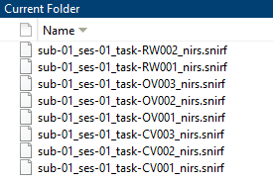

How to Load Data
Before loading your raw data, change your current directory to the folder containing your raw data.
First, select which file you want to load by choosing the ‘filename’.
Here, the dataset “sub-01_ses-01_task-RW001_nirs.snirf” is used as an example

Slide 9
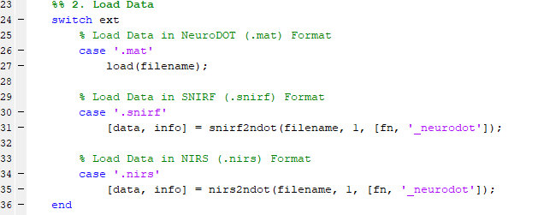
How to Load Data
The following section of code will run the appropriate function to load the raw data in a NeuroDOT compatible format
*.mat
Files can be loaded with Matlab’s built-in ‘load’ function
*.snirf
‘snirf2ndot’ loads the the *.snirf file in NeuroDOT format.
The optional input ‘save_file’ allows for saving an output file with the *.mat extension
*.nirs
‘nirs2ndot’ converts the NIRS data and info to NeuroDOT format
The optional input ‘save_file’ allows for saving an output file with the *.mat extension

Slide 10
Tutorial PowerPoints vs Tutorial Scripts
Tutorials are PowerPoints. You should have them open as a reference or guide as you run through the tutorial scripts in MATLAB.
Access tutorials through your FILE MANAGER
Tutorials should be completed in the order below
Tutorial Scripts are the MATLAB scripts, i.e. code, that the tutorials were made for
This is what you’ll actually be working with as you go through each tutorial
You can:
Access the scripts through MATLAB
Each Tutorial (blue) has a corresponding script (green), this is also the correct order for completing the tutorials
PreProcessing = NeuroDOT_PreProcessing_Script
Generating_a_Light_Model = Script_For_Basic_Head_Modeling
ImageReconstruction = NeuroDOT_ImageReconstruction_Script
Full_Data_Processing = NeuroDOT_Full_Processing_Script_Tutorial
Generating_a_Light_Model_Pad_Adult_96x92_Example = Script_For_Basic_Head_Modeling_Pad_Adult_96x92
Above formatting is: Tutorial name = Script name

Slide 11
How to Run Through a Tutorial
Two Methods
Highlight and Evaluate individual lines or sections of code
Set Breakpoints and run the script, continuing after each breakpoint
Which one is better?
It really depends on you
From a new MATLAB user standpoint, highlighting and evaluating is easiest
Many scripts in the lab are set up based on this method
Useful for when you want to execute a single line of code that does something important
Ex: create a figure, load in a file, run an analysis function
From a top-down debugging standpoint, setting breakpoints is best
Breakpoints allow for you to pause the code at specific lines where errors occur, and even skip those lines if you want to see if the rest of your code runs fine without that one line
They are more useful for debugging, but is still helpful for running the tutorials step by step

Slide 12
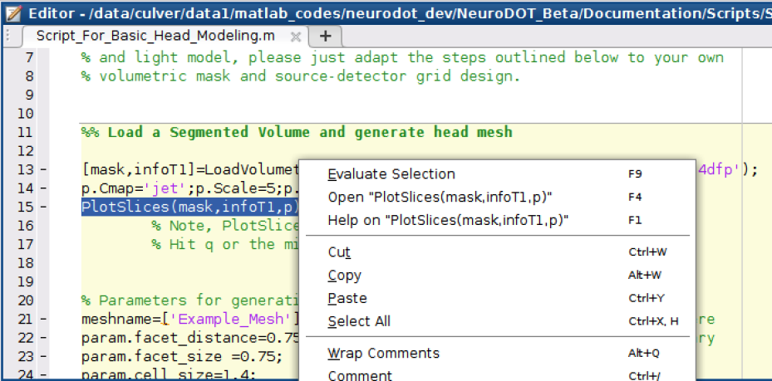
How to Evaluate Lines or Sections of Code
This method is useful for when you need to run a specific line(s) of code
For example: make a graph, run an analysis function
Instructions:
Highlight the desired line(s) of code that you want to run
Ex: line 15, PlotSlices function (creates figures)
Right click on the highlighted code
Click “Evaluate Selection”
You can bypass steps 2 and 3 by hitting f9 on your keyboard
You can run an entire program by highlighting and evaluating each individual line of code
Insert cool screenshot here ☺

Slide 13
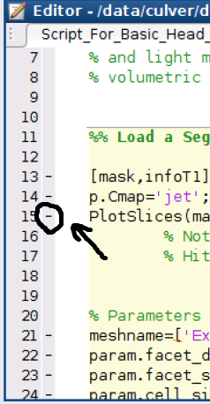
How to Set Breakpoints
Setting Breakpoints
Click on one of the hash marks on the left side of your code, that will create a breakpoint
Breakpoints look like small red dots
Insert even cooler screenshots here ;)

Slide 14
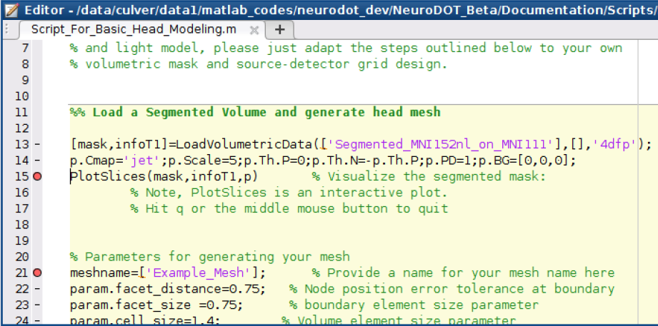
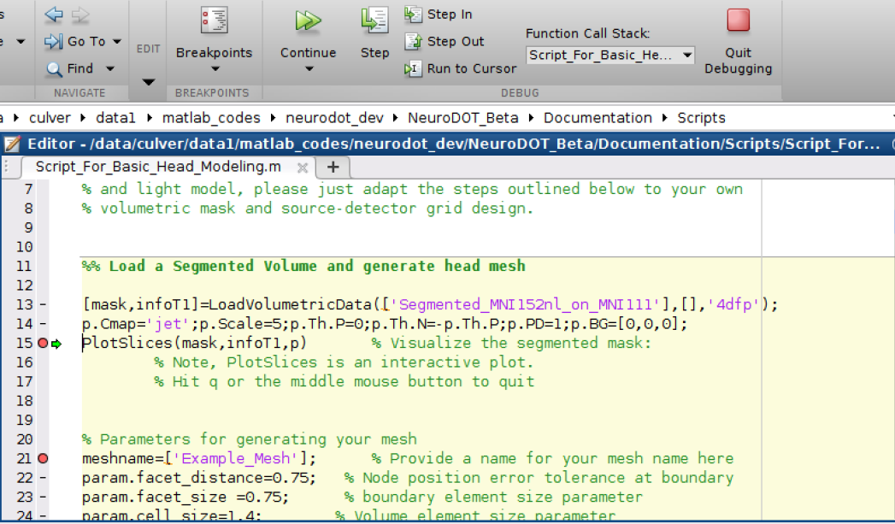
How to Use Breakpoints
Using Breakpoints
Code will pause before evaluating a line where a breakpoint is set
To resume, click the continue arrow at the top of MATLAB
Example: testing PlotSlices
Set breakpoints in line 15 and 21 (Top picture)
Hit “Run” in the “EDITOR” tab of MATLAB
It is right next to the breakpoints section
When the code reaches the first line with a breakpoint in it, it will pause before executing it
The “RUN” section will change to the “DEBUG” section seen in the second screenshot when the code hits a breakpoint
The green arrow on line 15 (bottom picture) indicates that the code is paused on that line
Hitting “Step” will execute the line the code is paused at
Executes only that line, and then stops before executing the next line
If you hit “Continue” the code will run until the next breakpoint, error, or completion
Setting a breakpoint at line 21 ensures that hitting continue by accident will not cause the code to run to completion

Slide 15
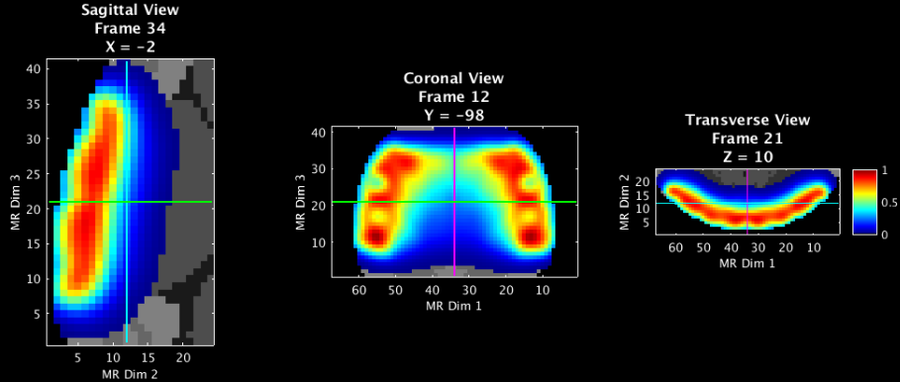
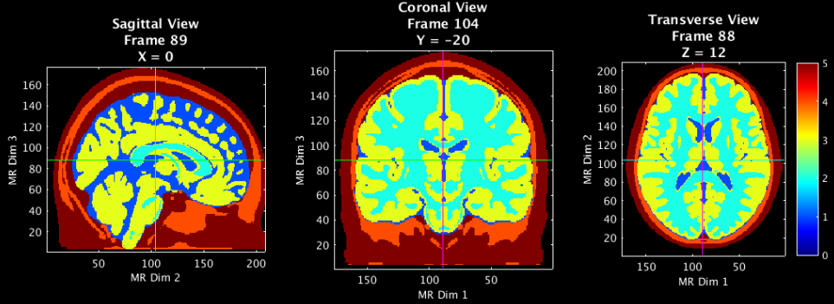
Potential Issue
Figures
Throughout the tutorials, you’ll create some figures, such as the ones shown here
For some figures, it is necessary to exit them in order to resume the script
Often these are figures that allow for user manipulation (via crosshair)
Simply hitting the red X in the top right corner will not allow you to close the figure
Instead, you must press the “Q” key on the keyboard, or the scroll wheel on your mouse, when the figure is selected in order to close out of the figure and move on with the script
You’ll create this figure in the Generating a Light Model tutorial (slide 15)
You’ll create this figure in the Generating a Light Model tutorial (slide 5)

Slide 16
Help Expand NeuroDOT’s Utility!
Please fill out the NeuroDOT registration form to help us better develop the NeuroDOT toolbox and expand its utility to address your fNIRS/DOT data analysis needs:
https://forms.gle/8QNGnx7ZbKuUHg3bA
Additionally, please provide specific feedback, or ask questions to the development team:
https://forms.gle/jv6RkX5s784LgQC89
Note: you will not be contacted by the NeuroDOT development team unless you opt-in to receiving communications.

Slide 17
That’s It (For Now)
Congratulations! You have finished the NeuroDOT Getting Started Tutorial
You are now ready to start the other NeuroDOT Tutorials
Recommended order for the tutorials is:
Preprocessing
Image Reconstruction
Generating a Light Model
Full Data Processing
Generating a Light Model PAD Adult 96x92
If you have any questions about the material presented in this tutorial, please consult the WUSTL Optical Radiology Lab (ORL) github page https://github.com/WUSTL-ORL/NeuroDOT in the documentation folder, or contact NeuroDOT Support: neurodot-support@wustl.edu

