Slide 1
AI and Small Businesses
William V. Fullerton

Slide 2
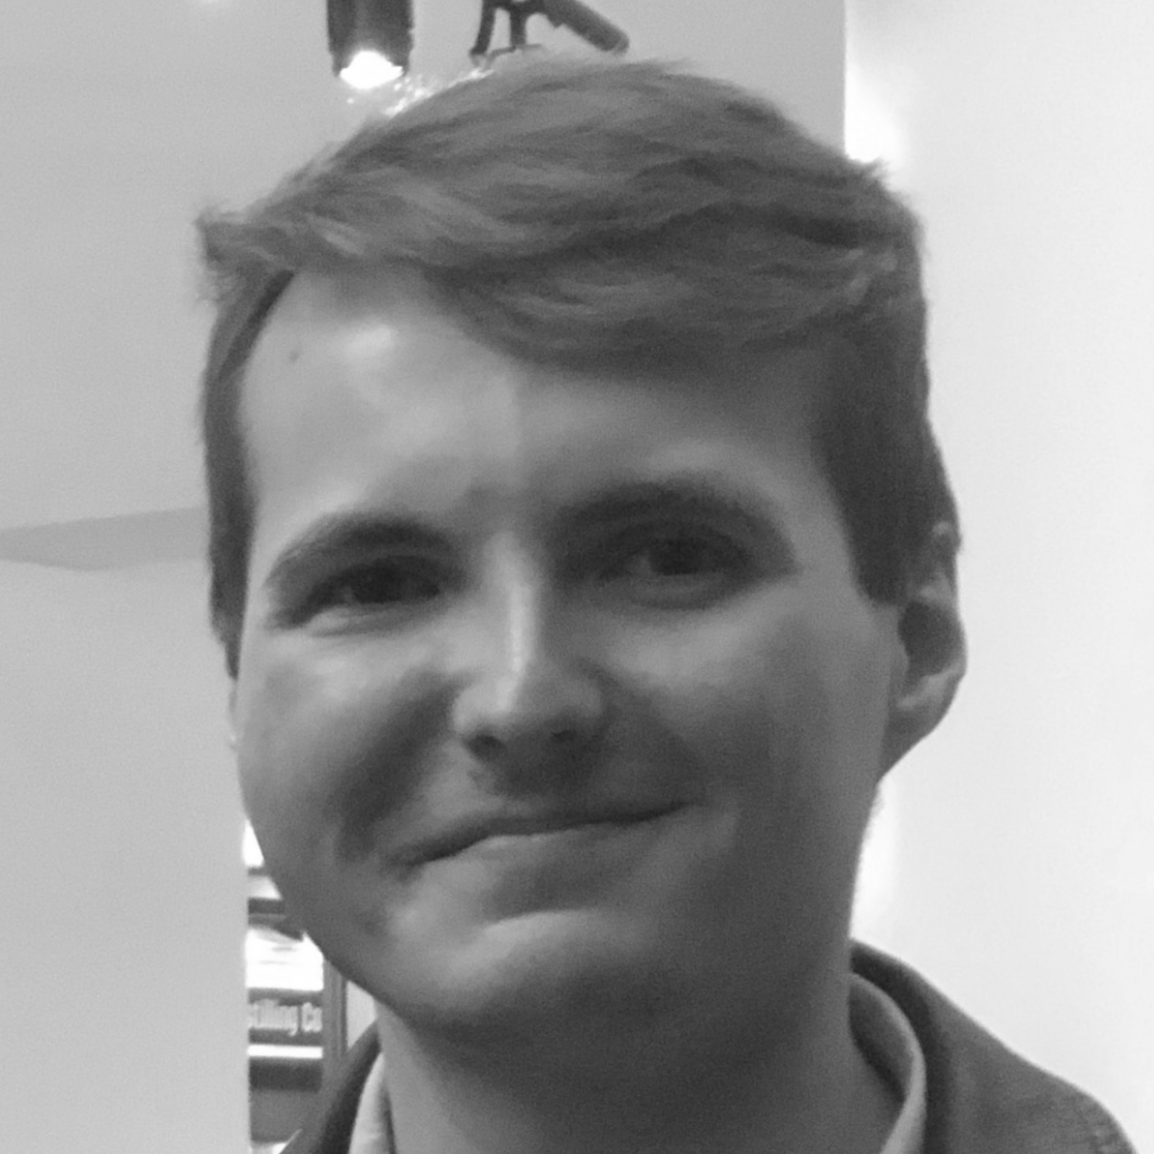
RMU BS Statistics & Data Science
Carlow University MA Psychology: Treatment
MLH Top 50 Class of 2026
AI Researcher and provisional patent author
Founding Member Welcome Committee
William V. Fullerton
Independent AI Researcher

Slide 3
Small Businesses in the Age of AI

Slide 4
The Problem
Roughly 43% of US GDP
Roughly 46% of private-sector employees
82% operating without employees
Limited capacity to adapt quickly
No dedicated tech, data, or AI team
Supporting our Small Businesses
Source: U.S. Small Business Administration, Office of Advocacy, Frequently Asked Questions About Small Business, 2026.

Slide 5
A Pittsburgh Solution
Small Businesses
Technology Leaders
Student Talent
Bring together local small businesses and nonprofits who are facing a challenge within their business, which they believe can be solved with the help of AI.
Industry and education leaders serve as mentors and judges, bringing experience and perspective to each challenge.
Students tackle these challenges through the AI in Action Hackathon, gaining meaningful hands-on experience with emerging technologies.

Slide 6
What is a Hackathon?

Slide 7
The AI in Action Difference
1. Reach out and understand
2. Connect to the challenge
3. Bridge the communities
4. Present the solutions

Slide 8
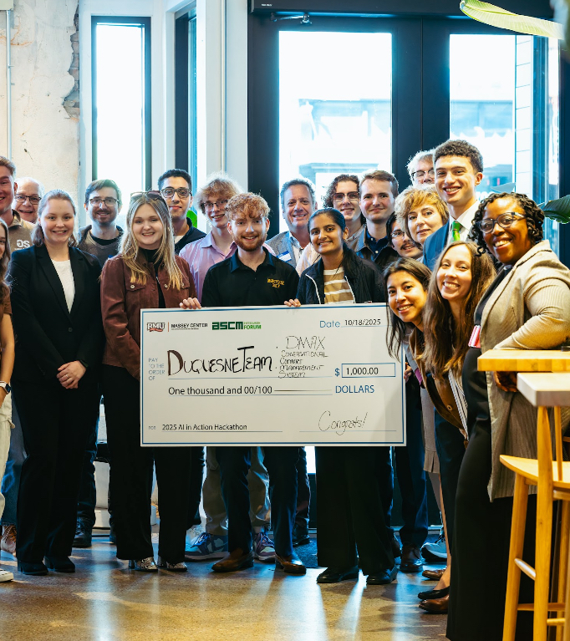
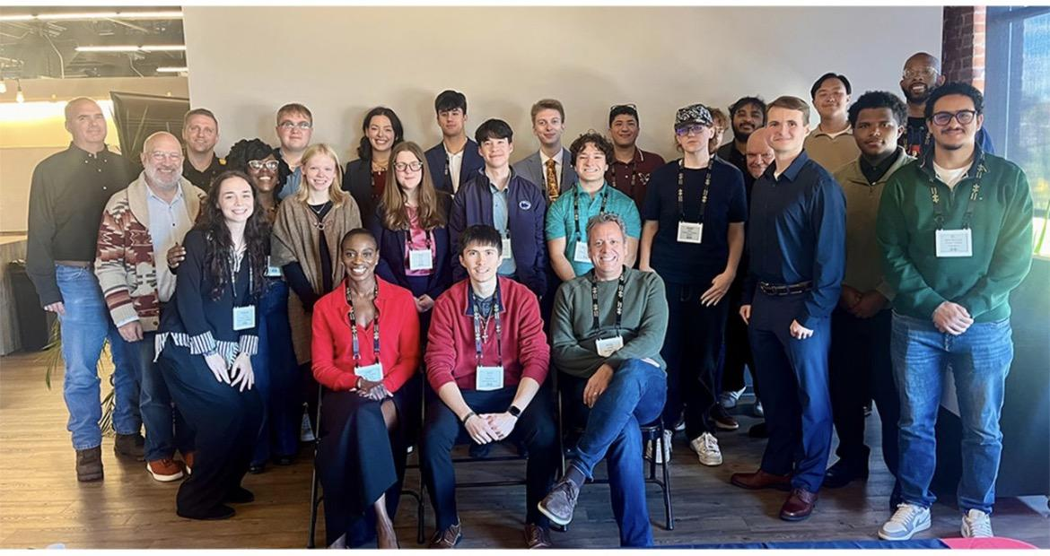
Putting AI into Action for Pittsburgh Small Businesses

Slide 9
What we Learned
Year One:
Establish a strong people base
Balance guidance, autonomy, and challenge scope
Broaden partnerships and build earlier
Year Two:
Expand who we can support
Preserve creativity while meeting real-world needs
Broaden our support without losing purpose
From years one and two

Slide 10





Connection to Positive Psychology
P
E
R
M
A
Positive Emotion:
Enjoyment, confidence, curiosity, and creativity
Engagement:
Hands-on challenge and involvement
Relationships:
Peers, mentors, small business and nonprofit partners, experts, and community
Meaning:
Contributing to an ecosystem greater than the individual
Achievement:
Brining a solution to a challenge full circle and presenting a final project
Students don’t just build AI; they interact with a community, make something real, and experience a true challenge.
Source: Seligman, M. E. P. (2011). Flourish: A Visionary new understanding of happiness and well-being. New York, NY: Free Press.

Slide 11
Looking to the Future
1. Create the space
2. Increase connectivity
3. Strengthen and empower
4. Interdisciplinary experience

Slide 12
Thank you
Are there any questions?

