Slide 1
Differential Expression Analysis with R and Bioconductor
WV-INBRE Bioinformatics Bootcamp
Summer 2021

Slide 2
Bioconductor
Bioconductor is a curated set of R packages for working with biological data
https://bioconductor.org
Provides a uniform interface for help pages and documentation
The BiocManager library allows for (relatively) easy installation of bioconductor packages

Slide 3
Installing Bioconductor
Log into the server and change to your RNA-Seq data folder
Start R in the terminal:
R
Install the BiocManager package:
install.packages("BiocManager")

Slide 4
Key Bioconductor packages for this analysis
We'll use the following packages from Bioconductor:
GenomicFeatures: R representation of genes, exons, transcripts, etc.
GenomicAlignments: R representation of alignments of reads to reference (i.e. representation of data in a bam file)
DESeq2: statistical analysis and identification of differentially expressed genes

Slide 5
Installing Bioconductor packages
Use BiocManager::install to install Bioconductor packages
Pass a list of package names
BiocManager::install(c("GenomicFeatures", "GenomicAlignments", "DESeq2"))
(Can also do this on three separate lines)

Slide 6
Gathering the bam files
Exit R with q()
There is no need to save the workspace
All we did was install some libraries
From your RNA-Seq-data folder, copy everyone else's bam files:
mkdir all_bams
cd all_bams
cp ../../../*/RNA-Seq-data/*.bam .
cp ../../../*/RNA-Seq-data/*.bam.bai .

Slide 7
RNA-Seq pipeline
Go back into R and load the libraries:
R
library(GenomicAlignments)
library(GenomicFeatures)
library(DESeq2)

Slide 8
Loading bam files
bamfiles <- BamFileList(list.files(pattern="\\.bam$"))
bamfiles

Slide 9
Reading the GTF file
We will create a "transcript database" from the GTF file:
txdb <- makeTxDbFromGFF(
"/seqdata/Genomes/Mus_musculus/Mus_musculus.GRCm38.81.gtf", circ_seqs=character(0))
exonsByGene <- exonsBy(txdb, "gene")

Slide 10
Counting reads per gene
Counting reads takes a long time
We'll parallelize this
Need another library:
BiocManager::install("BiocParallel")
library(BiocParallel)
register(MulticoreParam(workers=4))
se <- summarizeOverlaps(features=exonsByGene, reads=bamfiles,
mode="IntersectionStrict", singleEnd=F, ignore.strand=T, fragments=F)

Slide 11
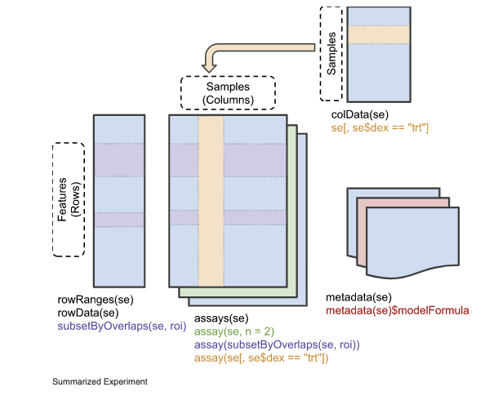
The summarized experiment object
The result of the summarizeOverlaps() function is a Summarized Experiment object
One or more matrices with meta data
Columns of the matrices are samples (bam files)
Rows are features (genes)
Have associated meta-data
For the rows, information about each gene
For the columns, information about each sample

Slide 12
Adding sample data to the column data
Examine the column names:
colnames(se)
Note these are the bam files names
We want to associate the diet with each sample
"Chow" or "HF"
#create an empty vector:
diet <- character(10)
diet[grepl("Chow", colnames(se))] <- "Chow"
diet[grepl("HF", colnames(se))] <- "HF"
colData(se) <- DataFrame(sample=colnames(se), Diet=diet)

Slide 13
Statistics review
We'll look at just the statistics we need to understand
Hypothesis testing
p-values
Explanatory and response variables
Multiple testing

Slide 14
Hypothesis testing
In hypothesis testing we essentially set up a competition between two competing hypotheses
The null hypothesis is what we would typically believe to be true without any evidence to the contrary
It's usually (always?) what we want to disprove
The alternative hypothesis is the logical opposite
It's usually what we want to prove (or at least provide evidence for)
For example, we might have a null hypothesis: There is no difference in expression of the Muc1 gene in the pancreas of mice fed the High Fat diet and mice fed the Chow diet
The alterative hypothesis would be The expression of Muc1 in the pancreas of mice fed the High Fat diet is different to that of mice fed the Chow diet

Slide 15
How hypothesis testing works
Ideally, we would like to be able to look at our data and compute how likely the null and alternative hypotheses are, given the data
Unfortunately, this is not possible to caclulate!
Instead, we calculate the following:
If the null hypothesis were true, how likely would it be that we would see data as extreme as the data we actually got
This likelihood is called the p-value
If the data we got would be unlikely, we conclude that the null hypothesis is false and that the alternative hypothesis is true

Slide 16
Example
Suppose we measure the expression of Muc1 in four mice fed a Chow diet, and four mice fed a High-Fat diet
We can measure the difference in average expression between the two groups
If we repeated this experiment, we would get a (slightly) different result
Even if, in reality, there were no actually effect of diet on Muc1 expression, then we would always observe some difference in the experiment
In hypothesis testing, we ask the question: "If the null hypothesis is true, i.e. if there is no effect of diet on Muc1 expression in reality, how often would I see differences as large as the ones I see in my actual experiment?"
This is the p-value
Under some assumptions, we can calculate this value

Slide 17
Explanatory and response variables
In any experiment, we can divide the variables into explanatory and response variables
The response variables are the outcomes of the experiment
The values which we are interested in measuring
The explanatory variables are the variables which we believe may affect the response variable
So in our example the response variable is
and the explanatory variable(s) are

Slide 18
Explanatory and response variables
In any experiment, we can divide the variables into explanatory and response variables
The response variables are the outcomes of the experiment
The values which we are interested in measuring
The explanatory variables are the variables which we believe may affect the response variable
So in our example the response variable is
Expression of Muc1
and the explanatory variable(s) are

Slide 19
Explanatory and response variables
In any experiment, we can divide the variables into explanatory and response variables
The response variables are the outcomes of the experiment
The values which we are interested in measuring
The explanatory variables are the variables which we believe may affect the response variable
So in our example the response variable is
Expression of Muc1
and the explanatory variable(s) are
Diet (and strain, sex, age…)

Slide 20
Explanatory and response variables in R
R has a specific syntax for experimental models
I.e. for specifying relationships between variables
The R syntax
y ~ x
means that y is the response variable and x is an explanatory variable
We can use this syntax to test the hypothesis that the value of x affects the value of y
The syntax
z ~ x + y
means that x and y are explanatory variables, and z is the response

Slide 21
Multiple hypothesis testing
In our differential expression experiment, we are actually testing the expression of 46,000 genes
We compute a p-value for each gene
Suppose diet had no effect whatsoever on gene expression in the pancreas
How many times do you think we would see a p-value less than 0.05?

Slide 22
Multiple hypothesis testing
In our differential expression experiment, we are actually testing the expression of 46,000 genes
We compute a p-value for each gene
Suppose diet had no effect whatsoever on gene expression in the pancreas
How many times do you think we would see a p-value less than 0.05?
If the null hypothesis is true, there is a 0.05 chance we would get data extreme enough to give us a p-value less than 0.05
So we would typically see 2,300 genes with p-values less than 0.05
Even if none were affected by diet!

Slide 23
Adjusted p-values and False Discovery Rate
There is a technique for adjusting p-values in the context of multiple hypothesis testing called the Benjamini-Hochberg procedure
The resulting p-values are at least as large as the original p-values
If we impose a cutoff of, for example, 0.1 for the Benjamini-Hochberg adjusted p-value, approximately 10% of the genes that survive that cutoff are estimated to be false positives
This is called "controlling the false discovery rate"

Slide 24
Using DESeq2
We can create a DESeq data set from our Summarized Experiment:
dds <- DESeqDataSet(se, ~ Diet)
The second argument is used as a statistical model for the expression of each gene
In our case, we are hypothesizing that the expression of each gene is a function of Diet
Then we can run the DESeq function that performs the analysis:
dds <- DESeq(dds)

Slide 25
Running the DESeq analysis
Run an analysis with
dds <- DESeq(dds)
# get the results of the analysis:
res <- results(dds)
# extract the significant (padj < 0.1) genes:
sig_genes <- subset(res, padj < 0.1)

Slide 26
Exporting results
We can write the results to a CSV file by converting to a tidyverse table and using write_csv(…):
Note we have to tell the tidyverse table what column name to use for the row names
library(tidyverse)
sig_genes_tbl <- as_tibble(sig_genes, rownames="EnsemblID")
write_csv(sig_genes_tbl, "F-B6-5wk-HF_vs_Chow-sig_genes.csv")

Slide 27
Using tidyverse pipes
Note we can do a lot of this with a tidyverse pipe!
This is just an alternative form of coding the pipeline
DESeqDataSet(se, ~Diet) %>%
DESeq() %>%
results() %>%
subset(padj < 0.1) %>%
as_tibble(rownames="EnsemblID") %>%
write_csv("F-B6-5wk-HF_vs_Chow-sig_genes.csv")

