Slide 1
samtools
to find help just type samtools
also: samtools --help
has a variety of subcommands…
to get samtools to work you need to give it a subcommand:
samtools subcommand <filename>

Slide 2
samtools view
samtools view -S -b sample.sam
samtools view -S -b sample.sam > sample.bam
Now, we can use the samtools view command to convert the BAM to SAM so we mere mortals can read it.
samtools view sample.bam | head

Slide 3
samtools sort
when you align a fastq the output will be in the order of sequence input
if we want our sequences arranged by genomic order we must sort
samtools view sample.bam | head
samtools sort sample.bam -o sample.sorted.bam
check the order:
samtools view sample.sorted.bam | head
Notice anything different about the coordinates of the alignments?

Slide 4
samtools index
indexing is required by genome viewers such as IGV so that the viewers can quickly display alignments in each genomic region
samtools index sample.sorted.bam
samtools view sample.sorted.bam 1:33000000-34000000
How many alignments are there in this region?
samtools view sample.sorted.bam 1:33000000-34000000 | wc -l

Slide 5
the BAM header
samtools view -H sample.sorted.bam

Slide 6
capture the FLAG
FLAG field in the BAM format encodes several key pieces of information regarding how an alignment aligned to the reference genome
we can use this information to filter reads based on their mapping characteristics
we often want to call variants solely from paired-end sequences that aligned “properly” to the reference genome…
samtools view -f 0x2 sample.sorted.bam
How many properly paired alignments are there?
samtools view -f 0x2 sample.sorted.bam | wc –l

Slide 7
capture the FLAG
Now, let’s ask for alignments that are NOT properly paired. To do this, we use the -F option (note the capitalization to denote “opposite”).
samtools view -F 0x2 sample.sorted.bam
How many improperly paired alignments are there?
samtools view -F 0x2 sample.sorted.bam | wc –l
Does everything add up?

Slide 8
FLAGS:
0x1 | PAIRED | paired-end (or multiple-segment) sequencing technology
0x2 | PROPER_PAIR | each segment properly aligned according to the aligner
0x4 | UNMAP | segment unmapped
0x8 | MUNMAP | next segment in the template unmapped
0x10 | REVERSE | SEQ is reverse complemented
0x20 | MREVERSE | SEQ of the next segment in the template is reverse complemented
0x40 | READ1 | the first segment in the template
0x80 | READ2 | the last segment in the template
0x100 | SECONDARY | secondary alignment
0x200 | QCFAIL | not passing quality controls
0x400 | DUP | PCR or optical duplicate
0x800 | SUPPLEMENTARY | supplementary alignment

Slide 9
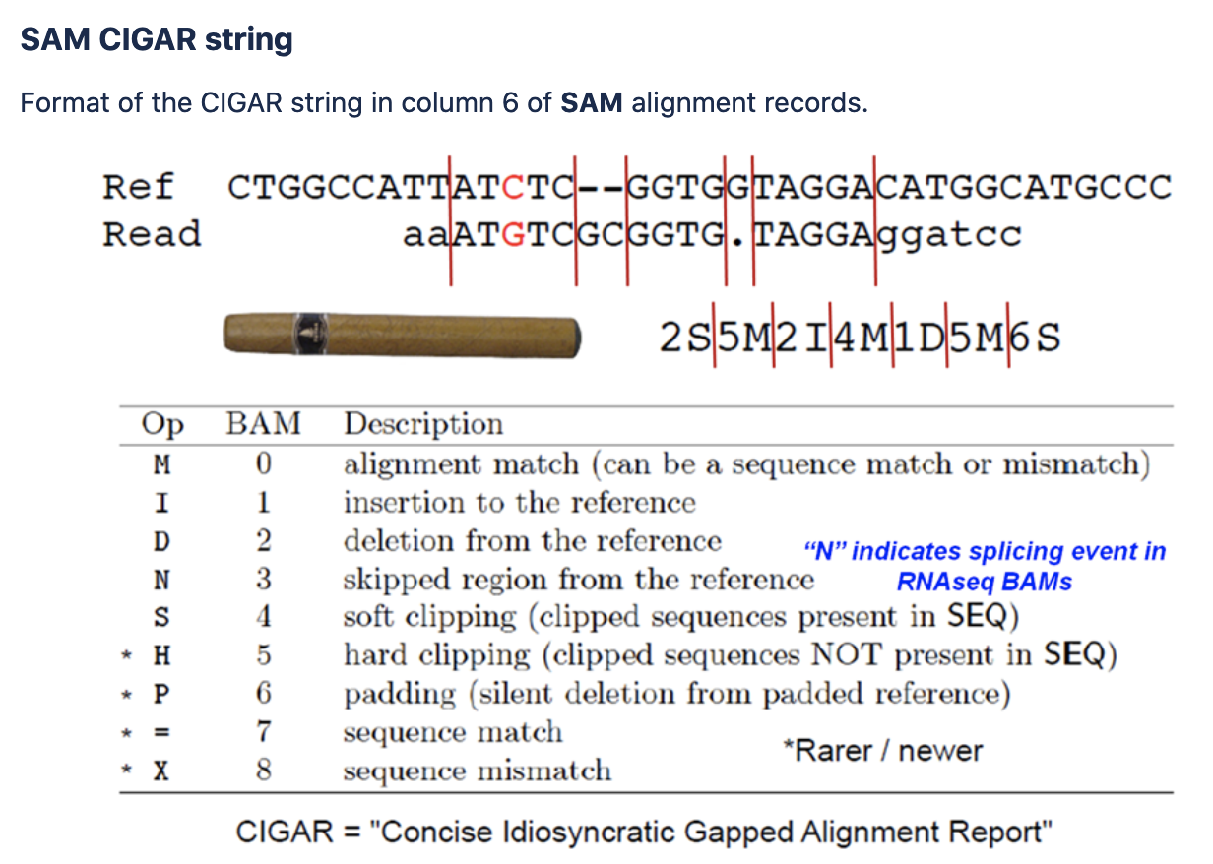
CIGAR

