Slide 1
Exploring Use of CLI
locate your cursor/command prompt: this is where you will type commands
programs are run in the command line following this pattern:
$ command -options <file or other input>
the $ in this context and throughout the presentation represents your prompt – you do not type that part out each time things I want you to type will be in red
Example: type the command pwd and see what happens…

Slide 2
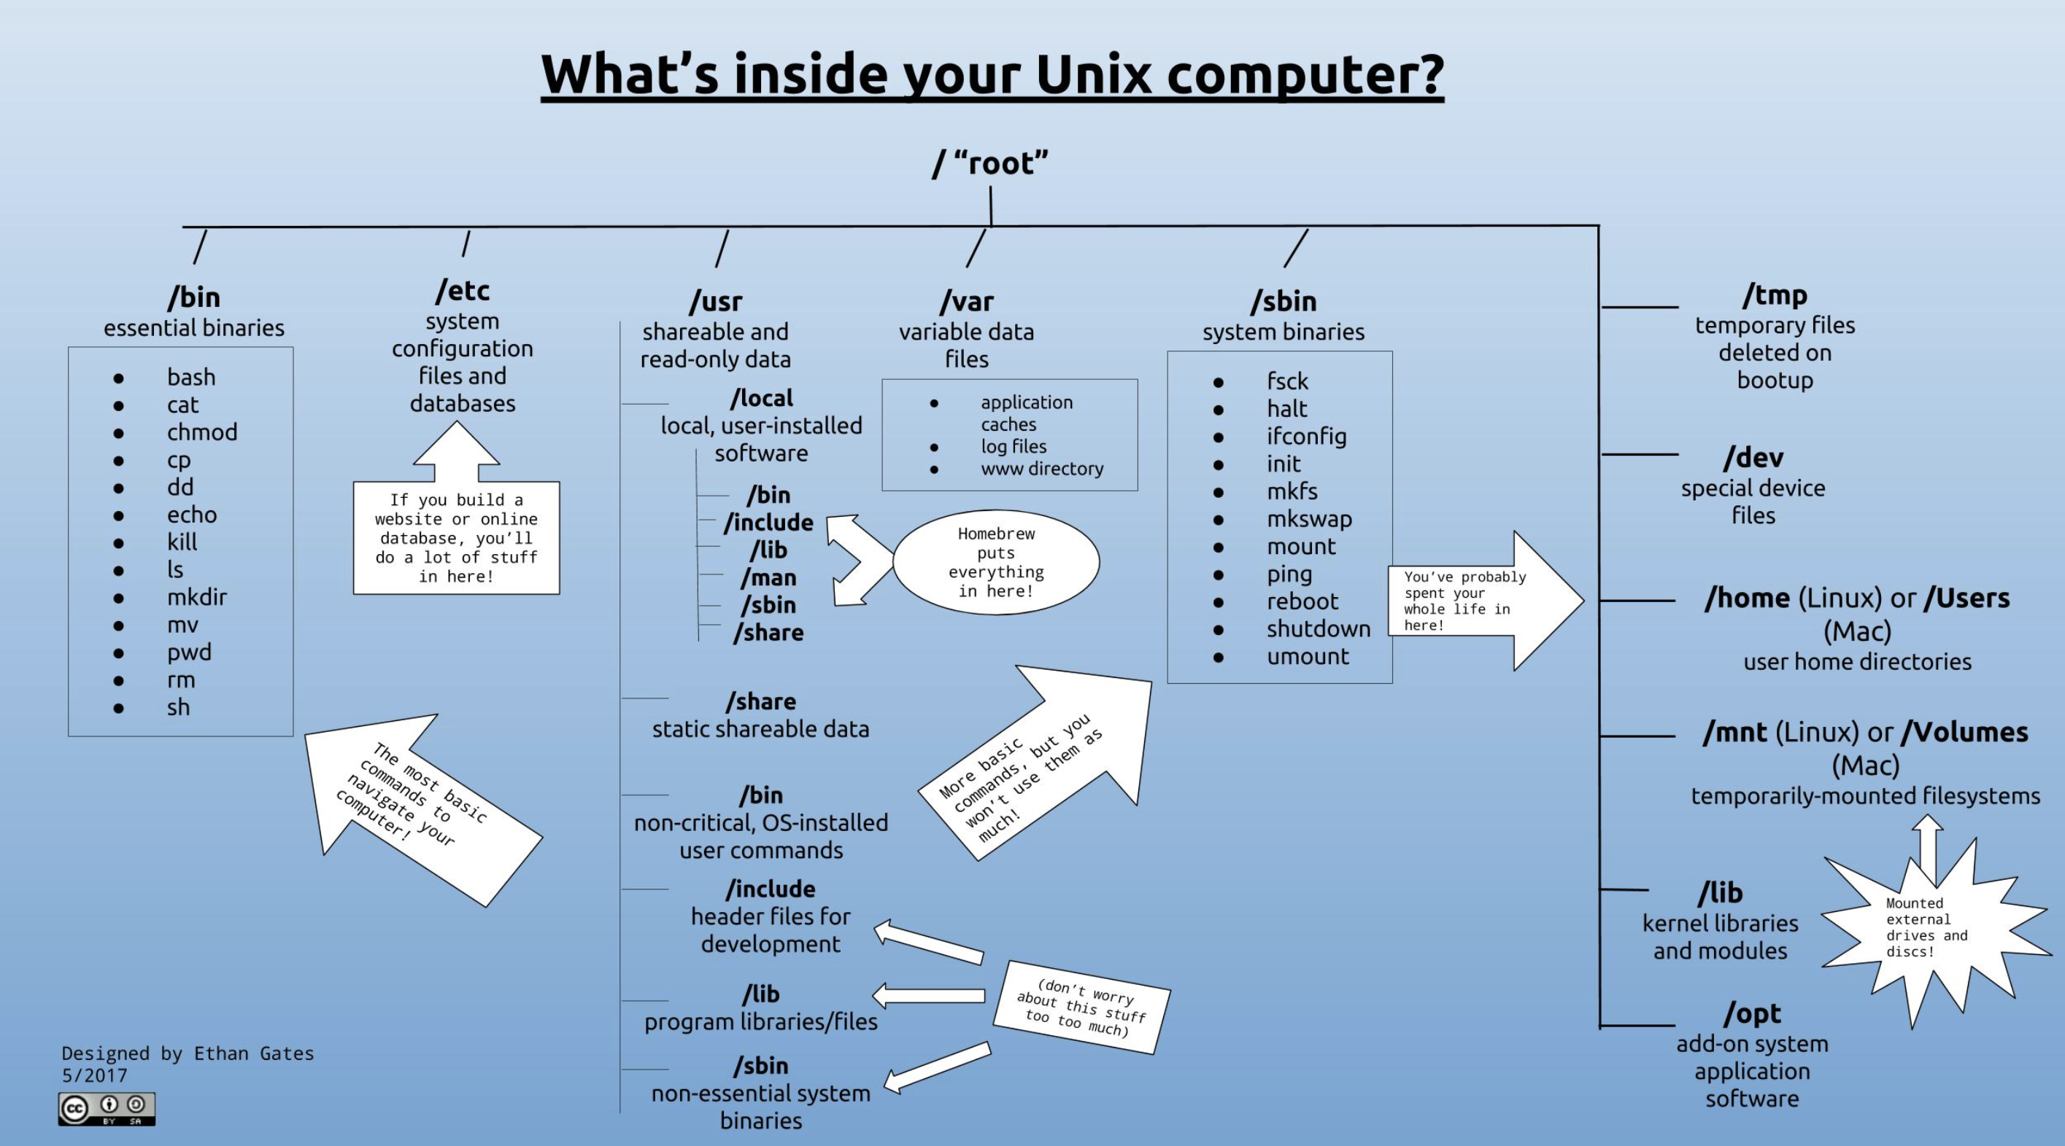
Filesystem
Notes:
cd
ls
pwd
paths
home directory
man
which

Slide 3
Exploring Use of CLI
we can change directories (move up and down the filesystem structure) using the command cd $ cd .. $ pwd
Notes:
tab autocomplete

Slide 4
Exploring Use of CLI
we can change directories (move up and down the filesystem structure) using the command cd $ cd .. $ pwd
try moving all the way up the filesystem using cd
how far can you go…what directory are you in?
Notes:
tab autocomplete

Slide 5
Filesystem
Notes:
cd
ls
pwd
paths
home directory
man
which

Slide 6
Exploring Use of CLI
we can change directories (move up and down the filesystem structure) using the command cd
$ cd .. $ pwd
try moving all the way up the filesystem using cd
Use the list command ls to see which directories exist
type cd by itself to return to your home directory
$ cd
Notes:
tab autocomplete, ls, options

Slide 7
Files and Directories
Think of directories like folders that contain individual files
We can create a directory with the command mkdir
Create 2 directories called “scripts” and “data” and then use ls to see them listed: $ mkdir scripts $ mkdir data $ ls

Slide 8
Files and Directories
Alternatively, we could have taken a shortcut and made the two directories simultaneously: $ mkdir scripts data
Try making a directory named whatever you want
Now remove it using rmdir

Slide 9
Files and Directories
Alternatively, we could have taken a shortcut and made the two directories simultaneously: $ mkdir scripts data

Slide 10
Files and Directories
Make a new directory in your home directory (use cd to get back if you aren’t sure): $ mkdir nested
Now cd into that directory and make a directory called one
Now cd into that directory and make a directory called two
Repeat until you get to five…

Slide 11
Files and Directories
Let’s make some files!
*make sure you are in your home directory*
there are many ways to make and modify files in the shell
nano, vi, vim etc.
much faster than using an outside GUI but has draw backs

Slide 12
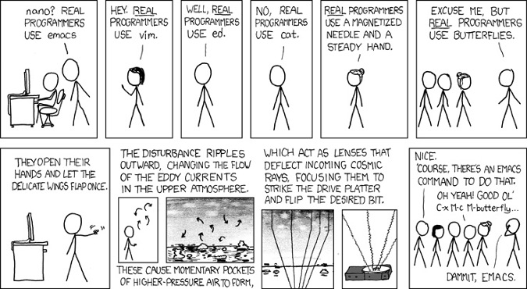

Slide 13
Files and Directories
Let’s make some files!
*make sure you are in your home directory*
see if the following programs exist on your system using which
$ which nano
… vi
… vim
… emacs

Slide 14
Files and Directories
Let’s make some files!
*make sure you are in your home directory*
now type nano and see what happens…

Slide 15
Files and Directories
mv
cp
rm

Slide 16
** Download git repository **
Github is a code and software sharing/collaboration platform
Allows anyone to start an account and keep track of different versions of their projects (kept in repositories)
version control
Has a GUI (quite nice) but is based on a command line operation git
We will first see how to clone a repository and then try it on the command line…
Go to: https://github.com/WVINBREbootcamp
git clone https://github.com/WVINBREbootcamp/BootcampData.git

Slide 17
Files and Directories
touch
cat
head
tail
less
>
>>

Slide 18
Pipes: first command | second command
Any command that sends output to standard out can be “piped” into another command immediately – this is one way we make pipelines
Use a pipe to cat a file, look at the first 500 lines with head and then look at the 500th line itself with tail

Slide 19
Finding Help
Most important skill you will learn while here
Built-in instructions for shell commands
Many online resources and tutorials
Forums
Direct communication with developer/researcher

Slide 20
man pages
NAME
head -- display first lines of a file
SYNOPSIS
head [-n count | -c bytes] [file ...]
DESCRIPTION
This filter displays the first count lines or bytes of each of the specified files, or of the standard input if no files are specified. If count is omitted it defaults to 10.
If more than a single file is specified, each file is preceded by a header consisting of the string ``==> XXX <=='' where ``XXX'' is the name of the file.
EXIT STATUS
The head utility exits 0 on success, and >0 if an error occurs.
SEE ALSO
tail(1)
HISTORY
The head command appeared in PWB UNIX.
BSD June 6, 1993 BSD

Slide 21
Online Resources
Documentation
Search for “command usage”
Tutorials and walkthroughs
Blogs
Forums (e.g. stackoverflow)
Direct communication with developer

Slide 22
Mini-Exercise 1
Use the man page of top to figure out how to see which processes/programs are currently using the most memory on your system
Use ifconfig to figure out your IP address
What does the command df do?

Slide 23
Basic shell commands
ls | list the files in the current directory
ls -a | list all files including hidden files
ls -l | long formatted list of files
cd dir | change directory to dir
cd | change to home
pwd | show current directory
mkdir dir | create a directory dir
rm file | delete file
cp file1 file2 | copy file1 to file2
mv file1 file2 | rename or move file1 to file2; if file2 is a directory, move file1 into directory file2
cat file | print the contents of a file to the screen
more file | output the contents of file
less file | output the contents of file
head file | output the first 10 lines of file
tail file | output the last 10 lines of file
tail -f file | output the contents of file as it grows, starting with the last 10 lines
grep pattern file | print the lines matching pattern in the file.
wc -l file | print the number of lines in a file.

Slide 24
File permissions…
U G O
rwx rwx rwx
U = user
G = group
O = other
r = read
w = write
x = execute
rw- rw- rw-
rwx r-- r--

Slide 25
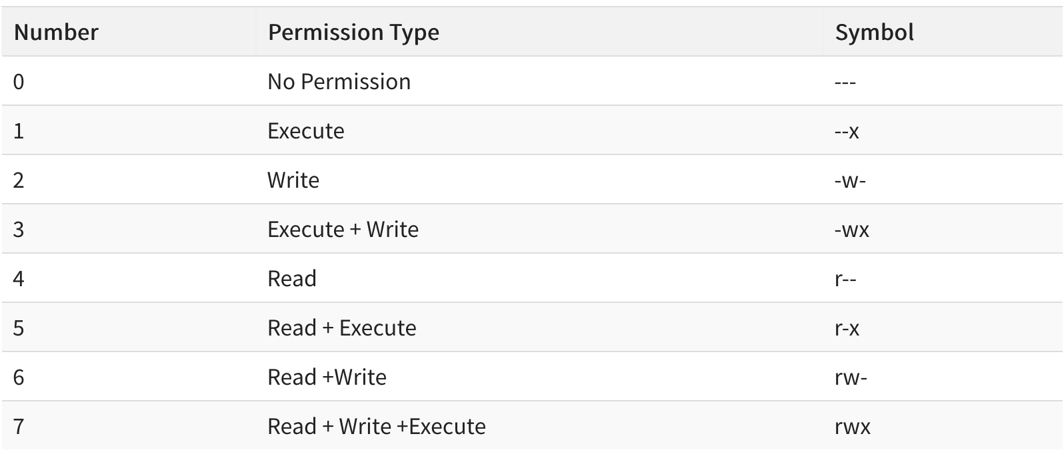
chmod 755 script.sh

Slide 26
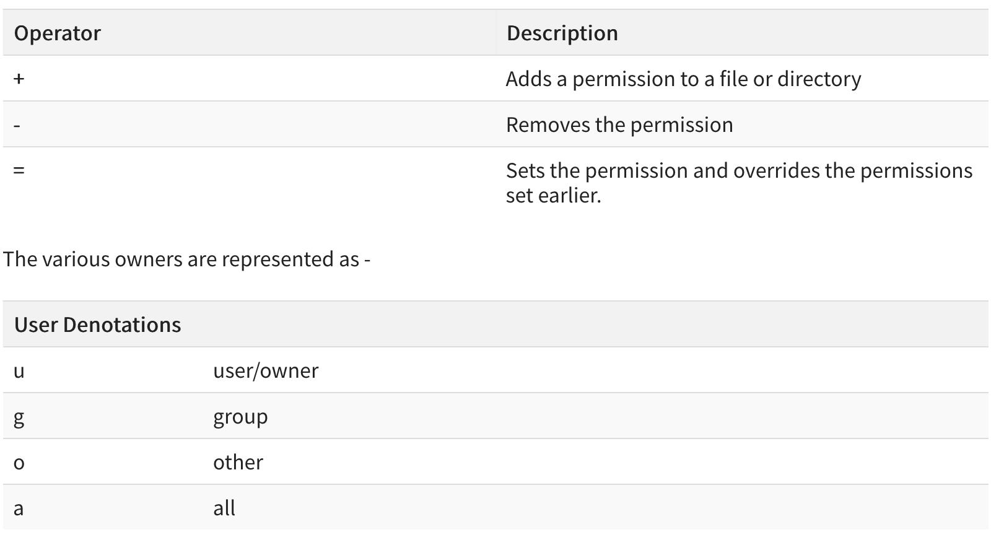
chmod a+x script.sh

Slide 27
Other useful text file commands
wc
tr
sort
uniq
cut
paste
grep

Slide 28
Searching and Modifying Files
grep, sed, awk

Slide 29
Text Editor Options – GUI and CLI
geany
atom
sublime text
Notepad ++ (works on windows)
emacs
vim/vi (CLI)
nano (CLI)

Slide 30
Finding Patterns - grep
Can use to find, count, isolate certain patterns or lines containing a pattern
MANY USES, be creative
egrep for use with extended regular expressions
Exact behavior may vary with shell type/system
Can be used with standard out (in a pipeline) or on individual files
Many files can be searched simultaneously

Slide 31
Make a file that looks like this:
ostechnix
Ostechnix
o$technix
linux
linus
unix
Unix
technology
hello world
HELLO world

Slide 32
Now let’s grep!
$ grep nix yourfilename.txt
What does your output look like?
Compare to your text file…what does grep do?

Slide 33
Now let’s grep!
$ grep hello yourfilename.txt
$ grep hello world yourfilename.txt
$ grep ‘hello world’ yourfilename.txt

Slide 34
Now let’s grep!
$ grep -n linus yourfilename.txt what does this do??
$ grep -i ‘hello world’ yourfilename.txt how about this??

Slide 35
Now let’s grep!
$ cat somefile.txt | grep ‘ ’
try out a little pipeline

Slide 36
regex = regular expressions
Powerful search and replace language
Use wildcards, positional data, and other characters to define a pattern
Allows you to edit thousands of files quickly if needed
Tips:
Some preliminary testing of your pattern always required
Helpful at first to use backup files just in case!

Slide 37
grep can use regular expressions
^ = search at the beginning of the line
$ = search at the end of the line
. = search any character

Slide 38
Now let’s grep!
$ grep tech somefile.txt
Append a word to your file using >>
one way to do this:
$ echo biotech >> somefile.txt
$ cat somefile.txt
you should now see the word at the end of your file

Slide 39
Now let’s grep!
$ grep tech somefile.txt
$ grep ^tech somefile.txt
$ grep tech$ somefile.txt
$ grep .nix somefile.txt

Slide 40
egrep = grep + extended regular expressions
$ egrep ‘^(l|o)’ somefile.txt
$ egrep ‘^[l-t]’ somefile.txt
$ egrep ‘[x-z]$’ somefile.txt
equivalent to grep -E

Slide 41
Many tools/programs use regex
Think of regex like shorthand language
Characters form patterns, we can use these patterns to search text
grep – global regular expression print
Can use regex patterns or full phrases to search a file
sed - stream editor
Uses regex to search for patterns in character “stream” (standard out) and very good at replacing patterns
Command line find/replace function similar to what your text editing software uses…

Slide 42
Wildcards, special characters, alphanumeric
. = any character
\w = any letter, digit or underscore
\s = any whitespace
\t = tab characters
\n = newline (line ending)
[a-z] = any lower case
[A-Z] = any upper case
[0-9] = digits

Slide 43
line endings
important to know that the end of a line is designated by a hidden character…
windows and mac have their own different line endings
will cause issues with lots of shell commands and bioinformatic software/code
typically, windows uses carriage return + line feed (CR/LF) symbol, classic mac uses CR
let’s try to create this problem and then fix it using notepad++

Slide 44
Quantifiers
+ = one or more occurrences (occurs at least once)
* = match zero or more times (may occur or may not)
? = match zero or one time (may occur once or twice)
{n} = match exactly n times (occurs exactly this many)
{n,}= match at least n times (occurs at least this many)
{,m} = match at most n times
{n-m} = match from n to m times

Slide 45
Positional/boundary symbols
^ = beginning of line
$ = end of line
\b = word boundary
Escape Punctuation & Negation
\ = escape, use literal meaning
[^pattern] = NOT this pattern/everything but

Slide 46
sed
sed ‘s/pattern/replacement/’ greeneggs.txt
By default replaces the first occurrence found
sed ‘s/ham/pork/g’ greeneggs.txt ->will replace all occurrences
sed ‘s/ham/pork/2’ greeneggs.txt ->will replace 2 occurrence
sed ‘9 s/ham/pork/g’ greeneggs.txt ->will replace on specific line
sed G filename.txt
echo “This Is The Best Bootcamp” | sed ‘s/([A-Z])/\1/g’

Slide 47
sed
echo “This Is The Best Bootcamp” | sed ‘s/([A-Z])/\1/g’
sed '5d’ filename.txt -> delete a specific line
sed ‘/pattern/d’ filename.txt -> delete a specific pattern
Search for “cookbook”, “one-liners”, “cheatsheet” online if you want to explore the variety of commands!

Slide 48
Exercise
Pull down the BootcampData repository…move or copy the script into your script directory and the files into your data directory.
Use commands you have learned to look at the contents of the script you just downloaded to understand what it is going to do when executed…you can test the command by typing out the contents of the script yourself in a terminal.
What does this script do?

Slide 49
Exercise
Modify the script behavior in some way and save it as a new script file called my_new_script.sh – make sure it is in your scripts directory.
Use chmod to make both scripts executable if they are not already.
Execute both scripts to see if they work!

Slide 50
Exercise
Make a pipeline that sends the percentage of degrees awarded to women in computer science in the year you were born to a new text file called birthyear_degrees.txt
How many genes are present in the F. tullarensis protein csv?
How many are called ‘hypothetical protein’?
How large is the F. tullarensis genome? To do this you will need to count the total number of nucleotides (ACGT)…

