Slide 1
The Sequencing Revolution
Dr. Nicole Garrison
Assistant Professor
West Liberty University
Notes:
Thank you for coming, today I want to give you all some background information on the concept of next generation sequencing. Some things I want you to take away from this presentation include...

Slide 2
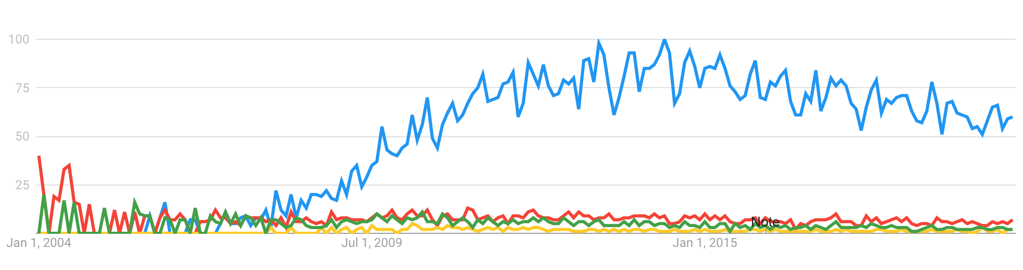
Next Generation Sequencing (NGS)
Next Generation Sequencing (NGS)
Second Generation
Massively Parallel
High Throughput
May
2011
August
2005

Slide 3
Next Generation Sequencing (NGS)
Second Generation
Massively Parallel
High Throughput
May
2011
August
2005

Slide 4
Next Generation Sequencing (NGS)
Second Generation
Massively Parallel
High Throughput
May
2011
August
2005

Slide 5
Next Generation Sequencing (NGS)
Second Generation
Massively Parallel
High Throughput
May
2011
August
2005

Slide 6
Next Generation Sequencing (NGS)
Second Generation
Massively Parallel
High Throughput
– technological advancement and biological breakthroughs
– sequencing reactions happen simultaneously
– millions of sequences, rapid processing
May
2011
August
2005

Slide 7
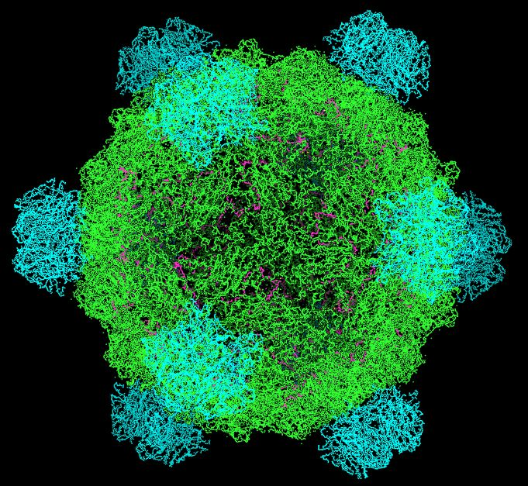
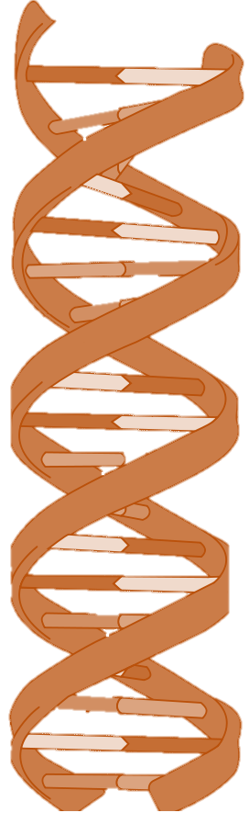
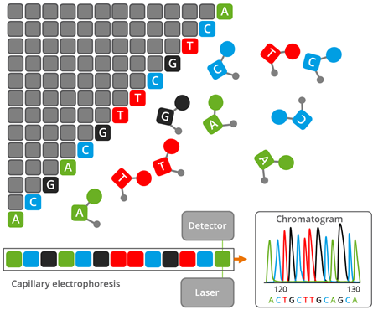
φX174
1977
Human Genome Project
13 years
20 labs/groups
3 billion dollars
~ 3 billion bp
Sanger
1990
5386 bp
1983
2003
1986
1953
Notes:
very briefly, Sanger sequencing uses a method called chain termination, where special fluorescently tagged nucleotides are incorporated into growing DNA strands, each time one of these dideoxy nucleotides is added extension of that strand stops. This method generated fragments of target dna of varying length with fluorescent labels attached to the last nuclotide. Capilary electrophoresis is used to separate the fragments by size and a laser is used to excite the fluorescent tag. If we order these fragements by size and look at the sequence of fluorescent signals we can reconstruct the sequence of our target DNA. This information is organized on a chromatogram, pictured here.

Slide 8
2011
PacBio
1977
2005
Sanger
Roche
454
1983
2020
1986
1953
Illumina/Solexa
2007
Oxford
Nanopore
2014

Slide 9
2011
PacBio
2005
Roche
454
2020
Illumina/Solexa
2007
Oxford
Nanopore
2014

Slide 10
Core Principles
Library preparation
Fragmentation, addition of adapters, amplification, size selection
DNA molecule isolation/fixation (more amplification)
Release of some signal (light, fluorescence, electrical…)
Some method of reporting in a controlled way the addition of nucleotides
Recording of signal in a massively parallel manner

Slide 11
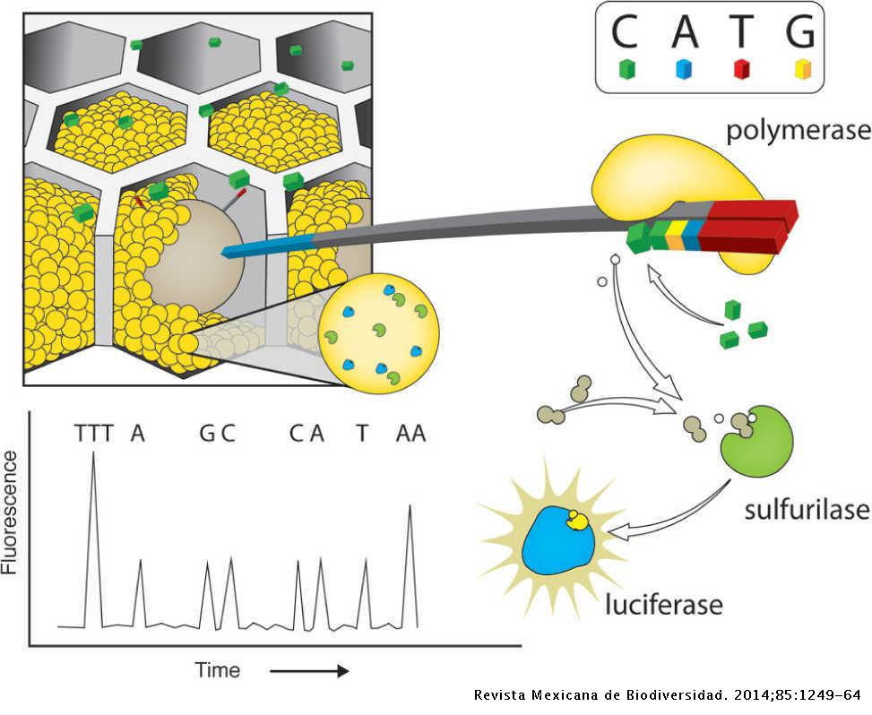

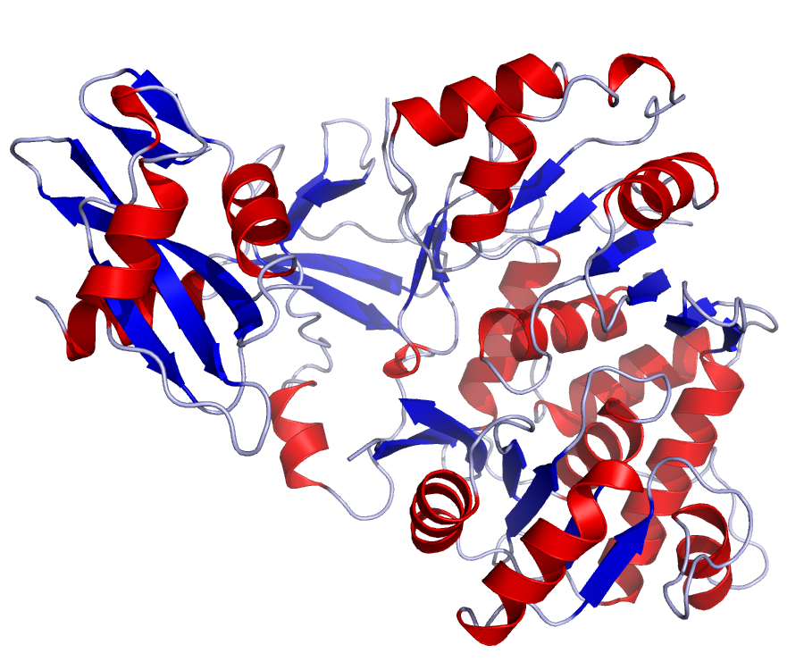
NGS Flavors - pyrosequencing
PacBio
Roche
454
Illumina/Solexa
Oxford
Nanopore
4 hours, 200-300bp reads, 20 – 30 Mb/h
Notes:
with this method of pyrosequencing, fragmented dna is isolated on beads and amplified on that bead using a special variation of PCR, single dna covered beads and all the ingredients needed for dna synthesis are then placed in wells, many wells in this plate, as nucleotides are washed across the wells they may become incorporated onto a dna strand...this releases pyrophosphate which sets on a chain reaction ultimately leading to the production of light by luciferase in this case firefly luciferase, so the same enzyme that is responsible for the glowing abdomen...each time you see fireflies I want you to think of pyrosequencing...

Slide 12
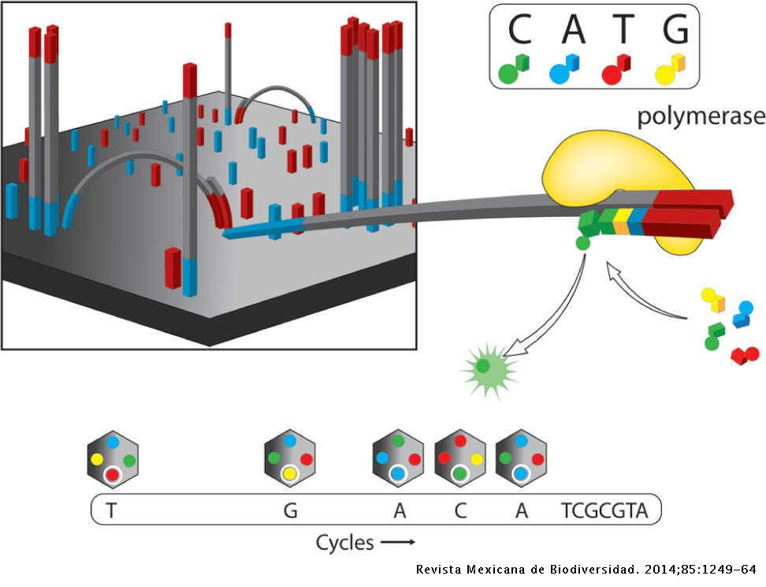
NGS Flavors - bridge amplification
PacBio
Illumina/Solexa
Oxford
Nanopore
1 – 3 days, 30-300bp reads, PE or SE, 20 – 67,000 Mb/h

Slide 13
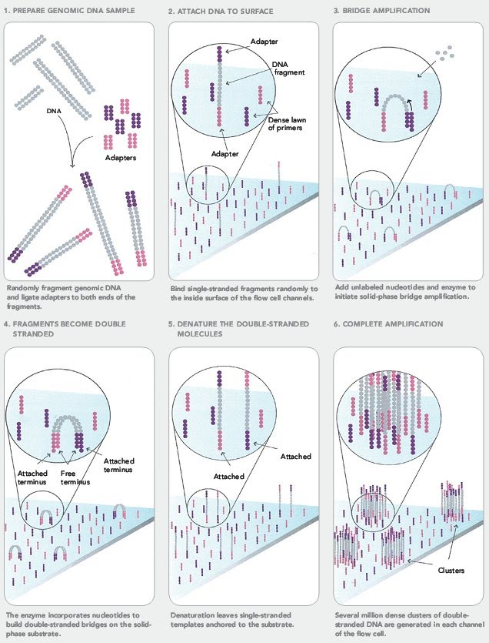

Sequence
A
C
G
T

Slide 14
Illumina Short Reads
Varying length, increasing with time
Can be “single end” or “paired end”
Large output files, storage can be a limiting factor
fastq file format – sequence (reads) + quality information
Sequencing design can influence data quantity/quality
PCR duplicates
Optical duplicates
Adapter contamination
Overrepresented sequences
Technical and biological replication is critical

Slide 15
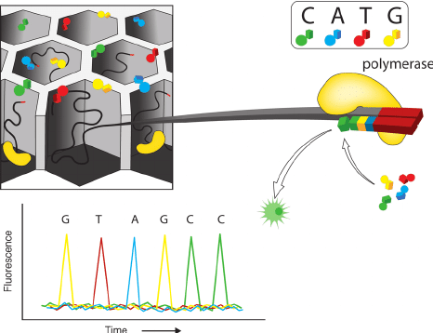
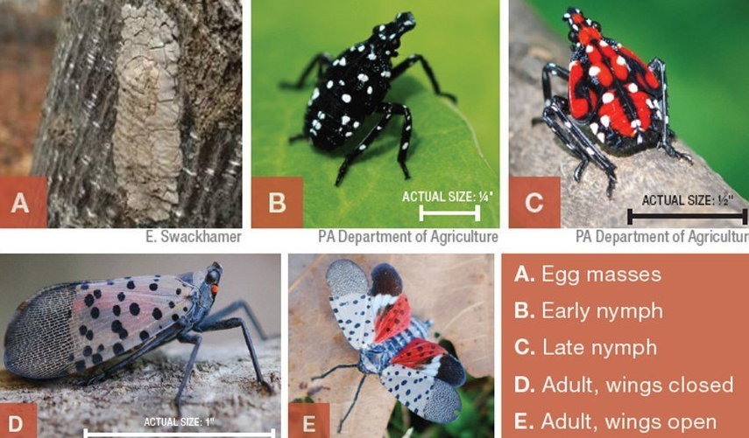
NGS Flavors - single molecule
PacBio
132 Gb of long-read sequences
36x coverage
96.8% of conserved genes
2 microbial symbionts
MinION
10-20 hours, 10-30 kb reads, 1300 Mb/h

Slide 16
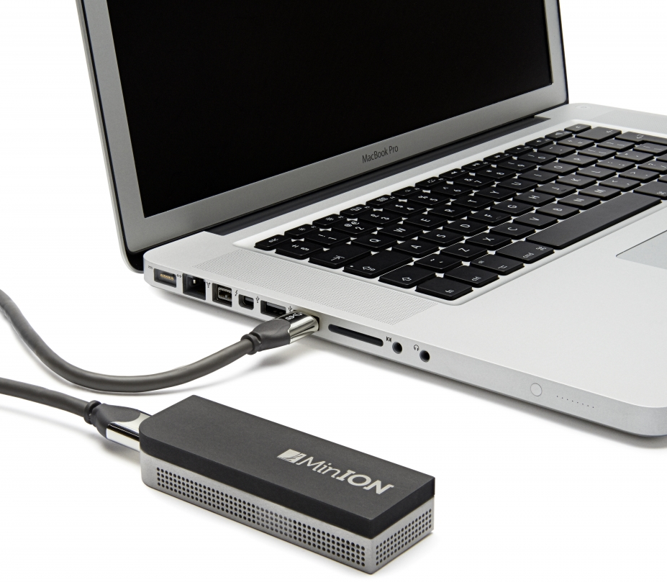
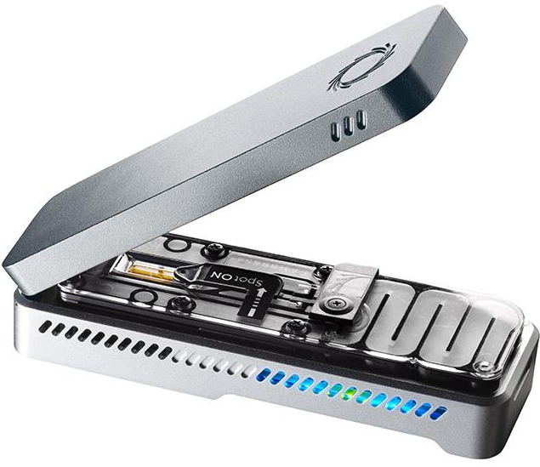
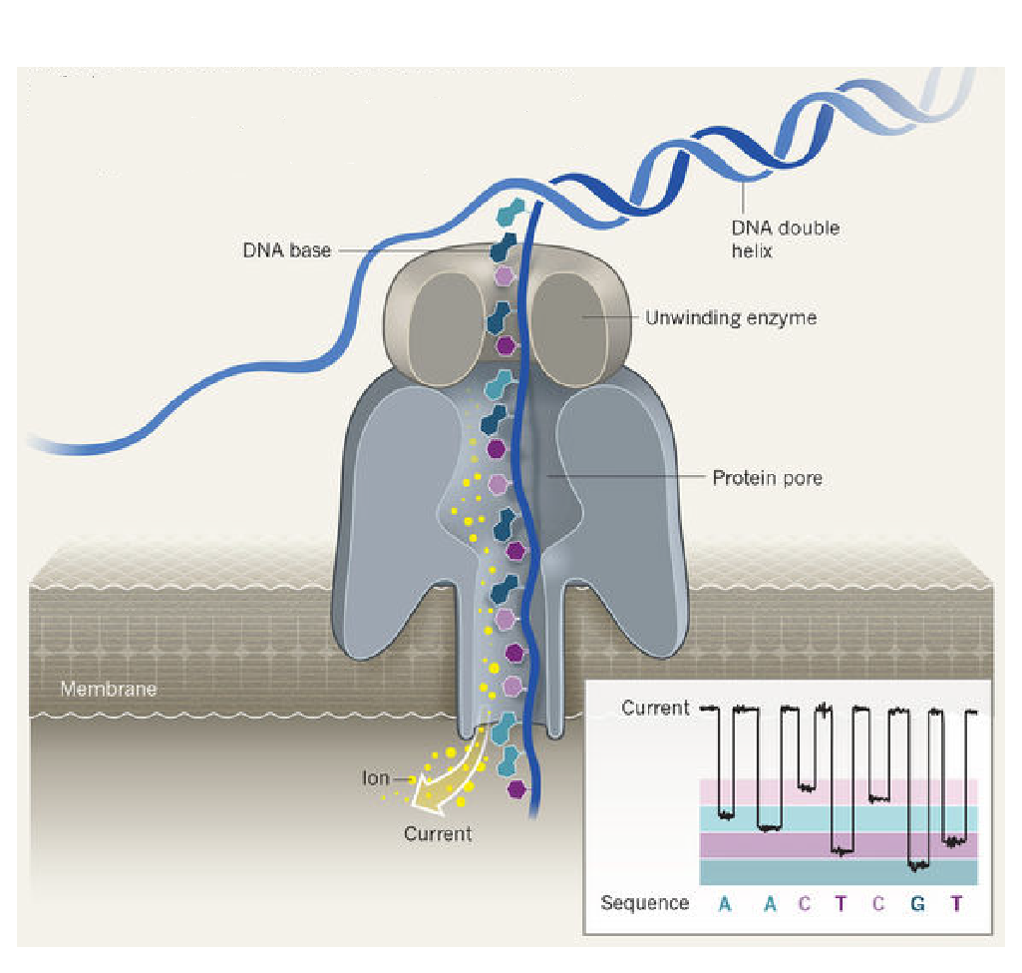
NGS Flavors - nanopore
minION
3 days, 13-20kb reads, 700 Mb/h

Slide 17
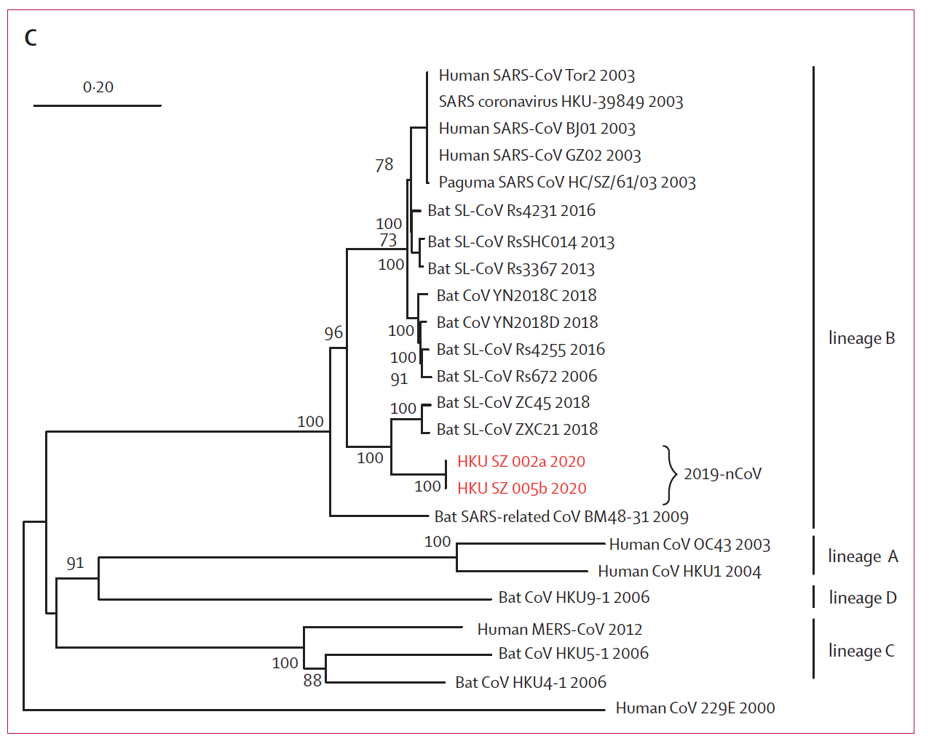
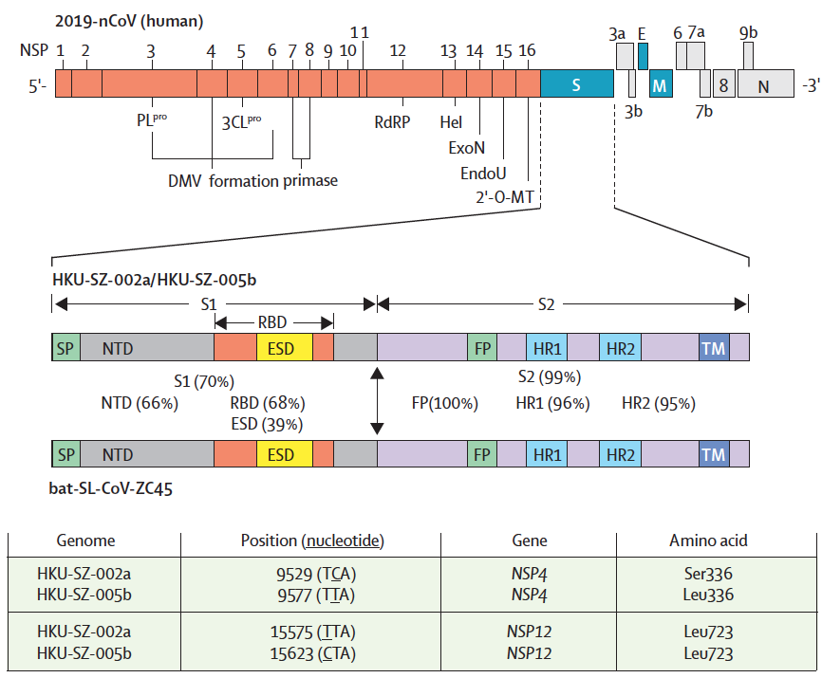

Slide 18
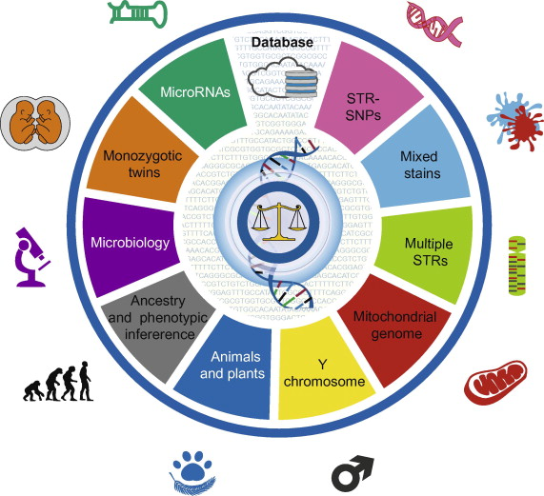
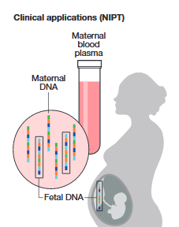
Applications
Epigenetics – WGBS, Chip-Seq
Personalized/Precision Medicine
Drug metabolism - CYP2D6
Organ transplants - HLA
Prenatal testing
Forensic Science
Mystery meat!
Traditional Chinese Medicine
Soil metagenomes

Slide 19
Next Generation Sequencing
Sequencing Precision
Sequencing Depth
Cost
Bioinformatic Burden
Time
Accessibility

