Slide 1
Genome Sequencing/Assembly

Slide 2
What is a genome?
complete set of genetic information (single cell in eukaryotes, single chromosome in prokaryotes, DNA/RNA of a virus)
heritable information encoded in DNA
nuclear genome
mitochondrial genome
chloroplast genome

Slide 3
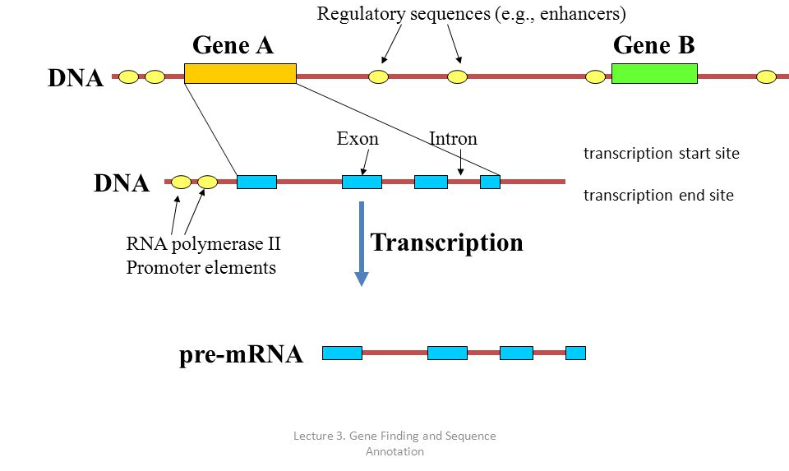
Nucleic Genome (Eukaryotes)
20-30,000 genes
introns!
repetitive non-coding DNA
not all ”junk” DNA is junk

Slide 4
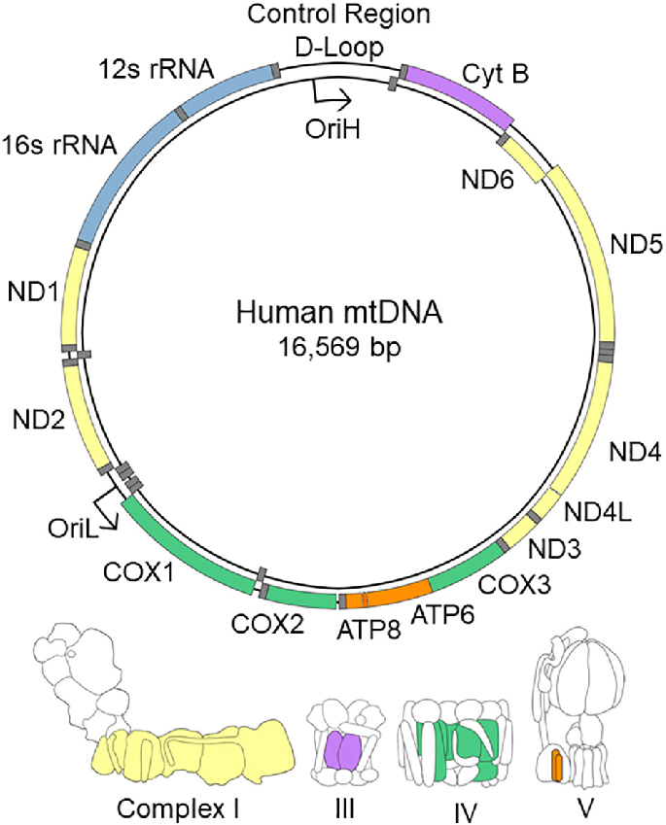
Mitochondrial Genome
~15000bp
13 protein coding genes
2 rRNA
21 tRNA genes
control region
Different genetic code than nuc.
Highly conserved at the protein level, third nucleotide positions variable

Slide 5
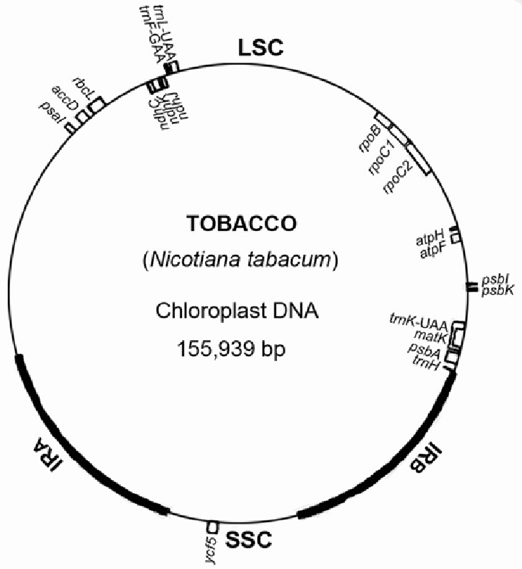
Chloroplast Genome
“small”
circular
stable, more stable than mt in plants

Slide 6
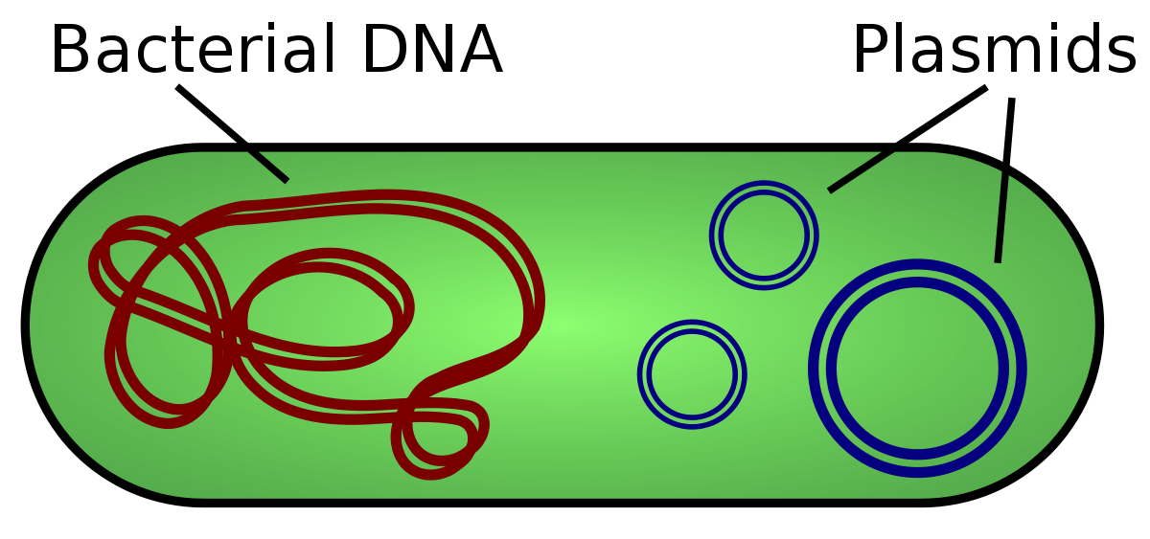

Slide 7
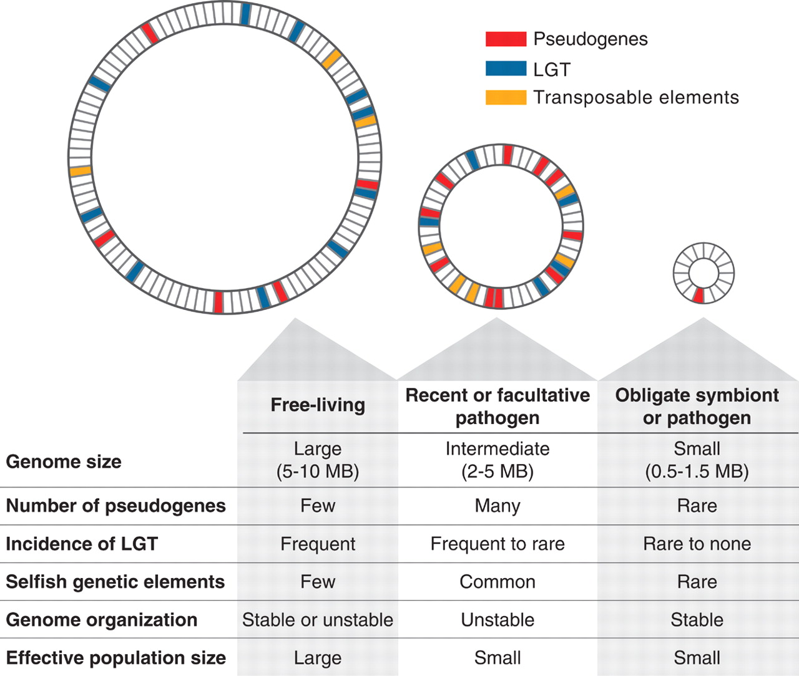
Prokaryotic Genomes
size and organization correlated with life history

Slide 8
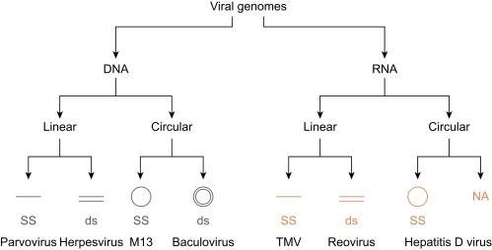

Slide 9
What is genomics?
Structure and function of genomes
study complete sets of genes/proteins and their interactions
study the organization of the genome
Looks at the big picture of genetic landscape
need to develop a map of relative physical locations of different genes
understand how the different parts function and interact
figure out evolutionary relationships using genomic information

Slide 10
Genome Sequencing
we talked about many different sequencing technologies …
many ways to figure out the sequence of bases in fragments of DNA (50bp – 10,000bp)
to span a 3,000,000 bp genome how many 100bp fragments?
sequencing must be deep enough to account for errors, contamination, sequencing artifacts, repetitive regions…
giant panda genome (~3Gb) required 50x coverage of 75bp reads

Slide 11
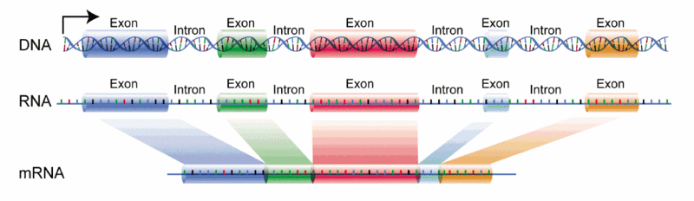
Genome Sequencing
library preparation will be different for WGS than for exome or transcriptome

Slide 12
Genome Sequencing
library preparation will be different for WGS than for exome or transcriptome
it is important to know how the library was prepared (paired end, single end, mate pair etc.) – this will determine which assembly options are appropriate
different assemblers for different assembly problems…

Slide 13
Genome Assembly
IF a reference genome already exists – reference guided/mapping assembly
ELSE a de-novo assembly is needed
uses only the information contained in the sequence reads
Genome size may determine which program you go with
Different long read and short read assemblers

Slide 14
Assembly
Whole genome – ABySS, Velvet, SOAPdenovo, Ray, SPAdes
Transcriptome – Trinity, salmon
Long read – Canu, Flye

Slide 15
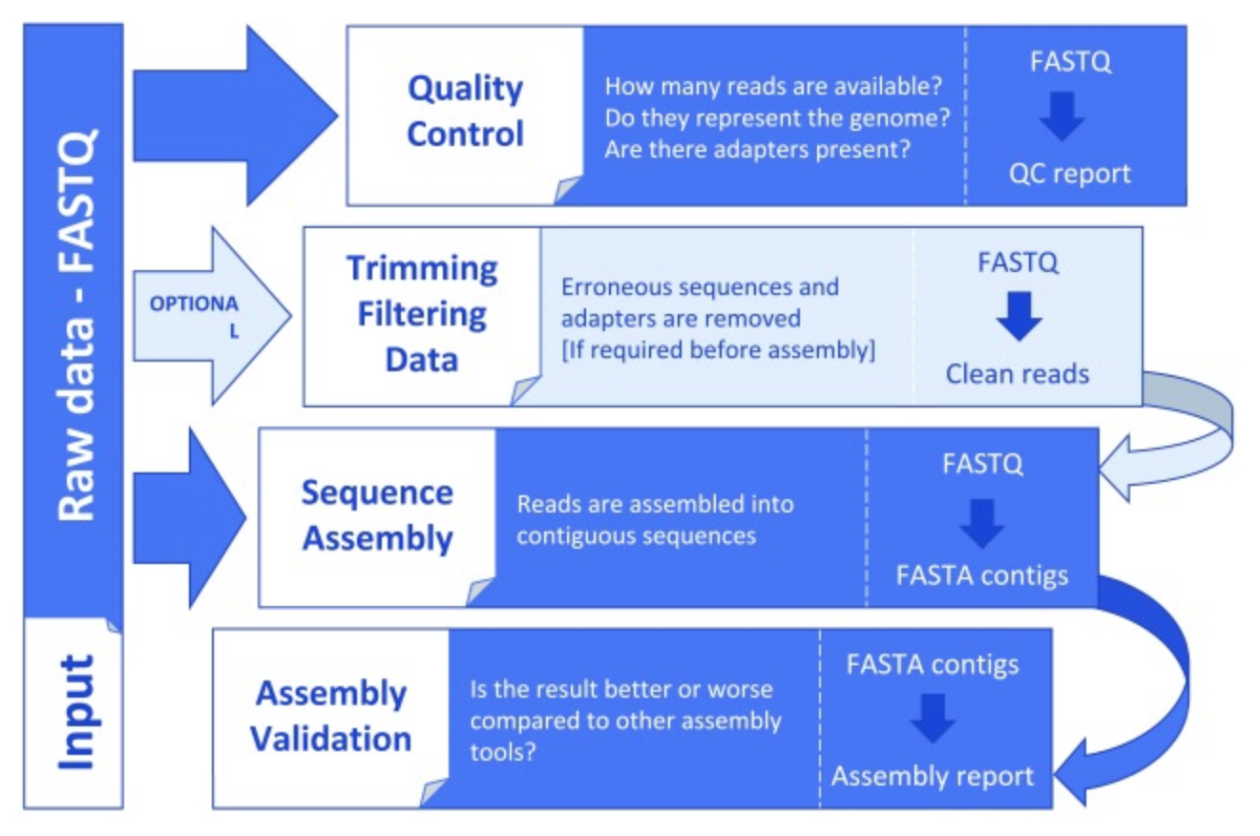
FastQC, fastx-toolkit
trimmomatic, cutadapt
many!
compare btw methods, look for completeness

Slide 16
Assembly Problem
you have just been handed several garbage bags full multiple copies of a shredded book….
reassemble each sentence of the book in the correct order using only observed overlap between fragments
someone has systematically removed parts of the book and created typos in some of the copies…

Slide 17
Assembly Problem
That Sam-I-am! I do not
That Sam-I-am! I do not like that Sam-I-am! Do you like green eggs and ham?
That Sam-I-am! I do not like that Sam-I-am! Do you like green eggs and ham?
That Sam-I-am! I do not like that Sam-I-am! Do you like green eggs and ham?
That Sam-I-am! I do not like that Sam-I-am! Do you like green eggs and ham?
That Sam-I-am! I do not like that Sam-I-am! Do you like green eggs and ham?

Slide 18
Assembly Problem – sequencing errors
That Pam-I-am! I do not
That Sam-I!am! I do not like that Sam-I-am! Do you like green eggs and ham?
That Sam-I-am! I do not like that Sam-I-am! Do you like green eggs and ham?
That Sam-I-am! I do not like that Sam-I-am! Do you like green eggs and ham?
That Sam-I-am! I do not like that Sam-I-am! Do you like preen eggs and ham?
That Pam-I?am! I do not like that Sam-I-am! Do you like ?reen eggs and ham?

Slide 19
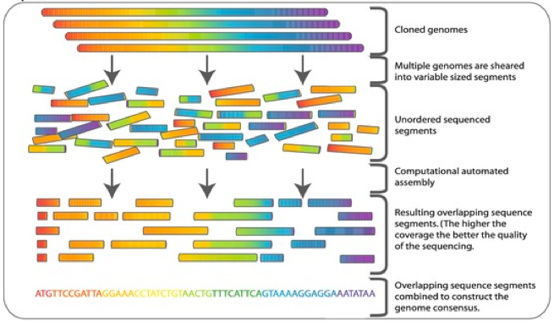

Slide 20
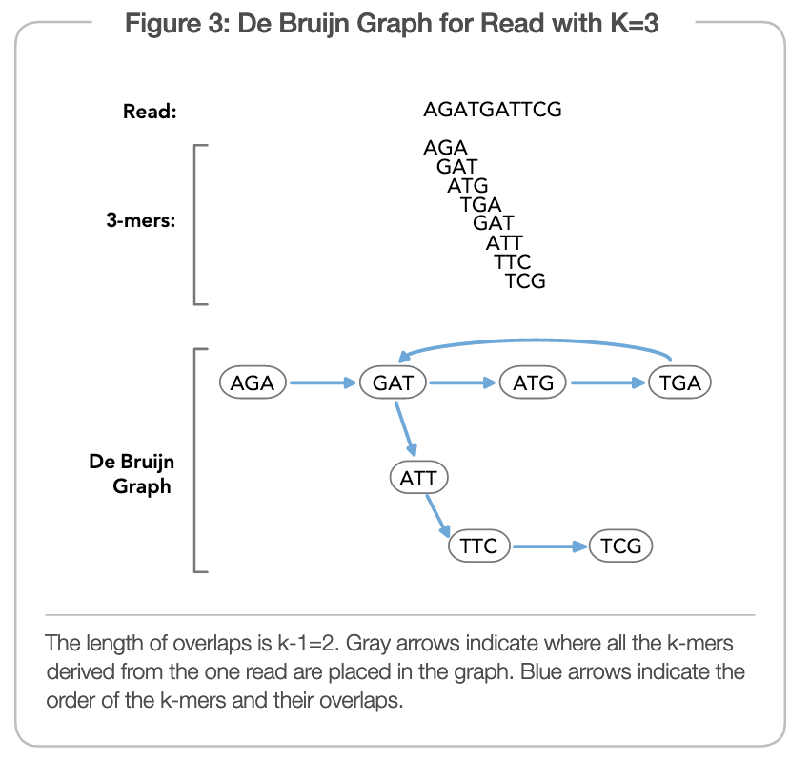

Slide 21
Sequencing and Assembly Challenges
contamination: apples and oranges
component mis-assemblies: lower level organization
path level mis-assemblies: higher level organization
large-scale duplication: multi-mapping
genome polymorphism: haplotype expansion

Slide 22
Genome Assembly
Many genomes are at different “life stages”
some are large scaffolds that cannot be placed
some have well developed maps corresponding to chromosomes
some may be well assembled but lacking proper annotation…
Obtain genome assemblies and associated data from many different sources - ensebl, UCSC, NCBI

Slide 23
Genome Annotation
Putting labels on all of the parts of the genome
gene names, functions, pathways etc.
Information needed to make conclusions or develop hypotheses about biological function
Allows us to put all of our bioinformatic information into biological context…
Plenty of wet lab validation yet to be done; classical genetics, molecular biology, biochemistry

Slide 24
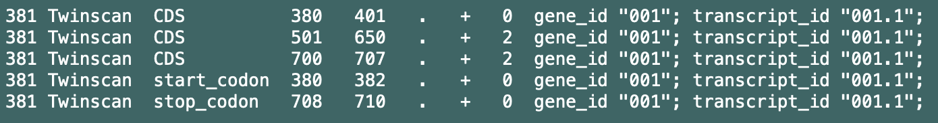
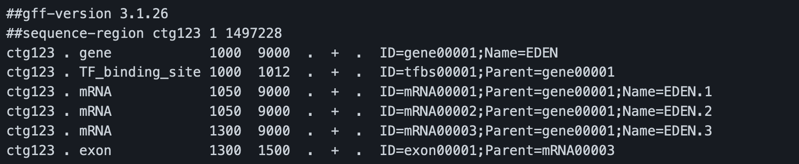
GTF and GFF3
Gene Transfer File
Generic Feature Format (version 3)

