Slide 1
Introduction to R and tidyverse
WV-INBRE Bioinformatics Bootcamp
Summer 2023

Slide 2
What is R?
R is a programming language and statistical computing environment
Why another language?
Different programming languages are designed with specific use cases in mind
Bash is a shell scripting language
Useful for invoking executables in UNIX/Linux and for automating system administration tasks
Python is a general-purpose programming language
Good for processing data, implementing complex algorithms
R is a statistical computing language
Designed to make it easy to perform statistical analyses

Slide 3
Installing R
Navigate to https://www.r-project.org.
Click on the download R link.
This provides a list of mirror sites from which you can install R. It doesn't really matter which mirror you pick, but I usually choose the geographically closest one. Choose a mirror and click on the link.
In the first box at the top, click on the "Download R for (your operating system)" link.
For Mac users: click on the R pkg file for the latest version.
For Windows users: click on the "install R for the first time" link, and then click on the "Download R for windows" link for the current version.
When your download is complete, open it. Click through the default options, which will install R.

Slide 4
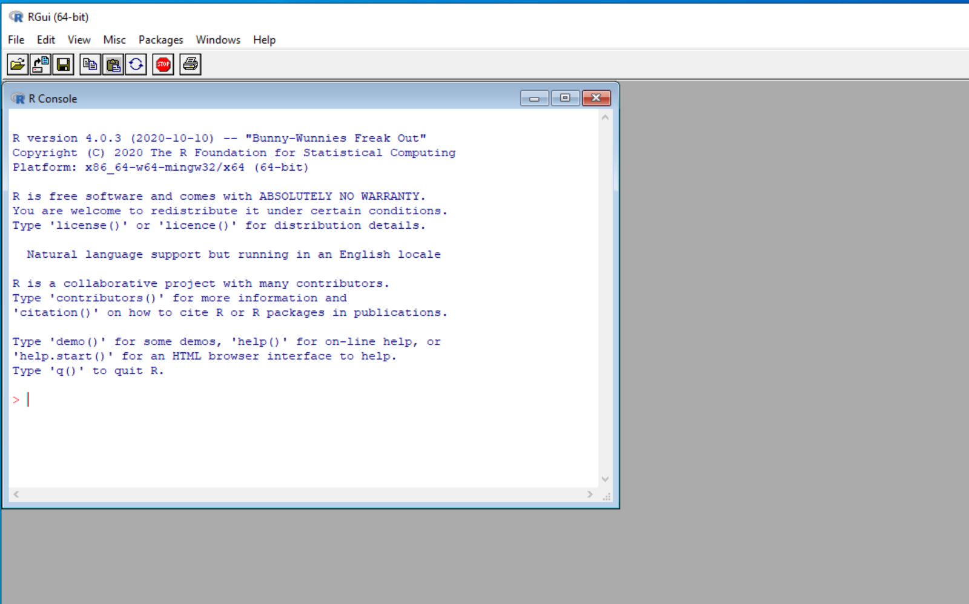
Testing the R installation
For Mac users: Open R either by clicking on the R app icon under Applications in Finder, or by finding the R app in LaunchPad
For Windows users: Click on the start (windows) menu and find R under programs. There will be two versions: a 32-bit version and a 64-bit version. Choose the version appropriate for your operating system (which is almost certainly the 64-bit version, "x64").
You should see an application like the one shown

Slide 5
Using R
The R console is a Read-Evaluate-Print Loop (REPL)
The > symbol is a prompt
Try typing 6 * 7 at the prompt
Since R is designed to do statistics, every data type in R represents a collection of values (similar to a list in python)
Vectors contain values all of the same type
Lists contain values that may be different types

Slide 6
Creating a vector of values
Try x <- c(2, 3, 5, 7, 8)
The c function is "combine"
Combines values into a vector
<- is a combination of the less than (<) character and the minus sign (-)
The <- combination of characters is an assignment operator
Assign the vector to the variable x
You can also use = (I find <- more descriptive)

Slide 7
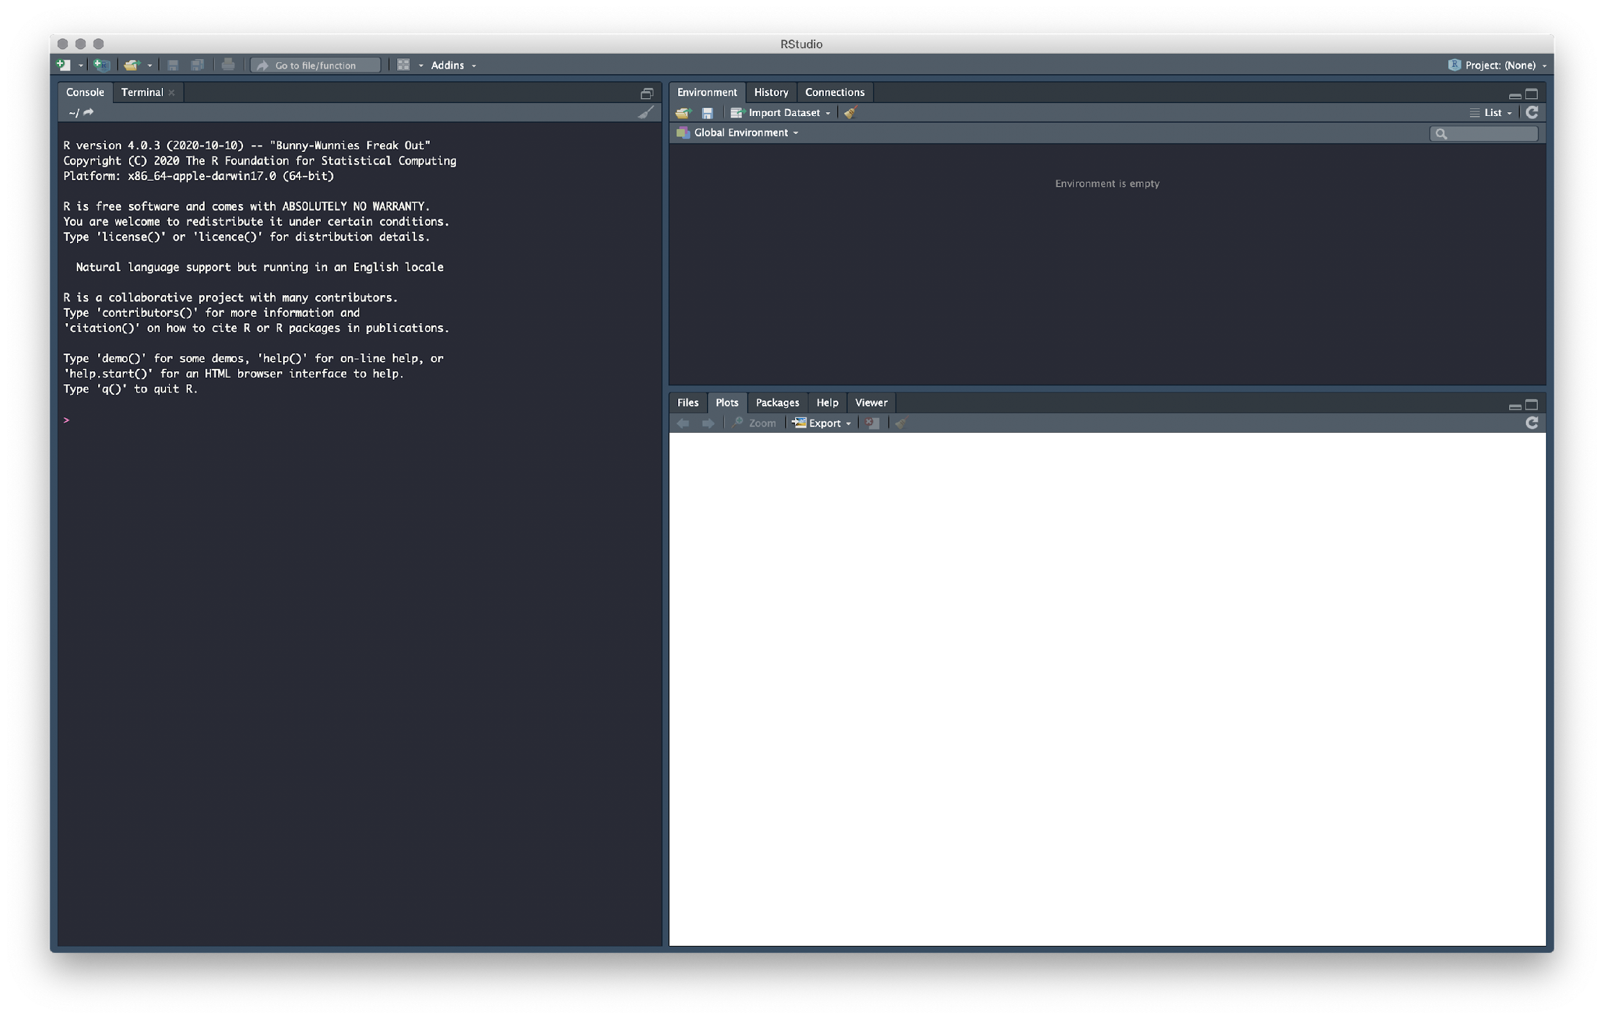
Installing R Studio
Using the console on its own is not very user friendly. Here, we'll install RStudio, which will make things easier going forward. Note we'll still be typing commands, but RStudio will give us lots of useful functionality for managing those commands.
To download RStudio, navigate to https://rstudio.com/products/rstudio/download/
Scroll down and press the "Download" button under the free "RStudio Desktop" version.
You have already installed R, so under step 2, click on the "Download RStudio" for your operating system (which should be automatically detected).
When the file has downloaded, open it and install RStudio.
Open RStudio, which should now appear in the Start Menu (windows) or in LaunchPad or the Applications folder (Mac).
You should see a screen similar to this:

Slide 8
Using R Studio
In the "console" area on the left, we can do something similar to the work we did before. Type x <- c(2,3,5,7,8)
If you look in the "Environment" tab in the top right, you'll see that x is displayed there, with its current value.
You can find the average of the five values in x using the mean function: mean(x)
Try to find the standard deviation of the values in x, using the sd function.
Try the following: boxplot(x)

Slide 9
R packages
R is modular: it's possible to write packages in R to solve related tasks
Many packages ("libraries") exist for R, including packages designed for bioinformatics
To use an R package it needs to be installed
Installation needs to happen only once
And then loaded
Loading needs to happen every session in which the library is used

Slide 10
Tidyverse
It’s common to find that a large portion of the time you spend in data analysis is in getting the data into a form where the software can perform the analysis
Informally known as “data wrangling”
Can be a frustrating, time-consuming, boring part of data analysis…
Recently, Hadley Wickham, a statistician from New Zealand, developed a collection of R packages for data wrangling, collectively known as the tidyverse
Make your data tidy

Slide 11
Installing tidyverse
Open R studio
Under the “Tools” menu, choose “Install Packages”
In the “Packages” field, type “tidyverse”
Leave the other fields as the default values and press “Install”
This will install the tidyverse package
You only need to do this step once; if you exit R and restart, the package will still be installed

Slide 12
Starting RStudio
Open RStudio
In the console, set the Working Directory to your sars-cov-2-reads directory by typing setwd("/Volumes/…/SarsSamples") setwd("Z:\\...\\SarsSamples")
We’ll put the code for today’s work in a script
This means we can easily save our work, and redo the same analysis later
In RStudio, select “File”, “New File”, and “R Script”
This will create a new tab in the top left, labelled “Untitled”
You can save it with a meaningful name in a folder of your choosing at any time

Slide 13
Loading the library
In the new script, enter the code library(tidyverse)
This will load the library into the current session, so its functionality will be available
We need to do this once per session in which we need the library
Click next to this command in the script, and press the “Run” button

Slide 14
Loading data
We can load the lineage report we generated for our SARS-CoV-2 data.
Since this is a CSV file, we can use the tidyverse function read_csv
Enter the following in your script and run it with the "Run" button:
lin <- read_csv("lineage_report.csv")
This will read the CSV file and store its contents in a tidyverse table (called a "tibble") with the variable name lin

Slide 15
Tidyverse tables
In RStudio, the table appears in the “Environment” tab under “Data”
Click on “lin” in the environment tab to view the data
This appears as a table in a tab next to your script
In tidyverse, this data type is called a “tibble”
In “Environment”, expand met by clicking on the small arrow next to the name
Note how it describes the types of each column

Slide 16
grep in R
R supports forms of the grep function
Examine the "qc_status" column of lineage in the data view
We can access individual columns of a data table in R using the $ operator
In the console, enter
lin$qc_status
Try the following (in the console):
grep("pass", lin$qc_status)
grepl("pass", lin$qc_status)

Slide 17
Filtering in tidyverse
Tidyverse has a filter function for filtering tibbles
Provide a tibble and a logical (i.e. TRUE or FALSE) vector
Enter the following in the script:
lin <- filter(lin, grepl("pass", qc_status))
Run that line and view the lin tibble again

Slide 18
Piping in tidyverse
Tidyverse supports a "pipe" operator
Works similarly to | in bash
The tidyverse pipe operator is %>%
Essentially treats the output of the previous command as the first argument to the next command
We can rewrite our script as:
lin <- read_csv("lineage_report.csv") %>%
filter(grepl("passed", status))

Slide 19
Counting lineage
The tidyverse pull(…) function extracts (pulls) a column from a tibble
In the console, try
pull(lin, lineage)
The plain R function table counts occurrences of each value in a vector or list
Try
table(pull(lin, lineage))
or
pull(lin, lineage) %>% table

Slide 20
Analyzing low coverage samples
Recall the pileup files we generated
Tab-separated value files with SequenceID, Position, Reference alllele, read depth, and two other columns
Choose one of your samples and, in the console, run
SRRxxxxxx_pileup <- read_tsv(”SRRxxxxxx_R1.pileup")
Check the file name and adjust accordingly
We're only interested in the first four columns, so we can do
SRRxxxxxx_pileup <- select(SRRxxxxxx_pileup, 1:4)

Slide 21
Analyzing low coverage samples
Load the same for a second sample:
SRRxxxxx_pileup <- read_tsv(”SRRxxxxx_R1.pileup") %>%
select(1:4)
View each of these tibbles

Slide 22
Analyzing low coverage samples
We can use the same idea to combine all samples
Do the following in the script
Check the values of each variable you create or change as you run each line
files <- list.files(pattern="\\.pileup")
pileups <- lapply(files, function(f)
read_tsv(f, col_names=c("Seq","Pos","Ref",gsub("\\.pileup","",f),"X1","X2")) %>%
select(1:4)
)
pileups <- reduce(pileups, inner_join)

Slide 23
Analyzing low coverage samples
We call a single base for a single sample "low coverage" if it has fewer than 10 reads
We want to count the number of low coverage bases for each sample
lowCovBases <- pileups[,4:(3+length(files))]<10
numDropoutBases <- colSums(lowCovBases)
numDropoutBases <- tibble(SampleID=names(numDropoutBases), NumberOfLowCoverageBases=numDropoutBases)
write_csv(numDropoutBases, "LowCoverageBasesBySample.csv")

Slide 24
Using R on the Server
Our server has no user interface
We can start a text-based console
From your terminal, log into the server and just enter
R
You can enter commands here
R scripts can be run with the /usr/local/bin/Rscript executable

Slide 25
Running your script on the server
Enter a shebang at the top of your script:
#! /usr/local/bin/Rscript
Save the script into your sars-cov-2-reads on the server
Use the mapped Z drive
Log into the server and run your Rscript

