Slide 1
Transcriptomics

Slide 2
Transcriptome
Complete set of RNAs in a given sample (cell, tissue, whole organism…)
Samples vary widely, capture specific moment in time
Many species of RNA out there…tRNA, rRNA, mRNA, lncRNA, snoRNA, miRNA, siRNA etc
We will be working with mRNA

Slide 3
Workflow
Total RNA extraction -> library preparation (fragmentation, polyA selection) -> Illumina sequencing -> raw fastq files ->
Quality Control (trimming & filtering)
Mapping (transcriptome or genome) or de novo assembly
Quantifying (count reads)
Differential Expression Analysis
Functional Annotation & Pathway Analysis

Slide 4
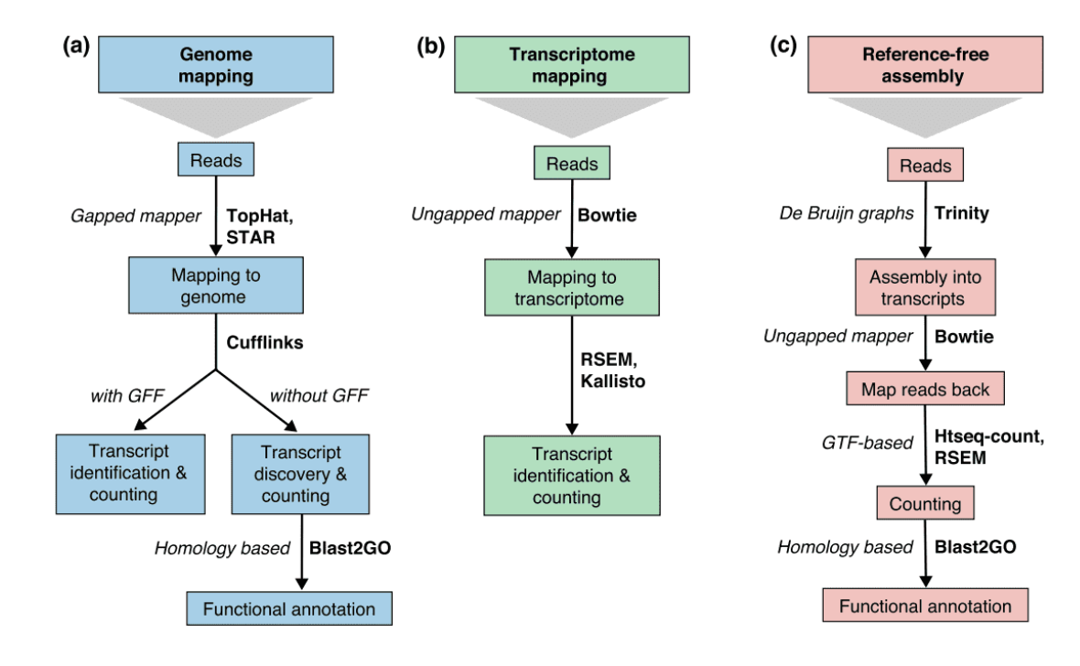
Conesa et al. 2016

Slide 5
Challenges of RNA sequencing
Different sample and reference genome origin
Incompletely processed RNAs or transcriptional background noise
Sequencing or other experimental biases…

Slide 6
Benefits of RNA-seq
Allows detection of known and unknown targets – unbiased look
Can be used on non-model or organisms without a reference genome
Reveals patterns associated with disease/conditions not visible in the DNA sequence itself
Provides an estimate of the magnitude of expression

Slide 7
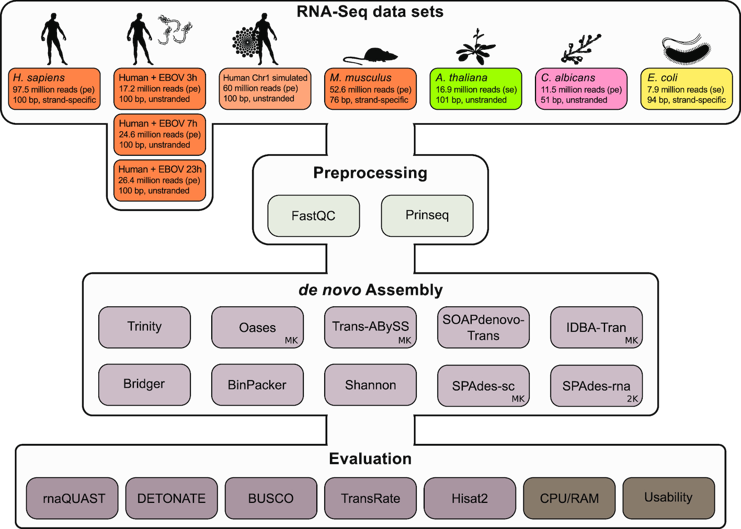

Notes:
Figure 1: Overview of the RNA-Seq data sets used (orange: eukaryote; light orange: simulated human Chr1; green: plant; pink: fungi; yellow: bacterium) and assembly tools evaluated. Each data set was quality controlled with FastQC [34] and preprocessed with Prinseq [35] before assembly. Overall, >200 single k-mer assemblies were calculated. For details about the data sets and assembly tools see Electronic Supplement Tables S1 and S2, respectively. We selected a combination of 20 biological-based and reference-free metrics from the different evaluation tools to assess the quality of each assembly (Table 4 in Methods). The CPU/RAM consumption and the usability of each assembler were not included in the calculated metric scores. Details can be found in the Methods. bp: base pairs; EBOV: Ebola virus; MK: the assembler's built-in multiple–k-mer approach was applied; pe: paired-end reads; se: single-end reads. SPAdes-rna uses 2 k-mers (2K) per default.
Unless provided in the caption above, the following copyright applies to the content of this slide: © The Author(s) 2019. Published by Oxford University Press.This is an Open Access article distributed under the terms of the Creative Commons Attribution License (http://creativecommons.org/licenses/by/4.0/), which permits unrestricted reuse, distribution, and reproduction in any medium, provided the original work is properly cited.

Slide 8
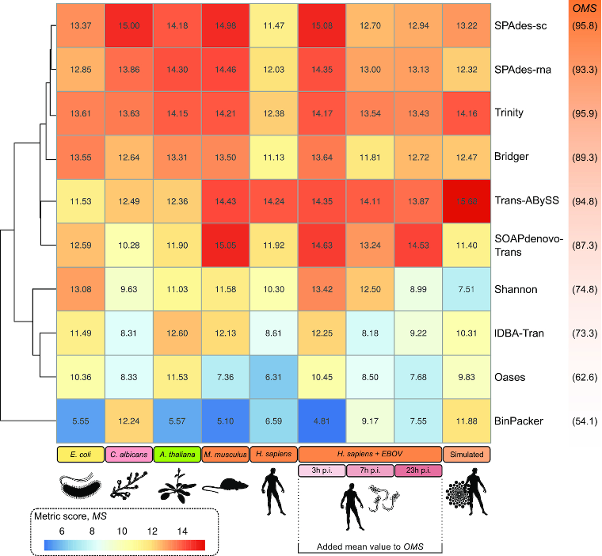

Slide 9

de novo assembly
Creates de Bruijn graphs representing the transcriptional complexity at a given gene or locus, extracts full-length splicing isoforms
Inchworm assembles the RNA-seq data into the unique sequences of transcripts, often generating full-length transcripts for a dominant isoform
Chrysalis clusters the Inchworm contigs into clusters and constructs complete de Bruijn graphs for each cluster
Butterfly then processes the individual graphs in parallel, tracing the paths that reads and pairs of reads take within the graph RAM limited

Slide 10
spades --rna / --sc
Let’s try a de novo assembly!
Look at the documentation for spades and try to figure out what your command should be…
Just type /software/SPAdes-3.15.2-Linux/bin/spades.py

Slide 11
Run your command!
/software/SPAdes-3.15.2-Linux/bin/spades.py --rna -o outdir \
-1 XXX_R1.fastq.gz \
-2 XXX_R2.fastq.gz -t 2

Slide 12
Working with quality score data
Assessing sequence quality scores
fastQValidator
http://genome.sph.umich.edu/wiki/FastQValidator
fastqc/multiqc
http://www.bioinformatics.babraham.ac.uk/projects/fastqc/
fastx-toolkit
http://hannonlab.cshl.edu/fastx_toolkit/download.html
Trimming sequences based on quality scores
fastx-toolkit
cutadapt, trimmomatic, sickle, condetri, etc…..
porechop (long reads)

Slide 13
Questions to ask yourself:
How aggressive should I be?
What cut-offs (quality score and/or length)?
Throw out or keep really “short” reads?

