Slide 1
Aligning short-read sequences
WV-INBRE Bioinformatics Bootcamp
Summer 2023

Slide 2
What is a short-read aligner?
The sequencer generates short sequences which are "small samples" of the viral genome
Called "reads"
In our sequencing protocol these are 75 bases long
We know these reads originated from somewhere on the genome, which is about 30,000 bases long
The role of an aligner is to locate each read on the genome

Slide 3
Alignment challenges
Imagine a very naïve approach:
To see if the read matches a specific location, we have to compare 75 bases
Assuming all reads match somewhere, on average we would have to compare 15,000 locations
So this is a total of 1,125,000 comparisons, on average to align each read
Our typical sample has about 3 million reads
So to align an entire sample, we would need to perform approximately 3.375x10¹² comparisons
Assuming the computer can perform 1 million comparisons per second, this would take 3,375,000 seconds, or about 39 days
We currently sequence more than 300 samples per week…

Slide 4
Additional Alignment Challenges
We're not only interested in exact matches
There may be errors in the sequencing
There may be natural genetic variation between our sample and the reference genome
E.g. human samples versus reference human genome
Typically looking for the "best" match, up to some threshold limit for the measure of "best"

Slide 5
Basic idea behind aligners
Suppose you were looking for something in a large reference book
Typically you wouldn't scan through the book from beginning to end, looking for your search text
Instead, the author can create an index, and you can scan the index
Aligners essentially work by creating an index of the genome
Use similar algorithms to compression algorithms

Slide 6
The Burrows-Wheeler Aligner
The Burrows-Wheeler Aligner was created by Heng Li and Richard Durbin https://www.ncbi.nlm.nih.gov/pmc/articles/PMC2705234/
Based on an indexing method called the Burrows-Wheeler Transform
Basic idea:
Take the reference sequence, add an "end of sequence character", $, at the end
Rotate the sequence one base at a time
Sort the rotated sequences
It is now easy and quick to find a sequence with a given prefix (because they are sorted), and we can find the original position of that sequence

Slide 7
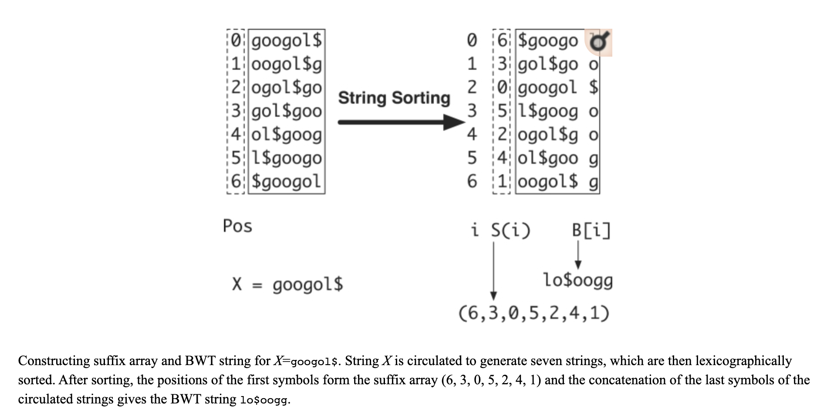
Burrows Wheeler Transform
Durbin and Li, 2009

Slide 8
Example read files
In your bootcamp folders there is a sub-folder called SarsSamples with *.fastq.gz reads in it
What does the extension .fastq.gz mean?
We can read a gzipped file without first unzipping it using the zcat command
Try cd SarsSamples zcat *_1.fastq.gz | less
Can you use zcat, grep, and wc to find the number of records in the file?

Slide 9
Using BWA: Creating an index
Navigate (cd) to your main folder on the bootcamp drive
Create a new folder called 'reference'
Copy the SARS-CoV-2 reference genome to that folder: cp ~/data/bootcamp/Genomes/sarscov2.fasta reference
Navigate into the reference folder
Run bwa index: bwa index sarscov2.fasta
Check the results by listing the contents of the folder

Slide 10
Running the aligner
Navigate back up to your SarsSamples folder
Run the aligner on one fastq file: bwa mem ../reference/sarscov2.fasta SRRxxxxx_1.fastq.gz > SRAxxxxxx.sam
This will generate an alignment in the .sam file
Try less SRAxxxxxx.sam
How big is the sam file?

Slide 11
Converting to bam
sam files are typically large, and need to be
compressed, to save disk space
sorted and indexed, to easily access specific portions of them
Standard zip compression does not allow for indexing
There is a specific compression format – bam (binary sam) for this purpose
The utility software samtools contains a collection of command-line tools for working with sam and bam files

Slide 12
samtools view
samtools view will simply view a sam/bam file
Try samtools view SRAxxxxxx.sam | less
To output to a file, use the –o option
Note redirecting will not work properly: it will not output the headers!
Try samtools view –o SRAxxxxxx.bam SRAxxxxxx.sam
This converts our sam file to a bam file
Compare the resulting file sizes

Slide 13
Sorting and indexing
To view the bam file in IGV it needs to be sorted and indexed
Allows IGV to easily locate alignments on a portion of the genome
Use samtools sort –o SRAxxxxxx_sorted.bam SRAxxxxxx.bam
and then samtools index SRAxxxxxx_sorted.bam

Slide 14
Install/access IGV
We are going to use the Integrated Genome Viewer (IGV) program
This is a GUI and we can install it on your local machine…
also a web app…
The version of the reference genome we want to use is already a built in option for IGV (NC_045512.2)
Retrieve your sorted .bam and index file (.bai) using scp
“pull down” like we did earlier or “push down” from the server (hint: need ifconfig)

Slide 15
Viewing in IGV
Now open the sorted bam file in IGV
From the menu, select "File", "Load from File", and navigate to the file on your mapped drive
It may take a minute or two to load

Slide 16
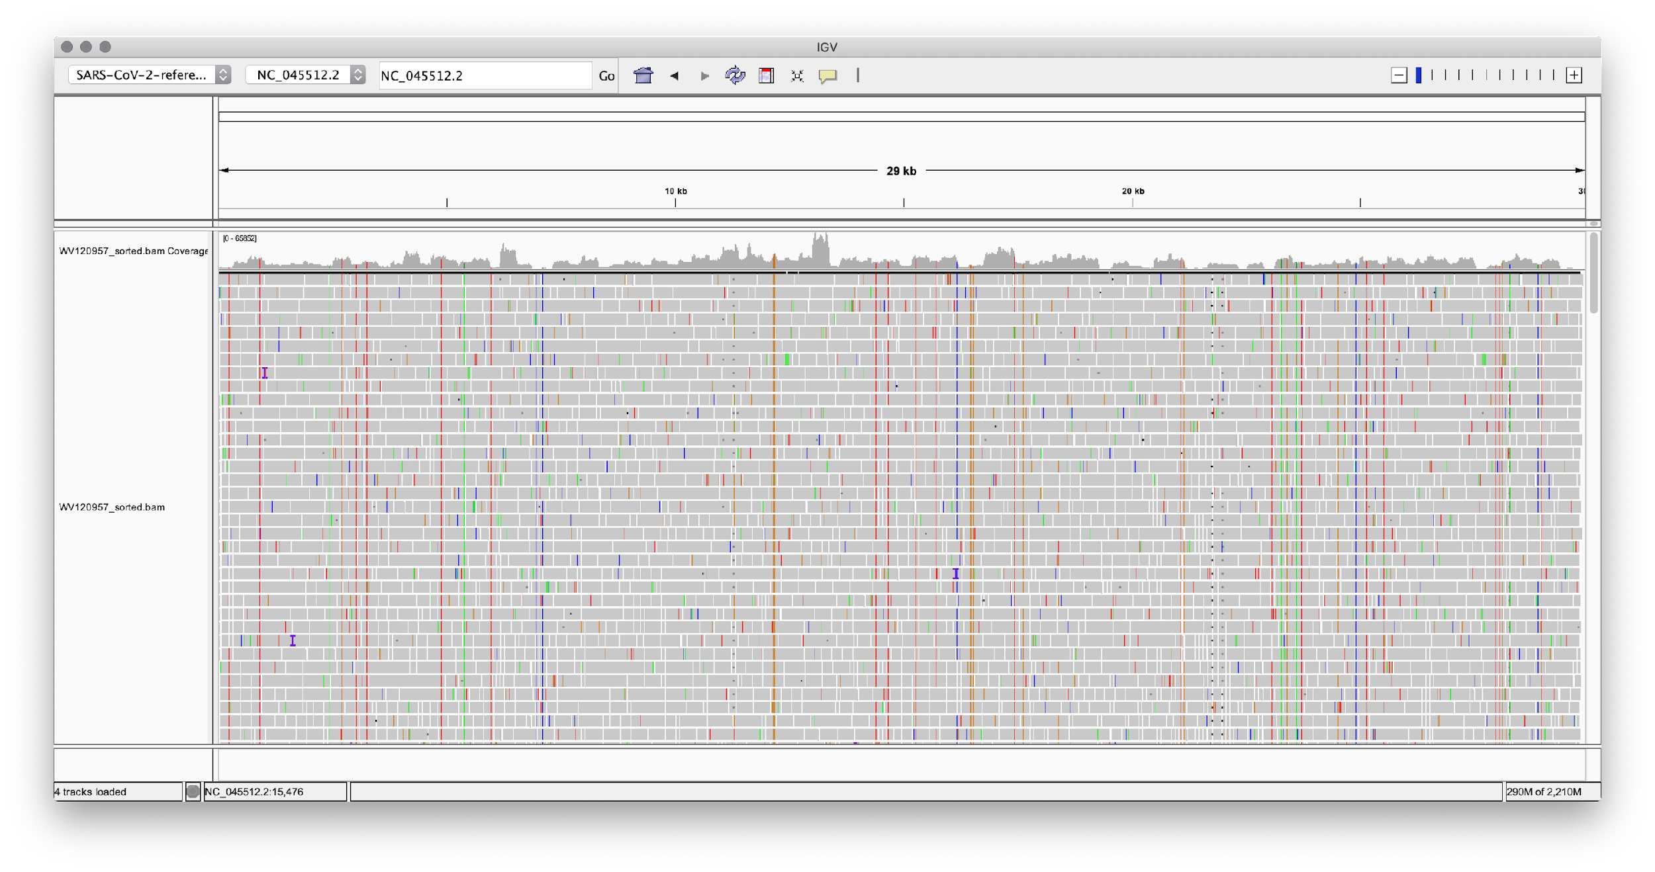
Viewing in IGV

Slide 17
Refining the pipeline
We have four steps so far:
Align the fastq file to generate a sam file
Convert the sam file to a bam file
Sort the bam file
Index the sorted bam file
We can omit step 2, just sorting the sam file, and outputting the sorted data to a bam file
We can also avoid writing the sam file. Instead, we send the aligned data to standard output, and sort data from standard input, piping between the two commands

Slide 18
Running the pipeline with a pipe
bwa mem reference/sarscov2.fasta SRAxxxxxx.fastq.gz | \ samtools sort –o SRAxxxxxx.bam –
samtools index SRAxxxxxx.bam
Notes:
The \ means the same command continues on the next line. There must be no space after the \
The – as an argument to samtools means "read from standard input instead of a file"
We can't pipe to the samtools index command, because we need to save the bam file for future use

Slide 19
Logging output
When we run the previous command, diagnostic and error messages will be sent to the console
Linux supports two different streams of data, which are both sent to the console by default
The first, which we’ve seen before, is standard output
The second is called standard error
Debugging and error messages are sent to this stream
To redirect standard error, we can use 2>filename.log

Slide 20
Pipeline with logging
We can capture the output into log files by redirecting standard error
Useful if something goes wrong
bwa mem reference/sarscov2.fasta SRAxxxxxx.fastq.gz \
2>SRAxxxxxx_align.log | \ samtools sort –o SRAxxxxxx.bam – 2>SRAxxxxxx_sort.log
samtools index SRAxxxxxx.bam
This will log the BWA output to SRAxxxxxx_align.log and the samtools sort output to SRAxxxxxx_sort.log

Slide 21
Running commands in the background
Aligning and sorting take a long time
When we're doing this from the command line, we'd like to be able to use our shell while it's running
When we do this in a script, we'd like to run multiple samples at the same time
We can do this by running the command as a "background job"
To do this, terminate the command with &: bwa mem reference/SARS-CoV-2-reference.fasta \ -1 SRAxxxxxx_1.fastq.gz | \ -2 SRAxxxxxx_2.fastq.gz | \ samtools sort –o SRAxxxxxx.bam - &

Slide 22
Creating a script for the pipeline
Creating a script for our pipeline is better than running it from the command line
We have an indelible record of what we did
Editing a script is an easier way of fixing bugs than re-entering all commands to date
We can use loops to perform the same code for multiple samples

Slide 23
Thinking about our pipeline
The "pseudocode" for our pipeline looks like this:
for each fastq file:
align the fastq file, and pipe the output to samtools sort
index the resulting bam file
To output the bam file (from samtools sort), we'll need a sample name
We'd like to run the alignment, sorting, and indexing for each file in the background
This means the script will continue, starting the next sample while the previous one is still running

