Slide 1
samtools
to find help just type samtools
also: samtools --help
has a variety of subcommands…
to get samtools to work you need to give it a subcommand:
samtools subcommand <filename>

Slide 2
samtools view
samtools view -S -b sample.sam
samtools view -S -b sample.sam > sample.bam
Now, we can use the samtools view command to convert the BAM to SAM so we mere mortals can read it.
samtools view sample.bam | head

Slide 3
samtools sort
when you align a fastq the output will be in the order of sequence input
if we want our sequences arranged by genomic order we must sort
samtools view sample.bam | head
samtools sort sample.bam -o sample.sorted.bam
check the order:
samtools view sample.sorted.bam | head
Notice anything different about the coordinates of the alignments?

Slide 4
samtools index
indexing is required by genome viewers such as IGV so that the viewers can quickly display alignments in each genomic region
samtools index sample.sorted.bam
samtools view sample.sorted.bam refname:lower-upper
samtools view sample.bam NC_045512.2:300-350
How many alignments are there in this region?

Slide 5
the BAM header
samtools view -H sample.bam
**if we wanted to only view the header information

Slide 6
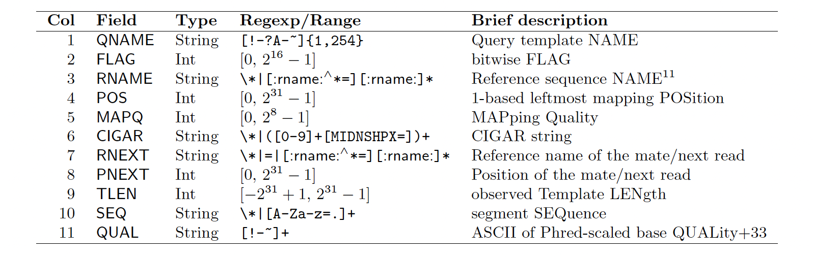
SAM/BAM data fields (columns)

Slide 7
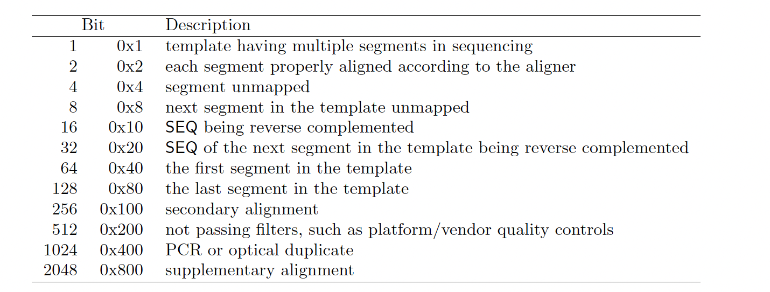
FLAGs

Slide 8
FLAGs
peek at end of bam…
77?
141?

Slide 9
FLAGs
peek at end of bam…
77?
141?

Slide 10
Capture the FLAG
we often want to call variants solely from paired-end sequences that aligned “properly” to the reference genome…
samtools view -f 0x2 sample.sorted.bam
How many properly paired alignments are there?
samtools view -f 0x2 sample.sorted.bam | wc –l

Slide 11
capture the FLAG
Now, let’s ask for alignments that are NOT properly paired. To do this, we use the -F option (note the capitalization to denote “opposite”).
samtools view -F 0x2 sample.sorted.bam
How many improperly paired alignments are there?
samtools view -F 0x2 sample.sorted.bam | wc –l
Does everything add up?

Slide 12
FLAGs (field 2)
how many mapped/unmapped reads?

Slide 13
SAM/BAM data fields (columns)

Slide 14
MAPQ (field 5)
Quality scores associated with the mapper you used - operate in a similar way to phred scores but indicate the confidence in the alignment to reference…
For bwa mem what is the max quality score?

Slide 15
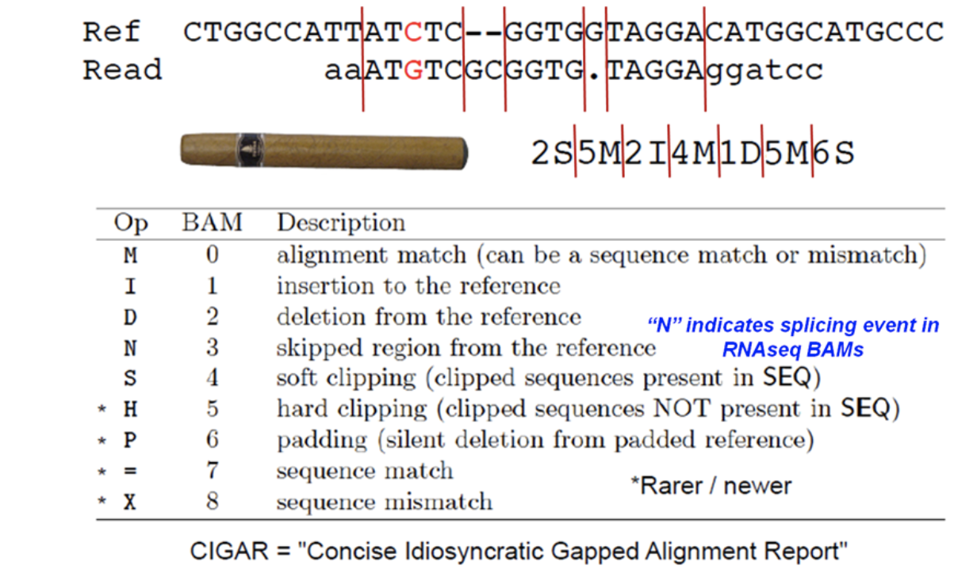
CIGAR (field 6)

