Slide 1
SARS-CoV-2 analysis pipeline
WV-INBRE Bioinformatics Bootcamp 2023

Slide 2
Background
Samples from COVID-19 positive PCR samples are sent to sequencing facilities at WVU and Marshall
Aim is to identify which variants (Alpha, Delta, Omicron, etc.) are present in WV
Samples are sequenced on Illumina sequencers
Typically use paired-end sequencing, and reads of 75 or 120 base pairs
We need to take the sequencing reads and determine the viral variant

Slide 3
Pipeline steps
Align the reads to the reference genome
Find the "consensus sequence" for each sample
Find the individual mutations (single nucleotide polymorphisms, short insertions and short deletions) for each sample
Use those to identify the variant

Slide 4
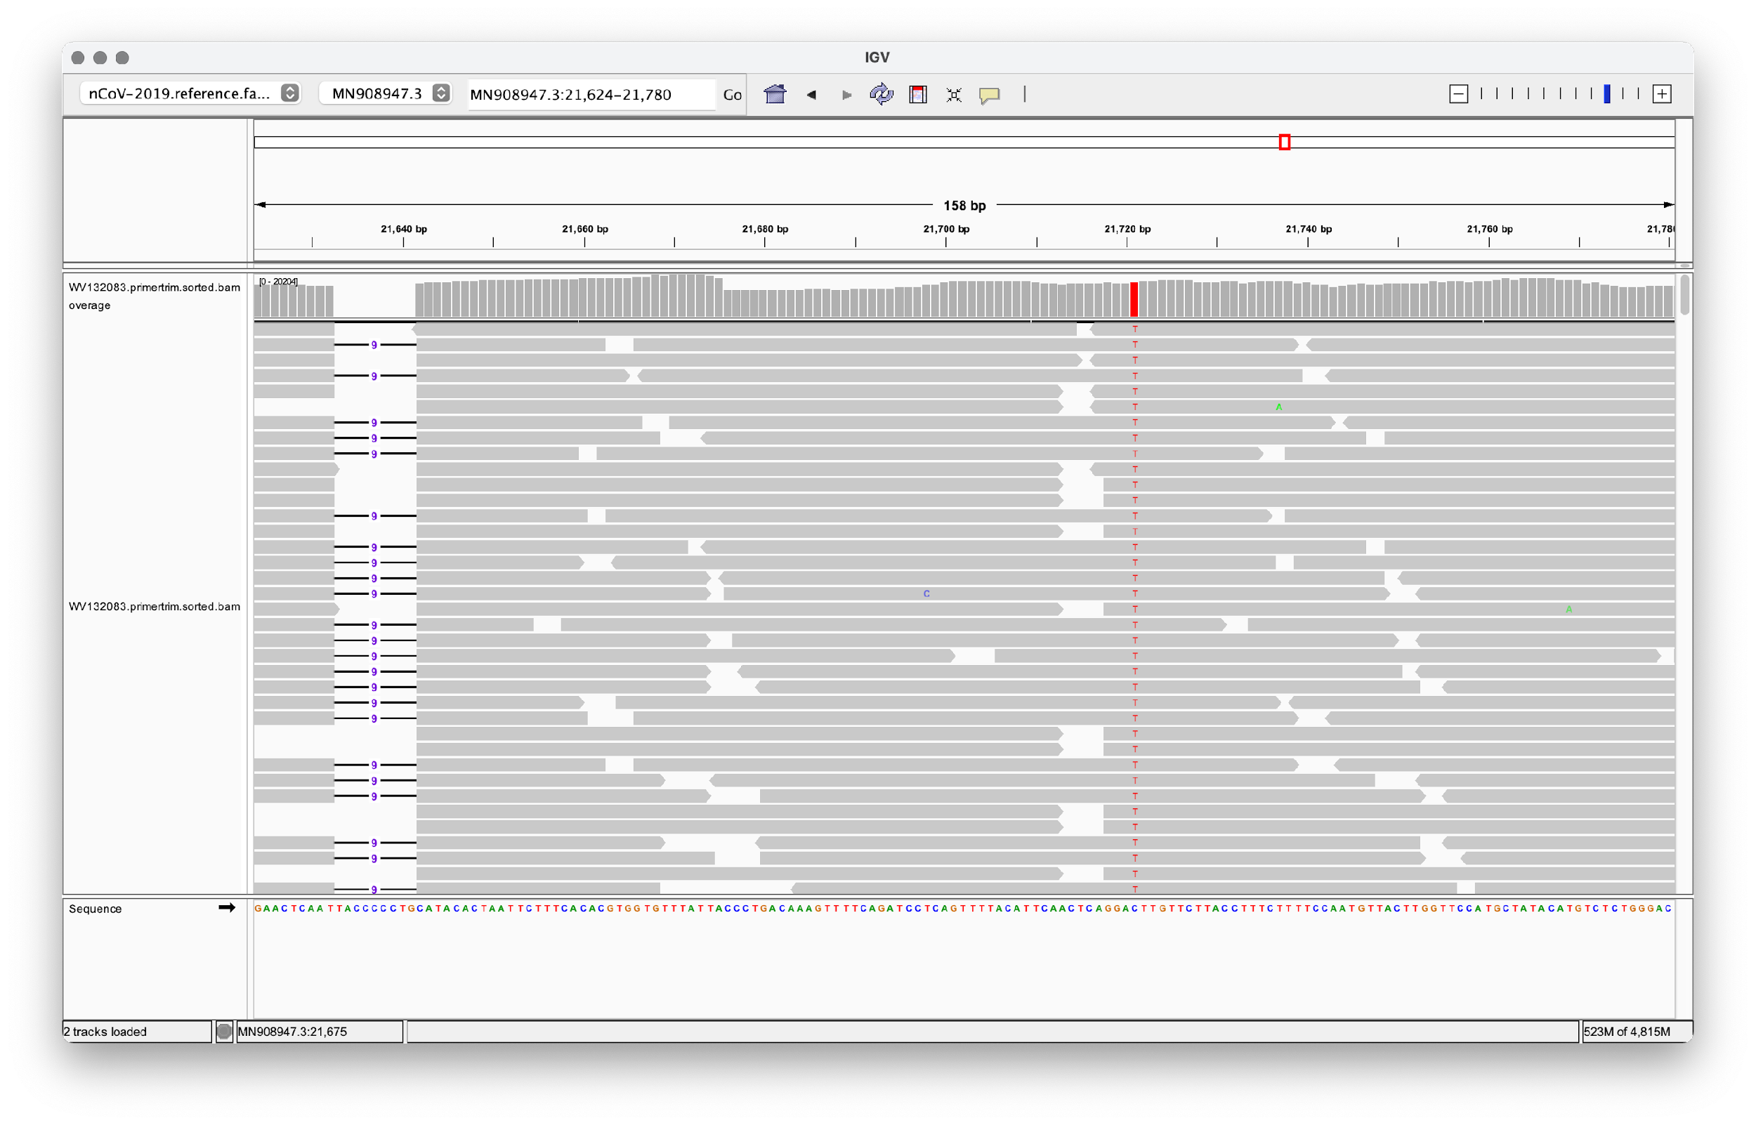
Example from IGV

Slide 5
Software
We will use BWA to align the reads to the reference
Need to use samtools to sort the resulting bam files
Use iVar to call the consensus sequence and mutations
iVar requires a "pileup"
"Pileup" is basically a list of every call for each locus (position) on the genome
samtools can generate this from bam files
Use pangolin to identify the variant from the consensus sequence

Slide 6
Processing multiple samples
Each sequencing run typically has between 92 and 384 different samples
Because the server has a lot of CPUs, we can process many samples simultaneously
However: we must be careful not to overload the server
We will see how this is done in the script later

