Slide 1

Exploring Use of CLI
locate your cursor/command prompt
yours will look a little different, should still have your name@computer followed by fixed symbol(s), followed by a blinking cursor
this is where you will type commands

Slide 2
Exploring Use of CLI
locate your cursor/command prompt: this is where you will type commands
programs are run in the command line following this pattern:
$ command -argument <file or other input>
the $ in this context and throughout the presentation represents your prompt – you do not type that part out each time!
Example: type the command pwd and see what happens…

Slide 3
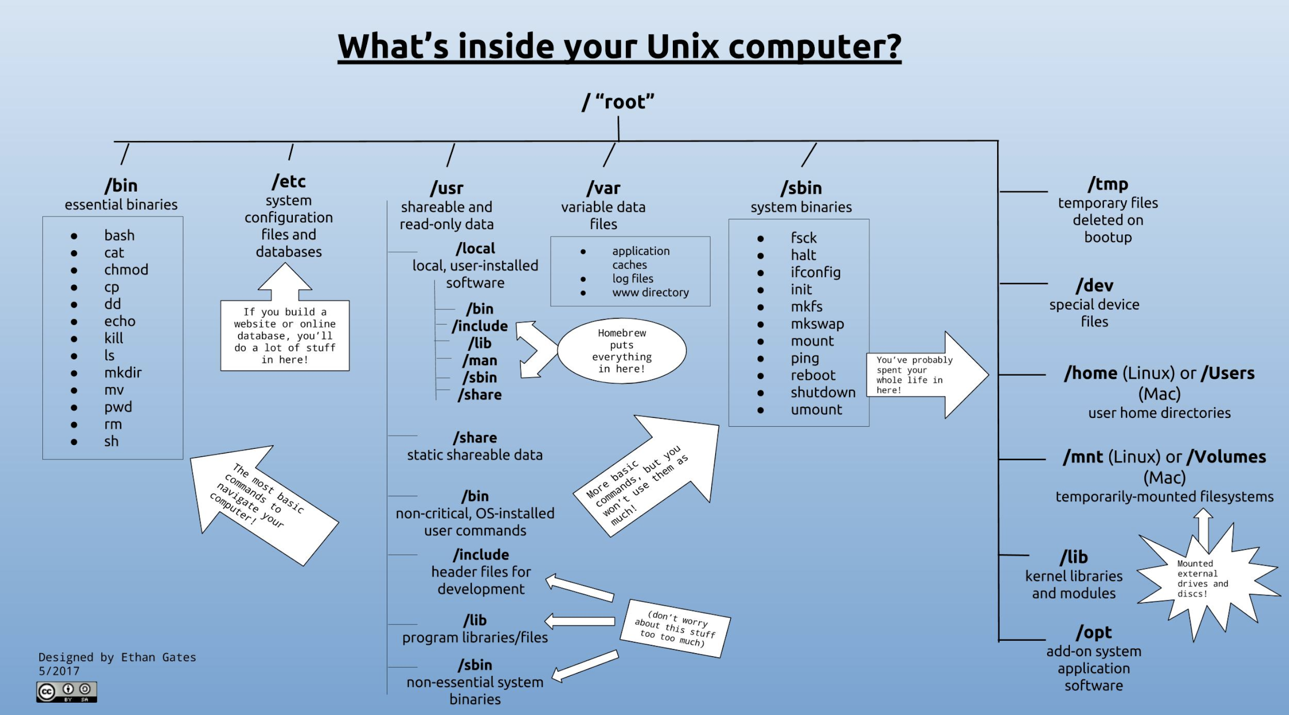
Filesystem
Notes:
cd
ls
pwd
paths
home directory
man
which

Slide 4
Exploring Use of CLI
we can change directories (move up and down the filesystem structure) using the command cd $ cd .. $ pwd
what does “..” mean?
Notes:
tab autocomplete

Slide 5
Exploring Use of CLI
we can change directories (move up and down the filesystem structure) using the command cd $ cd .. $ pwd
what does “..” mean?
. = the current directory
.. = the directory above the current directory
Notes:
tab autocomplete

Slide 6
Exploring Use of CLI
we can change directories (move up and down the filesystem structure) using the command cd $ cd .. $ pwd
try moving all the way up the filesystem using cd
how far can you go…what directory are you in?
Notes:
tab autocomplete

Slide 7
Filesystem
Notes:
cd
ls
pwd
paths
home directory
man
which

Slide 8
Exploring Use of CLI
we can change directories (move up and down the filesystem structure) using the command cd
$ cd .. $ pwd
try moving all the way up the filesystem using cd
Use the list command ls to see which directories exist
type cd by itself to return to your home directory
$ cd
Notes:
tab autocomplete, ls, options

Slide 9
Files and Directories
Think of directories like folders that contain individual files
We can create a directory with the command mkdir
Create 2 directories called “scripts” and “data” in your home directory and then use ls to see them listed: $ mkdir scripts $ mkdir data $ ls

Slide 10
Files and Directories
Alternatively, we could have taken a shortcut and made the two directories simultaneously: $ mkdir scripts data

Slide 11
Files and Directories
Alternatively, we could have taken a shortcut and made the two directories simultaneously: $ mkdir scripts data
Try making a directory named whatever you want
Now remove it using rmdir

Slide 12
Files and Directories
Make a new directory in your home directory (use cd to get back if you aren’t sure):
$ mkdir nested
Now cd into that directory and make a directory called one
Now cd into that directory and make a directory called two
$ mkdir ./three

Slide 13
Files and Directories
what happened with that last command?
use ls to see what is going on…
try to make a directory within the “three” directory without moving around

Slide 14
Orienting: Absolute vs Relative Path
when you use pwd you can see the absolute or full path of the directory you are currently in
we can use . and .. to move around with cd but also to direct a number of other programs to the desired location
using relative paths is faster than remembering the full path
good to know the difference and be able to switch between

Slide 15
Files and Directories
Let’s make some files!
*make sure you are in your home directory*
there are many ways to make and modify files in the shell
nano
vi
vim
much faster than using an outside GUI but has drawbacks

Slide 16
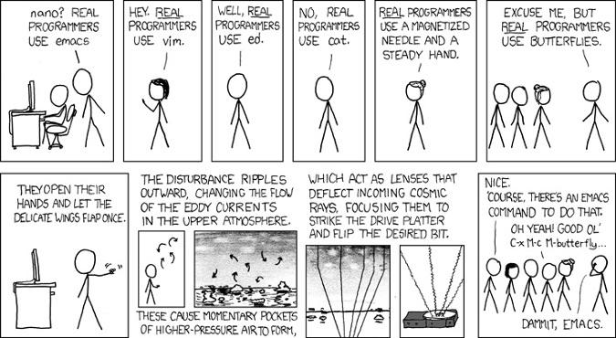

Slide 17
Files and Directories
Let’s make some files!
*make sure you are in your home directory*
see if the following programs exist on your system using which
$ which nano
… vi
… vim
… emacs

Slide 18
Files and Directories
Let’s make some files!
*make sure you are in your home directory*
now type nano and see what happens…

Slide 19
Files and Directories
mv
cp
rm

Slide 20
Files and Directories
mv - move a file from one place to another
can be used to rename a file
cp
rm

Slide 21
Files and Directories
mv - move a file from one place to another
can be used to rename a file
cp - make a copy of a file, specify new name
rm

Slide 22
Files and Directories
mv - move a file from one place to another
can be used to rename a file
cp - make a copy of a file, specify new name
rm - remove a file or a directory (may need extra argument)
gone for good! not like moving to recycling bin…

Slide 23
** Download git repository **
Github is a code and software sharing/collaboration platform
Allows anyone to start an account and keep track of different versions of their projects (kept in repositories)
version control
Has a GUI (quite nice) but is based on a command line operation git
We will first see how to clone a repository and then try it on the command line…
Go to: https://github.com/WVINBREbootcamp
git clone https://github.com/WVINBREbootcamp/BootcampData.git

Slide 24
Files and Directories
touch
cat
head
tail
less
>
>>

Slide 25
Pipes: first command | second command
Any command that sends output to standard out can be “piped” into another command immediately – this is one way we make pipelines
Use a pipe to cat a file, look at the first 500 lines with head and then look at the 500th line itself with tail

Slide 26
Finding Help
Most important skill you will learn while here
Built-in instructions for shell commands

Slide 27
man pages
NAME
head -- display first lines of a file
SYNOPSIS
head [-n count | -c bytes] [file ...]
DESCRIPTION
This filter displays the first count lines or bytes of each of the specified files, or of the standard input if no files are specified. If count is omitted it defaults to 10.
If more than a single file is specified, each file is preceded by a header consisting of the string ``==> XXX <=='' where ``XXX'' is the name of the file.
EXIT STATUS
The head utility exits 0 on success, and >0 if an error occurs.
SEE ALSO
tail(1)
HISTORY
The head command appeared in PWB UNIX.
BSD June 6, 1993 BSD

Slide 28
Online Resources
Documentation
Search for “command usage”
Tutorials and walkthroughs
Blogs
Forums (e.g. stackoverflow)
Direct communication with developer

Slide 29
Mini-Exercise 1
Use the man page of top to figure out how to see which processes/programs are currently using the most memory on your system
Use ifconfig to figure out your IP address
What does the command df do?
Which file is the largest in BootcampData?

Slide 30
Basic shell commands
ls | list the files in the current directory
ls -a | list all files including hidden files
ls -l | long formatted list of files
cd dir | change directory to dir
cd | change to home
pwd | show current directory
mkdir dir | create a directory dir
rm file | delete file
cp file1 file2 | copy file1 to file2
mv file1 file2 | rename or move file1 to file2; if file2 is a directory, move file1 into directory file2
cat file | print the contents of a file to the screen
more file | output the contents of file
less file | output the contents of file
head file | output the first 10 lines of file
tail file | output the last 10 lines of file
tail -f file | output the contents of file as it grows, starting with the last 10 lines
grep pattern file | print the lines matching pattern in the file.
wc -l file | print the number of lines in a file.

Slide 31
File permissions…
U G O
rwx rwx rwx
U = user
G = group
O = other
r = read
w = write
x = execute
rw- rw- rw-
rwx r-- r--

Slide 32
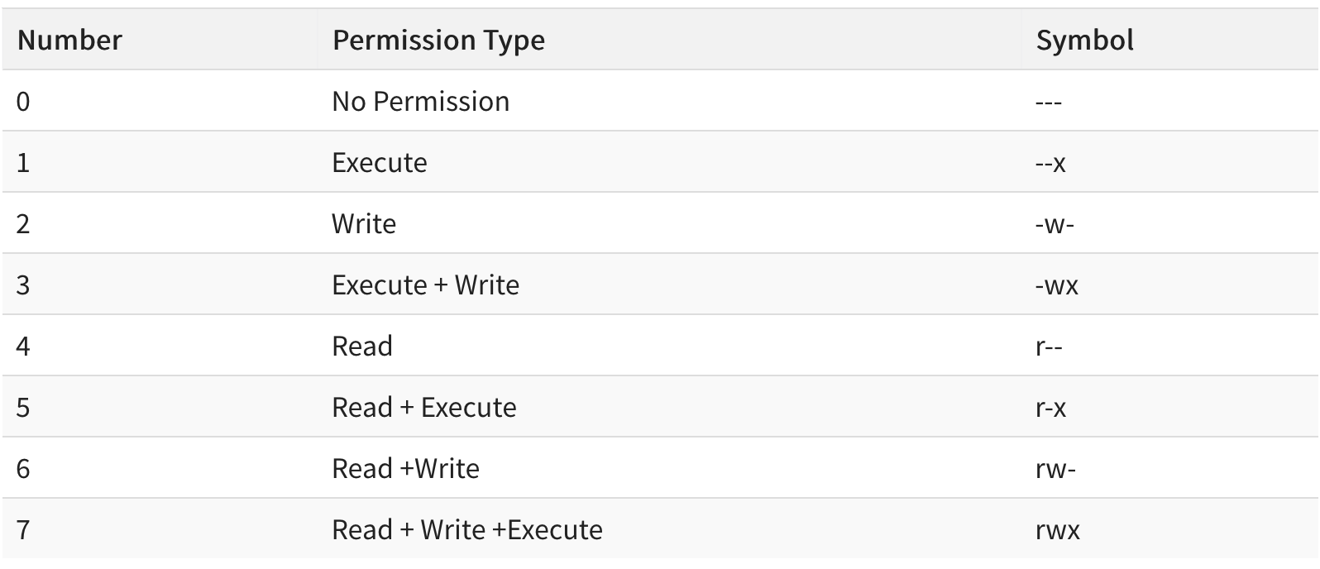
chmod 755 script.sh

Slide 33
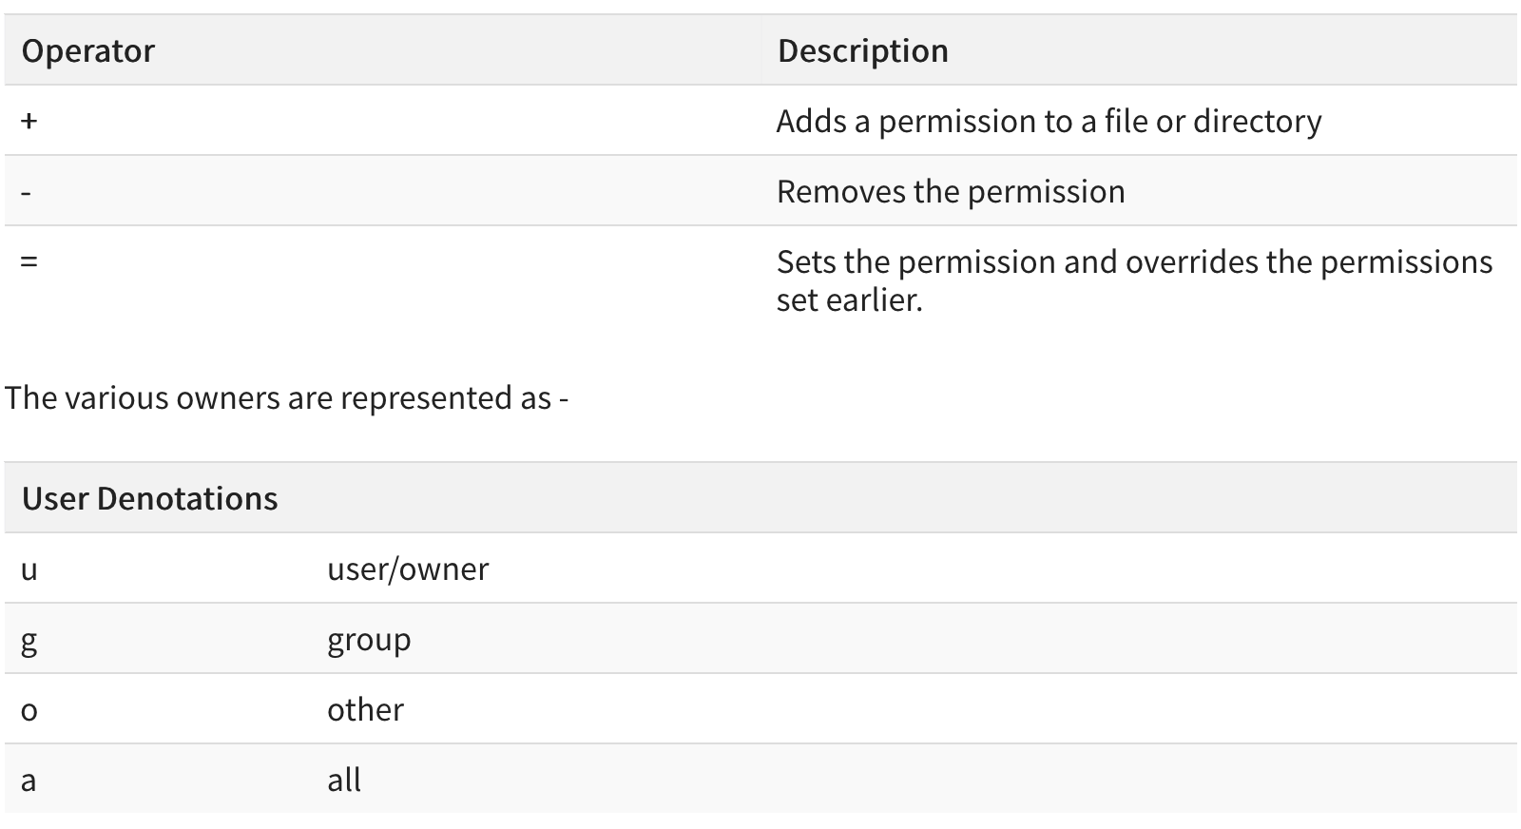
chmod a+x script.sh

Slide 34
Other useful text file commands
wc
tr
sort
uniq
cut
paste
grep

Slide 35
Searching and Modifying Files
grep, sed, awk

Slide 36
Text Editor Options – GUI and CLI
geany
bbedit
atom
sublime text
Notepad ++ (works on windows)
emacs
vim/vi (CLI)
nano (CLI)

Slide 37
Finding Patterns - grep
Can use to find, count, isolate certain patterns or lines containing a pattern
MANY USES, be creative
egrep for use with extended regular expressions
Exact behavior may vary with shell type/system
Can be used with standard out (in a pipeline) or on individual files
Many files can be searched simultaneously

Slide 38
Make a file that looks like this:
ostechnix
Ostechnix
o$technix
linux
linus
unix
Unix
technology
hello world
HELLO world

Slide 39
Now let’s grep!
$ grep nix yourfilename.txt
What does your output look like?
Compare to your text file…what does grep do?

Slide 40
Now let’s grep!
$ grep hello yourfilename.txt
$ grep hello world yourfilename.txt
$ grep ‘hello world’ yourfilename.txt

Slide 41
Now let’s grep!
$ grep -n linus yourfilename.txt what does this do??
$ grep -i ‘hello world’ yourfilename.txt how about this??

Slide 42
Now let’s grep!
$ cat somefile.txt | grep ‘ ’
try out a little pipeline

Slide 43
regex = regular expressions
Powerful search and replace language
Use wildcards, positional data, and other characters to define a pattern
Allows you to edit thousands of files quickly if needed
Tips:
Some preliminary testing of your pattern always required
Helpful at first to use backup files just in case!

Slide 44
grep can use regular expressions
^ = search at the beginning of the line
$ = search at the end of the line
. = search any character

Slide 45
Now let’s grep!
$ grep tech somefile.txt
Append a word to your file using >>
one way to do this:
$ echo biotech >> somefile.txt
$ cat somefile.txt
you should now see the word at the end of your file

Slide 46
Now let’s grep!
$ grep tech somefile.txt
$ grep ^tech somefile.txt
$ grep tech$ somefile.txt
$ grep --color=auto .nix somefile.txt

Slide 47
egrep = grep + extended regular expressions
$ egrep ‘^(l|o)’ somefile.txt
$ egrep ‘^[l-t]’ somefile.txt
$ egrep ‘[x-z]$’ somefile.txt
equivalent to grep -E

Slide 48
Many tools/programs use regex
Think of regex like shorthand language
Characters form patterns, we can use these patterns to search text
grep – global regular expression print
Can use regex patterns or full phrases to search a file
sed - stream editor
Uses regex to search for patterns in character “stream” (standard out) and very good at replacing patterns
Command line find/replace function similar to what your text editing software uses…

Slide 49
Wildcards, special characters, alphanumeric
. = any character
\w = any letter, digit or underscore
\s = any whitespace
\t = tab characters
\n = newline (line ending)
[a-z] = any lower case
[A-Z] = any upper case
[0-9] = digits

Slide 50
line endings
important to know that the end of a line is designated by a hidden character…
windows and mac have their own different line endings
will cause issues with lots of shell commands and bioinformatic software/code
typically, windows uses carriage return + line feed (CR/LF) symbol, classic mac uses CR
let’s try to create this problem and then fix it using notepad++

Slide 51
Quantifiers
+ = one or more occurrences (occurs at least once)
* = match zero or more times (may occur or may not)
? = match zero or one time (may occur once or twice)
{n} = match exactly n times (occurs exactly this many)
{n,}= match at least n times (occurs at least this many)
{,m} = match at most n times
{n-m} = match from n to m times

Slide 52
Positional/boundary symbols
^ = beginning of line
$ = end of line
\b = word boundary
Escape Punctuation & Negation
\ = escape, use literal meaning
[^pattern] = NOT this pattern/everything but

Slide 53
sed (on server)
sed ‘s/pattern/replacement/’ greeneggs.txt
sed ‘s/ham/pork/’ greeneggs.txt ->will replace all occurrences
sed -z ‘s/ham/pork/2’ greeneggs.txt ->will replace 2nd occurrence
sed ‘9 s/ham/pork/g’ greeneggs.txt ->will replace on specific line
sed G filename.txt -> ???
echo "This Is The Best Bootcamp" | sed -r 's/([A-Z])./\1/g'

Slide 54
sed
echo “This Is The Best Bootcamp” | sed ‘s/([A-Z].)./\1/g’
sed '5d’ filename.txt -> delete a specific line
sed ‘/pattern/d’ filename.txt -> delete a specific pattern
Search for “cookbook”, “one-liners”, “cheatsheet” online if you want to explore the variety of commands!

Slide 55
Exercise
Make a pipeline that sends the percentage of degrees awarded to women in computer science in the year you were born to a new text file called birthyear_degrees.txt
How many genes are present in the F. tullarensis protein csv?
-> How many are called ‘hypothetical protein’?
How large is the F. tullarensis genome? To do this you will need to count the total number of nucleotides (ACGT)…

Slide 56
Exercise
move into /seqdata/bootcamp/yourlastname/
look around…do you see your BootcampData folder?
What it is going to do when executed?
Test the command by typing out the contents of the script yourself…

Slide 57
Exercise
Execute the script by typing ./example_script.sh
what happened??

Slide 58
Exercise
Execute the script by typing ./example_script.sh
what happened??
try sh example_script.sh

Slide 59
Exercise
Execute the script by typing ./example_script.sh
what happened??
try sh example_script.sh
we need to fix the shebang line

Slide 60
Exercise
Execute the script by typing ./example_script.sh
what happened??
try sh example_script.sh
we need to fix the shebang line
Modify the script behavior in some way and save it as a new script file called my_new_script.sh
Use chmod to make both scripts executable if they are not already.
Execute both scripts to see if they work! If the shebang is fixed you should not need to use sh

