Slide 1
Bioinformatics File Formats
WV-INBRE Bioinformatics Bootcamp 2022

Slide 2
What is a file format?
All bioinformatics data is basically text data
Sequence data
Meta-data associated with sequences
A file format specifies the structure of a (text) file
Having a defined structure allows software to process files and generate useful data from them

Slide 3
Bioinformatics file formats
There are many file formats defined by bioinformaticians
fasta files: define and name sequences
can be DNA, RNA, or protein sequences
fastq files: sequences, typically generated by a sequencer, with "quality" information associated with each sequence
sam/bam files: "sequence alignment mapping" define the results of aligning a set of sequences to another set of sequences
vcf/bcf files: "variant call format" define changes/mutations from one sequence compared to another sequence
others….

Slide 4
Fasta files
Simple file format that defines and names sequences
One or more "header lines" followed by the sequence associated with that header
Sequence can optionally be split over multiple lines
Header lines begin with a >
Sequence can be
DNA sequences (made of ACGT, or "ambiguous base" characters)
RNA sequences (ACGU)
Protein sequences (characters are amino acid letters)

Slide 5
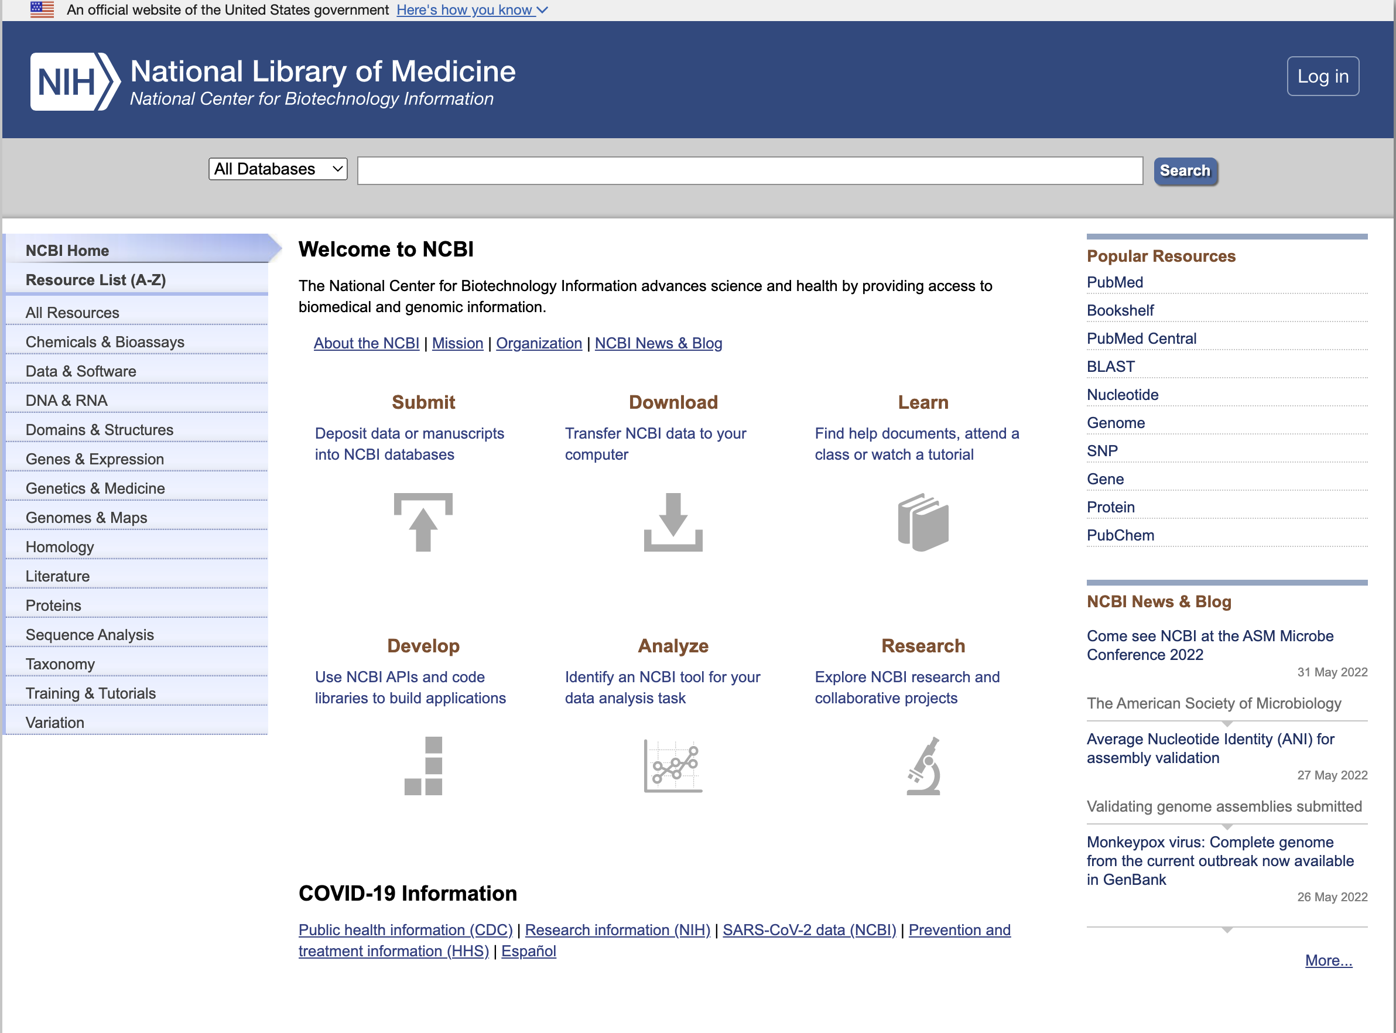
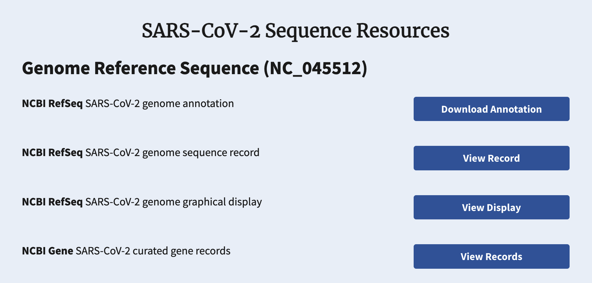
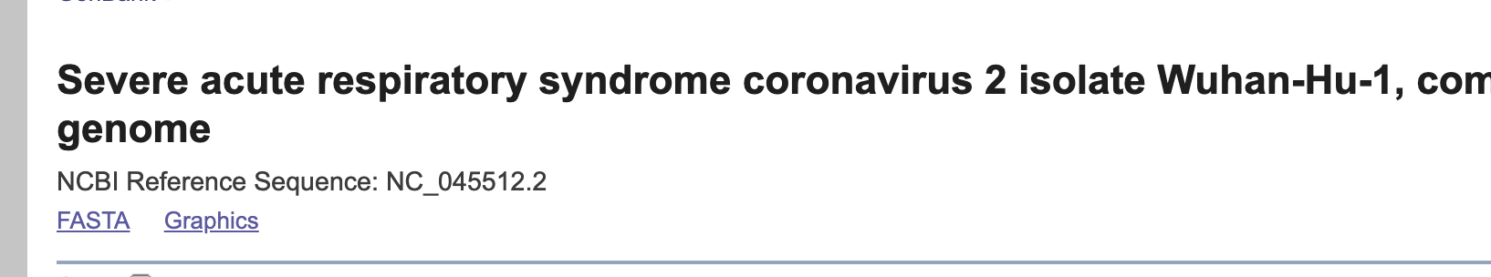
Example fasta file (single sequence)
Download a sequence from the National Center for Biotechnology Information (NCBI)
Go to https://ncbi.nlm.nih.gov
Under "COVID-19 Information", follow the "SARS-CoV-2 data (NCBI) link
Scroll down to the "SARS-CoV-2 Sequence Resources" section and click on "View Record"
Click on the "FASTA" link

Slide 6
Explore the fasta file
Click on "Send to", choose "Complete record" and "File". This will download a file, usually called "sequence.fasta"
Open a terminal and look through the file using more (or less)
What is the first line?
What does the rest of the file look like?
How many lines are there? How many characters in the file? How many characters excluding the first line? How many bases?

Slide 7
Aside: Nucleic Acid Notation
Weak | W | A |  |  | T
Strong | S |  | C | G
Amino | M | A | C
Keto | K |  |  | G | T
Purine | R | A |  | G
Pyrimidine | Y |  | C |  | T
Not A | B |  | C | G | T
Not C | D | A |  | G | T
Not G | H | A | C |  | T
Not T | V | A | C | G
Any one base | N | A | C | G | T
The sequence in the fasta file in the previous example comprised of the letters A, C, G, T, and N
Deoxyribonucleic Acid (DNA) is composed of the four nucleotides Adenine (A), Cytosine (C), Guanine (G), and Thymine (T).
Other letters are used to represent "ambiguities": if we don't know which base is represented at a position
N refers to "Any base"
Other ambiguous bases are in the table

Slide 8
Another example
Return to https://www.ncbi.nlm.nih.gov/sars-cov-2/ and click on "Nucleotide Records"
This provides access to all SARS-CoV-2 sequences submitted by labs to the NCBI
Scroll down the filters on the left, and under "Geographic Region" find "North America" and press the right arrow
Scroll down in the box to "USA" and press the right arrow, and select "WV"
How many sequences are there submitted from WV?
Scroll back to the top and press the "Download" button
Make sure "Nucleotide" is selected under "Sequence Data" and press "Next".
Select "Download all records" and press "Next"
Use the default definition line and press "Download"

Slide 9
Exploring the fasta file
From a terminal, display the first six lines of the fasta file
Display the first six header lines
How many header lines are there?

Slide 10
File Compression
Bioinformatics data files can be large
How much disk space does the sequences.fa file you downloaded take up?
Hint: use ls -lh to see the files and their sizes
Files can be compressed using a variety of different algorithms and file formats
Compression takes advantage of repetition in a file to reduce its size
Sequence data tends to be repetitive

Slide 11
Working with file compression
Use the gzip utility to zip a file:
gzip sequences.fasta
What file does this create? How much disk space does it consume?
The gunzip utility will unzip a file…
However: we rarely need to do this
Instead, we can unzip directly to standard out (i.e. the console) and pipe the result through whatever we need
zcat is a shorthand utility for “gunzip and then cat the result”
gunzip -c is equivalent
Try
zcat sequences.fasta.gz | less
zcat sequences.fasta.gz | wc -l
zcat sequences.fasta.gz | grep “^>” | wc -l

Slide 12
The human reference genome
Go to https://ncbi.nlm.nih.gov
In the Search box, type "Homo sapiens" and choose "Genome" for the database
Clink the link to "Download sequences in FASTA format for Genome"
Note the download is zipped
View the headers
Hint: use zcat, grep, and less in combination
We will discuss the different types of sequences represented here in the RNA-Seq section

Slide 13
Fastq format
The fastq format is an extension of the fasta format that allows for sequences, along with a per-base quality measure
Designed primarily for reads from next-generation sequencing
The sequencer will estimate the confidence/quality of the call for each base, expressed as a probability the call is incorrect
The basic format of a fastq file is that each sequence/read is represented in a block with four entries:
A header/id, prefixed by "@"
The sequence
"+", followed optionally by the same header/id
The quality score, which should be the same length as the sequence

Slide 14
Quality score encoding
Quality scores are represented by probabilities of errors
Inefficient (takes too many characters) to directly represent the numerical value in a text file
Probabilities are encoded as "Phred scores"
Compute -10 log(p) + 33 where p is the probability of the error
Note the negative sign means high probabilities result in low scores
Represent the resulting value as a character using ASCII codes
Adding 33 means that we always avoid any "control characters", and everything is represented as a printable character

Slide 15
Example fastq files
ASCII | Character
33 | !
34 | "
35 | #
36 | $
37 | %
38 | &
39 | '
40 | (
41 | )
42 | *
43 | +
44 | ,
45 | -
46 | .
47 | /
ASCII | Character
48 | 0
49 | 1
… | …
57 | 9
58 | :
59 | ;
60 | <
61 | =
62 | >
63 | ?
64 | @
65 | A
66 | B
67 | C
68 | D
… | …
Log into the server
ssh username@htseq.marshall.edu
Navigate to /seqdata/bootcamp/RNA-Seq-Male
Examine one or more of the fastq files
Note these are zipped
Use zcat and less in combination
Can you figure out the probabilities of errors for some of the phred scores? (Select ASCII codes are in the table)

Slide 16
Other bioinformatic file formats
sam format ("Sequence alignment format")
Describes the results of aligning sequences (typically reads) to a reference genome
We will see alignment in the next section
vcf ("Variant call format")
Describes variations between genome sequences in samples and a reference
Many others…
https://genome.ucsc.edu/FAQ/FAQformat.html

