Slide 1
Final Projects!

Slide 2
QC – fastqc/multiqc
Trim and Filter – trimmomatic
Map or Quantify – Hisat2, bwa, salmon
Count Reads - htseq-count
Differential Expression – R (DESeq2)

Slide 3
Two Datasets -
/seqdata-new/bootcamp25/F_tularensis_data
1199_RNAseq
Salt_RNAseq
/seqdata-new/bootcamp25/Thyroxine_Mouse_data
Sagittal_RNAseq
Coronal_RNAseq

Slide 4
Francisella tularensis
Class A bioterrorism agent (think Ebola, Yersinia pestis, anthrax)
potential for high mortality, ease of dissemination, ability to cause public panic
Causative agent of tularemia – “rabbit fever”
symptoms vary depending on mode of infection, but all cases are serious and potentially lethal
Facultative intracellular, gram-negative bacterium
only ~1800 genes, capable of infiltrating red blood cells

Slide 5
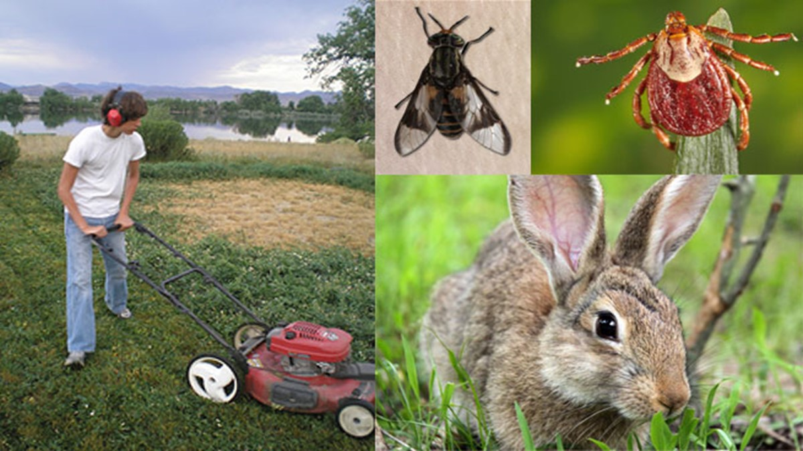

Slide 6
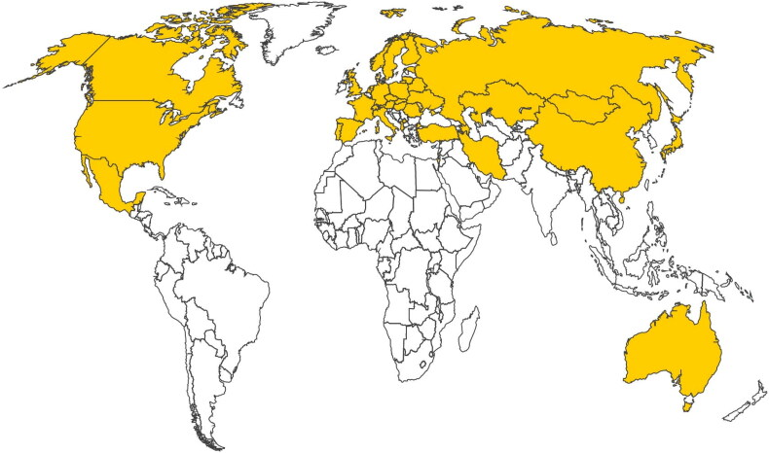

Slide 7
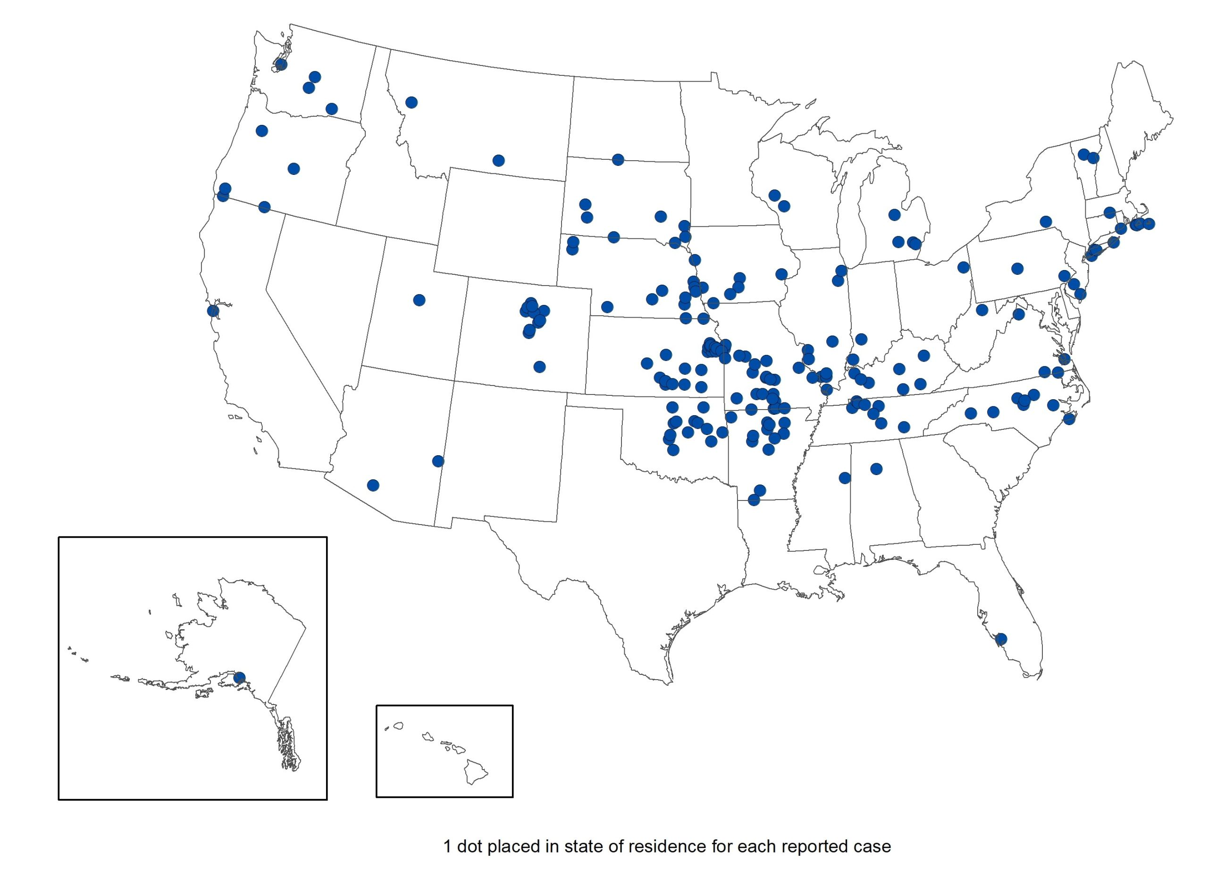

Slide 8
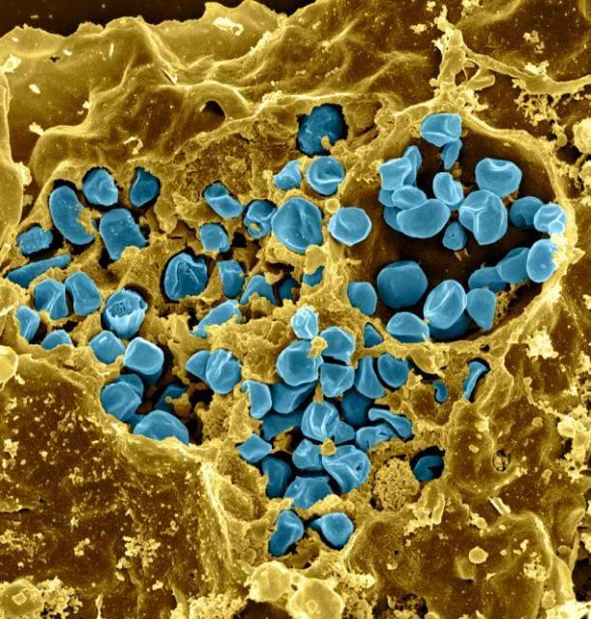
Francisella tularensis
RNA-seq 1 – The role of FTL_1199 in erythrocyte invasion by F. tularensis
F. tularensis LVS with and without FTL_1199
RNA-seq 2 – Investigating modulation of cell wall peptidoglycan under low salt conditions
F. tularensis LVS in high and low salt growth conditions

Slide 9
Craniosynostosis and thyrotoxicosis
hyper or hypothyroidism in pregnant women can lead to birth defects in newborns – 1 in 2500 in US
leads to improper fusing of skull sutures, can happen too early and close before brain is fully developed

Slide 10
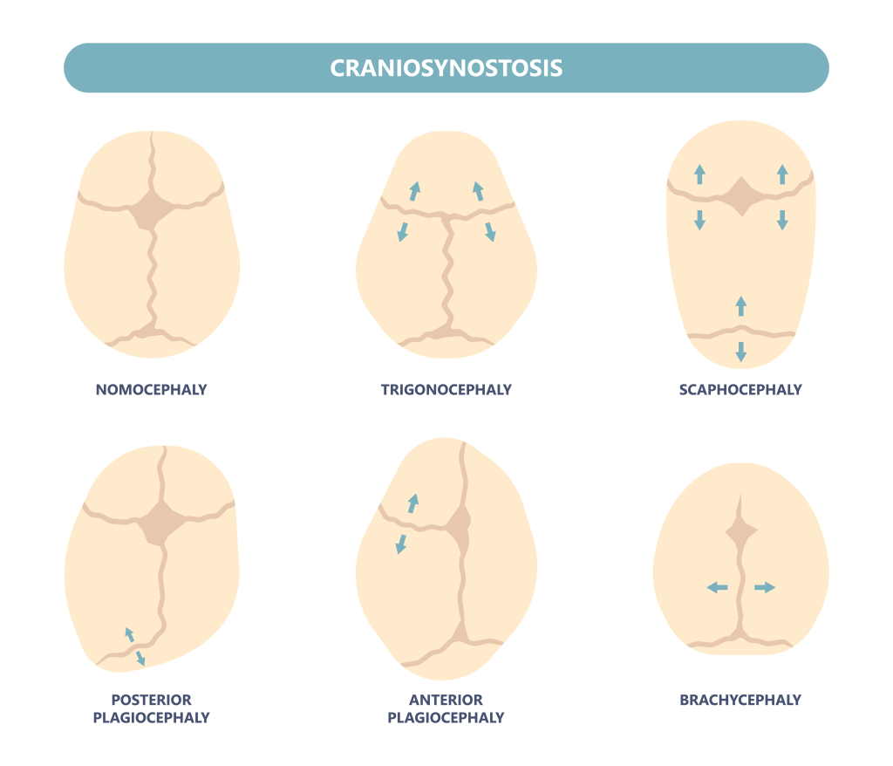

Slide 11
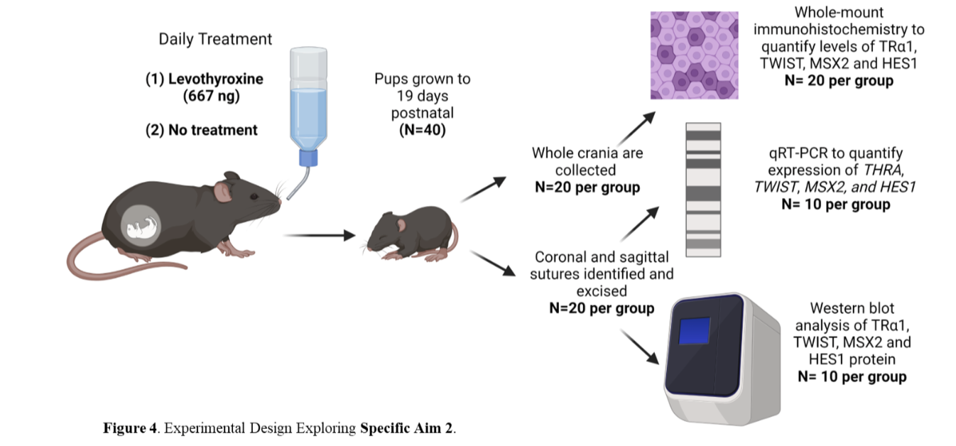

Slide 12
Mouse Tissue RNA-seq
RNA-seq subset 1 – coronal suture samples from fetal mice exposed to thyroxine + control sutures (saline)
RNA-seq subset 2 – sagittal suture samples from fetal mice exposed to thyroxine + control sutures (saline)

