Slide 1


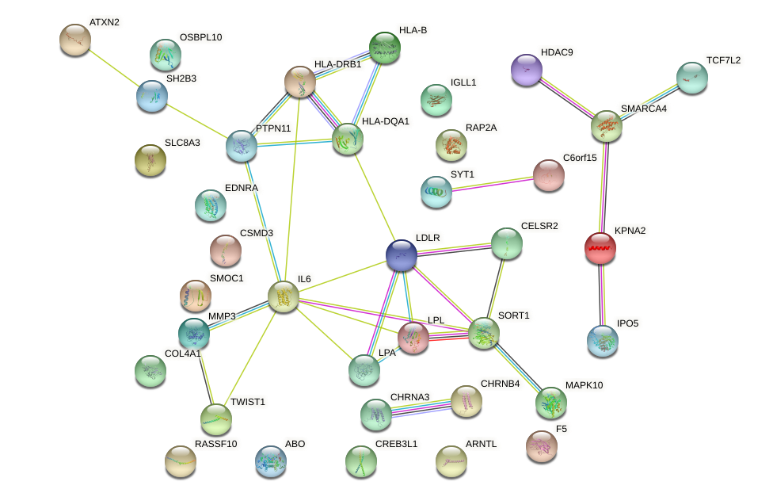
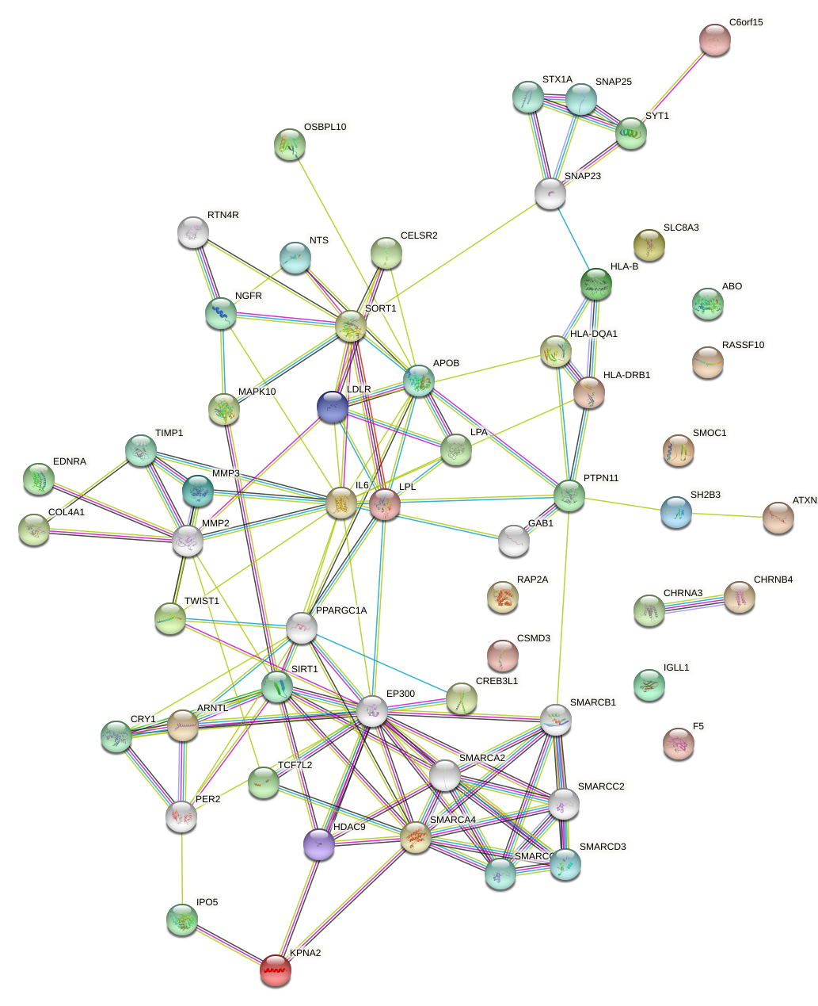
Pathway analysis of Peripheral Arterial Disease
Austin Taylor [1], Vinícius Magalhães Borges, [2], Nicole Garrison [3], James Denvir [4], Alejandro Q. Nato, Jr. [5]. [1] Alejandro Q. Nato, Jr Department of Biomedical Sciences, Joan C. Edwards School of Medicine, Marshall University, Huntington, WV 25755[2] Department of Biological Sciences Sciences, Concord University
Background
Materials and Methods I
Figure 3: a
Peripheral Arterial Disease (PAD) is present in over 230 million people. PAD is a comorbid disease that can be commonly found in patients with diabetes or previous myocardial infarctions. PAD is caused by the build up of fatty deposits on the arterial walls which can restrict blood flow in the leg and lead to numbness in the legs, slow healing ulcers, and wasting on the muscles in the legs.
The first step was to clean out and filter the dataset focusing only on the data that had expression for the arterial disease phenotype. This was done by removing the intergenic hits as well as removing data that was not directly involved with PAD. Then we sorted for the genes that had a high negative log p value. This was then used in Cytoscape to create a network of the genes and provide a graph of candidate genes and pathways.
Introduction
Results
Figure 3a.
This project focuses on the genes that lead to the expression of PAD and using the GWAS dataset we filtered out data not directly relating to PAD. After organizing the data, we then picked the 10 with the highest negative log p values and using Cytoscape we looked at the connection of the genes and were able to find candidate genes and pathways that could be used for further study
Figure 1: STRNG with normal values
Figure 4: a
Figure 4:a
Discussion
Pathway
The IL6 gene is a nesting gene and looks very comfortable
GWAS dataset
Conclusion
In conclusion these genes are involved with PAD and the interactions between these genes show how certain novel genes can be involved with this disease.
R
This figure shows the genes found in the gwas dataset and how they associate with each other within the normal limits of Cytoscape
Filtered Data
Figure 2:STRNG with changed parameters
f
Acknowledgment
Cytoscape
Supported by NIH Grant P20GM103434 to the West Virginia IDeA Network for Biomedical Research Excellence
Buniello A, MacArthur JAL, Cerezo M, Harris LW, Hayhurst J, Malangone C, McMahon A, Morales J, Mountjoy E, Sollis E, Suveges D, Vrousgou O, Whetzel PL, Amode R, Guillen JA, Riat HS, Trevanion SJ, Hall P, Junkins H, Flicek P, Burdett T, Hindorff LA, Cunningham F and Parkinson H. The NHGRI-EBI GWAS Catalog of published genome-wide association studies, targeted arrays and summary statistics 2019. Nucleic Acids Research, 2019, Vol. 47 (Database issue): D1005-D1012.
Supported by NIH Grant P20GM103434 to the West Virginia IDeA Network for Biomedical Research Excellence
High performance cluster computing from Marshall university
https://natolab.marshall.edu/
Comparison scatterplots
Figure 2: This shows the same genes but allows with more interactions between other genes not listed within the given dataset.

