Slide 1


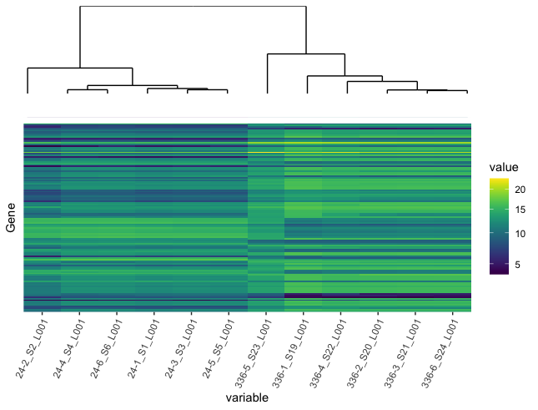
Analysis of Differential Gene Expression in the Intracellular Pathogen, Francisella tularensis LVS
Rachelle Patterson¹, Nicole Garrison¹ , Stuart Cantlay¹, and James Denvir². ¹Department of Biomedical Sciences, West Liberty University; ²Department of Biomedical Sciences, Marshall University
Abstract
Methods
Functional Annotation of Differentially Expressed Genes
Francisella tularensis (FTL) is a highly infectious bacterium that holds bioterror potential. F. tularensis can enter a viable but non-culturable (VBNC) state when exposed to stressful conditions, such as nutrient deficiency. Genes involved in the survival and persistence of F. tularensis in the VBNC state are of interest. RNA extractions were collected from 24-hour and 336-hour cultures of F. tularensis. RNA-seq, a form of Next-generation sequencing (NGS) was conducted in order to quantify gene expression changes between cultures in the control and VBNC state. Bioinformatic analyses such as pre-processing, mapping, and a differential expression analysis were used to identify variation. To further interpret the gene expression data, functional annotation of the differentially expressing genes was conducted using the online tool DAVID.
Pre-Processing – FastQC
Differential Expression Analysis – DESeq2
Functional Annotation – DAVID
Alignment to Reference Genome – HISAT2
RefSeq Protein ID # | Protein | Function
WP_003014393 | Chaperone protein HtpG(htpG) | Protein folding
WP_003017219 | S-adenosylmethionine synthase(metK) | One-carbon metabolic process
WP_003015178 | Serine hydroxymethyltransferase(glyA) | Amino acid biosynthesis
Merge
NAO
Table 1. Functions of Differentially Expressed Genes Using the functional annotation tool in the online software DAVID, functions were identified for differentially expressing genes. Due to incomplete functional annotation of the F. tularensis genome, functions were not mapped to many of the differentially expressed genes.
Results
Discussion and Conclusions
Differential Expression in 24-hour vs 336-hour cultures
Francisella tularensis can enter the VBNC state under stressful conditions. With RNA-Seq, the transcriptome of F. tularensis in this state has been analyzed. Through comparing a 24-hour and 336-hour culture, differential gene expression has been detected. Bioinformatic processes such as quality control, alignment, and quantification were first conducted before the differential gene expression analysis. Differences in gene expression were identified in F. tularensis in the two culture conditions. Many differentially expressed genes were not annotated by DAVID and suggests that the functional annotation of the F. tularensis genome is incomplete.
Introduction
Merge
BODIPY
FL DHPE
Francisella tularensis
Gram-negative intracellular pathogen that causes the disease tularemia.
Classified as a category A bioterrorism agent by the CDC
LVS is the attenuated, live vaccine strain of Francisella tularensis
VBNC State
Viable but non-culturable state
Defined by a change in morphology, reduced metabolic activity and inability to grow on routine growth media
Harder to detect in the environment & pose a risk to public health
Future Directions
Objectives
Conduct a pathway analysis of differentially expressed genes in FTL
Perform quality control on raw RNA sequence data of FTL at two time-points: 24-hours and 336-hours
Conduct a differential expression analysis comparing the 24-hour and 336-hour culture of FTL.
Classify functional relationships of the differentially expressed genes.
Figure 1. Differential Expression in 24-hour and 336-hour cultures of F. tularensis LVS. Heatmap visualizing the differential gene expression between the 24-hour and 336-hour cultures of F. tularensis. Samples were hierarchically clustered and the dendrogram depicts the relationship between the samples, and the two timepoints. Upregulation and downregulation of gene expression was detected in the 336-hr culture samples compared to the 24-hr cultures.
Acknowledgements
Supported by NIH Grant P20GM103434 to the West Virginia IDeA Network for Biomedical Research Excellence

